Slide 1


THE ENTIRE SITE
Safehubby
Real people. For anything. Puerto Rico · 24/7
Notes:
A walk through every screen: the customer’s app, the Wingman Club, the assistants’ portal and the management portal. Screenshots use demo data.

Slide 2
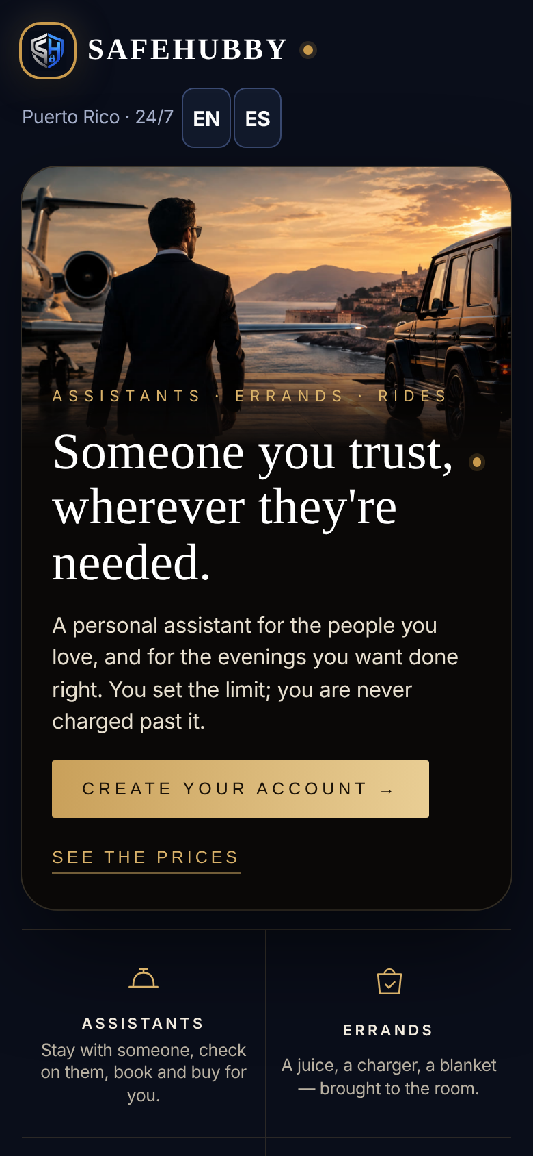
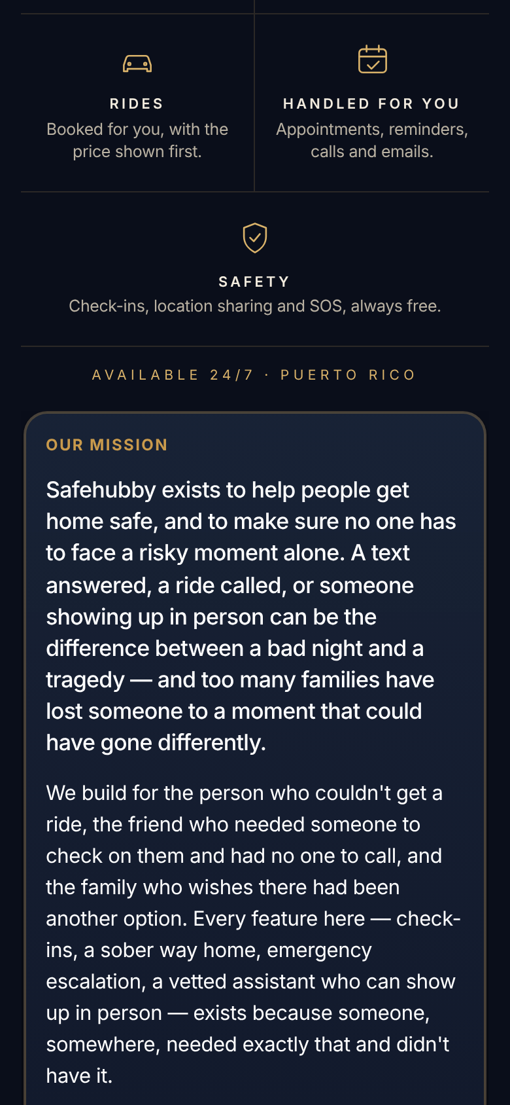
The front door
THE WEBSITE
The jet-and-G-Wagon photo, one gold button to create an account, and what Safehubby does: assistants, errands, rides, things handled for you, and safety.

Slide 3
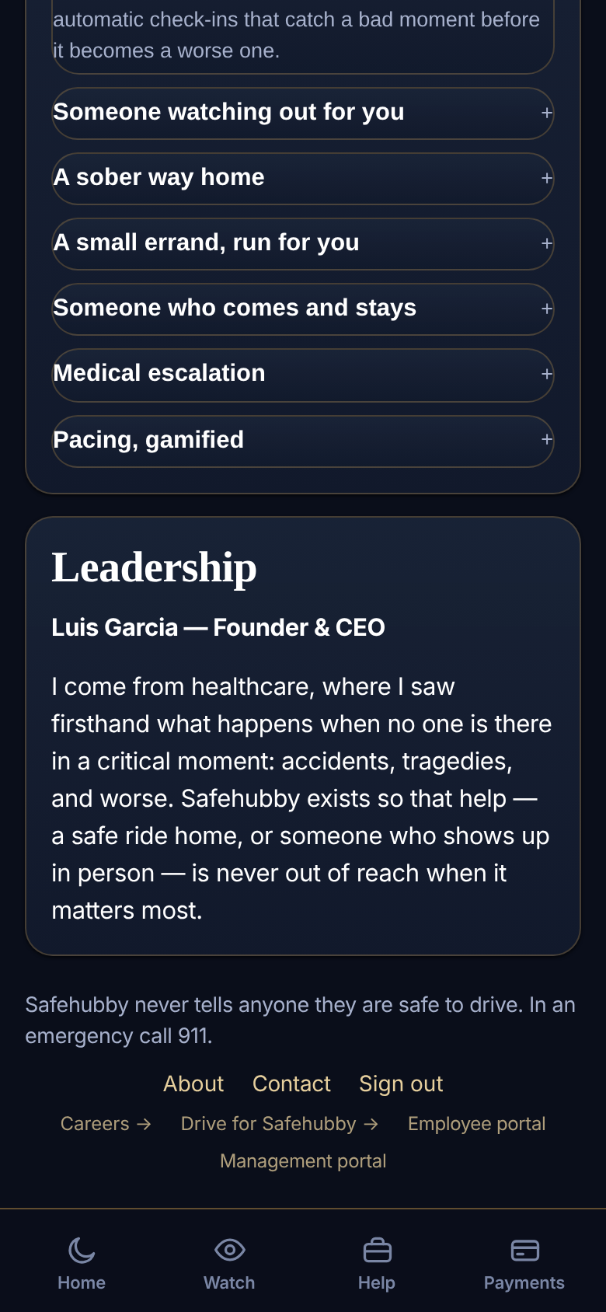
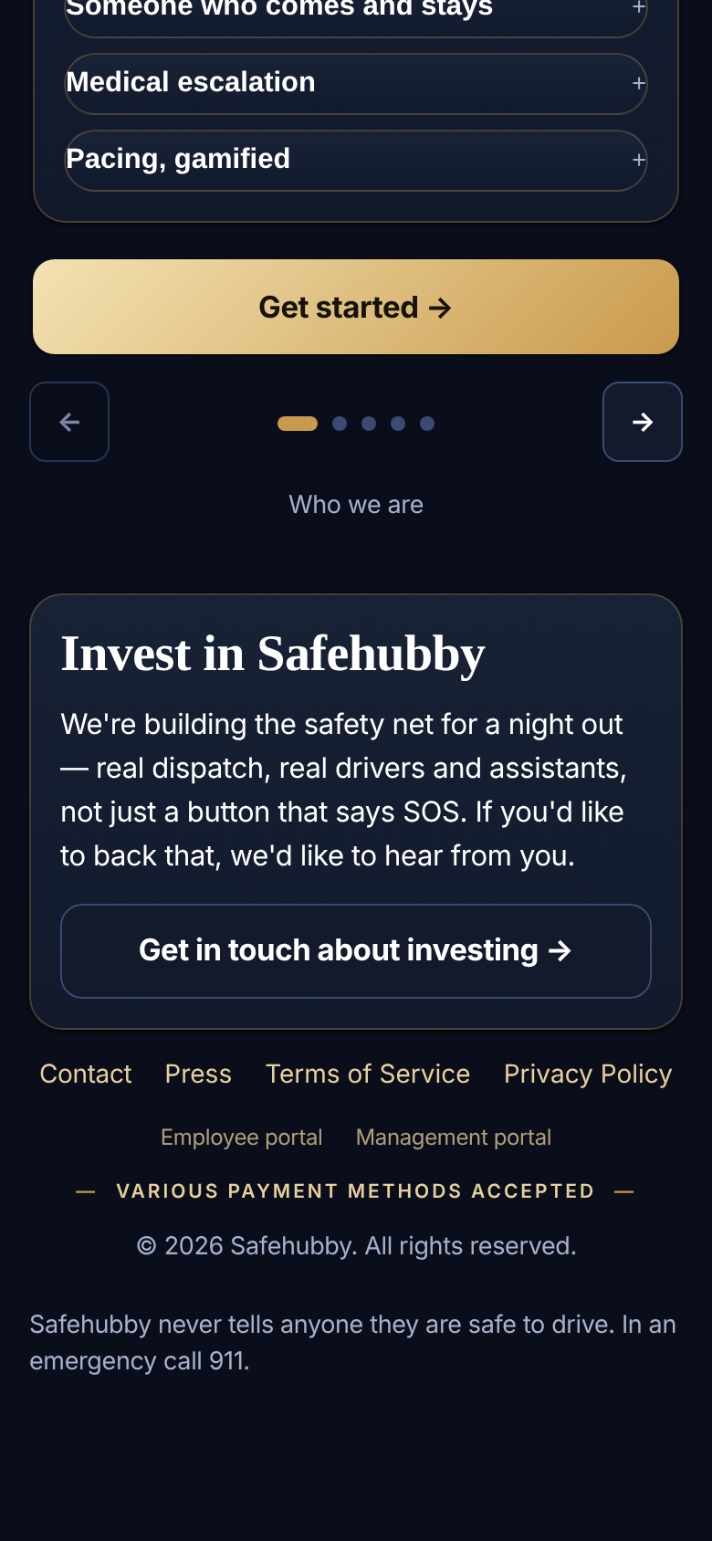
Who we are, and the way in
THE WEBSITE
Leadership and the mission, then a quiet footer: Contact, Press, Terms, Privacy, the Employee and Management portals, and “Various payment methods accepted.”

Slide 4
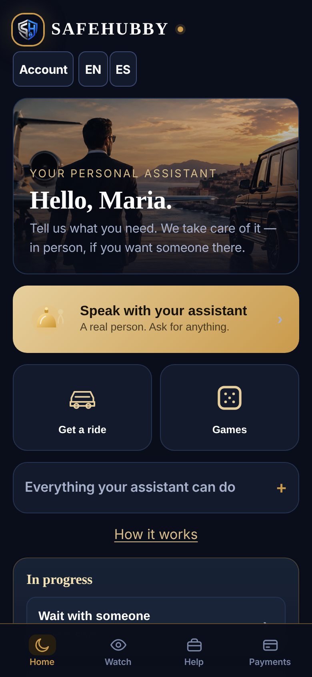
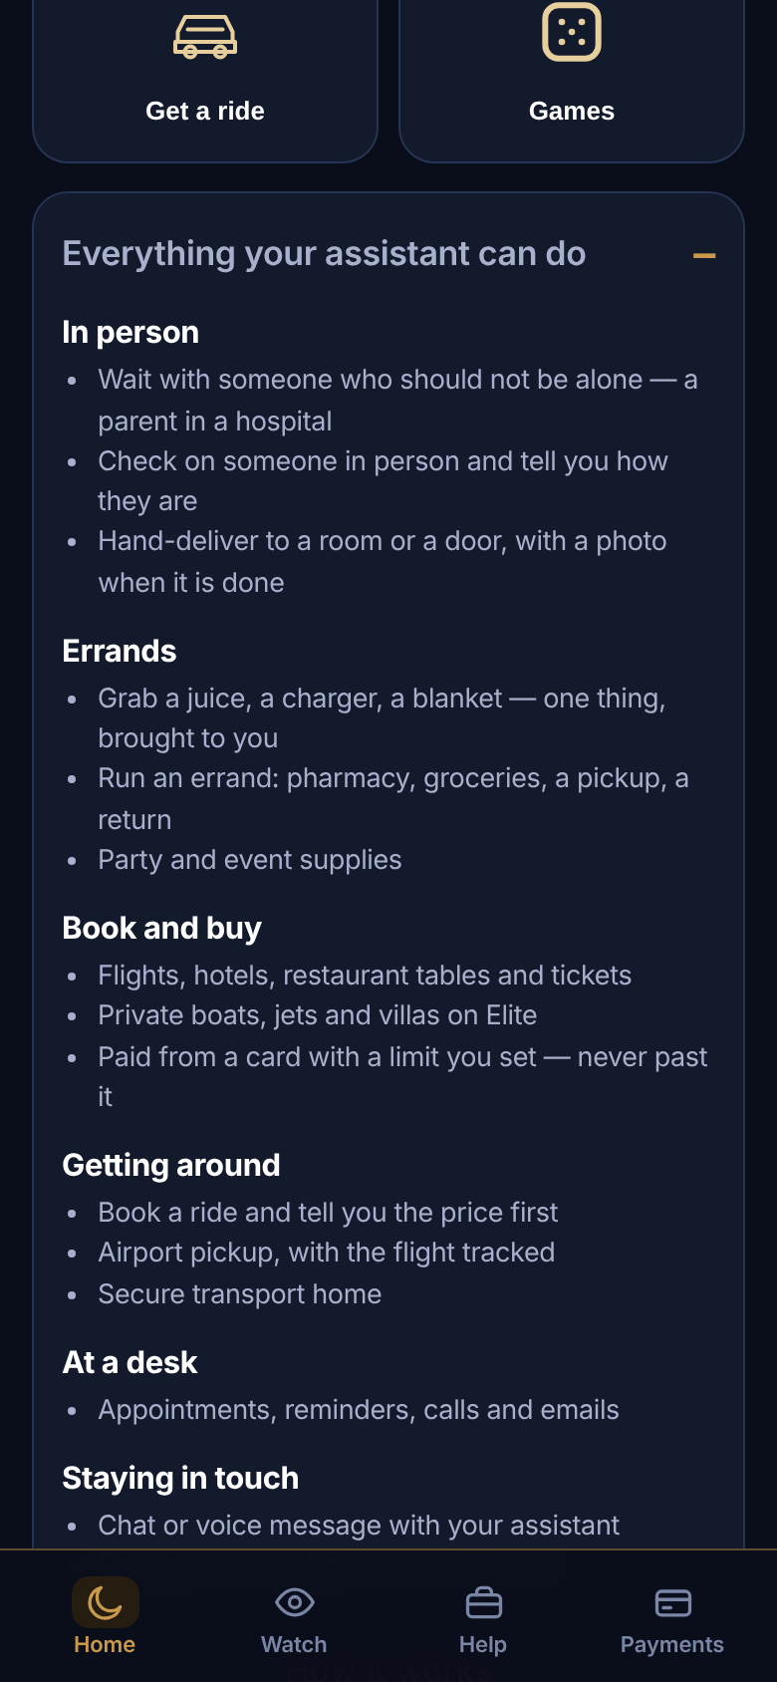
Home: one big ask
THE CUSTOMER’S APP
“Hello, Maria.” A gold “Speak with your assistant” button, Get a ride and Games beside it, and a fold-out list of everything an assistant can do.

Slide 5
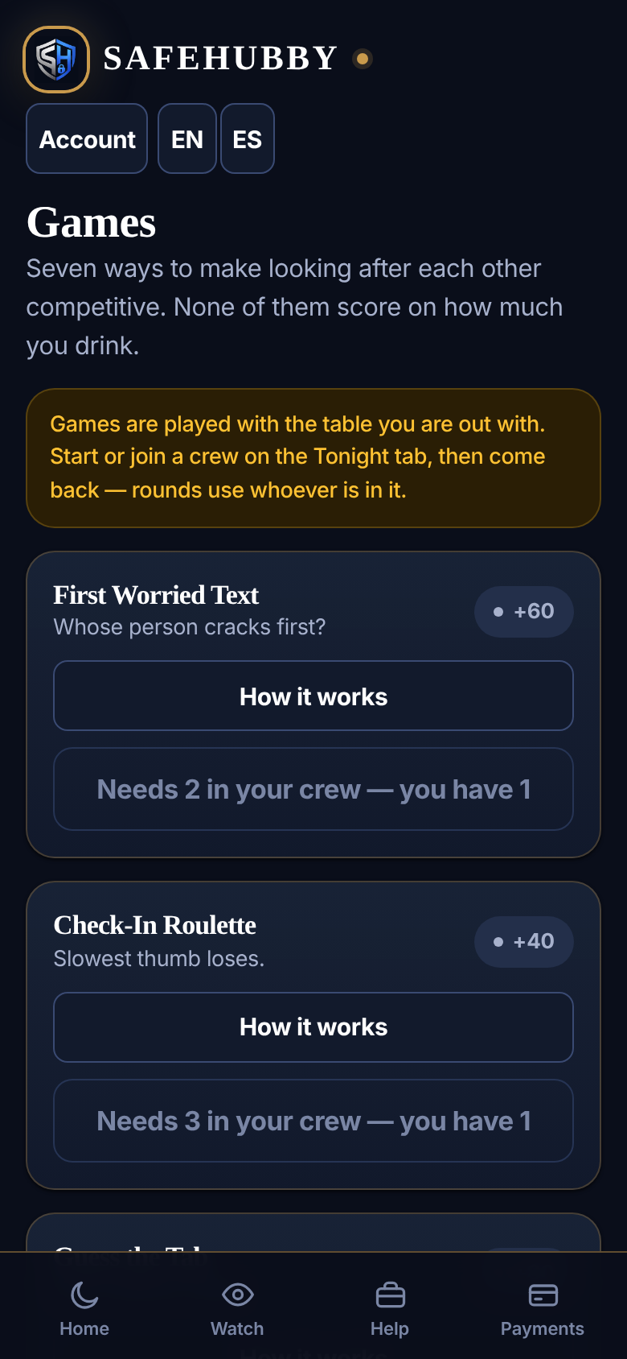
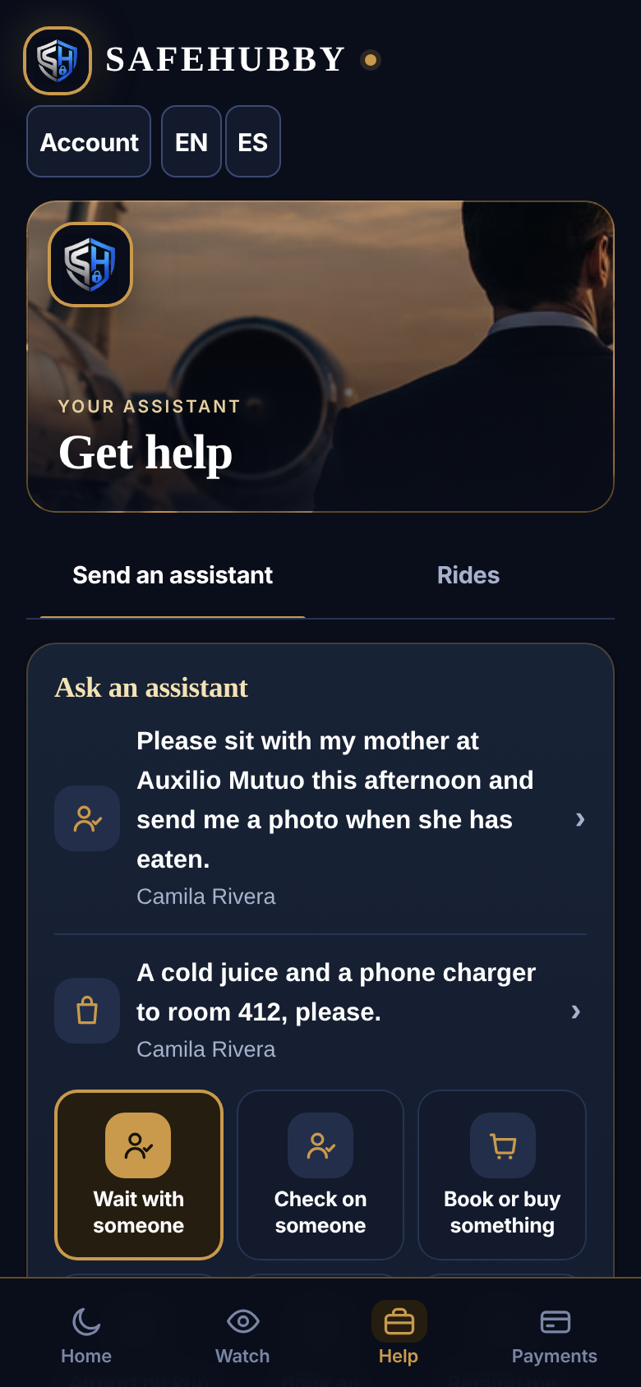
Games, and Get help
THE CUSTOMER’S APP
Games for the group, right from home. Get help opens on the jet photo with just two tabs: Send an assistant, and Rides.

Slide 6
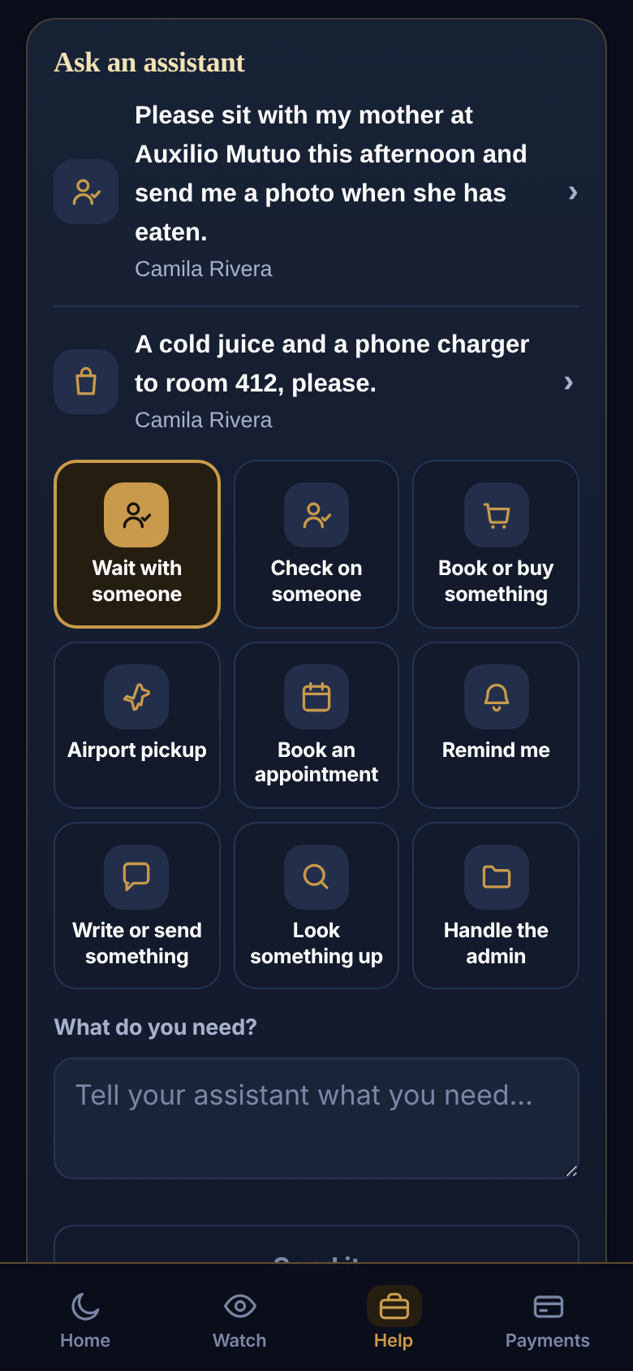
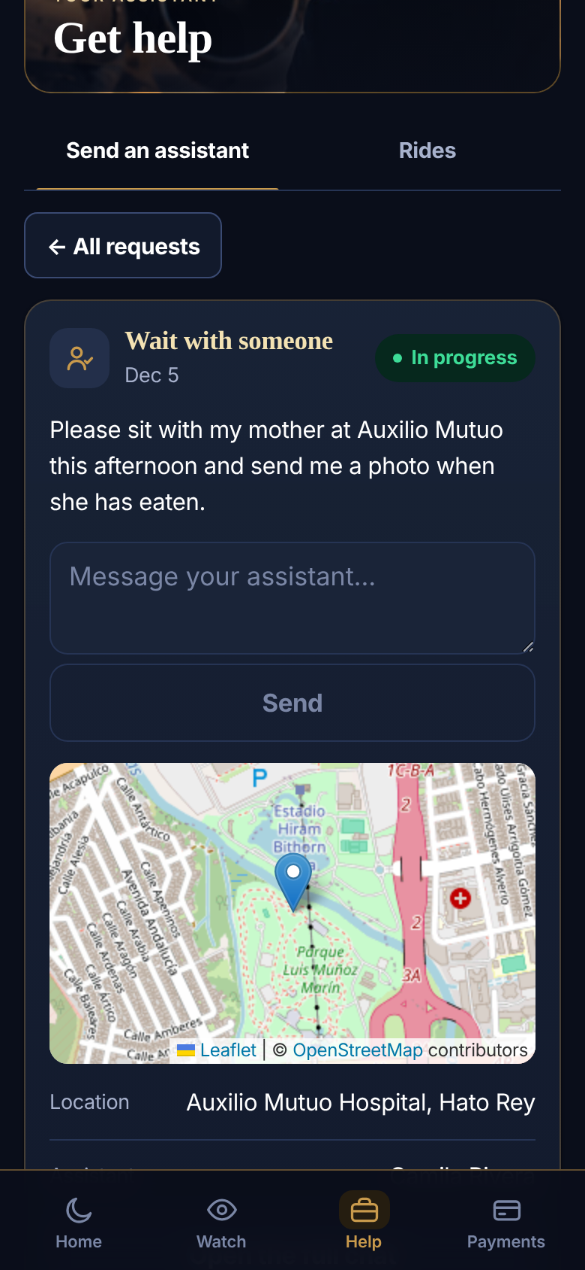
Ask an assistant
THE CUSTOMER’S APP
One grid of nine choices, one “What do you need?” box, one Send it. No prices on screen — the cost is emailed. Each request has its own page with a Send box, the map, and who is with her.

Slide 7
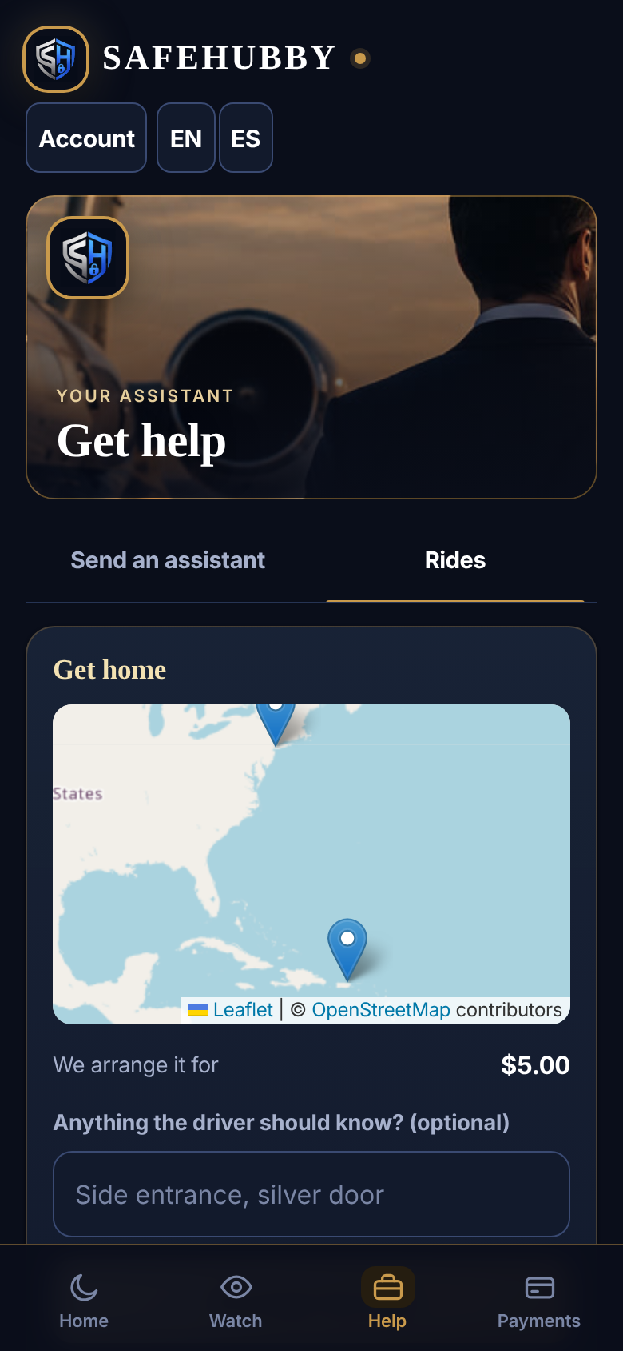
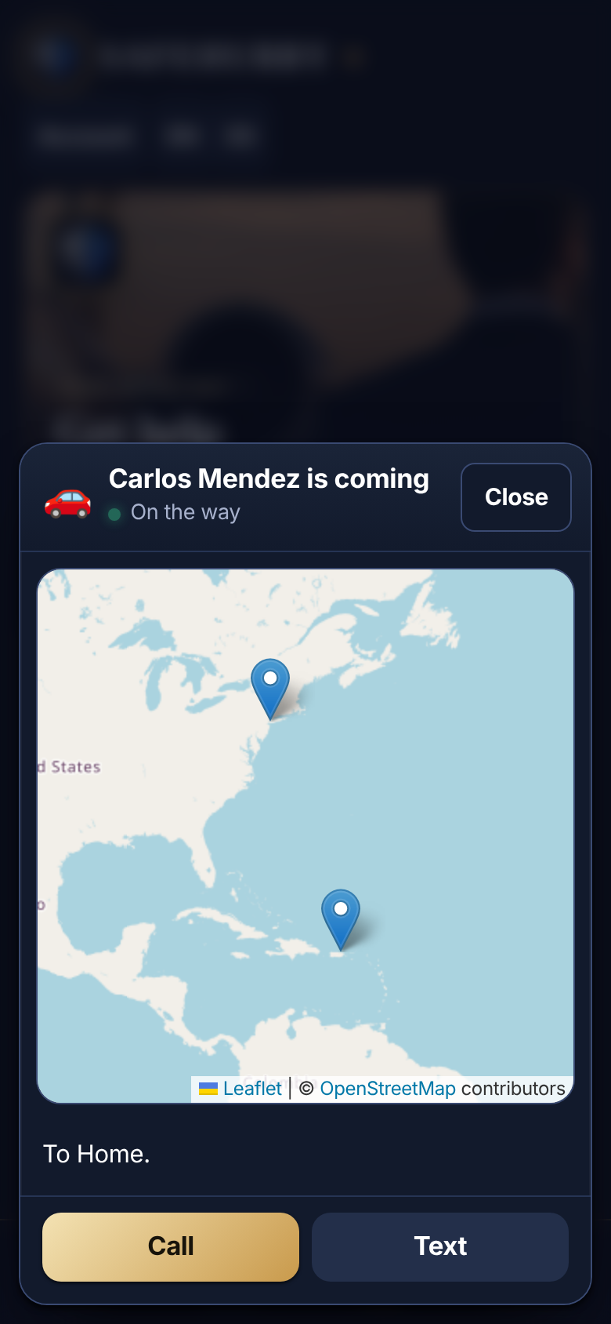
Rides, on the map
THE CUSTOMER’S APP
Drop a pin and someone books the ride for you. The moment a driver is assigned, a map pops up with who is coming and buttons to call or text.

Slide 8
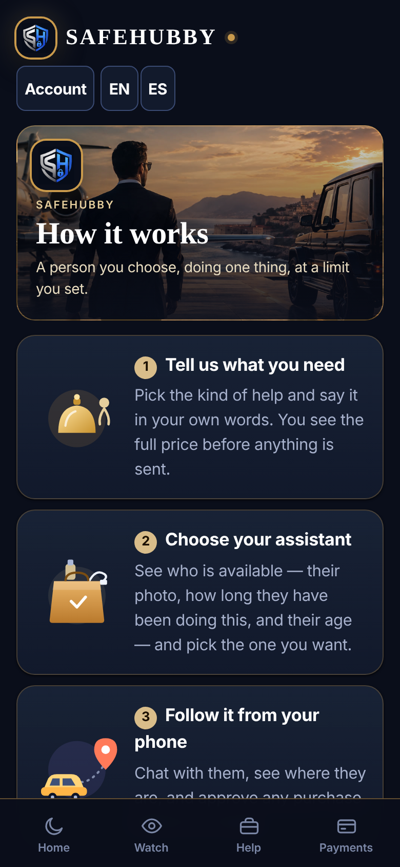
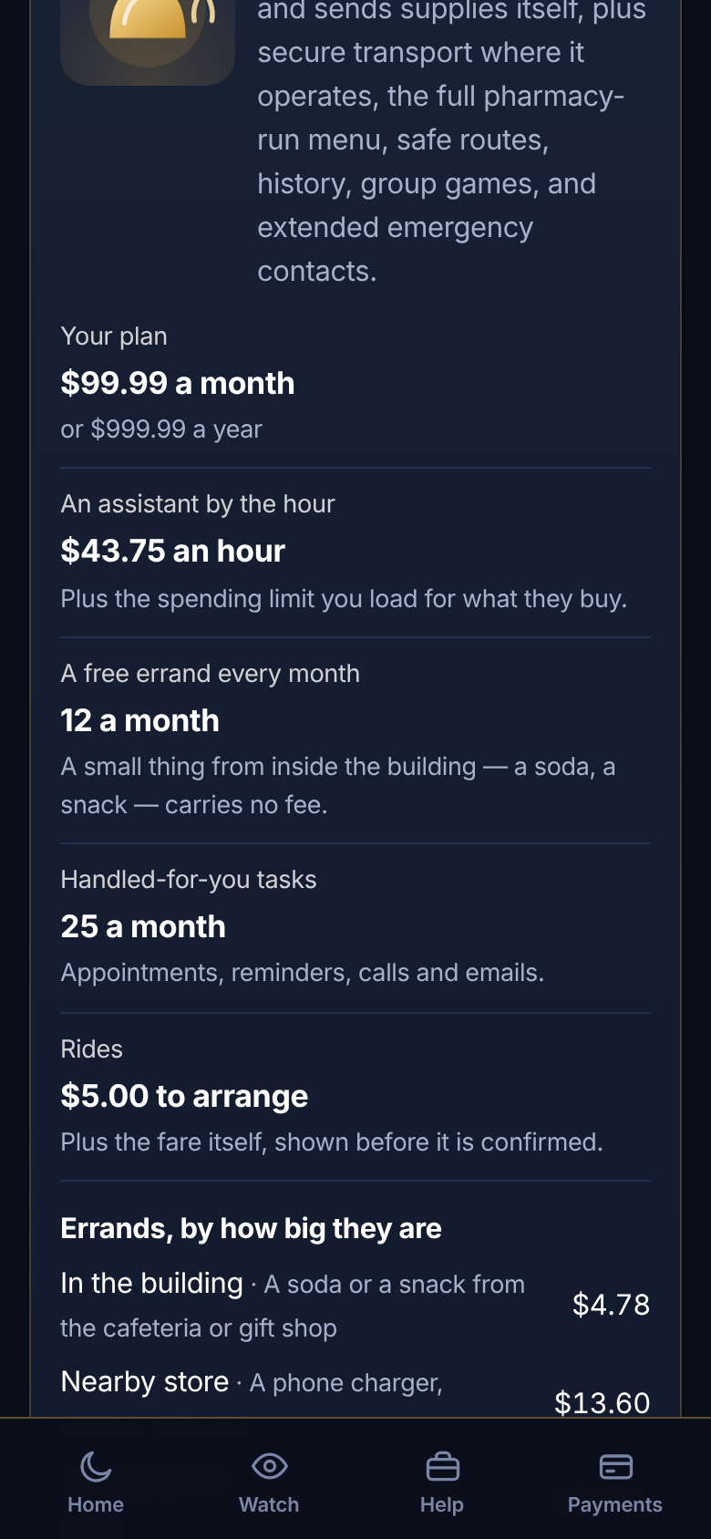
How it works
THE CUSTOMER’S APP
Four steps: tell us what you need, choose your assistant, follow it from your phone, pay only for what was used. Then what each plan includes and costs.

Slide 9
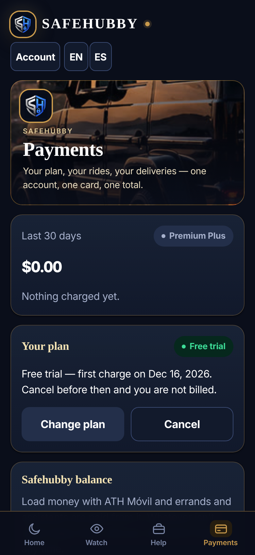
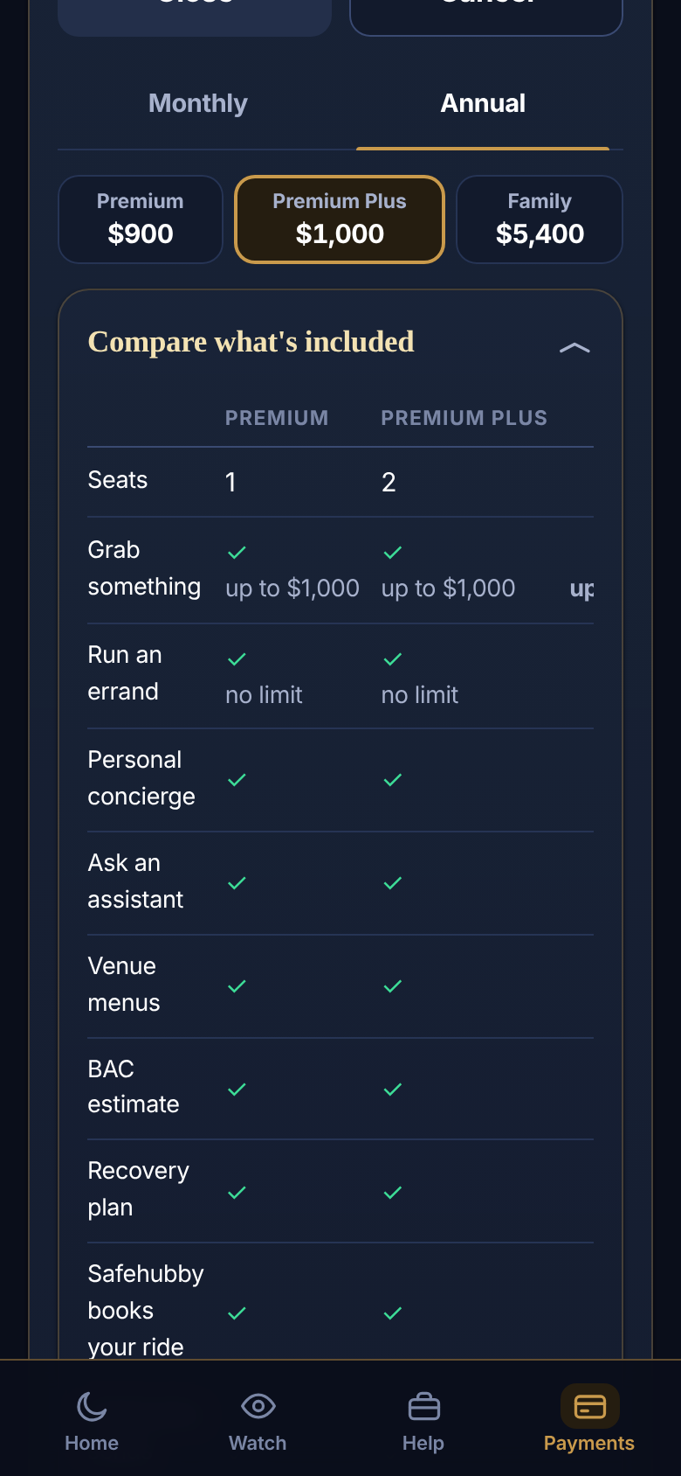
Payments and plans
THE CUSTOMER’S APP
Your plan, an ATH Móvil balance, your card or PayPal. Premium ($89.99), Premium Plus ($99.99) and Family ($539.94) a month, side by side.

Slide 10
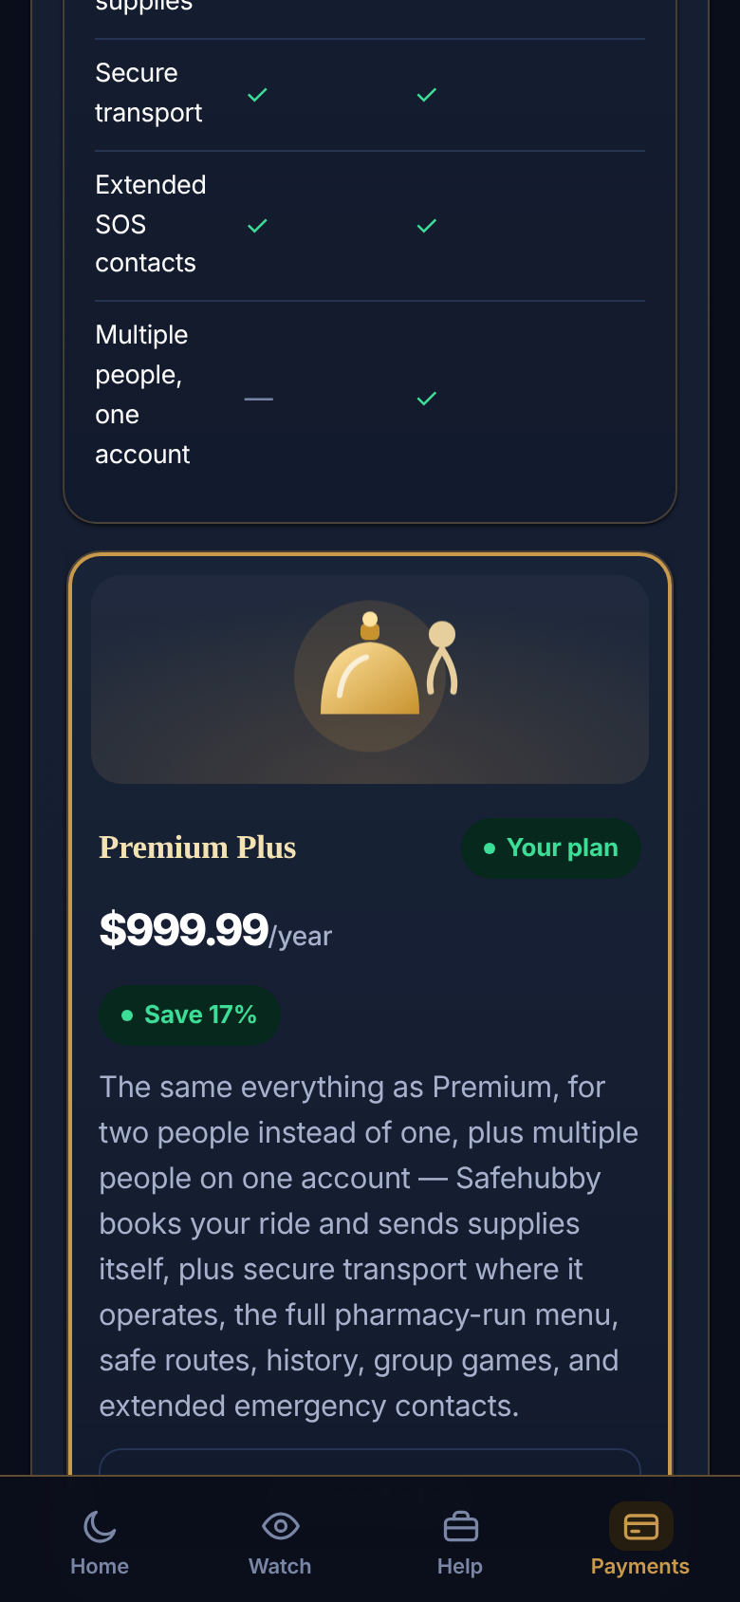
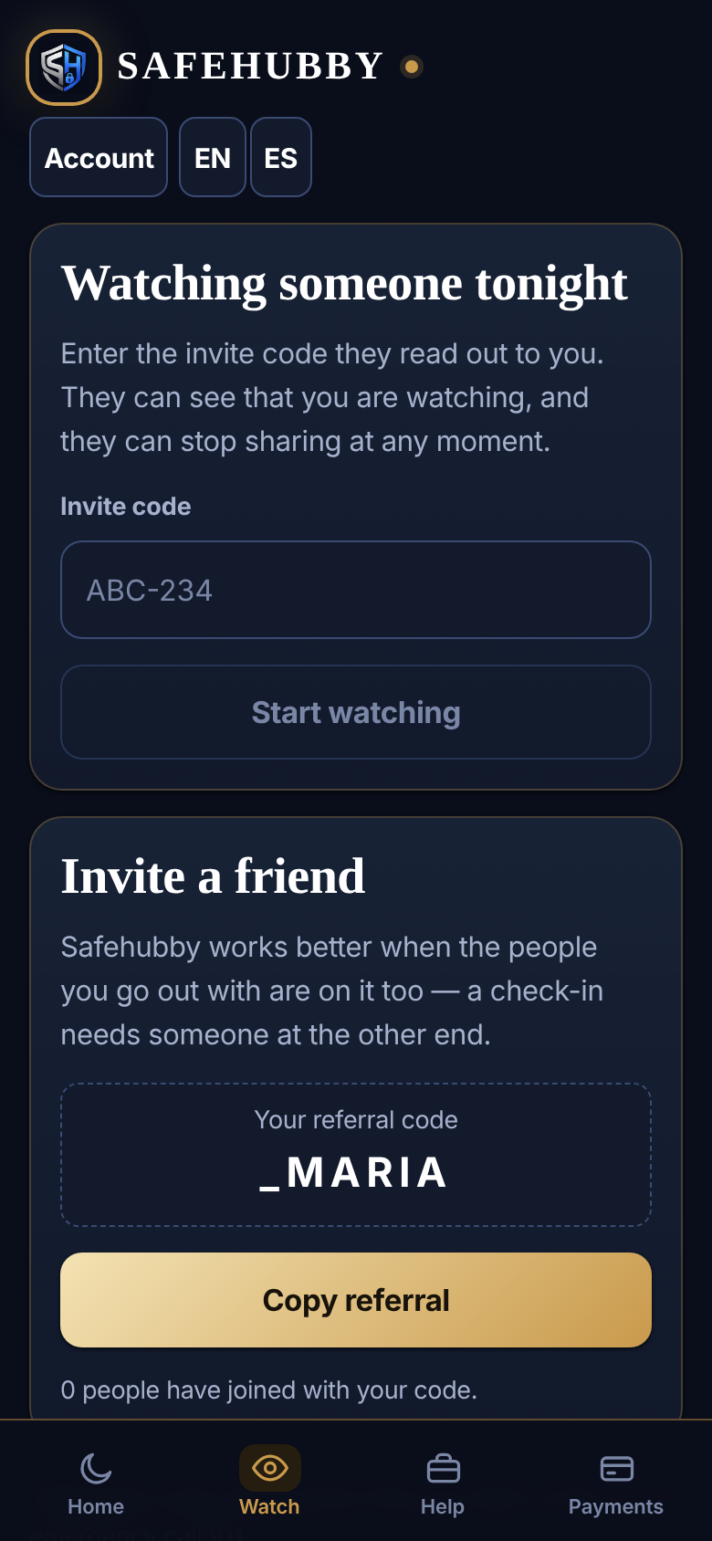
Elite, and watching over someone
THE CUSTOMER’S APP
Elite memberships from $1,500 a month: jets, villas, yachts and a 24/7 desk. Watch lets family follow a night out with check-ins and SOS, always free.

Slide 11
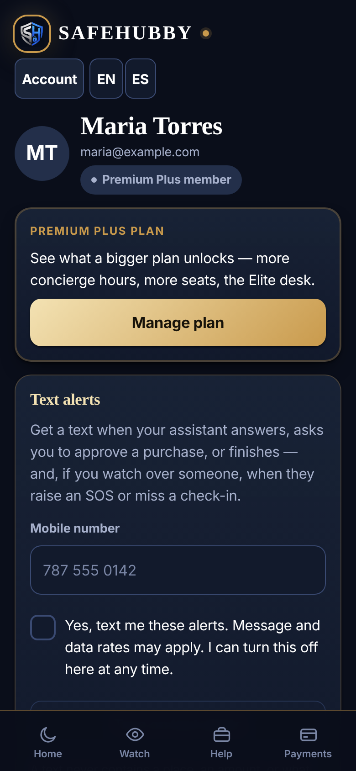
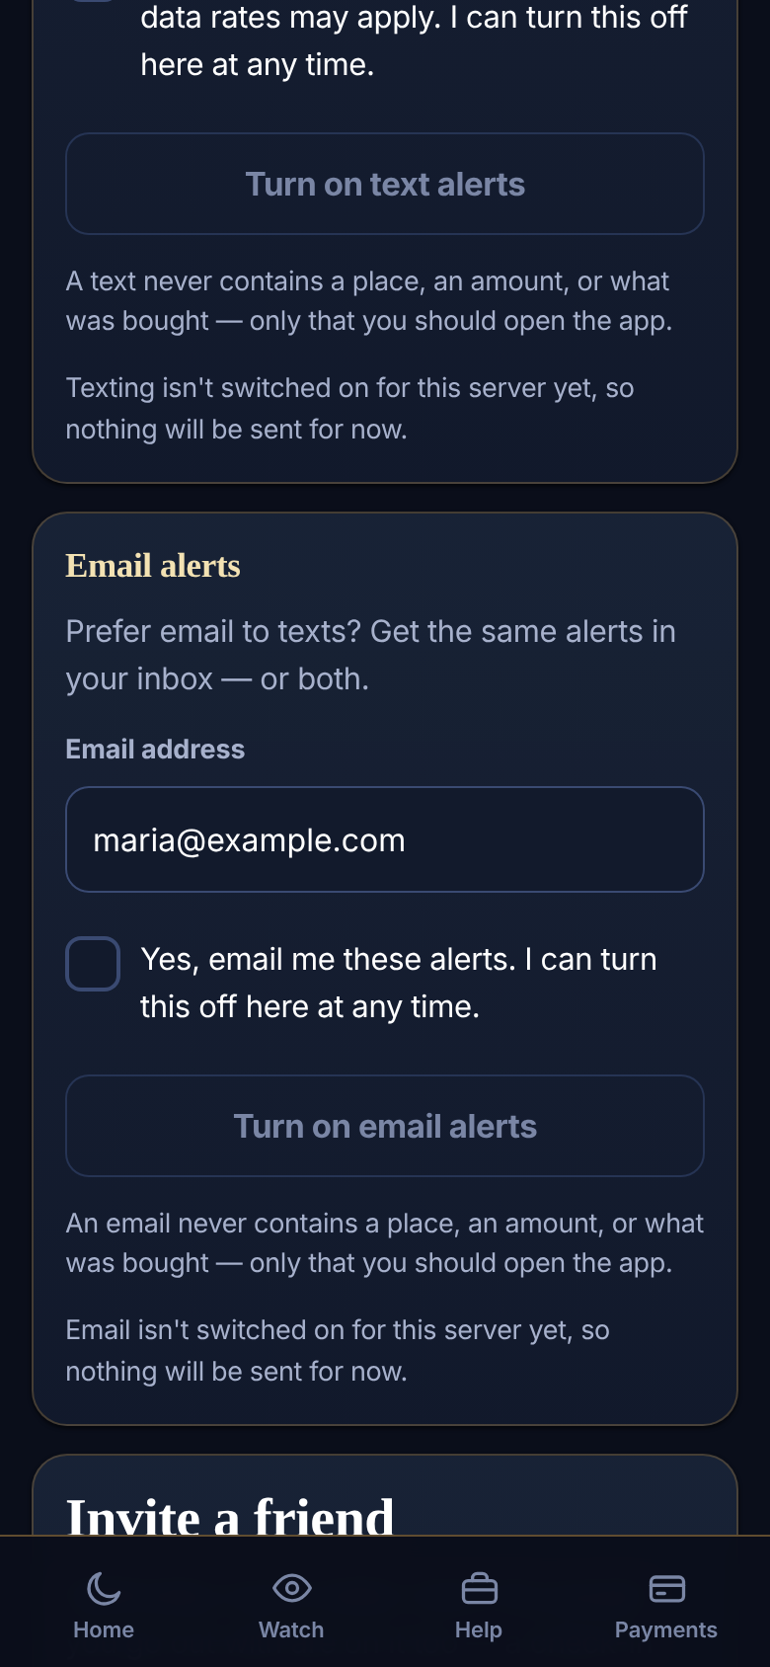
Your account, your alerts
THE CUSTOMER’S APP
Your plan at a glance, and alerts by text, by email, or both. Each says only “open the app” — never a place or an amount.

Slide 12
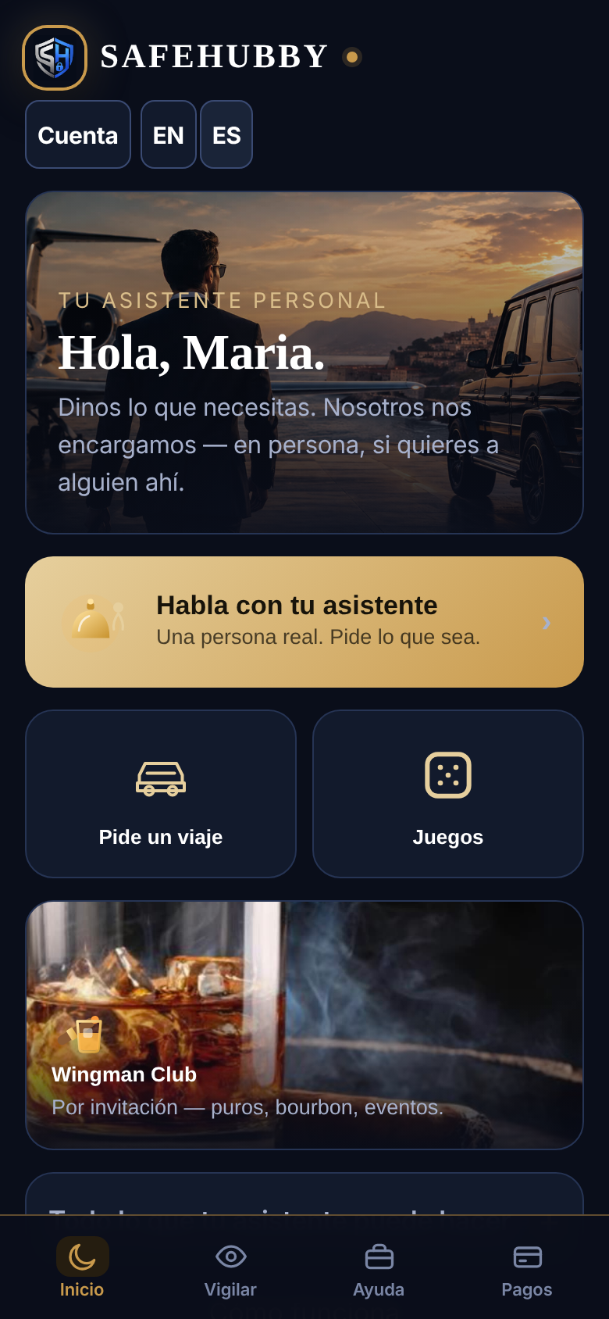
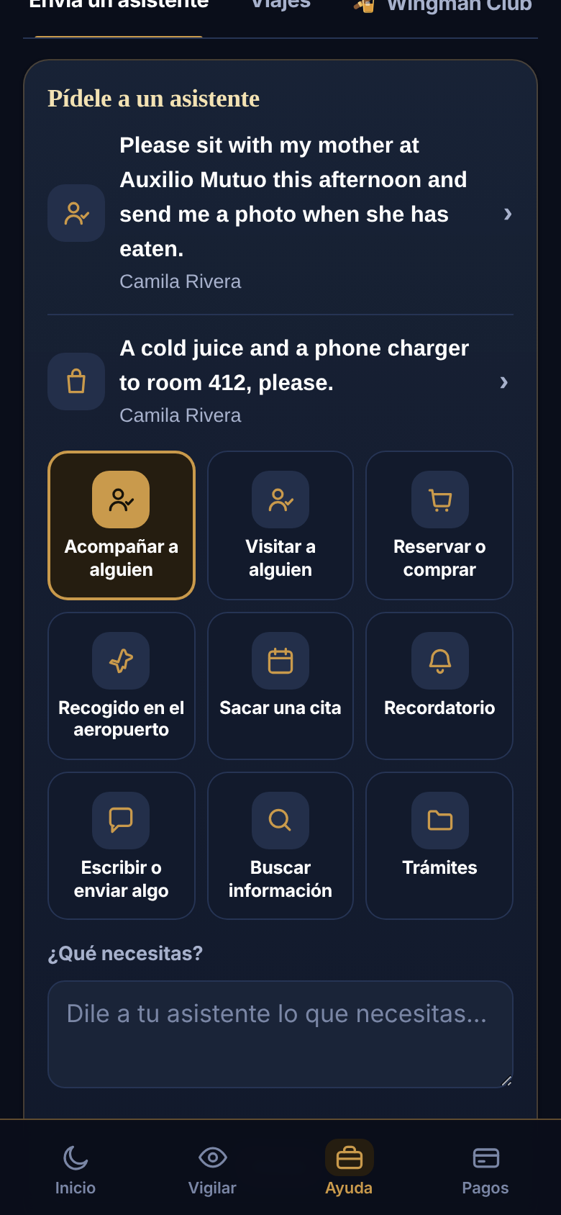
Hola, Maria.
EN ESPAÑOL
One tap on ES and the home screen and Get help speak Spanish: “Habla con tu asistente”, “Pide un viaje”, and every choice — Acompañar a alguien, Sacar una cita, Trámites.

Slide 13
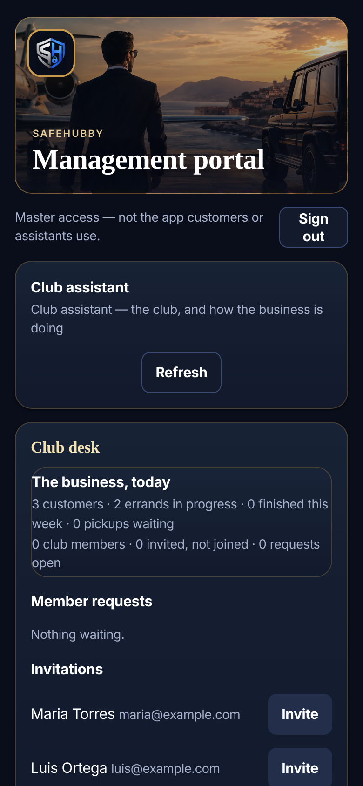
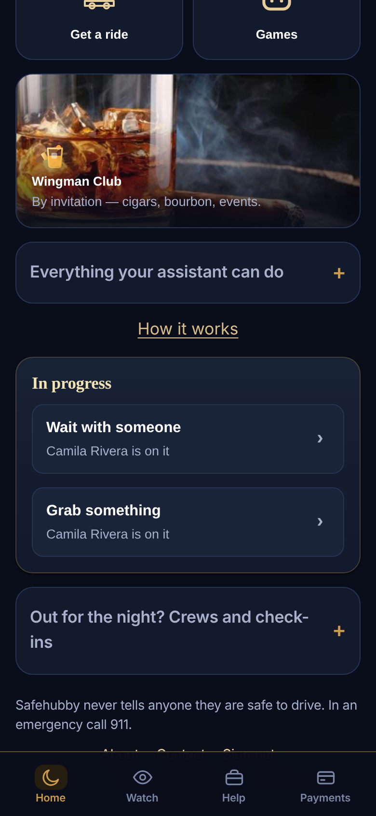
By invitation only
THE WINGMAN CLUB
Your club assistant signs in with their own key, sees how the business is doing, and invites customers. Only then does the club appear on their home screen.

Slide 14
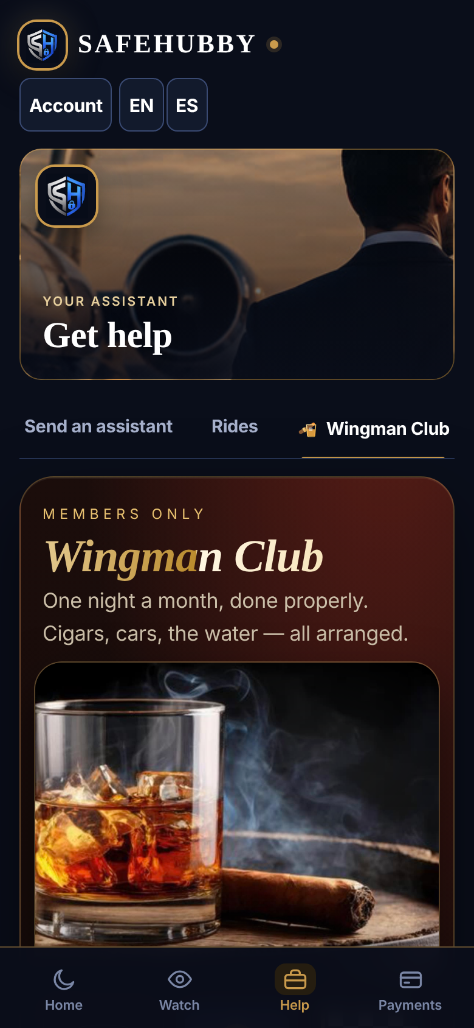
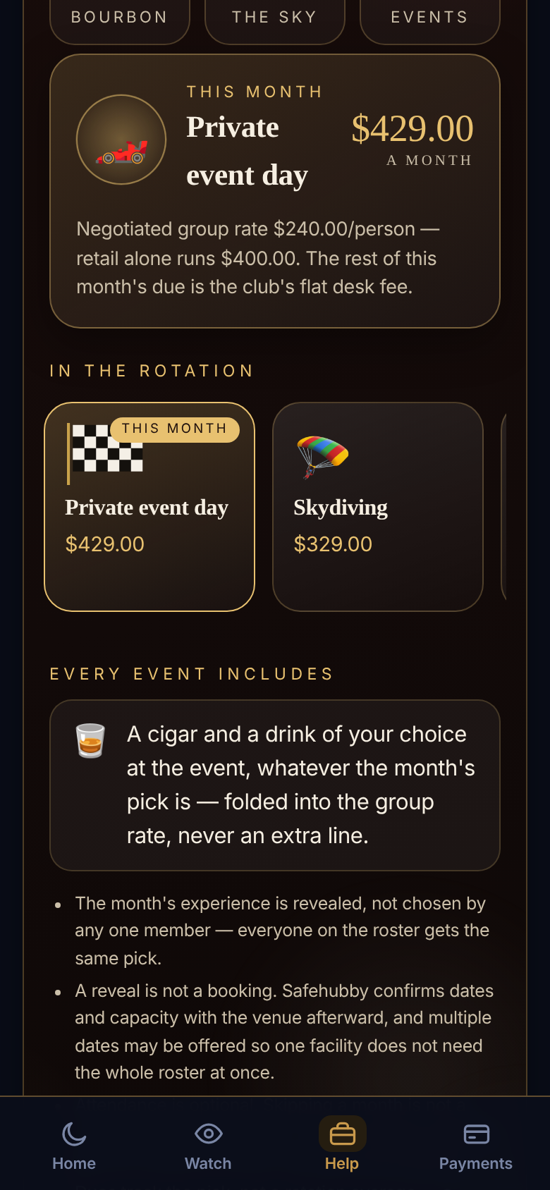
One evening a month
THE WINGMAN CLUB
Cigars, bourbon, events and the sky — one pick a month for the whole club, a cigar and a drink at every event, and a club assistant who arranges anything a member asks.

Slide 15
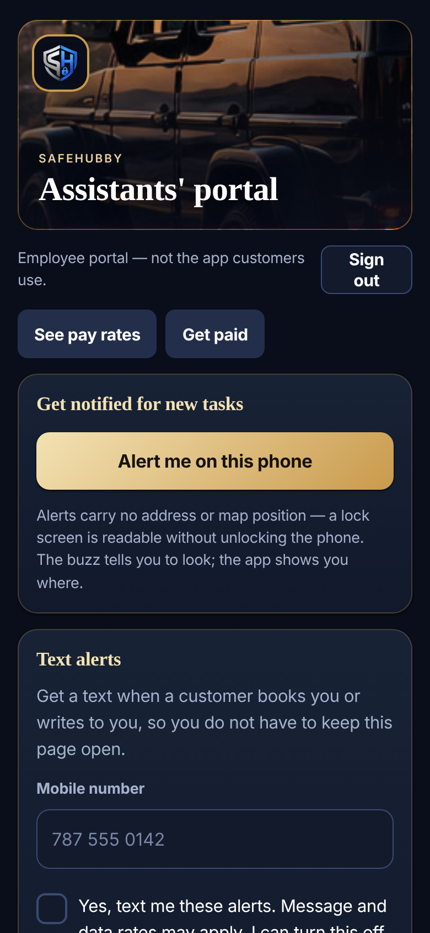
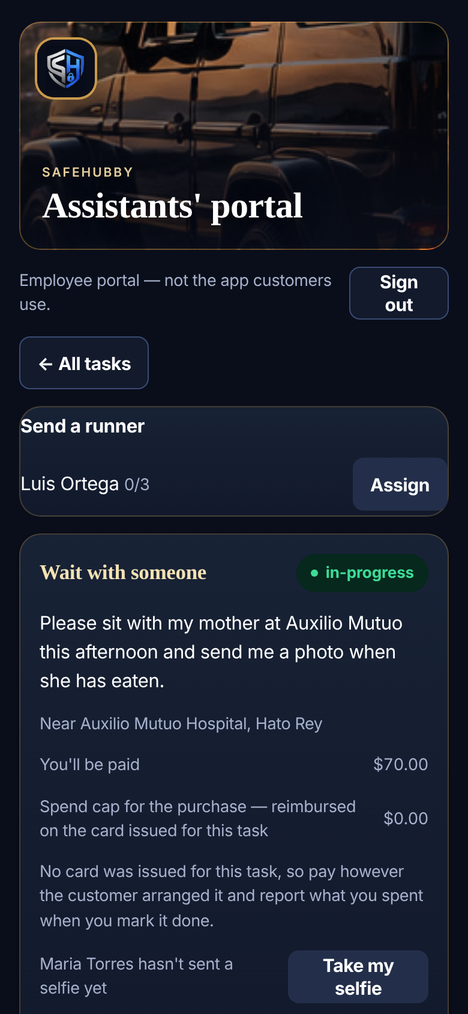
Every assistant’s own sign-in
THE ASSISTANTS’ PORTAL
Requests from customers, alerts by phone, text or email. Open a request to chat, send photos — and hand the legwork to a runner. The customer never sees the runner.

Slide 16
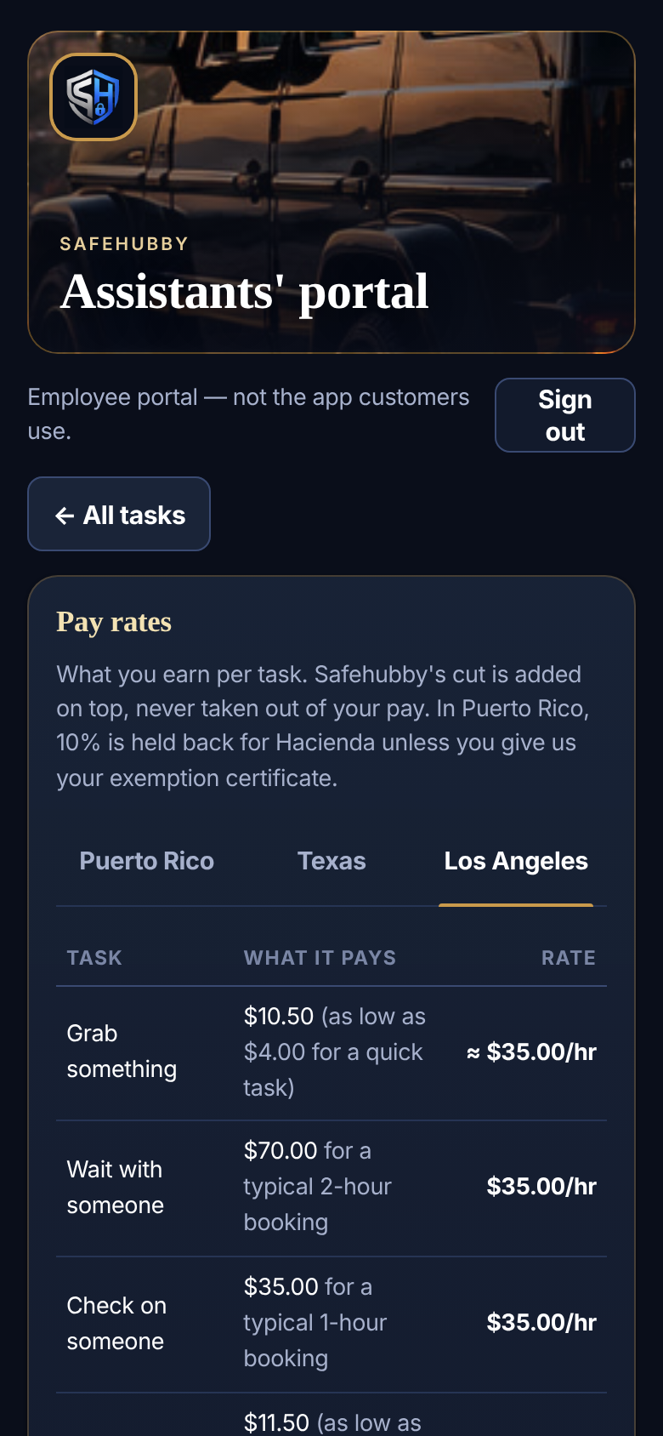
How assistants are paid
THE ASSISTANTS’ PORTAL
Pay rates published up front — $35 an hour in Puerto Rico — paid every 14 days, with 10% held back for Hacienda unless they have an exemption certificate.

Slide 17
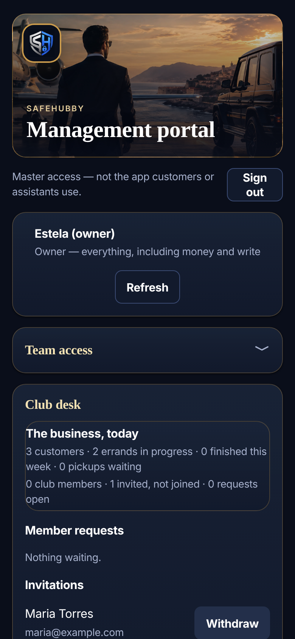
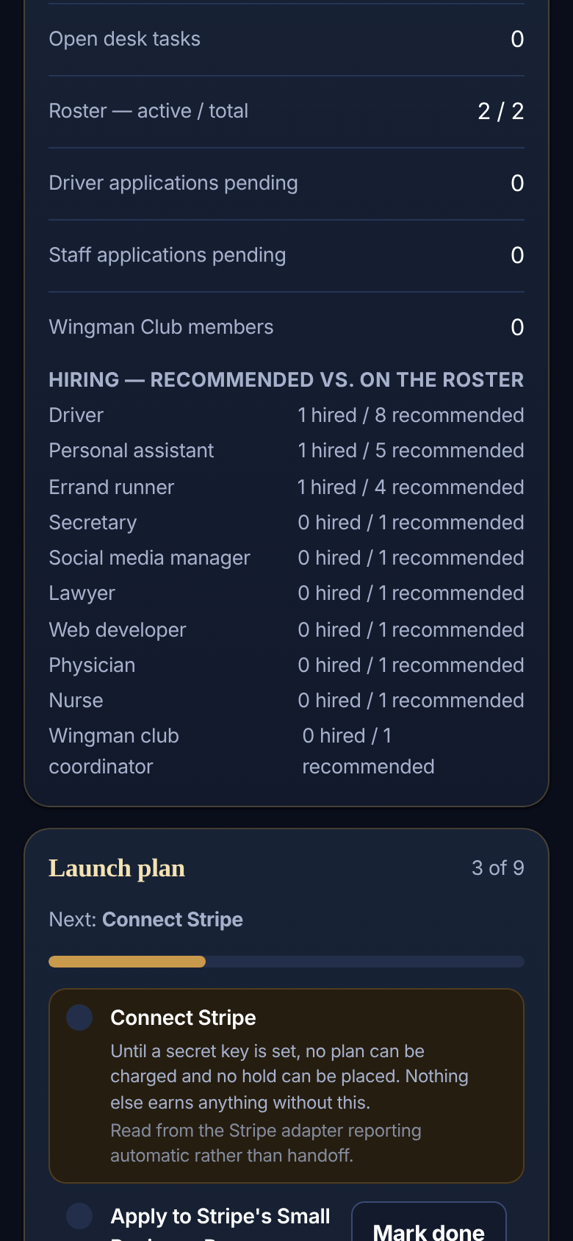
The whole business, one place
THE MANAGEMENT PORTAL
You, your secretary and your club assistant sign in here, each seeing only what their key allows: the club desk, customers, errands in progress, hiring and pickups.

Slide 18
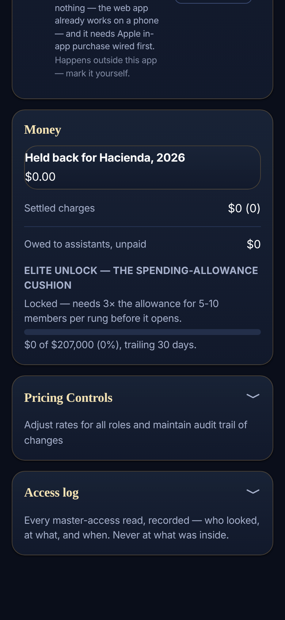
Money, prices and the access log
THE MANAGEMENT PORTAL
What was charged, what is owed to assistants, what is held back for Hacienda, the launch checklist and pricing controls — and a log of every look.

Slide 19
BEHIND THE SCENES
How the money moves
The customer pays
The assistant spends
The assistant is paid
Their saved card is held through Stripe when they ask, charged only what was spent when it’s done, and emailed both amounts.
A one-task Stripe card capped at the limit. Stripe shows the number in their portal; they can add it to Apple Wallet.
Every 14 days, worked out for you, with 10% held back for Hacienda in Puerto Rico. You send it from the bank or ATH Business.
Notes:
Needs Stripe keys and Stripe Issuing approval before real money moves. PayPal and plan subscriptions are not charged yet.

Slide 20

safehubby.com
contact@safehubby.com · Puerto Rico

