Slide 1

Deep Learning for
Computer Vision with Python
김규리

Slide 2
Parameterized Learning
Notes:
파라미터화 학습의 개념을 검토하고 간단한 선형 분류를 구현하는 방법에 대한 챕터

Slide 3
An Introduction to Linear Classification
Four Components of Parameterized Learning
Parameterization is the process of defining the necessary parameters of a given model
1. Data : Input data that we are going to learn from
Includes both the data points and their associated class labels
Multi-dimensional design matrix
2. Scoring Function : Accepts our data as an input and maps the data to class labels

Slide 4
An Introduction to Linear Classification
Four Components of Parameterized Learning
3. Loss Function : Quantifies how well our predicted class labels agree with our ground-truth labels
4. Weights and Biases : Be tweaked and fiddled with the values of the W and b to increase classification accuracy
Notes:
Ground-truth(지상 실측)는 기상학에서 유래된 용어로 어느 한 장소에서 수집된 정보를 의미
기계학습의 관점에서 보았을때 Ground-truth는 학습하고자 하는 데이터의 원본 혹은 실제 값을 표현할 때 사용

Slide 5

An Introduction to Linear Classification
Linear Classification: From Images to Labels
Training dataset is denoted as xi where each image has an associated class label yi.
i=1, …, N and yi = 1, …, K, implying that we have N data points of dimensionality D, separated into K unique categories.

Slide 6
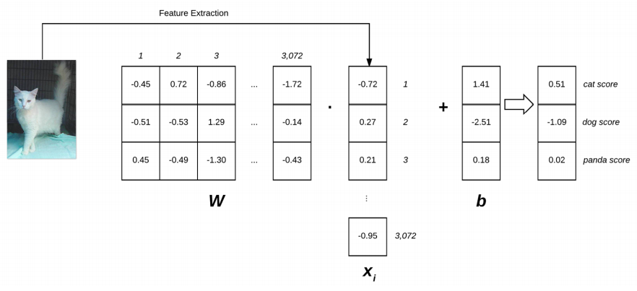
An Introduction to Linear Classification
Linear Classification: From Images to Labels

Slide 7
An Introduction to Linear Classification
Advantages of Parameterized Learning and Linear Classification
1. Once we are done training our model, we can discard the input data and keep only the weight matrix W and the bias vector b.
2. Classifying new test data is fast

Slide 8
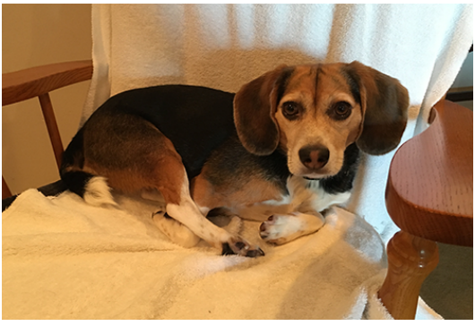
An Introduction to Linear Classification
A Simple Linear Classifier With Python

Slide 9
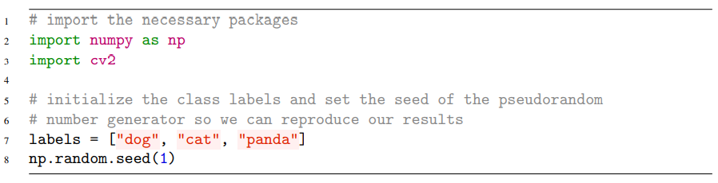
An Introduction to Linear Classification
A Simple Linear Classifier With Python

Slide 10
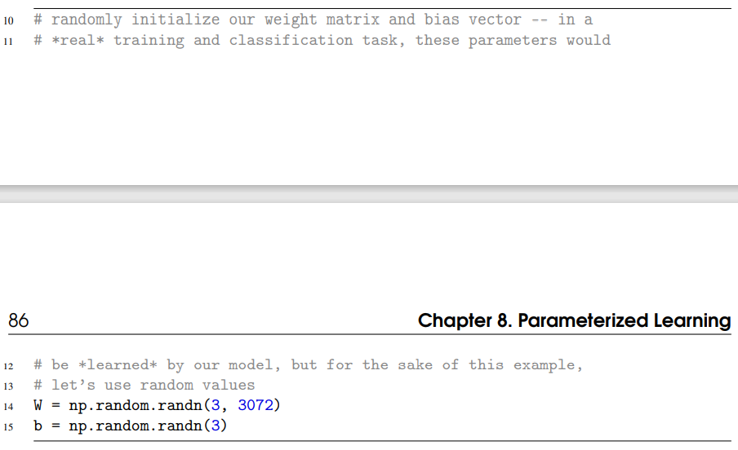
An Introduction to Linear Classification
A Simple Linear Classifier With Python

Slide 11
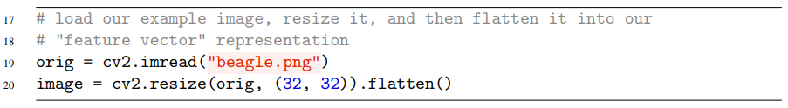

An Introduction to Linear Classification
A Simple Linear Classifier With Python

Slide 12
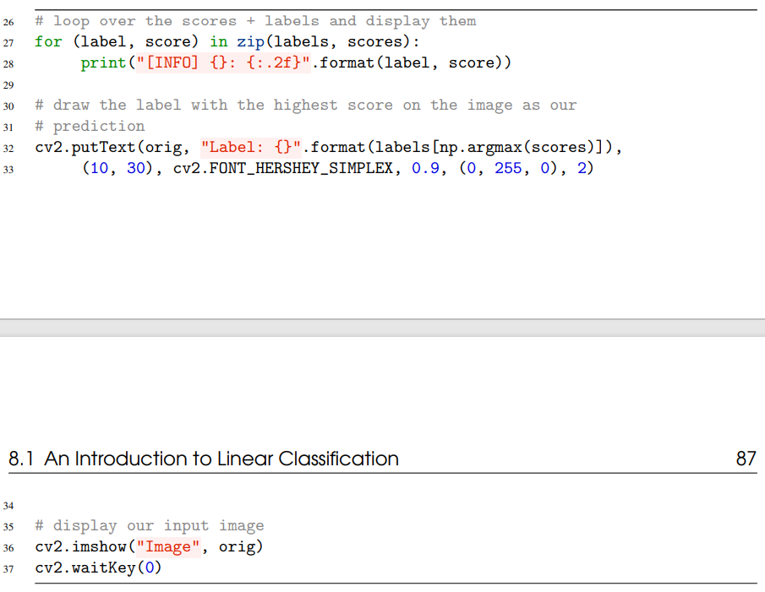
An Introduction to Linear Classification
A Simple Linear Classifier With Python

Slide 13
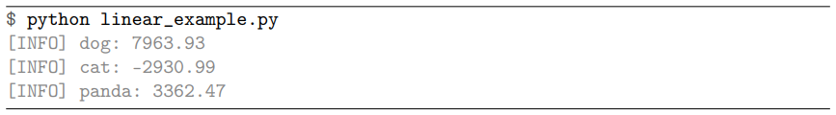
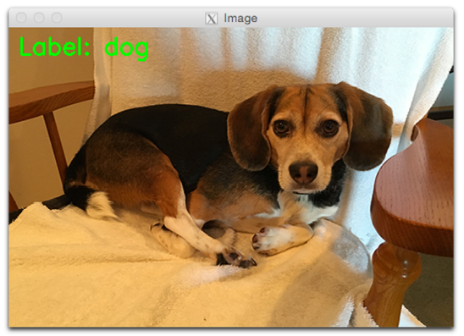
An Introduction to Linear Classification
A Simple Linear Classifier With Python

Slide 14
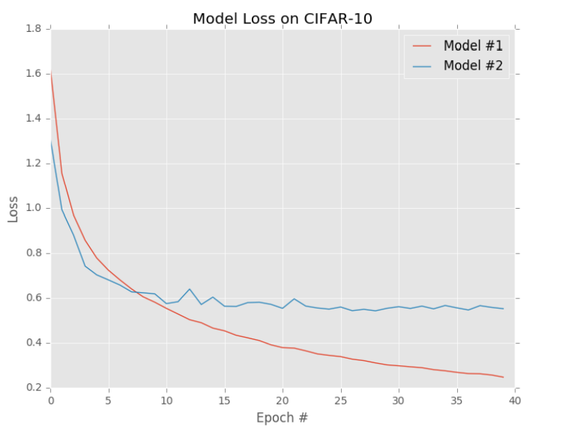
The Role of Loss Functions
What Are Loss Functions?

Slide 15


The Role of Loss Functions
Multi-class SVM Loss

Slide 16


The Role of Loss Functions
Multi-class SVM Loss

Slide 17
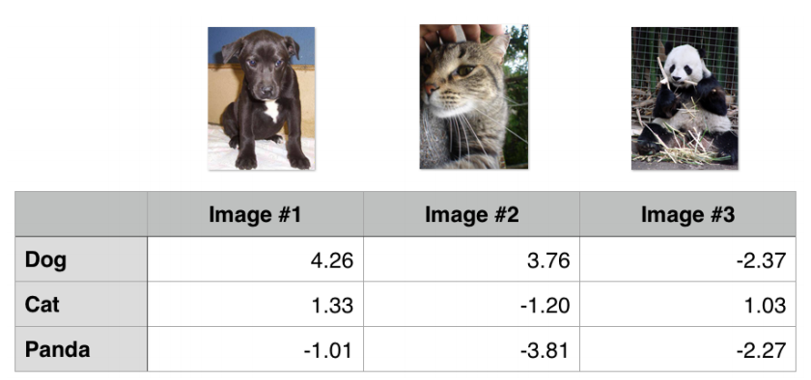
The Role of Loss Functions
A Multi-class SVM Loss Example

Slide 18
The Role of Loss Functions
A Multi-class SVM Loss Example

Slide 19






The Role of Loss Functions
Cross-entropy Loss and Softmax Classifiers
Understanding Cross-entropy Loss

Slide 20
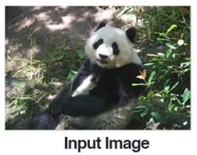
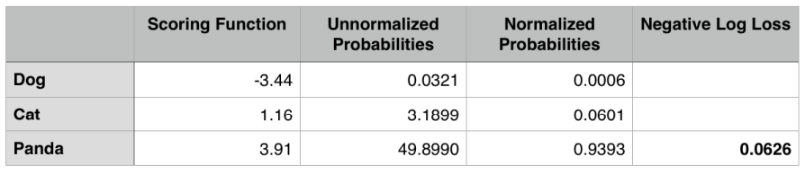
The Role of Loss Functions
Cross-entropy Loss and Softmax Classifiers
A Worked Softmax Example

Slide 21
Thank you
감사합니다!

