Slide 1
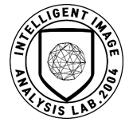
Deep Learning for
Computer Vision with Python

Slide 2
Optimization Methods and Regularization
Notes:
최적화 방법과 정규화에 대하여

Slide 3
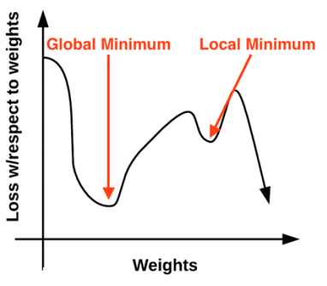
Gradient Descent
The Loss Landscape and Optimization Surface

Slide 4

Gradient Descent
The “Gradient” in Gradient Descent

Slide 5


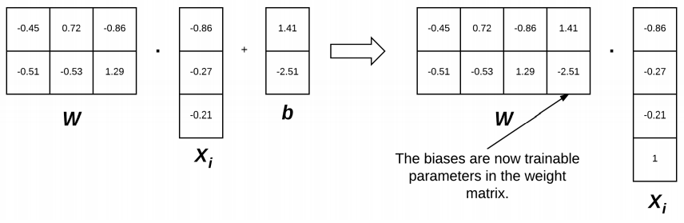
Gradient Descent
The Bias Trick

Slide 6

Gradient Descent
Pseudocode for Gradient Descent
1. A specified number of epochs has passed
2. Our loss has become sufficiently low or training accuracy satisfactory high
3. Loss has not improved in M subsequent epochs

Slide 7
Gradient Descent
Pseudocode for Gradient Descent
1. loss: A function used to compute the loss over our current parameters W and input data
2. data: Our training data where each training sample is represented by an image
3. W: Our actual weight matrix that we are optimizing over

Slide 8
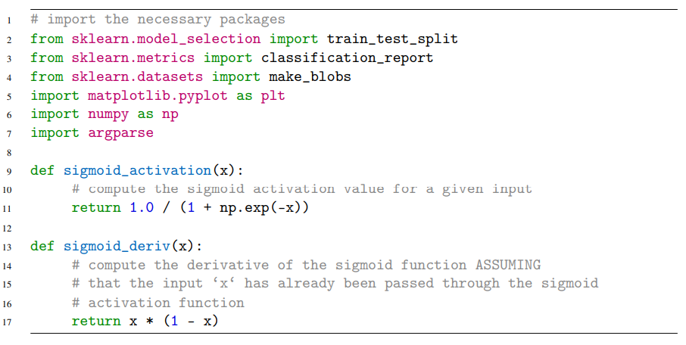
Gradient Descent
Implementing Basic Gradient Descent in Python

Slide 9
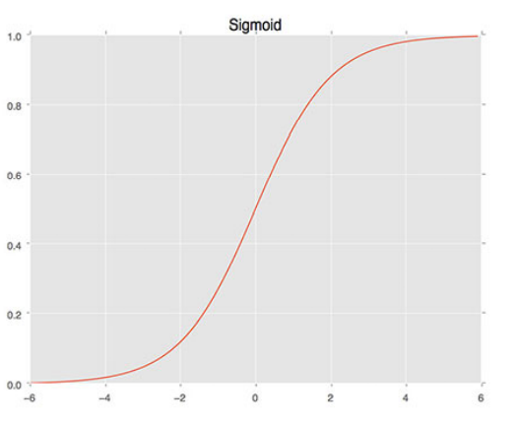
Gradient Descent
Implementing Basic Gradient Descent in Python

Slide 10
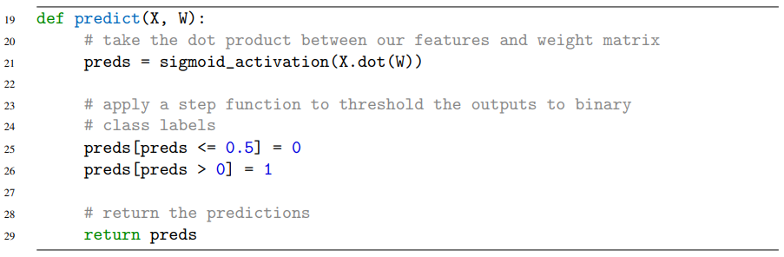
Gradient Descent
Implementing Basic Gradient Descent in Python

Slide 11
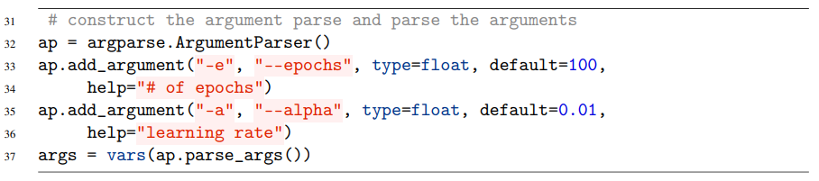
Gradient Descent
Implementing Basic Gradient Descent in Python

Slide 12
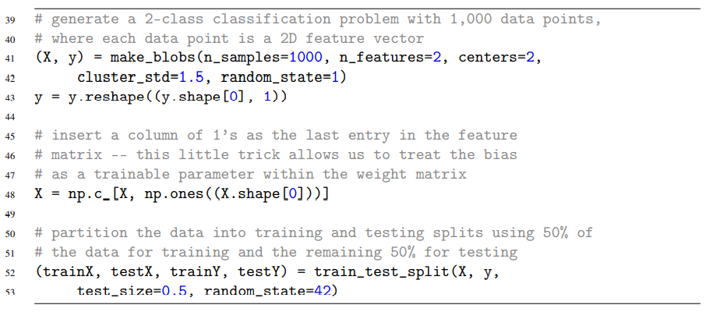
Gradient Descent
Implementing Basic Gradient Descent in Python

Slide 13
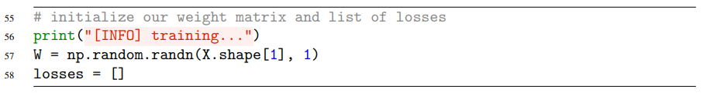
Gradient Descent
Implementing Basic Gradient Descent in Python

Slide 14
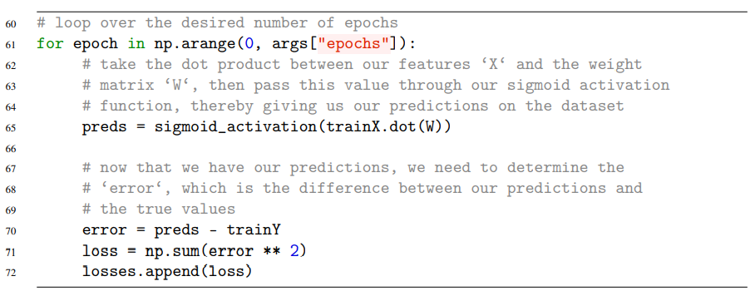
Gradient Descent
Implementing Basic Gradient Descent in Python

Slide 15
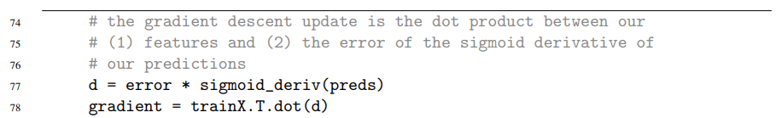
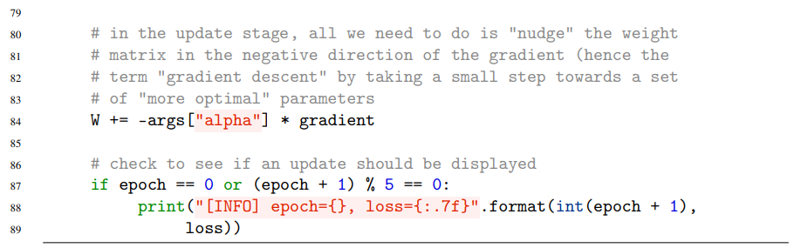
Gradient Descent
Implementing Basic Gradient Descent in Python

Slide 16
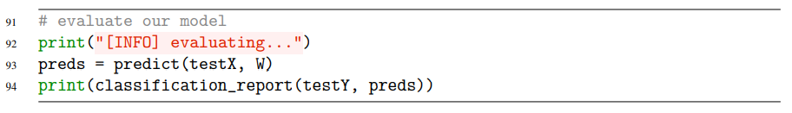
Gradient Descent
Implementing Basic Gradient Descent in Python

Slide 17
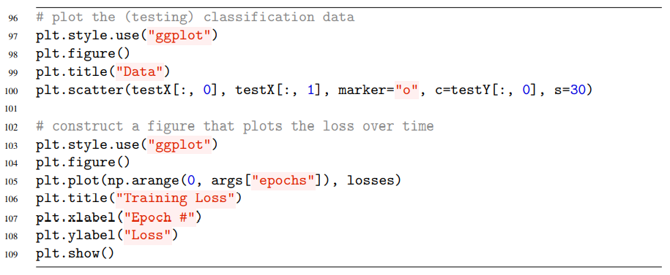
Gradient Descent
Implementing Basic Gradient Descent in Python

Slide 18
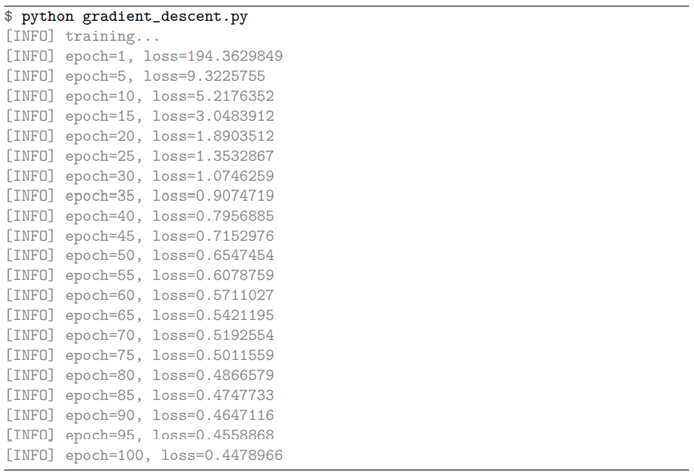
Gradient Descent
Simple Gradient Descent Results

Slide 19
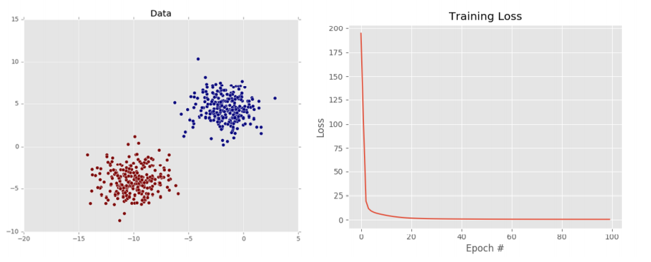
Gradient Descent
Simple Gradient Descent Results

Slide 20
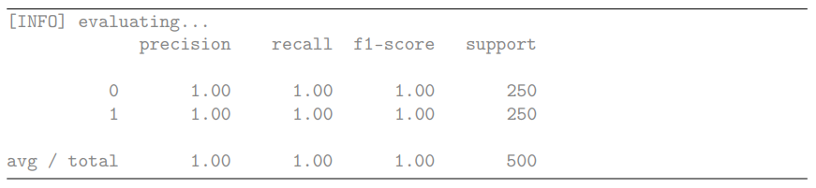
Gradient Descent
Simple Gradient Descent Results

Slide 21
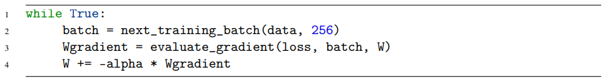
Stochastic Gradient Descent (SGD)
Mini-batch SGD

Slide 22
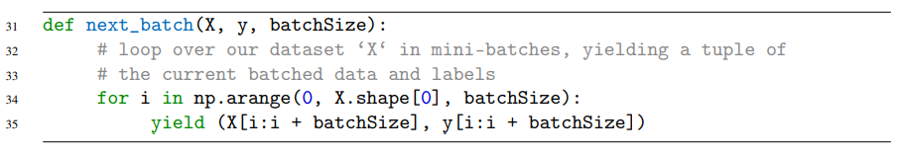
Stochastic Gradient Descent (SGD)
Implementing Mini-batch SGD
1. X: Our training dataset of feature vectors/raw image pixel intensities
2. y: The class labels associated with each of the training data points
3. batchSize: The size of each mini-batch that will be returned

Slide 23
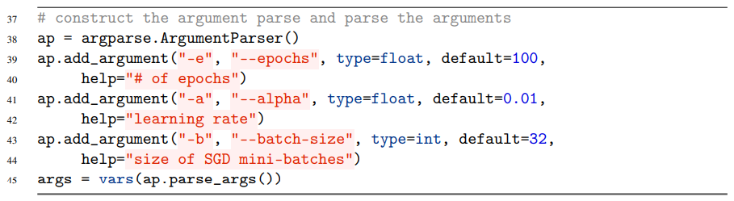
Stochastic Gradient Descent (SGD)
Implementing Mini-batch SGD

Slide 24
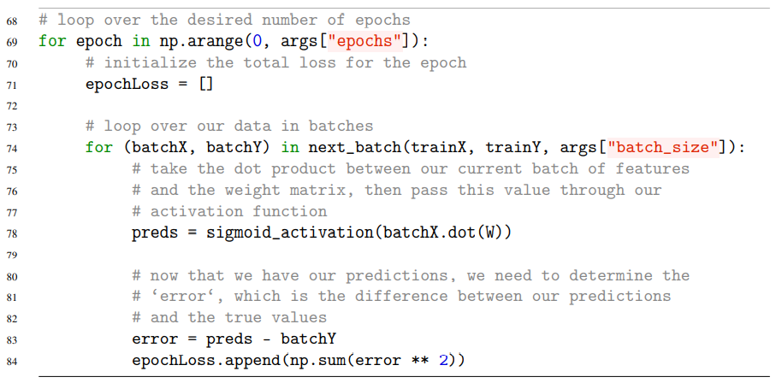
Stochastic Gradient Descent (SGD)
Implementing Mini-batch SGD

Slide 25
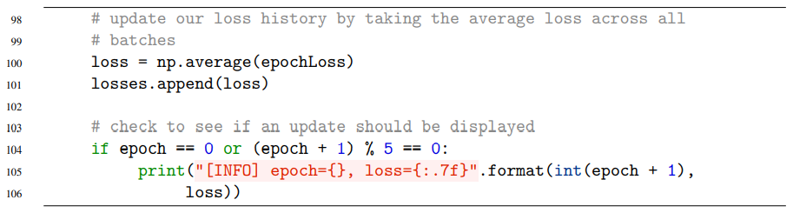
Stochastic Gradient Descent (SGD)
Implementing Mini-batch SGD

Slide 26
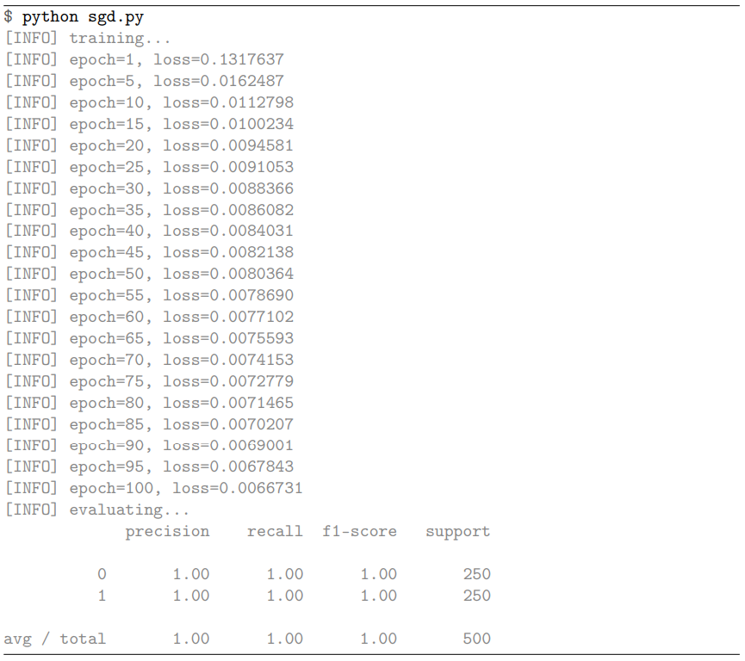
Stochastic Gradient Descent (SGD)
SGD Results

Slide 27
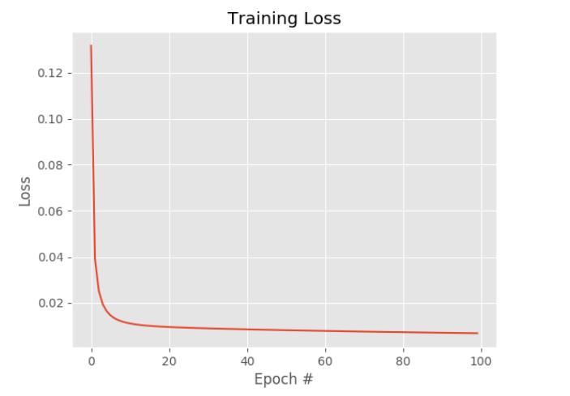
Stochastic Gradient Descent (SGD)
SGD Results

Slide 28

Extensions to SGD
Momentum

Slide 29
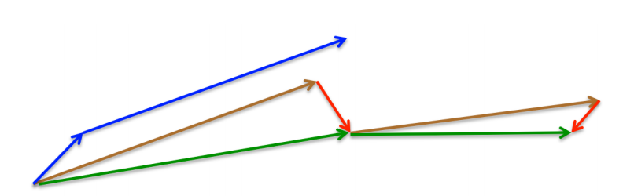
Extensions to SGD
Nesterov’s Acceleration

Slide 30
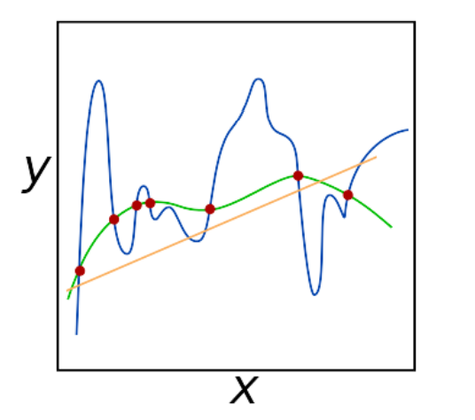
Regularization
What Is Regularization and Why Do We Need It?

Slide 31
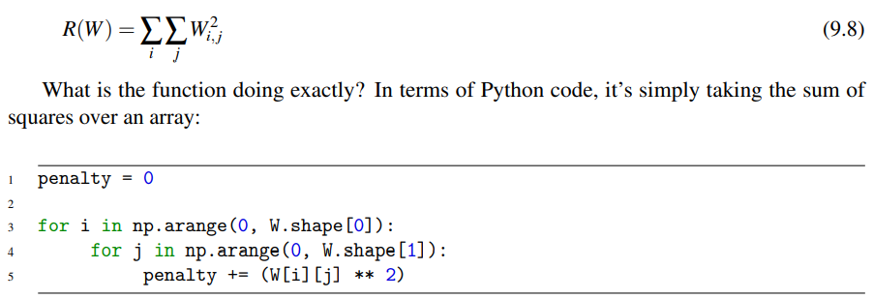

Regularization
Updating Our Loss and Weight Update To Include Regularization

Slide 32



Regularization
Updating Our Loss and Weight Update To Include Regularization

Slide 33



Regularization
Types of Regularization Techniques

Slide 34
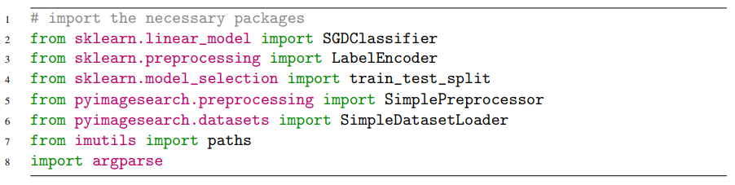
Regularization
Regularization Applied to Image Classification

Slide 35
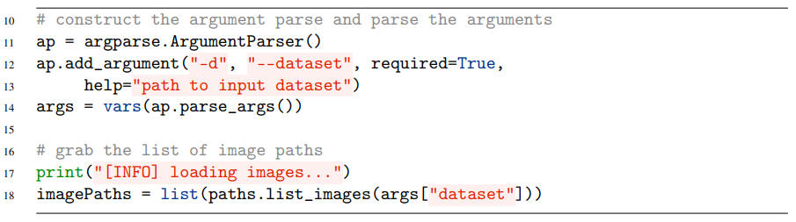
Regularization
Regularization Applied to Image Classification

Slide 36
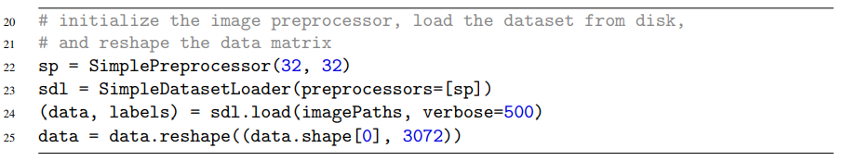
Regularization
Regularization Applied to Image Classification

Slide 37
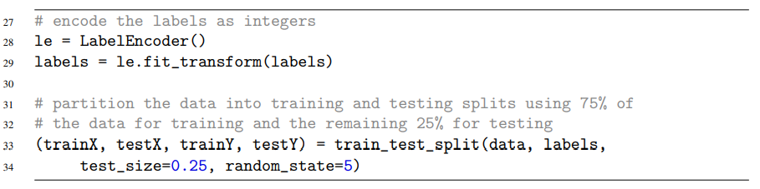
Regularization
Regularization Applied to Image Classification

Slide 38
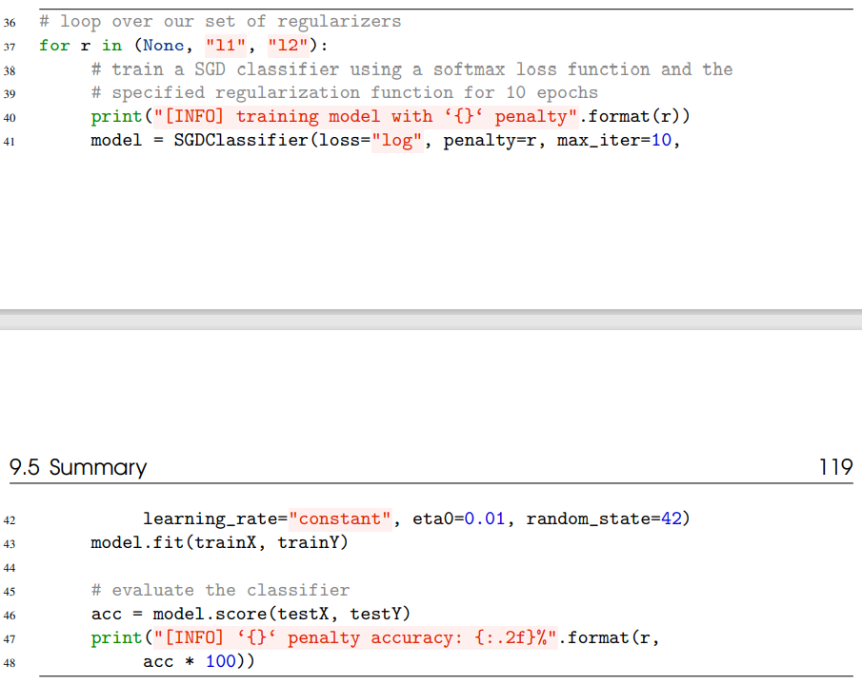
Regularization
Regularization Applied to Image Classification

Slide 39
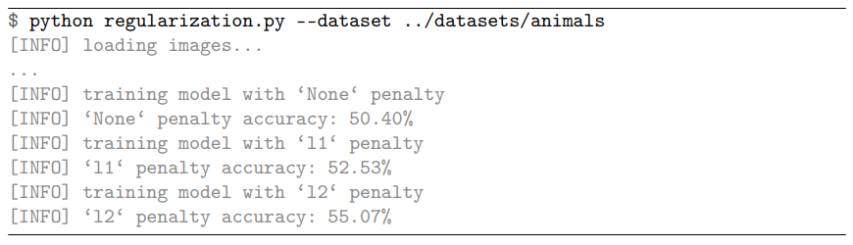
Regularization
Regularization Applied to Image Classification

Slide 40
Thank you
감사합니다!

