Slide 1
Deep Learning for
Computer Vision with Python

Slide 2
Neural Network Fundamentals
Notes:
최적화 방법과 정규화에 대하여

Slide 3
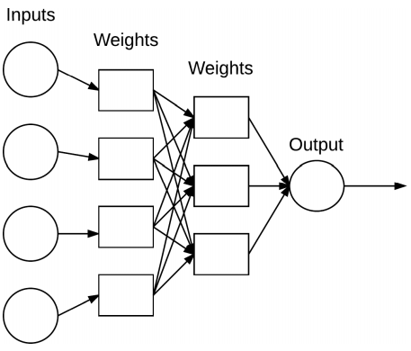
Neural Network Basics

Slide 4
Neural Network Basics
Introduction to Neural Networks
Artificial Neural Network
Computation system that attempts to mimic the neural connections in our nervous system

Slide 5
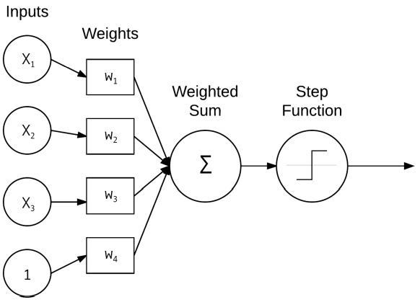
Neural Network Basics
Introduction to Neural Networks

Slide 6

Neural Network Basics
Introduction to Neural Networks
Activation Functions
The most simple activation functions is the “step function”, used by Perceptron algorithm

Slide 7
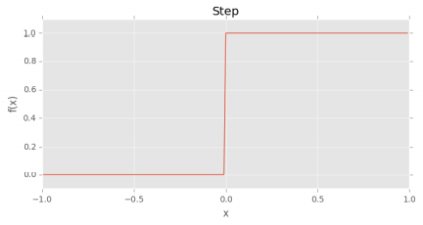
Neural Network Basics
Introduction to Neural Networks

Slide 8
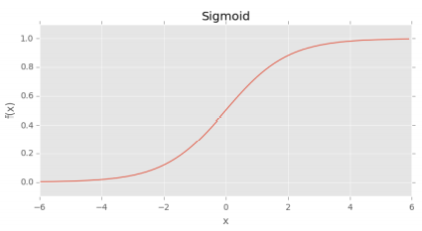

Neural Network Basics
Introduction to Neural Networks

Slide 9
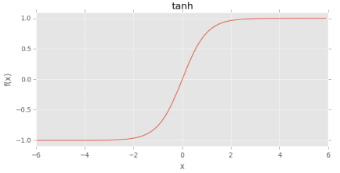

Neural Network Basics
Introduction to Neural Networks

Slide 10
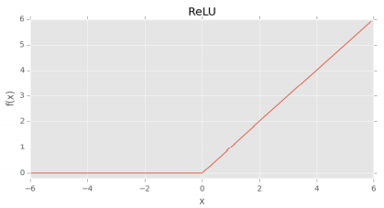

Neural Network Basics
Introduction to Neural Networks

Slide 11
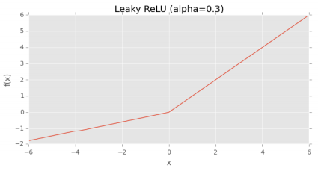

Neural Network Basics
Introduction to Neural Networks

Slide 12
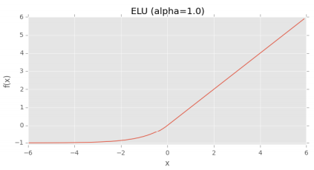

Neural Network Basics
Introduction to Neural Networks

Slide 13
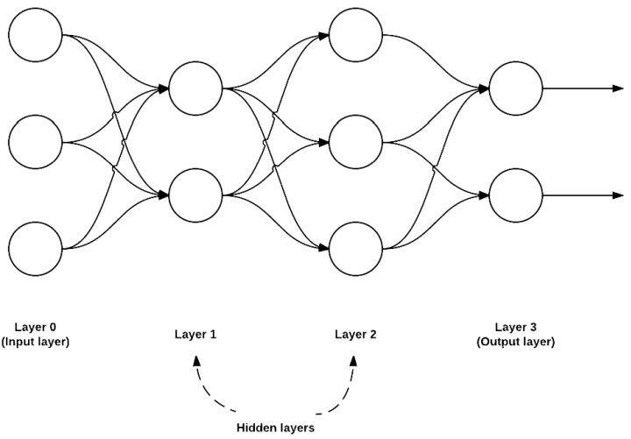
Neural Network Basics
Introduction to Neural Networks
3-2-3-2 feedforward network

Slide 14
Neural Network Basics
The Perceptron Algorithm

Slide 15
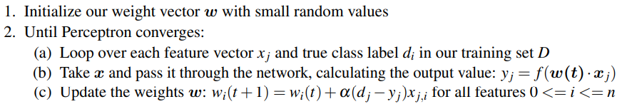
Neural Network Basics
The Perceptron Algorithm
Perceptron algorithm training procedure

Slide 16
Neural Network Basics
Backpropagation and Multi-layer Networks
Backpropagation algorithm
The forward pass where our inputs are passed through the network and output predictions obtained.
The backward pass where we compute the gradient of the loss function at the final layer of the network and use this gradient to recursively apply the chain rule to update the weights in our network.

Slide 17
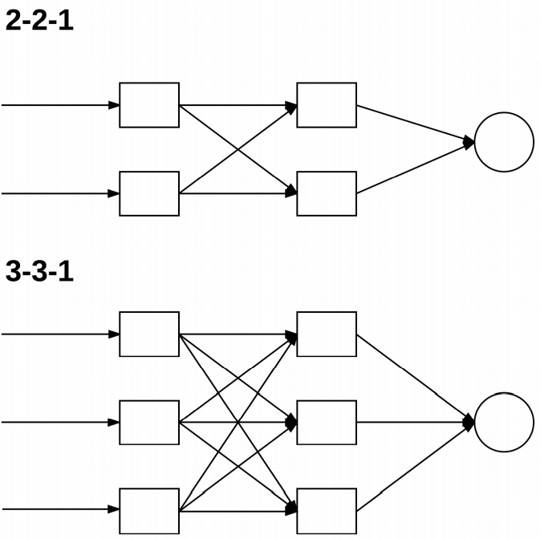
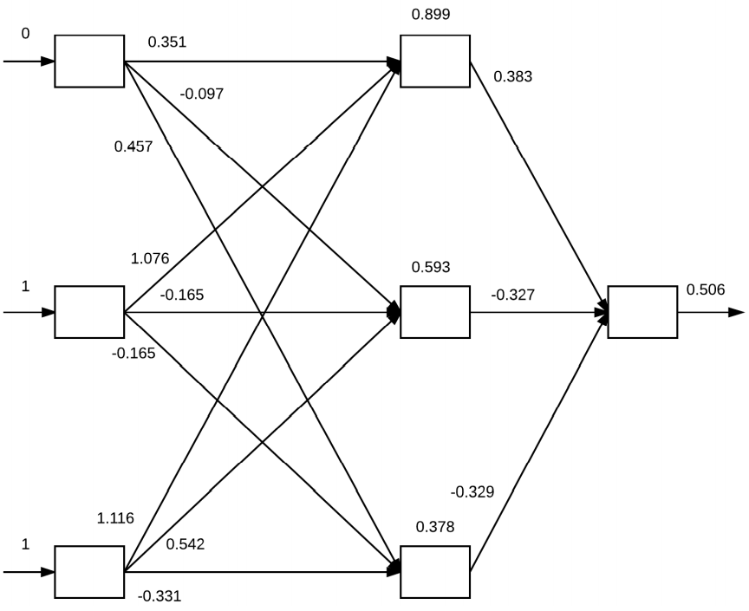
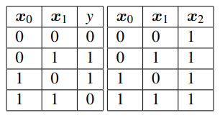
Neural Network Basics
Backpropagation and Multi-layer Networks
Forward Pass

Slide 18

Neural Network Basics
Backpropagation and Multi-layer Networks
Backward Pass

Slide 19
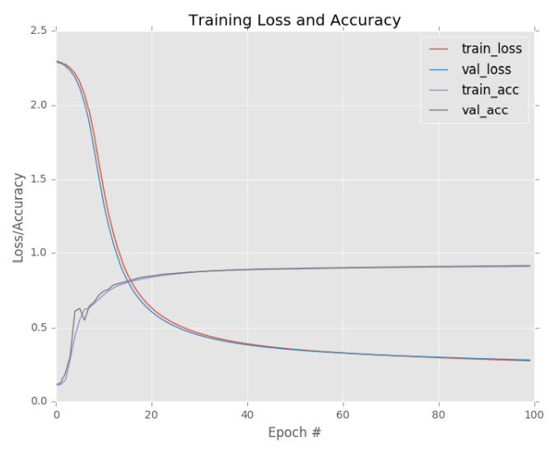
Neural Network Basics
Backpropagation and Multi-layer Networks

Slide 20
Neural Network Basics
Summary
Dataset
Loss function
Four Ingredients in a Neural Network
Model/
architecture
Optimization
method

Slide 21
Thank you
감사합니다!

