Slide 1
Deep Learning for
Computer Vision with Python

Slide 2
Convolutional Neural Networks
Notes:
최적화 방법과 정규화에 대하여

Slide 3
Understanding Convolutions
What a convolution is
Take two matrices
Multiply them, element-by-element (not the dot product)
Sum the elements together

Slide 4
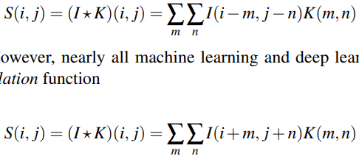
Understanding Convolutions
Convolutions versus Cross-correlation

Slide 5
Understanding Convolutions
The “Big Matrix” AND “Tiny Matrix” Analogy
Big Matrix – Image
Tiny Matrix – Kernel or Convolutional matrix
(used for blurring, sharpening, edge detection, and other processing functions)

Slide 6
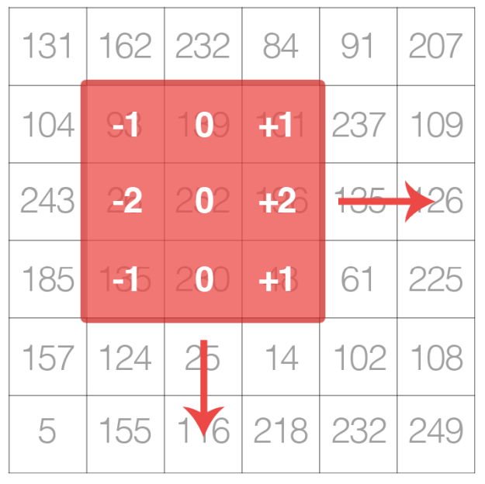
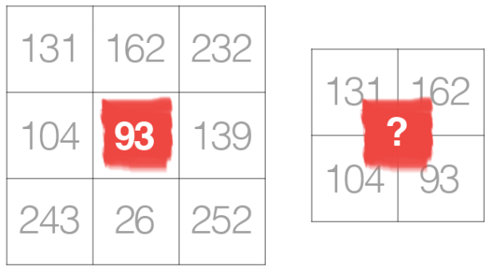
Understanding Convolutions
Kernels

Slide 7
Understanding Convolutions
A Hand Computation Example of Convolution
Convolution requires three components
An input image
A kernel matrix that we are going to apply to the input image
An output image to store the output of the image convolved with the kernel

Slide 8
Understanding Convolutions
A Hand Computation Example of Convolution
All we need to do for convolution is
Select an (x, y)-coordinate from the original image
Place the center of the kernel at this (x, y)-coordinate
Take the element-wise multiplication of the input image region and the kernel, then sum up the values of these multiplication operations into a single value
Use the same (x, y)-coordinates from Step #1, store the kernel output at the same (x, y)-location as the output image

Slide 9
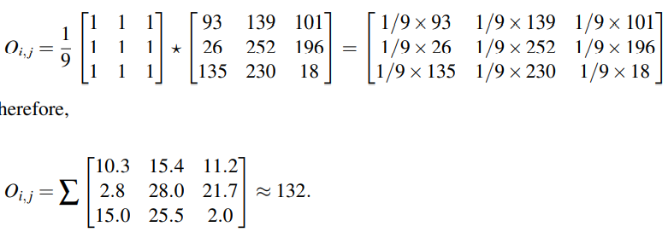
Understanding Convolutions
A Hand Computation Example of Convolution

Slide 10
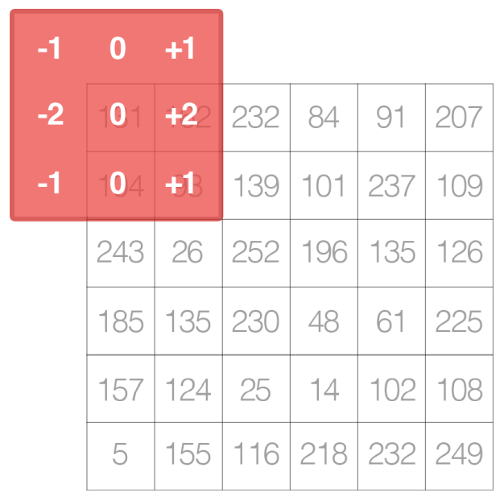
Understanding Convolutions
Implementing Convolutions

Slide 11
CNN Building Blocks
Layer Types
Convolutional (CONV)
Activation (ACT or RELU)
Pooling (POOL)
Fully-connected (FC)
Batch normalization (BN)
Dropout (DO)

Slide 12
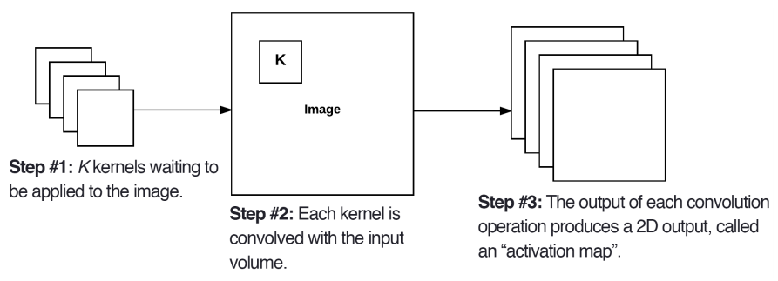
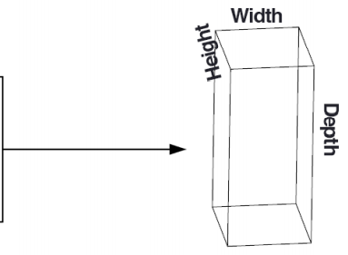
CNN Building Blocks
Convolutional Layers

Slide 13
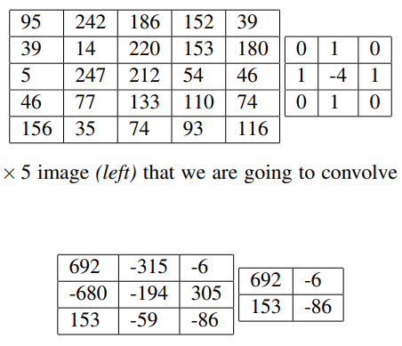
CNN Building Blocks
Convolutional Layers _ Stride

Slide 14
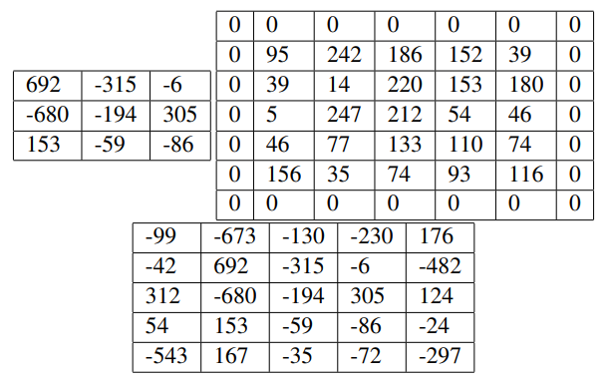
CNN Building Blocks
Convolutional Layers _ Zero-padding

Slide 15

CNN Building Blocks
Convolutional Layers

Slide 16
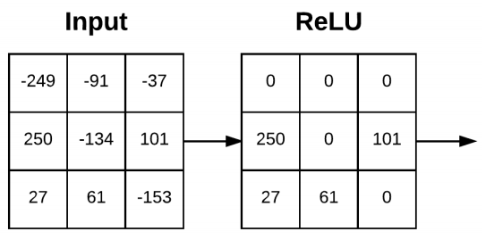
CNN Building Blocks
Activation Layers

Slide 17
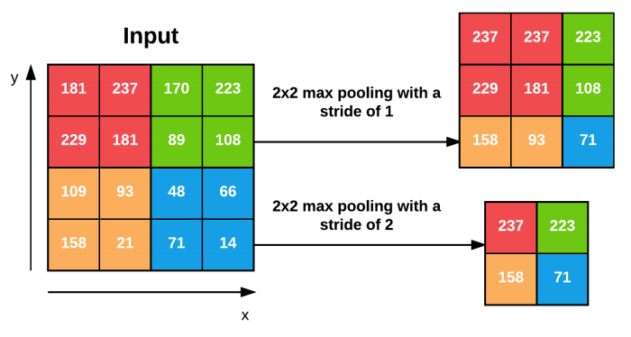
CNN Building Blocks
Pooling Layers

Slide 18

CNN Building Blocks
Pooling Layers

Slide 19
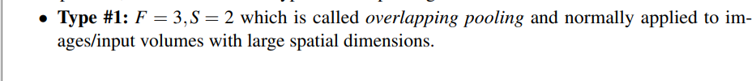
CNN Building Blocks
Pooling Layers

Slide 20
CNN Building Blocks
Fully-connected Layers

Slide 21
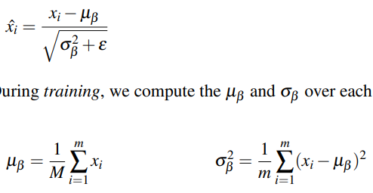
CNN Building Blocks
Batch Normalization

Slide 22
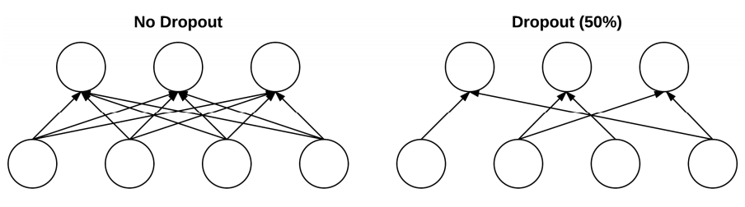
CNN Building Blocks
Dropout

Slide 23
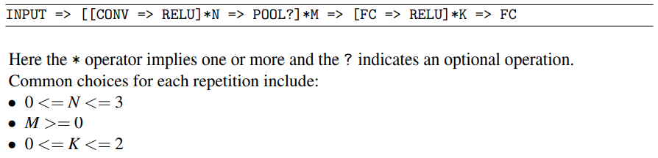
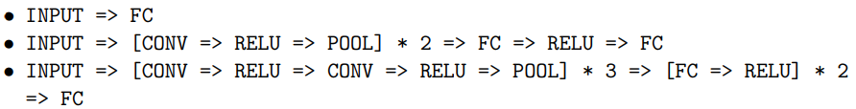
Common Architectures and Training Patterns
Layer Patterns

Slide 24
Thank you
감사합니다!

