Slide 1
Deep Learning for
Computer Vision with Python

Slide 2
Training First CNN
Notes:
최적화 방법과 정규화에 대하여

Slide 3
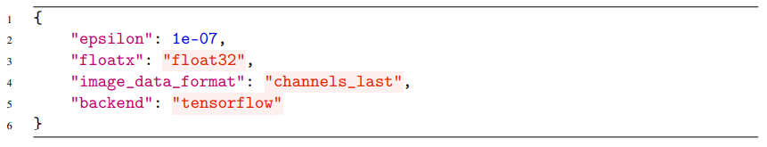
Keras Configurations and Converting Images to Arrays
Understanding the keras.json Configuration File

Slide 4
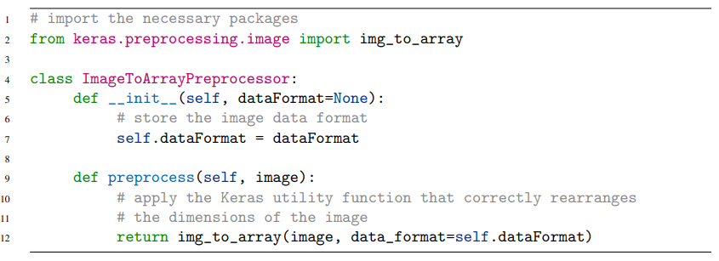
Keras Configurations and Converting Images to Arrays
The Image to Array Preprocessor

Slide 5
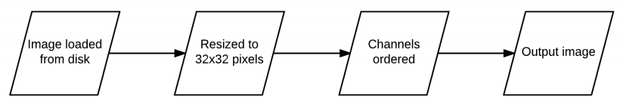
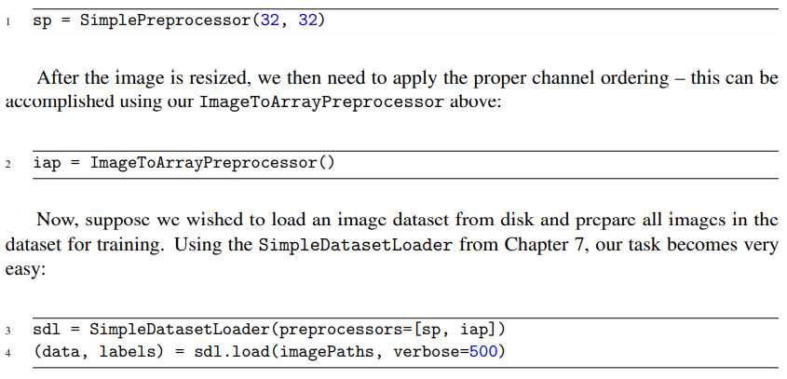
Keras Configurations and Converting Images to Arrays
The Image to Array Preprocessor

Slide 6
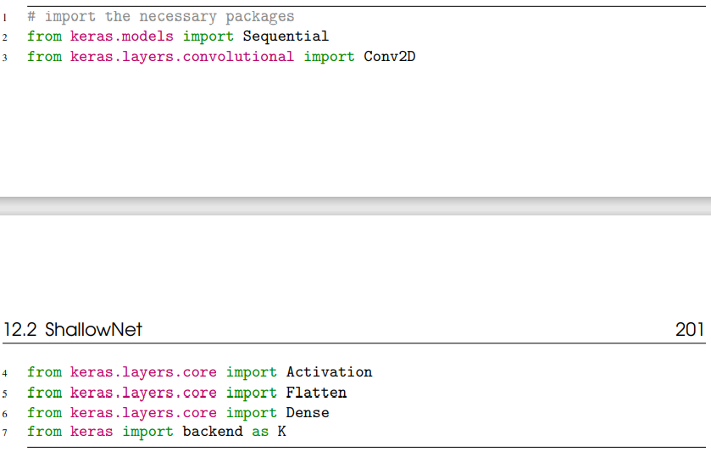
ShallowNet
Implementing ShallowNet

Slide 7
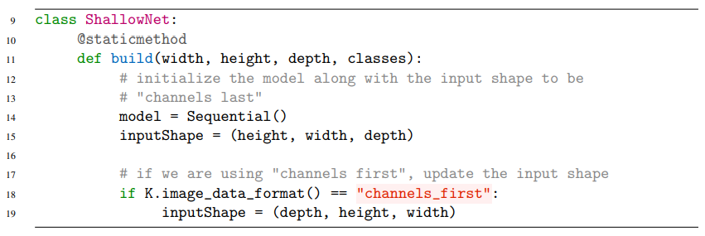
ShallowNet
Implementing ShallowNet

Slide 8
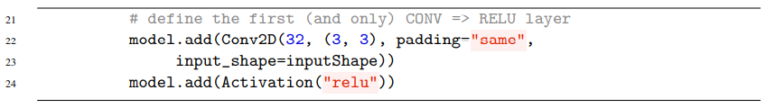
ShallowNet
Implementing ShallowNet

Slide 9
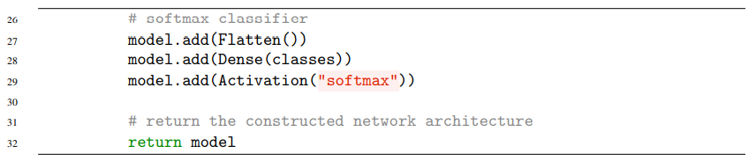
ShallowNet
Implementing ShallowNet

Slide 10
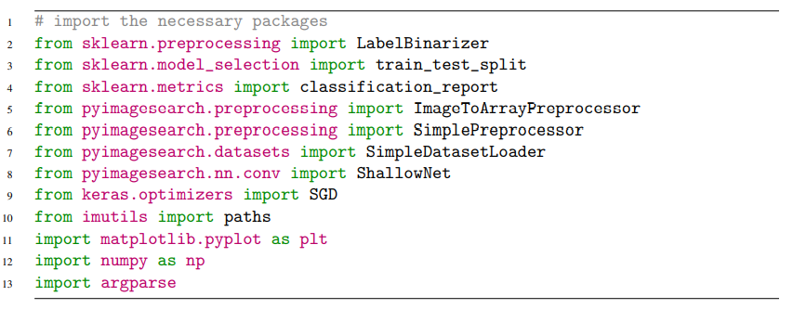
ShallowNet
ShallowNet on Animals

Slide 11
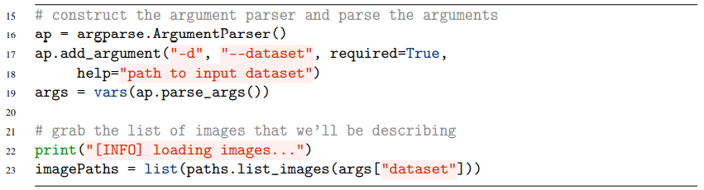
ShallowNet
ShallowNet on Animals

Slide 12
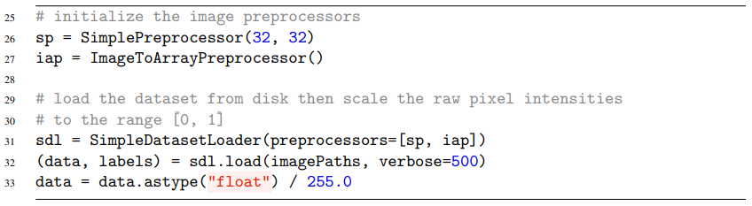
ShallowNet
ShallowNet on Animals

Slide 13
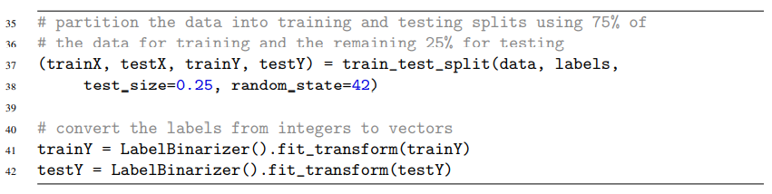
ShallowNet
ShallowNet on Animals

Slide 14
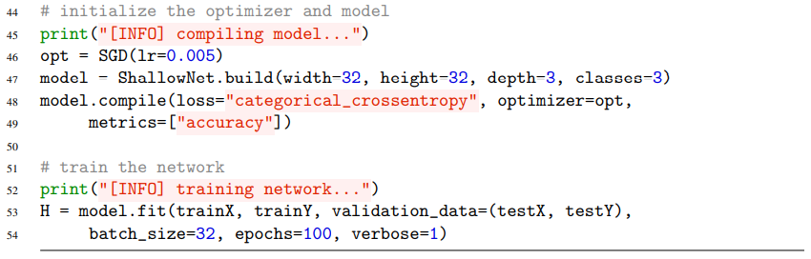
ShallowNet
ShallowNet on Animals

Slide 15
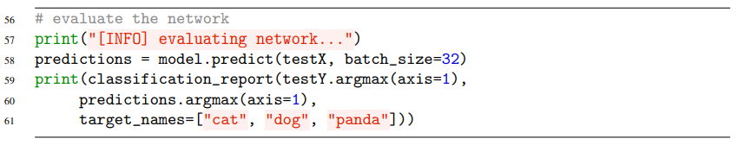
ShallowNet
ShallowNet on Animals

Slide 16
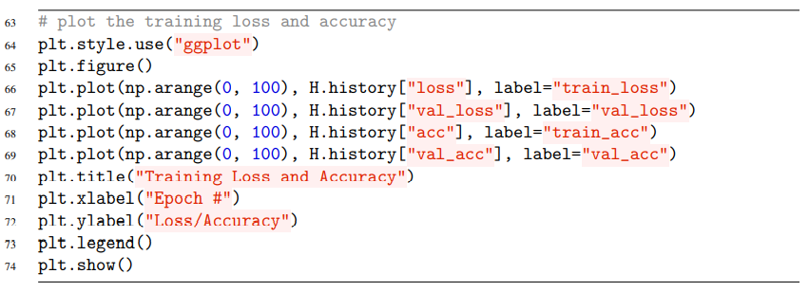
ShallowNet
ShallowNet on Animals

Slide 17
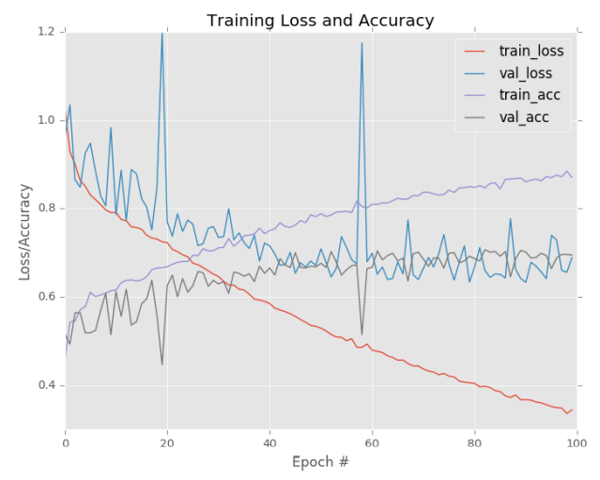
ShallowNet
ShallowNet on Animals

Slide 18
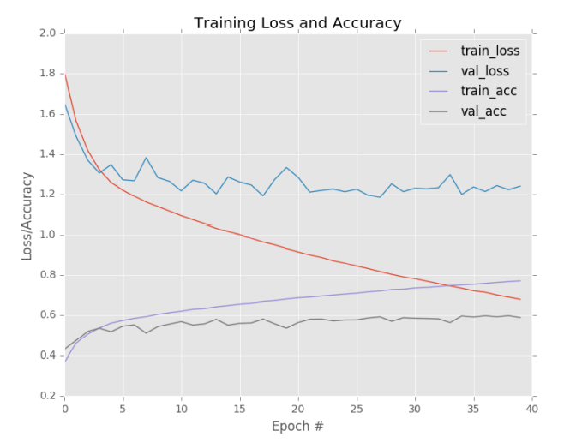
ShallowNet
ShallowNet on CIFAR-10

Slide 19
Thank you
감사합니다!

