Slide 1
Deep Learning for
Computer Vision with Python

Slide 2
Saving and Loading Models
Notes:
최적화 방법과 정규화에 대하여

Slide 3
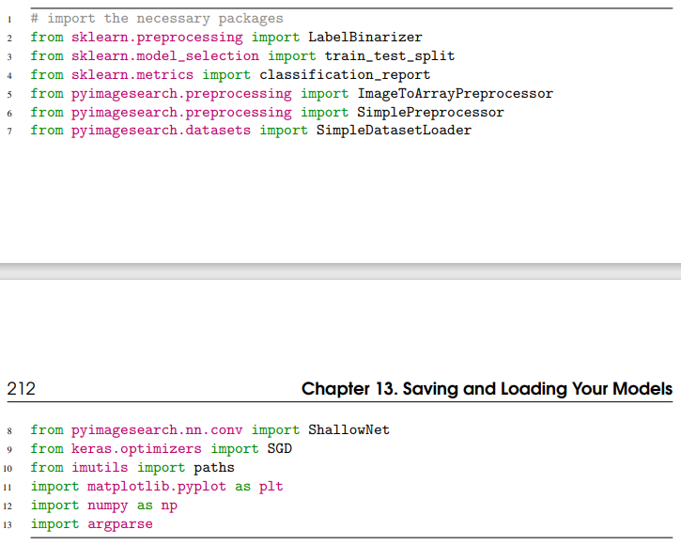
Serializing a Model to Disk

Slide 4
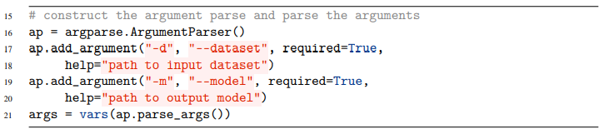
Serializing a Model to Disk

Slide 5
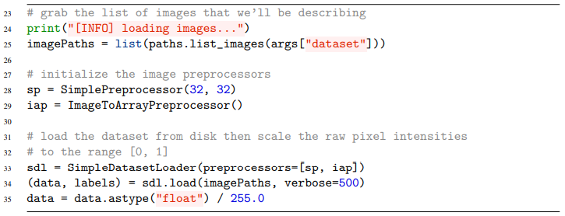
Serializing a Model to Disk

Slide 6
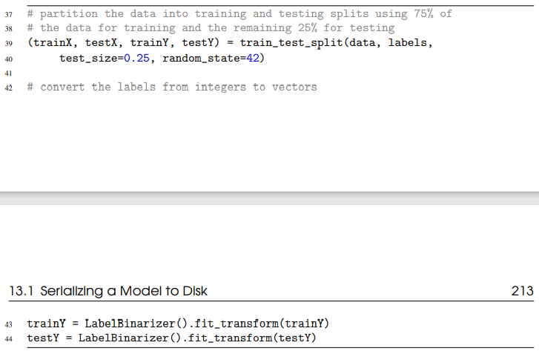
Serializing a Model to Disk

Slide 7
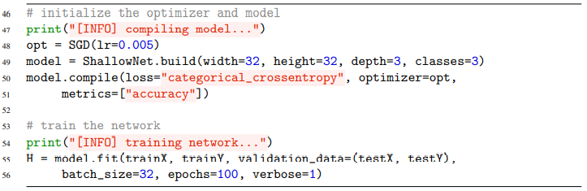
Serializing a Model to Disk

Slide 8
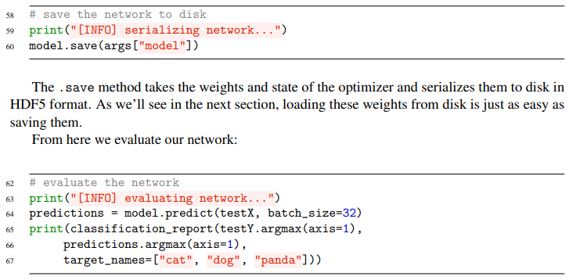
Serializing a Model to Disk

Slide 9
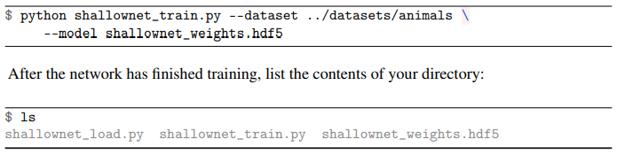
Serializing a Model to Disk

Slide 10
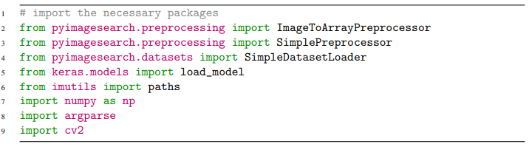
Loading a Pre-trained Model from Disk

Slide 11
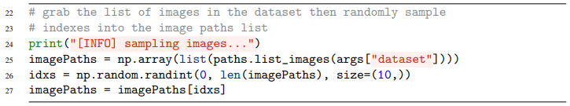
Loading a Pre-trained Model from Disk

Slide 12
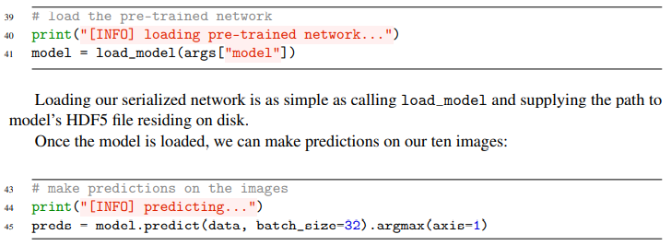
Loading a Pre-trained Model from Disk

Slide 13
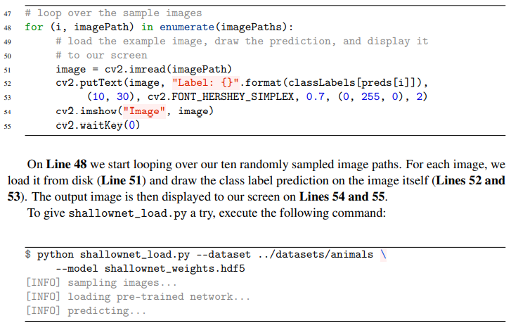
Loading a Pre-trained Model from Disk

Slide 14
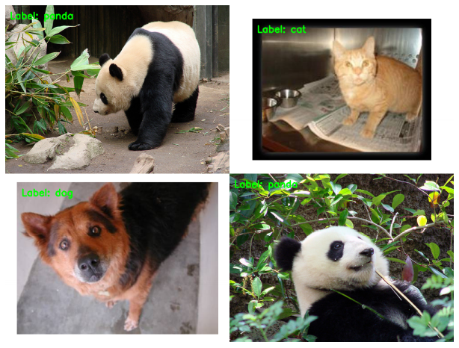
Loading a Pre-trained Model from Disk

Slide 15
LeNet: Recognizing Handwritten Digits
Notes:
최적화 방법과 정규화에 대하여

Slide 16
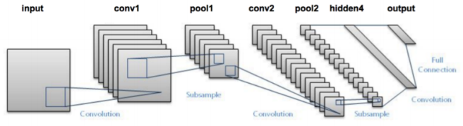
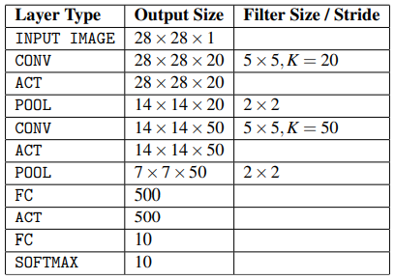
The LeNet Architecture

Slide 17
The LeNet Architecture

Slide 18
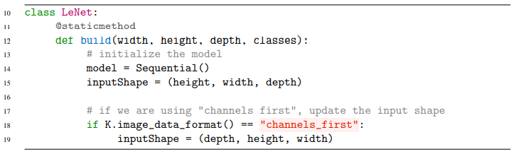
Implementing LeNet

Slide 19
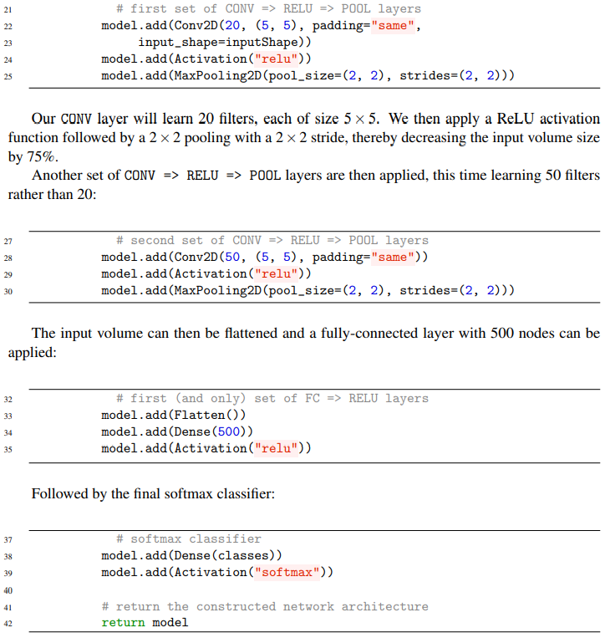
Implementing LeNet

Slide 20
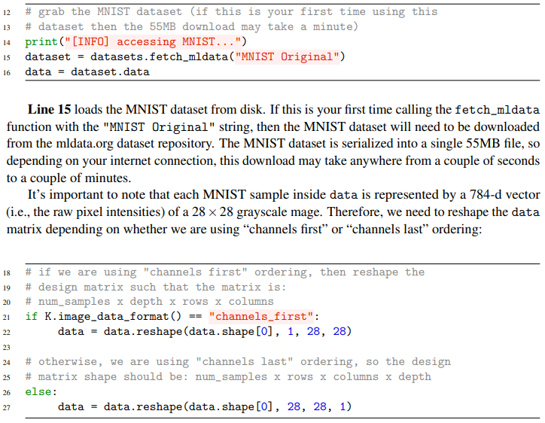
LeNet on MNIST

Slide 21
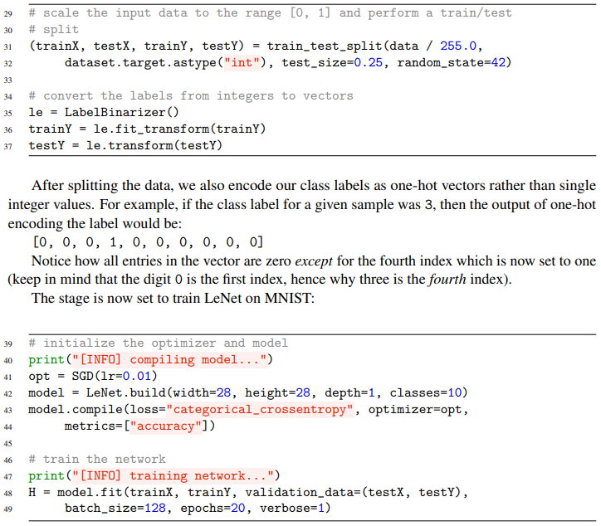
LeNet on MNIST

Slide 22
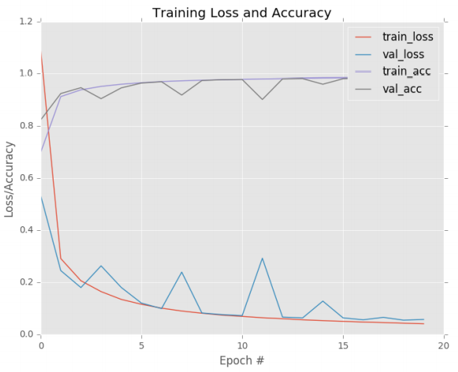
LeNet on MNIST

Slide 23
Thank you
감사합니다!

