Slide 1
Detection of Human Falls on Furniture Using Scene Analysis Based on Deep Learning and Activity Characteristics
IEEE 2018

Slide 2
Introduction
Achieving highly accurate fall detection in complicated environments
such as falls on furniture is extremely important

Slide 3
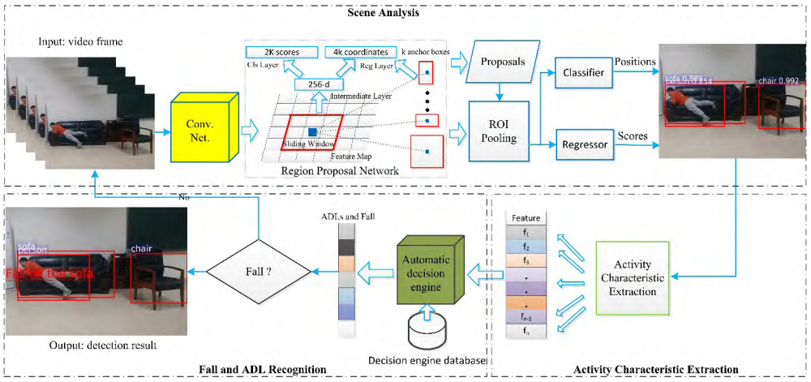
Overview of Proposed Method
Notes:
장면(Scene) 내 위치 및 객체 정보를 얻기 위한 Faster R-CNN 기반 장면 분석 모듈
종횡비, 중심, 동작 속도와 같은 감지된 사람의 활동 특성을 계산하는 Activity 특징 추출 모듈
Fall 및 ADL 인식 모듈

Slide 4
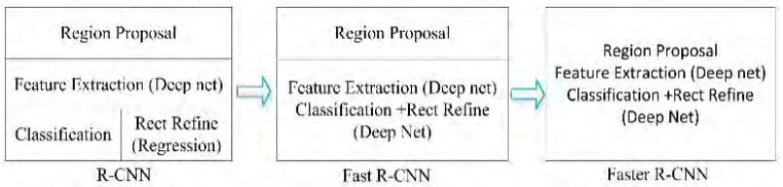
Fall Detection Using Scene Analysis
Scene Analysis Using Faster R-CNN

Slide 5
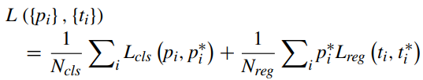
Fall Detection Using Scene Analysis
Scene Analysis Using Faster R-CNN
Notes:
loss function

Slide 6
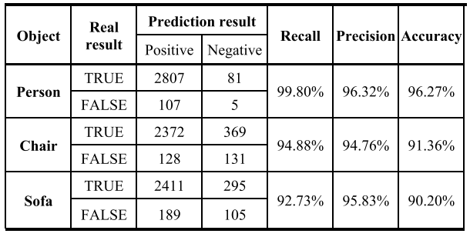
Fall Detection Using Scene Analysis
Scene Analysis Using Faster R-CNN

Slide 7
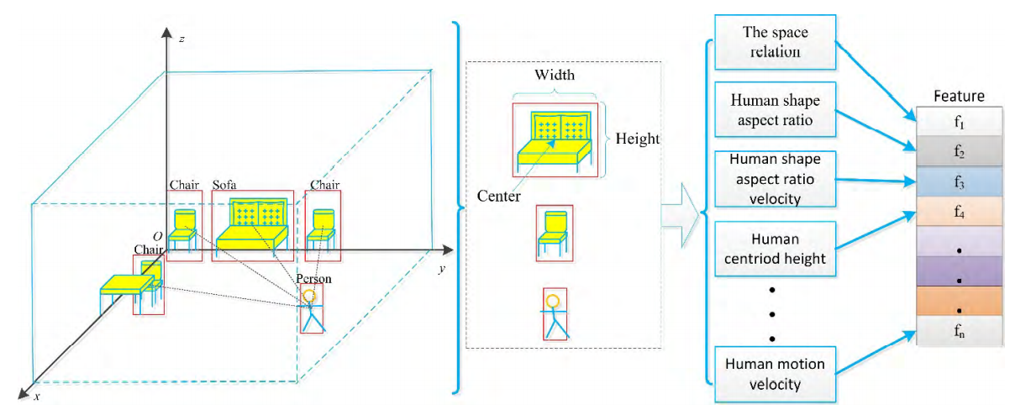
Fall Detection Using Scene Analysis
Activity Characteristics of Human Falls

Slide 8


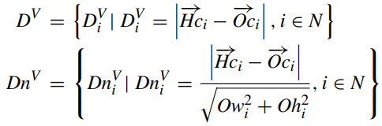
Fall Detection Using Scene Analysis
Activity Characteristics of Human Falls
Notes:
PersonV 수식 이상

Slide 9
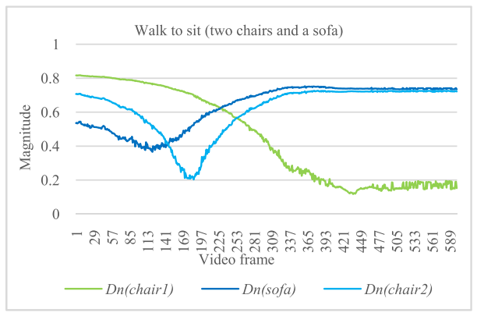
Fall Detection Using Scene Analysis
Activity Characteristics of Human Falls

Slide 10
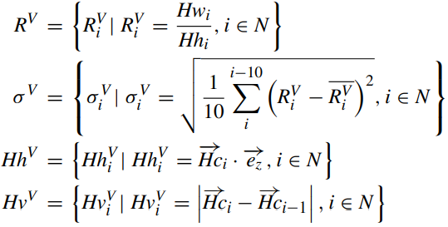
Fall Detection Using Scene Analysis
Activity Characteristics of Human Falls

Slide 11
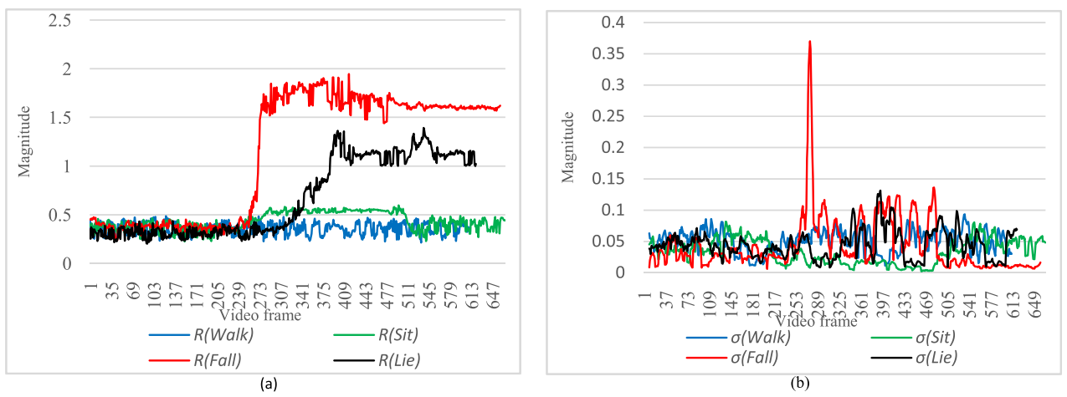
Fall Detection Using Scene Analysis
Activity Characteristics of Human Falls

Slide 12
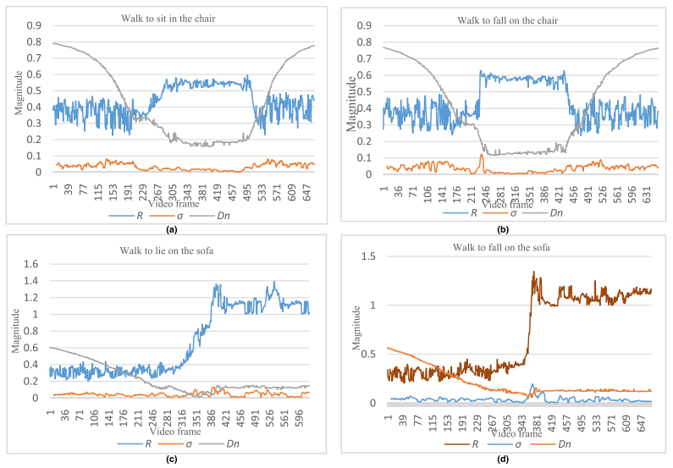
Fall Detection Using Scene Analysis
Activity Characteristics of Human Falls

Slide 13
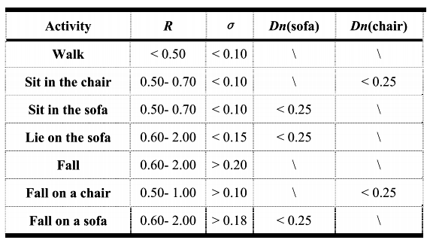
Fall Detection Using Scene Analysis
Activity Characteristics of Human Falls

Slide 14
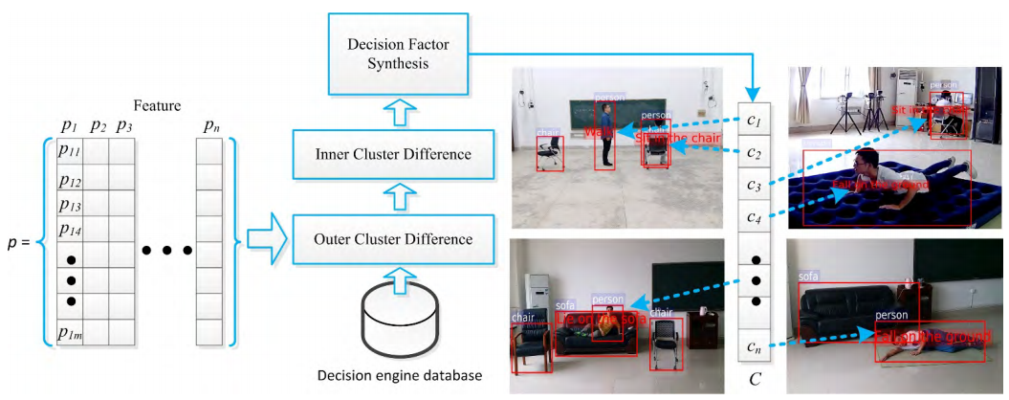
Fall Detection Using Scene Analysis
Activity Characteristics of Human Falls

Slide 15


Fall Detection Using Scene Analysis
Algorithm of Fall and ADL Recognition

Slide 16
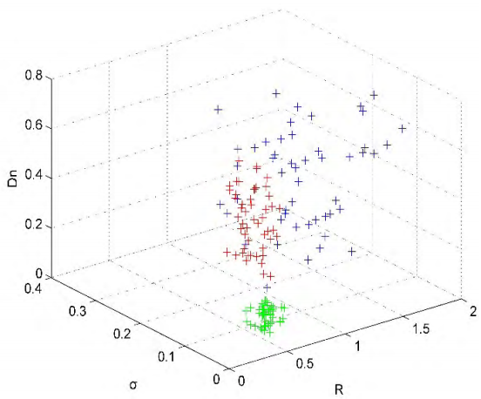
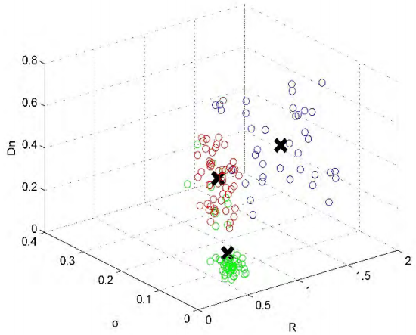
Fall Detection Using Scene Analysis
Algorithm of Fall and ADL Recognition

Slide 17
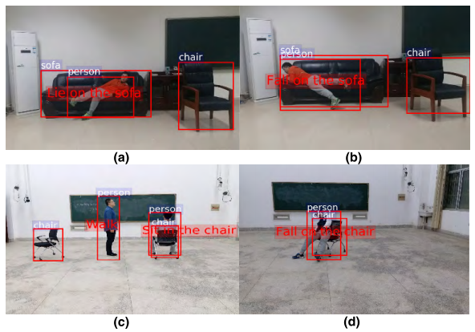
Experiments
Qualitative Analysis

Slide 18
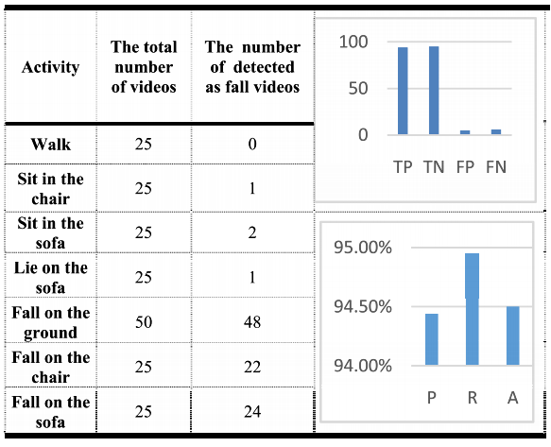
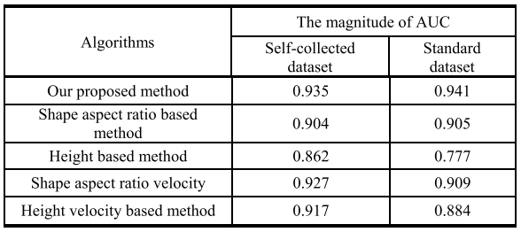
Experiments
Quantitative Analysis

