Slide 1
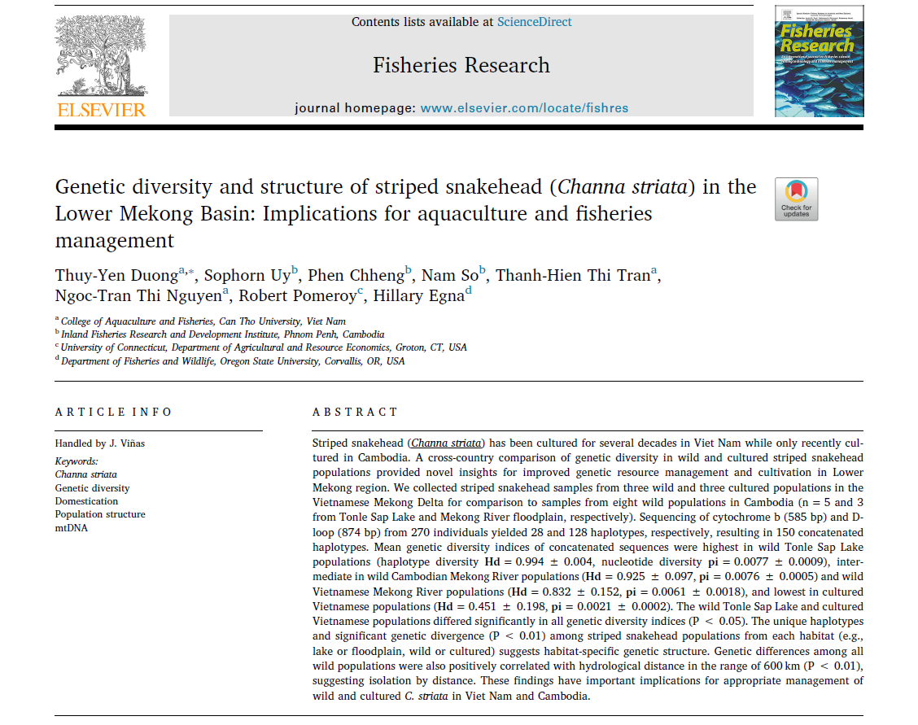
Presented by:
Name: Sok Hui "Stella" LIM
Student ID: 45675414
Duong, T.Y., Uy, S., Chheng, P., So, N., Tran, T.H.T., Nguyen, N.T.T., Pomeroy, R. and Egna, H., 2019. Genetic diversity and structure of striped snakehead (Channa striata) in the Lower Mekong Basin: Implications for aquaculture and fisheries management. Fisheries Research, 218, pp.166-173.

Slide 2
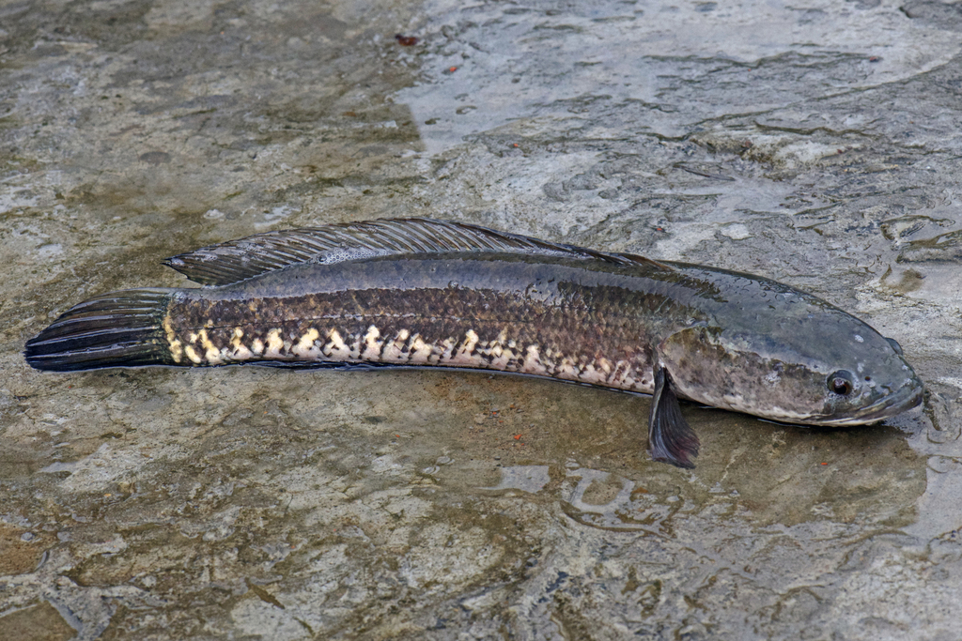
Introduction
Lower Mekong River region of focus – Cambodia and Vietnam
Striped snakehead (Channa striata)
Over-exploited for local consumption
Cultured in Vietnam since 1990s
Farming was banned in Cambodia in 2004 – illegal fishing of small fish for feed – ban lifted in 2016
Problem: need good broodstock sources with high genetic diversity for Cambodia!
Fig.1: Striped snakehead (Channa striata) photo extracted from
https://inaturalist.ala.org.au/taxa/97280-Channa-striata

Slide 3
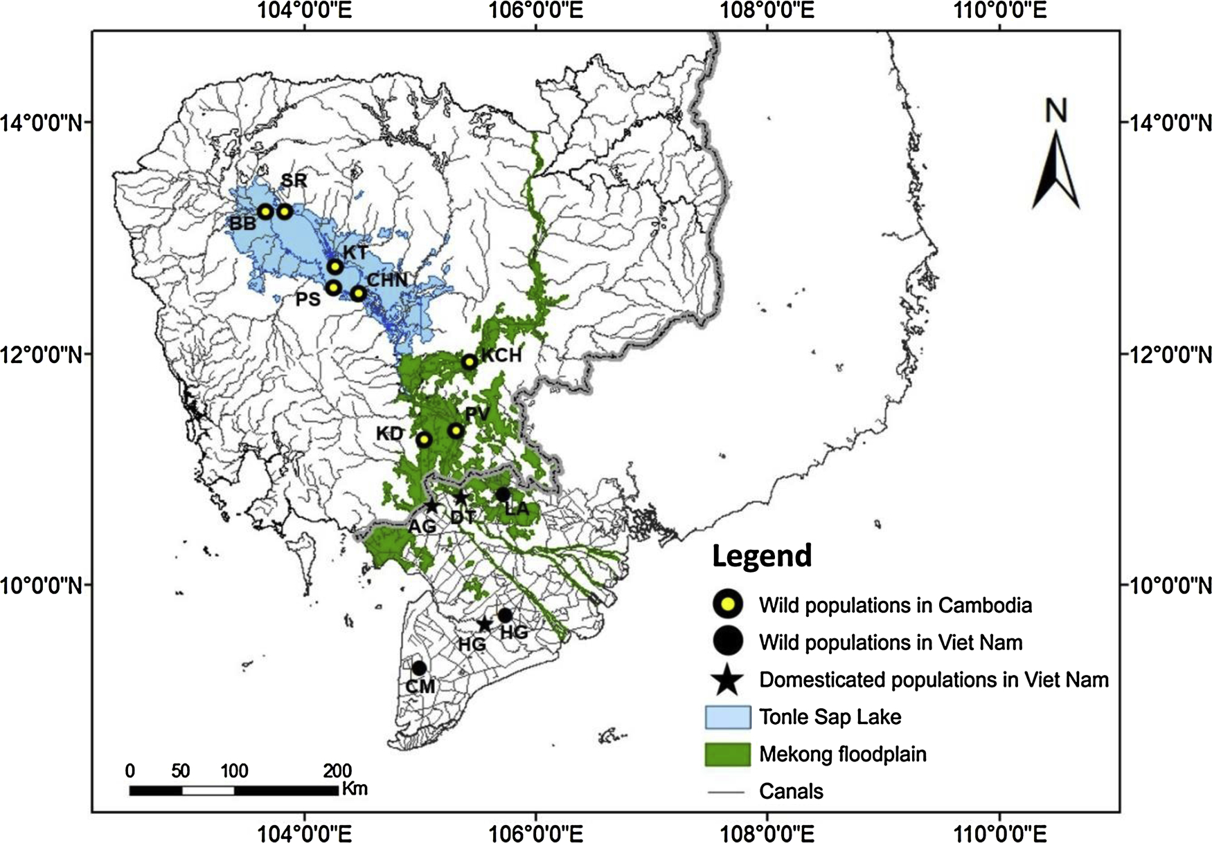
Materials & Methods
Sample collection:
Cambodia: 8 wild populations
5 Tonle Sap Lake population
3 Mekong River floodplain
Vietnam: 6 populations
3 wild population
3 domesticated population
Fig. 2: Sampling locations for striped snakehead

Slide 4
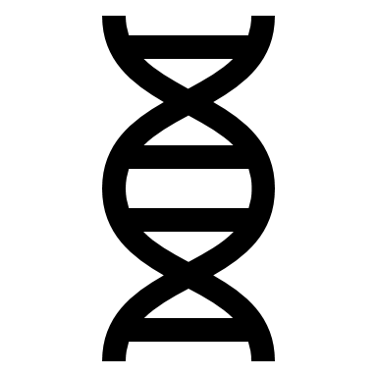
Materials & Methods
Genetic analysis:
Extracted DNA from 20 to 30 individuals of each population
Used two mitochondrial markers for DNA amplification:
Cytochrome b gene
D-loop
Polymerase chain reaction (PCR)
Sent off for DNA sequencing

Slide 5

Materials & Methods
Data analysis:
Used bioinformatics software to:
align the sequences
estimate genetic diversity indices (GDI) – number of haplotypes, haplotype diversity, and nucleotide diversity
Used non-parametric Kruskal-Wallis tests to compare GDI
Constructed median-joining phylogenetic tree based on Tamura and Nei model with bootstrapping 1000 times
Evaluate genetic structure based on genetic distances, genetic differences (F_{ST}), and partitioning of genetic variation (AMOVA)

Slide 6
Results
Genetic diversity
Obtained 270 sequences
Cytochrome b generated 28 haplotypes and 26 polymorphic sites
D-loop generated 128 haplotypes and 100 polymorphic sites

Slide 7
Results
Genetic diversity
Population GDI from highest to lowest:
Tonle Sap lake (haplotype diversity Hd = 0.994 ± 0.004 and nucleotide diversity, pi = 0.0077 ± 0.0009)
Cambodian Mekong River (Hd = 0.925 ± 0.097, pi = 0.0076 ± 0.0005)
Vietnamese wild (Hd = 0.832 ± 0.152, pi = 0.0061 ± 0.0018)
Vietnamese domesticated (Hd = 0.451 ± 0.198, pi = 0.0021 ± 0.0002)
Tonle Sap lake vs Vietnamese domesticated population differ significantly in all GDI (P = 0.017)
Overall, genetic diversity was high
0.955 ± 0.009 haplotype diversity
0.0077 ± 0.0002 nucleotide diversity

Slide 8
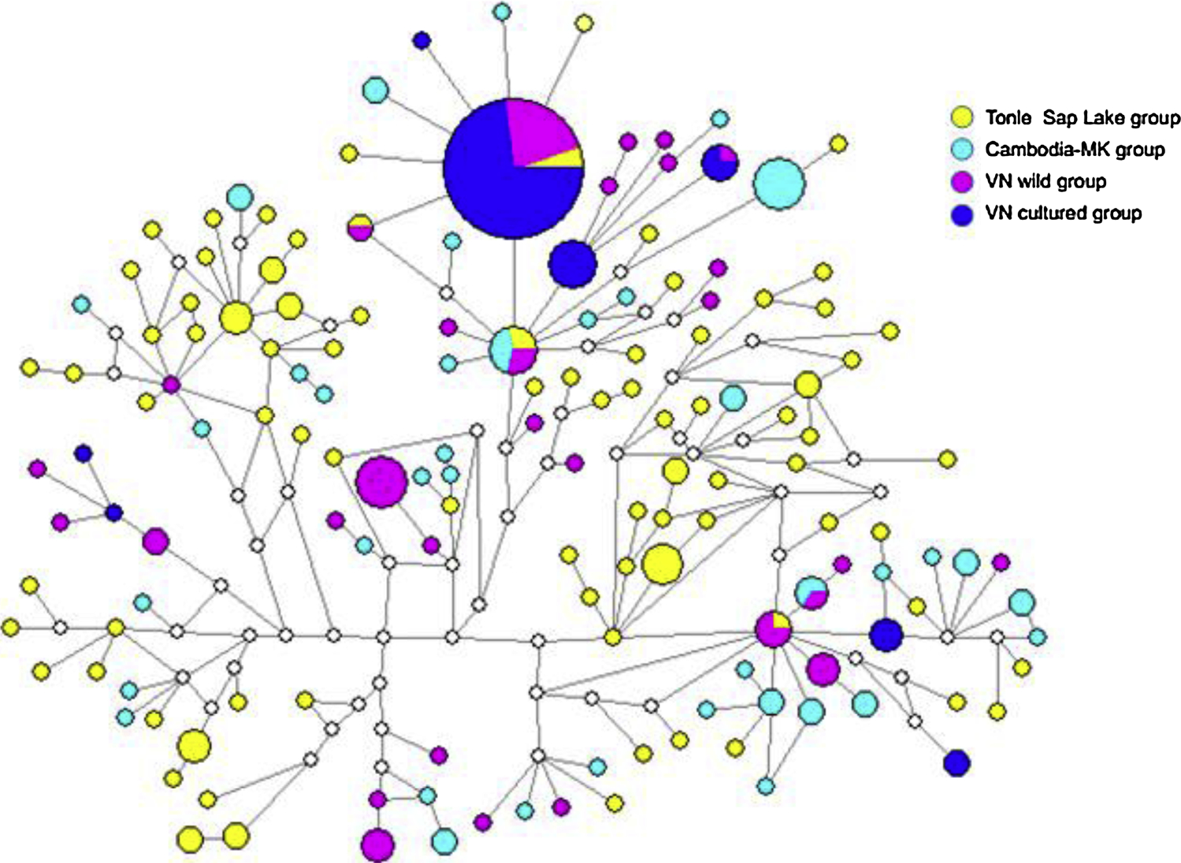
Results
Phylogeographic
Number of unique haplotypes:
highest in Tonle Sap group
Lowest in Vietnamese domesticated group
Only one haplotype shared among all populations
Phylogenetics showed no common haplotype among the 4 groups
Phylogenetically clustered by wild vs domesticated, not geography
Fig. 3: Median-joining network of haplotypes of the striped snakehead groups. The size circles is proportional with the number of individuals. White dots represent median vectors (inferred and unsampled haplotypes).

Slide 9
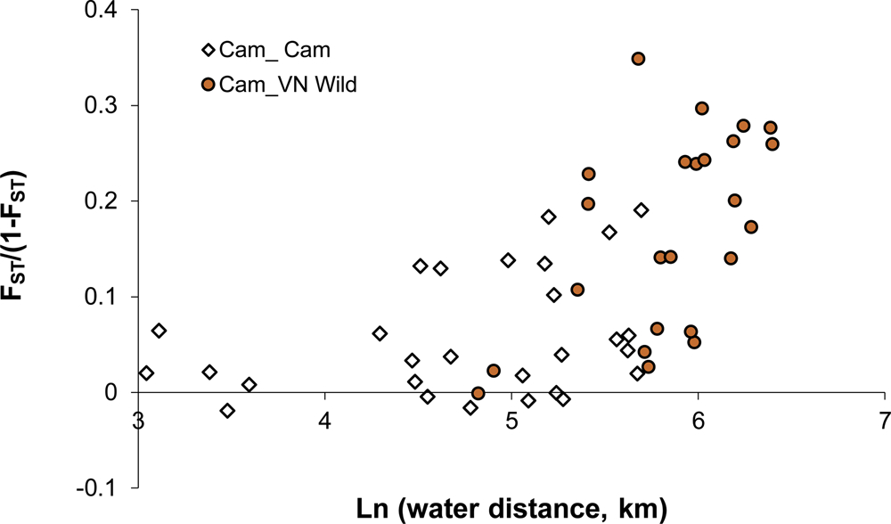
Results
Genetic structure
Low F_{ST} within habitat group
Moderate to high F_{ST} among group
AMOVA showed that all fixation indices were significant (P < 0.001)
Majority of genetic variation was from sampling locations
The four groups had the lowest heterogeneity (6.9%) within groups and a relatively large variation among groups (12.5%)
Pairwise populations among the two countries show genetic differences increase faster with the increase of hydrological distances → limited gene flow
Fig. 4: Plot of genetic distance vs hydrological distance

Slide 10
Discussion
Genetic diversity
Different levels of genetic diversity in the wild can be related to:
Population sizes
Different pressures of exploitation (overfishing)
Founder effects in the Vietnamese domesticated population (small-scale farming)

Slide 11
Discussion
Genetic structure
Both F_{ST} and AMOVA support that there is genetic structure by living environments
Migration capacity
Hydrological connectivity
Possible anthropogenic factors
Gene flow could be affected by transportation of striped snakehead from Vietnam to Cambodia

Slide 12
Discussion
Implications
Should NOT use Vietnamese broodstock for Cambodian domestication because of the low genetic diversity
Use Tonle Sap population
Genetic monitoring
Genetic improvement in Vietnam to prevent inbreeding depression
Supplement local wild individuals
Increase size of the breeding population
Should not translocate between the two countries (outbreeding depression)
Control fishing pressures

Slide 13
Similar studies
[1] Boonkusol and Tongbai, 2016
Striped snakehead populations in Central Thailand
396 bp in mitochondria Cytochrome c oxidase subunit I
Median-joining tree did not show that haplotype clades correspond to the geographic distribution
Suggest a high genetic variation in this area – high gene flow between regional populations due to fish dispersal by flood and aquaculture
[2] Hornick and Plough, 2021
Chesapeake Bay eastern oysters (Crassostrea virginica)
Investigated the broader genetic impacts of large-scale hatchery-based bivalve restoration
Diversity increased when using large numbers of local, natural broodstock in hatchery
[1] Boonkusol, D. and Tongbai, W., 2016. Genetic variation of striped snakehead fish (Channa striata) in river basin of Central Thailand inferred from mtDNA COI gene sequences analysis.
[2] Hornick, K.M. and Plough, L.V., 2021. Genome‐wide analysis of natural and restored eastern oyster populations reveals local adaptation and positive impacts of planting frequency and broodstock number. Evolutionary applications, 15(1), pp.40-59.

Slide 14
Conclusion
It is a sound solution to use the Tonle Sap population for striped snakehead broodstock in Cambodia.

