Slide 1
StreamSphere Technologies
Call Center Performance Analysis
Stella Obase
Data Analyst

Slide 2





PROBLEM SUMMARY
Key operational challenges impacting customer experience
Unanswered Calls
Slow Response Times
Unresolved Issues
Nearly 19% of calls (946 of 5,000) go unanswered, eroding customer trust and accessibility.
Average speed of answer is 67.5 seconds; some customers wait over 2 minutes before connection.
10% of answered calls remain unresolved; Streaming and Payment topics show lower resolution rates.
Inconsistent Agent Performance
Variable Satisfaction
Recurring Topics
Satisfaction and resolution rates vary across the 8 agents; Joe and Stewart lag in key metrics.
Overall satisfaction averages 3.4/5; ratings drop when talk duration or wait times are extreme.
Streaming and Technical Support dominate volume, signalling potential product or process gaps.
2 / 12

Slide 3
OBJECTIVES
What this analysis set out to achieve
01
Call Volume Analysis
Identify trends in calls received, answered, and unanswered over time (Jan 2025 – Mar 2026).
02
Agent Performance Evaluation
Assess individual agents on answer rate, resolution rate, response speed, and satisfaction.
03
Call Resolution Analysis
Determine overall and topic-level resolution rates; pinpoint low-resolution areas.
04
Customer Issue Analysis
Examine the most common topics and which issues require the most time or effort.
05
Customer Satisfaction Assessment
Evaluate how speed of answer and talk duration influence satisfaction ratings.
06
Operational Efficiency Review
Identify bottlenecks and deliver actionable recommendations for improvement.
3 / 12

Slide 4
DATASET OVERVIEW
Source data and preparation summary
5,000
8
5
15 months
Total Calls
Agents
Topics
Date Range
Key Columns Used
• call id • agent • date • time • topic • answered (Y/N) • resolved • speed of answer (sec) • avg talk duration • satisfaction rating
Data Cleaning Notes
Unanswered calls correctly show blank speed and satisfaction fields; talk duration set to 0.
No duplicate call IDs; dates span 1 Jan 2025 – 9 Mar 2026.
Satisfaction ratings (1–5) available only for answered calls (4,054 records).
Resolution flag present for all records; analysis of resolution rate performed both overall and on answered subset.
StreamSphere Technologies Ltd. | Confidential
4 / 12

Slide 5
KEY PERFORMANCE INDICATORS
Snapshot of overall call-center health
81.1%
89.9%
67.5 s
Answer Rate
Resolution Rate*
Avg. Speed of Answered Calls
4,054 of 5,000
Among answered
3.7 min
3.40 / 5
18.9%
Avg. Talk Duration
Avg. Satisfaction
Unanswered Calls
Answered calls
4,054 ratings
946 calls lost
StreamSphere Technologies Ltd. | Confidential
5 / 12

Slide 6
Call VOLUME
Monthly call volume & answer trends
Peak Volume
Dec 2025 & Jan 2026 saw highest call volumes (387 & 383). Unanswered peaked in Dec (88).
Consistent Gap
Unanswered rate stays ~18–20% every month — a structural capacity issue, not seasonal.
StreamSphere Technologies Ltd. | Confidential
6 / 12

Slide 7
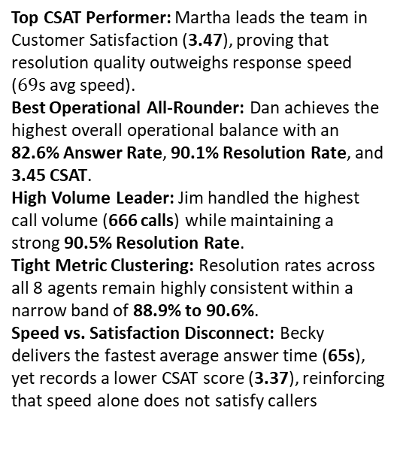
AGENTS
Agent performance comparison
Top CSAT Performer: Martha leads the team in Customer Satisfaction (3.47), proving that resolution quality outweighs response speed ($69\text{s}$ avg speed).
Best Operational All-Rounder: Dan achieves the highest overall operational balance with an 82.6% Answer Rate, 90.1% Resolution Rate, and 3.45 CSAT.
High Volume Leader: Jim handled the highest call volume (666 calls) while maintaining a strong 90.5% Resolution Rate.
Tight Metric Clustering: Resolution rates across all 8 agents remain highly consistent within a narrow band of 88.9% to 90.6%.
Speed vs. Satisfaction Disconnect: Becky delivers the fastest average answer time (65s), yet records a lower CSAT score (3.37), reinforcing that speed alone does not satisfy callers
Agent | Calls | Answer % | Resolve %* | Avg Speed | Avg Sat
Martha | 638 | 80.6% | 89.7% | 69 s | 3.47
Dan | 633 | 82.6% | 90.1% | 67 s | 3.45
Diane | 633 | 79.2% | 90.2% | 66 s | 3.41
Greg | 624 | 80.5% | 90.6% | 68 s | 3.40
Stewart | 582 | 82.0% | 88.9% | 66 s | 3.40
Jim | 666 | 80.5% | 90.5% | 66 s | 3.39
Becky | 631 | 81.9% | 89.4% | 65 s | 3.37
Joe | 593 | 81.6% | 90.1% | 71 s | 3.33
* Resolve % calculated on answered calls only
| Confidential
7 / 12

Slide 8
TOPICS & SATISFACTION
Issue mix and drivers of customer ratings
Resolution by Topic (answered)
Technical Support — 91.4%
Admin Support — 90.9%
Contract related — 89.9%
Payment related — 89.1%
Streaming — 88.4%
Satisfaction Drivers
Very long waits (>120 s) correlate with lower satisfaction (3.28). Moderate waits (90–120 s) still average 3.46. Talk duration alone is a weaker predictor than first-call resolution.
8 / 12

Slide 9
OPERATIONAL EFFICIENCY REVIEW
Bottlenecks and improvement opportunities
Capacity Gap
18.9% unanswered rate is stable month-over-month. Staffing or queue management is insufficient for peak demand.
Speed of Answer
Average 67.5 s; 25% of answered calls wait >90 s. Long waits reduce satisfaction and increase abandonment risk.
First-Call Resolution
Streaming issues have the lowest resolution rate (88.4%). These may need specialised knowledge or escalation paths.
Agent Variance
Joe has lowest avg satisfaction (3.33) and highest avg speed (71 s). Stewart has lowest resolution among answered (88.9%). Targeted coaching needed.
StreamSphere Technologies Ltd. | Confidential
9 / 12

Slide 10
Summary
1
Nearly 1 in 5 calls is never answered — a persistent structural issue across all months.
2
Once answered, resolution is strong (≈90%), but Streaming and Payment topics lag slightly.
3
Agent performance is relatively tight; Martha and Dan lead on satisfaction; Joe and Stewart need support.
4
Average wait of 67 s is acceptable, yet waits beyond 2 minutes clearly hurt satisfaction.
5
Call volume is highest in Dec–Jan; capacity planning should anticipate seasonal peaks.
10 / 12

Slide 11
RECOMMENDATIONS
Data-driven actions to improve service
Close the Capacity Gap
Increase staffing or introduce callback / IVR self-service for peak hours. Target unanswered rate < 10% within 90 days.
Reduce Wait Times
Implement skills-based routing and real-time queue alerts. Aim for 80% of calls answered within 45 seconds.
Boost First-Call Resolution
Create specialised playbooks for Streaming and Payment issues; equip agents with better knowledge-base tools.
Targeted Agent Coaching
Focus coaching on Joe (speed & satisfaction) and Stewart (resolution). Share best practices from Martha & Dan.
Monitor & Iterate
Use the interactive dashboard weekly. Track answer rate, ASA, FCR and CSAT by agent and topic as leading indicators.
11 / 12

Slide 12
CONCLUSION
With this analysis and dashboard, leadership now has clear visibility into where capacity, speed, resolution and agent performance are constraining customer experience — and a concrete roadmap to fix them.

