Slide 1



GUESTBOOK DEMO DAPP WALKTHROUGH
Notes:
Hi!
My name is Carsten Jacobsen, I’m a Developer Advocate at Steller Development Foundation
In this presentation we will take a closer look at the guestbook demo dapp, which you can find in our documentation under the Build tab.

Slide 2
CONTENTS
01
02
03
04
Introduction
High-Level Architecture
Smart Contract
Frontend Bindings
05
06
07
Passkeys
Dapp Frontend
Try It Out!
Presentation Template 2024
Notes:
First we take a high level look at what the guestbook does, and try out the live version of the guestbook.
Then we examine the high level architecture of the dapp
We go through the smart contracts that is used for reading and storing messages
The guestbook uses TypeScript bindings to connect the frontend and the smart contracts, so we give a quick intro to frontend bindings
The guestbook uses passkeys for user authentication, so we walk through the requirements and for integrating passkeys
And finally we take a high level look at the frontend.

Slide 3
INTRODUCTION
Section 01

Slide 4
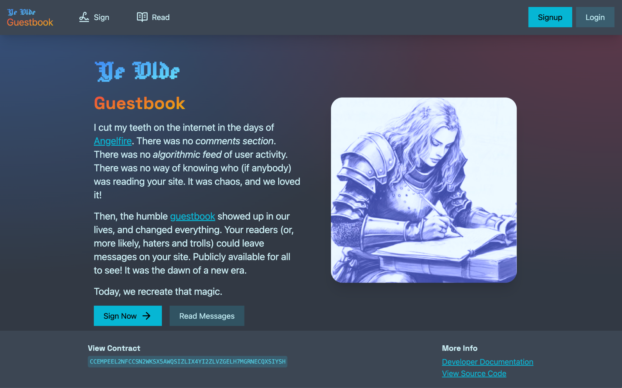
INTRODUCTION
Guestbook Dapp
In this walkthrough, we will take a closer look at the guestbook dapp described in the documentation.
The guestbook dapp is a traditional online guestbook, but it’s built with cutting-edge Stellar features, including passkey auth.
We will dive into the architecture of the dapp, the solutions used, and the necessary 3rd party services.
Live Demo: https://ye-olde-guestbook.vercel.app
Documentation: https://developers.stellar.org/docs/build/apps/guestbook
Guestbook Dapp
Notes:
The guestbook dapp is a really good example of a complete dapp built on Stellar.
The guestbook dapp is a traditional online guestbook where you can leave a message on a website.
It’s a simple dapp, it’s easy to understand what the dapp does - yet it’s built using multiple Stellar features

Slide 5
INTRODUCTION
Guestbook Dapp
Let’s try the live demo and sign the guestbook!
Live Demo: https://ye-olde-guestbook.vercel.app
Documentation: https://developers.stellar.org/docs/build/apps/guestbook
Guestbook Dapp
Notes:
Let’s try the dapp, so we have some context when we walk through the architecture and code.

Slide 6
HIGH-LEVEL ARCHITECTURE
Section 02

Slide 7
HIGH-LEVEL ARCHITECTURE
The guestbook dapp stores messages on-chain by using smart contract functions.
The frontend is connected to the smart contract functions through TypeScript bindings.
The guestbook uses passkeys for convenient user signup and login.
Frontend
Frontend
Bindings
Smart Contracts
Passkeys
Launchtube
Mercury Zephyr
Guestbook Dapp

Slide 8
HIGH-LEVEL ARCHITECTURE
Passkeys are a convenient and way for users to sign up and log in, without using a browser wallet plugin. Passkeys require a couple of external services to operate:
Launchtube is similar to a "paymaster" service. The passkey-kit needs it, but we don’t interact with it directly.
Mercury Zephyr is a data indexer used by the passkey-kit.
Frontend
Frontend
Bindings
Smart Contracts
Passkeys
Launchtube
Mercury Zephyr
Guestbook Dapp

Slide 9
SMART CONTRACT
Section 03
Notes:
Let’s get into the smart contract

Slide 10

SMART CONTRACT OVERVIEW
The guestbook smart contract consists of five functions:
write_message: This function will allow a message to be written in the guestbook.
edit_message: This function makes it possible for a user to edit an already existing message.
read_message: Reading a message is as simple as querying the contract's persistent storage.
read_latest: Call this function to show the latest message without knowing the message ID.
claim_donations: This function allows users to make a donation.
Guestbook Dapp

Slide 11
SMART CONTRACT
pub fn write_message(
env: Env,
author: Address,
title: String,
text: String,
) -> Result<u32, Error> {
check_string_not_empty(&env, &title);
check_string_not_empty(&env, &text);
author.require_auth();
let new_message = Message {
author,
ledger: env.ledger().sequence(),
title,
text,
};
let message_id = save_message(&env, new_message);
return Ok(message_id);
}
write_message:
author: The Address of the user
title: The title of the guestbook message
text: The guestbook message
The write_message function is used to add a new message to the guestbook.
First, the function checks if the title and text parameters are not empty, and then if the user is authorized to write a message.
An instance of the Message struct is created with the message data, including the author and current ledger sequence number, and stored with the utility function save_message().
Source Code
Guestbook Dapp

Slide 12
SMART CONTRACT
pub fn edit_message(
env: Env,
message_id: u32,
title: String,
text: String,
) -> Result<(), Error> {
if title.is_empty() {
check_string_not_empty(&env, &text);
}
if text.is_empty() {
check_string_not_empty(&env, &title);
}
let mut message = get_message(&env, message_id);
message.author.require_auth();
let edited_title = if title.is_empty() {
message.title
} else {
title
};
let edited_text = if text.is_empty() { message.text } else { text };
message.title = edited_title;
message.text = edited_text;
message.ledger = env.ledger().sequence();
env.storage()
.persistent()
.set(&DataKey::Message(message_id), &message);
return Ok(());
}
edit_message:
message_id: The ID of the message to edit
title: The title of the guestbook message
text: The guestbook message
The edit_message function is used to edit a message.
First, the function checks if either title or text parameters are not empty, gets the current message data, and then checks if the user is authorized to edit a message.
The existing message data is updated with the parameter data. If either title or text is empty, the existing value is used.
Finally, the message is stored.
Source Code
Guestbook Dapp

Slide 13
SMART CONTRACT
read_message:
message_id: The ID of the message to read
The read_message function is used to get an existing message from storage.
This function is simple since anyone can read guestbook messages without being authenticated first. The message is read with the utility function get_message().
Source Code
pub fn read_message(env: Env, message_id: u32) -> Result<Message, Error> {
let message = get_message(&env, message_id);
Ok(message)
}
Guestbook Dapp

Slide 14
SMART CONTRACT
read_latest:
The read_latest function is a convenient way to get the last message added to the guestbook.
First, the function gets the message count to get the ID of the latest message. Messages are never deleted, so the message count will be equal to the ID of the last message.
The latest message is read with the utility function get_message() that takes the message ID as an argument.
Like the read_message() function, read_latest() doesn’t require the caller to be authenticated.
Source Code
pub fn read_latest(env: Env) -> Result<Message, Error> {
let latest_id = env
.storage()
.instance()
.get(&DataKey::MessageCount)
.unwrap();
let latest_message = get_message(&env, latest_id);
Ok(latest_message)
}
Guestbook Dapp

Slide 15
SMART CONTRACT
pub fn claim_donations(env: Env, token: Address) -> Result<i128, Error> {
let token_client = token::TokenClient::new(&env, &token);
let contract_balance = token_client.balance(&env.current_contract_address());
if contract_balance == 0 {
panic_with_error!(&env, Error::NoDonations);
}
let admin_address: Address = env.storage().instance().get(&DataKey::Admin).unwrap();
token_client.transfer(
&env.current_contract_address(),
&admin_address,
&contract_balance,
);
Ok(contract_balance)
}
claim_donations:
token: The Address of the token from where the donations should be claimed
Most of the donation functionality is handled by the frontend; the smart contract function just claims a donation.
First, the function creates a token client, checks the contract's balance of that token, and if there's a positive balance, then we send the tokens to the admin address.
This workshop doesn’t go into details about the donation feature; see the documentation for more details.
Source Code
Guestbook Dapp

Slide 16
SMART CONTRACT UTILITY FUNCTIONS
The guestbook smart contract functions use a few utility functions that are used in the previously mentioned contract functions:
check_string_not_empty: This function is used to check if a string, provided by a user (e.g., title), is empty or not.
get_message: This function reads a guestbook message from storage, based on the message ID.
save_message: This function writes a new guestbook message to storage and returns the message ID of the new message.
Guestbook Dapp

Slide 17
SMART CONTRACT UTILITY
check_string_not_empty:
sus_string: The string to check
The check_string_not_empty() function is used to check if a string is empty or not.
If the string is empty, an error is thrown.
Source Code
fn check_string_not_empty(env: &Env, sus_string: &String) {
if sus_string.is_empty() {
panic_with_error!(env, Error::InvalidMessage);
}
}
Guestbook Dapp

Slide 18
SMART CONTRACT UTILITY
get_message:
message_id: The ID of the message to read
The get_message() function is used to read a message from storage and it contains error handling.
First, the function checks if the message, with the ID provided as a parameter, exists. If it doesn’t, an error is thrown.
If the message does exist, the message is read from storage and returned to the calling function.
Source Code
fn get_message(env: &Env, message_id: u32) -> Message {
if !env
.storage()
.persistent()
.has(&DataKey::Message(message_id))
{
panic_with_error!(env, Error::NoSuchMessage);
}
let message: Message = env
.storage()
.persistent()
.get(&DataKey::Message(message_id))
.unwrap();
return message;
}
Guestbook Dapp

Slide 19
SMART CONTRACT UTILITY
fn save_message(env: &Env, message: Message) -> u32 {
let mut num_messages = env
.storage()
.instance()
.get(&DataKey::MessageCount)
.unwrap_or(0 as u32);
num_messages += 1;
env.storage()
.persistent()
.set(&DataKey::Message(num_messages), &message);
env.storage()
.instance()
.set(&DataKey::MessageCount, &num_messages);
return num_messages;
}
save_message:
message: The message to save
The save_message() function is used to write a new message to storage. Note that this function is only used to store a new message, and not to update an existing message.
First, the function initializes a variable with the current message count and increments the value. Note that the message counter is stored separately from the message storage.
Next, the message is written to storage using the incremented message count as the key and the message from the function parameter as the value. Finally, the incremented message counter is stored and returned.
Source Code
Guestbook Dapp

Slide 20
FRONTEND BINDINGS
Section 04

Slide 21

FRONTEND BINDINGS
We need a way to invoke the smart contract functions from the web-based frontend. This is where TypeScript bindings come into play.
The Stellar CLI can generate and produce a fully typed NPM package, ready to integrate into your frontend. Add the bindings package to invoke a smart contract and use its interface.
Let’s take a look at how we set up the bindings for the guestbook frontend.
Guestbook Dapp

Slide 22
FRONTEND BINDINGS
Prerequisites
Build smart contract
Deploy smart contract
Before we can create the bindings, we need to build and deploy the smart contract.
When the smart contract is deployed, a few arguments are mandatory to initialize the guestbook (admin, title, and text).
% stellar contract build
% stellar contract deploy \
--wasm target/wasm32-unknown-unknown/release/ye_olde_
guestbook.wasm \
--source peter \
--network testnet \
-- \
--admin peter \
--title "Welcome to the guestbook" \
--text "Join our guestbook and leave a message"
Guestbook Dapp

Slide 23
FRONTEND BINDINGS
Generate Bindings
Now that the contract has been built and deployed, we can use the Stellar CLI to generate the TypeScript bindings.
Step 1: Run the Stellar CLI bindings command, using the contract address. Use the contract address returned by the deploy command.
Step 2: The binding package is now generated in the packages/ye_olde_guestbook folder. Now we install and build it.
Step 3: The last step is to import the bindings package as a project dependency so we can use it in the frontend code.
% stellar contract bindings typescript \
--network testnet \
--id <contract_address_from_deploy_step> \
--output-dir ./packages/ye_olde_guestbook \
--overwrite
% cd packages/ye_olde_guestbook
% pnpm install
% pnpm run build
% cd ../..
% pnpm add file:./packages/ye_olde_guestbook
Guestbook Dapp

Slide 24
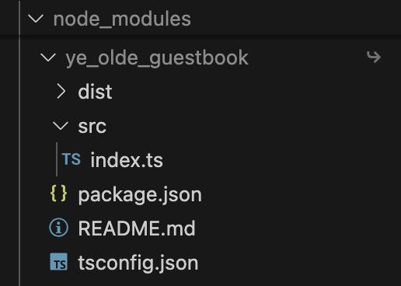
FRONTEND BINDINGS
Evaluate Bindings
After building and installing the TypeScript contract bindings, we have a package in the frontend project’s node_modules folder, and can use it as any other NPM package.
Guestbook Dapp

Slide 25
FRONTEND BINDINGS
Implementing Bindings
The example on the right is a simplified version of a contract function call in the guestbook, but it’s a good example of how the bindings can be implemented.
First, the package is imported, and a guestbook client is instantiated with the appropriate network settings: in this case, testnet.
The read_message() contract function can now be invoked using the guestbook binding client.
import * as Client from 'ye_olde_guestbook';
const guestbook = new Client.Client({
...Client.networks.testnet,
rpcUrl: PUBLIC_STELLAR_RPC_URL,
});
let { result } = await guestbook.read_message({
message_id: parseInt(params.id),
});
Guestbook Dapp

Slide 26
PASSKEYS
Section 05

Slide 27
PASSKEYS
How the passkey feature works
Device
Passkey
Launchtube
Mercury Zephyr
Dapp
Frontend
Passkey
Client
Passkey
Server
Guestbook Dapp
Notes:
Let’s take a look at how we can use passkeys to authenticate users
The passkey-kit has a client and a server part
Passkeys relies on two services - Launchtube and Mercury Zephyr
Let’s look at the services first

Slide 28
PASSKEYS
How it works
The passkey-kit relies on a couple of external services, so access to these services must be set up first.
Launchtube
Launchtube is similar to a "paymaster" service, if you're familiar with account abstraction in EVM networks. Launchtube is needed by the passkey-kit package and is used to submit passkey-signed transactions to the network.
Generate free testnet Launchtube JWT tokens with 100 XLM in credits: https://testnet.launchtube.xyz/gen
Mercury Zephyr
Zephyr is a data indexer service that is used for reverse lookup of smart wallet contract addresses based on passkey IDs, so a user’s smart wallet address can be easily retrieved at login.
Mercury Zephyr’s basic functionality can be used for free. Sign up here: https://www.mercurydata.app and see the documentation for setup instructions.
Guestbook Dapp

Slide 29
PASSKEYS
How it works
The guestbook passkey integration is split into two:
A passkey client that is used by the Svelte frontend that deals with all user interactions.
A passkey server that is used for secure communication with other services.
Passkey
Client
Passkey
Server
Guestbook Dapp

Slide 30
PASSKEYS - CLIENT INSTANCES
import { Server } from '@stellar/stellar-sdk/rpc';
import { PasskeyKit, SACClient } from 'passkey-kit';
import type { Tx } from '@stellar/stellar-sdk/contract';
export const account = new PasskeyKit({
rpcUrl: PUBLIC_STELLAR_RPC_URL,
networkPassphrase: PUBLIC_STELLAR_NETWORK_PASSPHRASE,
factoryContractId: PUBLIC_FACTORY_CONTRACT_ADDRESS,
});
export const rpc = new Server(PUBLIC_STELLAR_RPC_URL);
export const sac = new SACClient({
rpcUrl: PUBLIC_STELLAR_RPC_URL,
networkPassphrase: PUBLIC_STELLAR_NETWORK_PASSPHRASE,
});
export const native = sac.getSACClient(PUBLIC_NATIVE_CONTRACT_ADDRESS);
Instances
account: an instance of the passkey-kit class, used for signing transactions, creating the wallet, and authenticating users
rpc: for handling RPC interactions
sac: an instance of passkey-kit’s SAC client
native: using the SAC instance for interacting with the native XLM asset contract
Source Code
Guestbook Dapp
Notes:
To setup the passkey integration in the frontend, we first need to create client instances for communication with the network

Slide 31
PASSKEYS - CLIENT HELPERS
send:
tx: Transaction
This function will send a transaction to the network via Launchtube using the server send endpoint.
Source Code
export async function send(tx: Tx) {
return fetch('/api/send', {
method: 'POST',
body: JSON.stringify({
xdr: tx.toXDR(),
}),
}).then(async (res) => {
if (res.ok) return res.json();
else throw await res.text();
});
}
Guestbook Dapp
Notes:
The client has some helper functions that makes integration easy.
The first helper we look at is the send() function, which is used to send transactions to the network through launchtube.

Slide 32
PASSKEYS - CLIENT HELPERS
export async function getContractId(signer: string) {
return fetch(`/api/contract/${signer}`).then(async (res) => {
if (res.ok) return res.text();
else throw await res.text();
});
}
export async function fundContract(address: string) {
return fetch(`/api/fund/${address}`).then(async (res) => {
if (res.ok) return res.json();
else throw await res.text();
});
}
getContractId:
signer: Passkey ID
This function takes a passkey ID as a parameter and calls the server endpoint that will retrieve the contract address from Mercury Zephyr.
fundContract:
address: User wallet address
This function is used to fund user wallets, since Friendbot can’t fund C-addresses.
Source Code
Guestbook Dapp

Slide 33
PASSKEYS - SERVER
The passkey server gives us an importable server instance that can be accessed and used in other server-side logic.
This server instance will be used for sending transactions (via Launchtube) and reverse-looking-up contract addresses from a known passkey ID (via Mercury).
The passkey server creates the endpoints mentioned in the client helper functions. See the documentation and code for a deeper understanding of the passkey server.
Also, Svelte gives us the added benefit of keeping the code in this directory safe, so sensitive credentials, tokens, etc. are not exposed.
Source Code
import { PasskeyServer } from 'passkey-kit';
export const server = new PasskeyServer({
rpcUrl: PUBLIC_STELLAR_RPC_URL,
launchtubeUrl: PUBLIC_LAUNCHTUBE_URL,
launchtubeJwt: PRIVATE_LAUNCHTUBE_JWT,
mercuryProjectName: 'smart-wallets-next-dima',
mercuryUrl: PUBLIC_MERCURY_URL,
mercuryKey: PRIVATE_MERCURY_KEY,
});
Guestbook Dapp

Slide 34
DAPP FRONTEND
Section 06

Slide 35
DAPP FRONTEND
High-level description of the frontend:
The frontend is based on the Svelte framework
The smart contract functions are invoked through the generated frontend bindings
The passkey-kit is imported and provides the passkey authentication functionality
Most of the frontend is not different from a Web2 frontend, so let’s dive into some of the Stellar integrations.
Guestbook Dapp

Slide 36
DAPP FRONTEND - READ MESSAGES
How it works
Frontend Dapp
Frontend Bindings + Passkey Kit
Page (Markup)
+page.svelte
Component
+page.server.ts
Server
GuestbookMessage.svelte
getLedgerEntries.ts
Guestbook Dapp
Notes:
This illustration shows how the frontend renders a guestbook message in the browser
The svelte application has three parts - the page markup rendered in the browser, a server populating the page and a message component for formatting the message data
The svelte server provides different ways to get messages.
The Frontend bindings and Passkey Kit instances are used to get the message from the network
Let’s take a closer look at the getLedgerEntries usage to understand how messages are retrieved

Slide 37
DAPP FRONTEND - READ MSG -
GET LEDGER ENTRIES
import { rpc } from '$lib/passkeyClient';
import { Address, networks, Contract, type Message, xdr, scValToNative } from 'ye_olde_guestbook';
export async function getWelcomeMessage(): Promise<Message> {
const result = await rpc.getLedgerEntries(buildMessageLedgerKey(1));
return scValToNative(result.entries[0].val.contractData().val());
}
export async function getAllMessages(): Promise<Message[]> {
const totalCount = await getMessageCount();
const ledgerKeysArray = [];
for (let messageId = 2; messageId <= totalCount; messageId++) {
ledgerKeysArray.push(buildMessageLedgerKey(messageId));
}
const result = await rpc.getLedgerEntries(...ledgerKeysArray);
const messages = result.entries.map((message) => {
return {
...scValToNative(message.val.contractData().val()),
};
});
return messages;
}
getWelcomeMessage:
The welcome message is the first message stored by the admin when the contract was deployed from the ledger. The function uses RPC to get the message with getLedgerEntries.
getAllMessages:
This function will get all messages after the first message. It uses a function called getMessageCount to get the total number of messages stored, and then iterates over the message count to populate an array of ledger keys representing the messages. Finally, the messages are retrieved from the ledger, using getLedgerEntries.
Source Code
Guestbook Dapp

Slide 38
DAPP FRONTEND - READ MSG -
+PAGE.SERVER.TS
+page.server.ts:
The messages are loaded when the page is loaded, and this is handled by the page’s server script.
The message data will be available for use in +page.svelte.
Source Code
import { getAllMessages, getWelcomeMessage } from '$lib/server/getLedgerEntries';
import type { PageServerLoad } from './$types';
export const load: PageServerLoad = async () => {
return {
welcomeMessage: await getWelcomeMessage(),
messages: await getAllMessages(),
};
};
Guestbook Dapp

Slide 39
DAPP FRONTEND - READ MSG -
+PAGE.SVELTE
<script lang="ts">
import GuestbookMessage from '$lib/components/GuestbookMessage.svelte';
import type { PageData } from './$types';
export let data: PageData;
let messages = data.messages;
</script>
<div class="flex flex-col md:flex-row justify-start md:justify-between space-y-4">
…
</div>
<GuestbookMessage message={data.welcomeMessage} messageId={1} />
<hr class="!border-t-2" />
{#each messages as message, i (message.ledger)}
<GuestbookMessage {message} messageId={i + 2} />
{/each}
+page.svelte:
data: Message data
This page renders the /read page, which shows the welcome message and the complete list of messages. The code on the right is reduced; see the source code for the full code.
The GuestbookMessage component is used twice, first for showing the welcome message (messageId = 1) and second for showing the complete list of messages (messageId > 1). The message data is loaded by +page.server.ts when the page is loaded.
Source Code
Guestbook Dapp

Slide 40
DAPP FRONTEND - READ MSG -
COMPONENT
<script lang="ts">
import type { Message } from 'ye_olde_guestbook';
export let message: Message;
export let messageId: number;
let messageTitle = message.title;
let messageText = message.text;
const cancelEdit = () => { … }
const submitEdit = async () => { … }
</script>
<section class="card w-full variant-soft-primary">
<div class="p-4 space-y-4">
…
<div class="flex gap-8 justify-between">
<div class="space-y-2 grow">
<h3 class="h3">
{messageTitle}
</h3>
<article>
<p>{messageText}</p>
</article>
</div>
</div>
…
</div>
</section>
GuestbookMessage.svelte:
props: message, messageId
This component renders a guestbook entry, and takes message and messageId as props.
The code is reduced down to just the script and HTML to show the guestbook entry, the complete component includes both controls and functions to edit the message (if the user is the author of the message).
Source Code
Guestbook Dapp

Slide 41
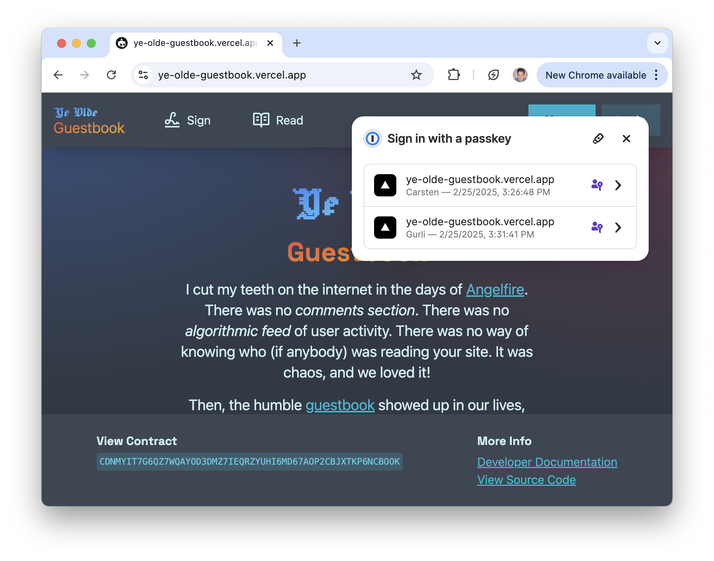
DAPP FRONTEND - PASSKEY
async function login() {
console.log('logging in');
try {
const { keyId_base64, contractId: cid } = await account.connectWallet({
getContractId,
});
keyId.set(keyId_base64);
console.log($keyId);
contractId.set(cid);
console.log($contractId);
} catch (err) {
console.log(err);
toastStore.trigger({
message: 'Something went wrong logging in. Please try again later.',
background: 'variant-filled-error',
});
}
}
The Passkey Kit is handling the passkey prompt, so we don’t need to do anything besides calling the Passkey Kit.
The code here shows how the Passkey Kit is implemented for the login function. By calling connectWallet() the passkey prompt will automatically appear.
Source Code
Guestbook Dapp

Slide 42
TRY IT OUT!
Section 07

Slide 43
TRY IT OUT!
Try the live version of the guestbook and take a look at the documentation and the source code. You can even deploy it locally to experiment with the project.
Live Demo: https://ye-olde-guestbook.vercel.app
Documentation: https://developers.stellar.org/docs/build/apps/guestbook
Source Code: https://github.com/ElliotFriend/ye-olde-guestbook
Guestbook Dapp

Slide 44








THANK
YOU FOR YOUR TIME!
stellar.org
© 2023 Stellar Development Foundation

