Slide 1


Adaptive Auto-Tuning of Computations on Heterogeneous Environments
Melissa Castillo (PM) & Christian Curley
Sponsor/Technical Mentor: Carlos Reyes

Slide 2
Pitch
Heterogeneous computing offers increased performance making it popular for data intensive computations (modeling and simulations)
For programs that operate on rented hardware, it is essential to execute as fast as possible in order to save money
OpenCL allows programs to execute on heterogeneous platforms from multiple processor vendors
But OpenCL suffers poor performance portability; needs re-tuning on different devices to achieve similar performance
Solving the auto tuning problem would make heterogeneous computing invaluable to companies that spend a lot on modeling and simulations

Slide 3
Project Challenges and Project Evolution
Challenges
Initially, we had no knowledge of OpenCL, Heterogeneous Computing, Machine Learning, Python, Scikit-Learn, and Matplotlib
The limitations of OpenCL and Random Forest were discovered during the project lifecycle
Evolutions
Our project transformed as our understanding of the project tools became clearer
Resource constraints also changed the initial intentions for the project (primarily concerning testing equipment)

Slide 4
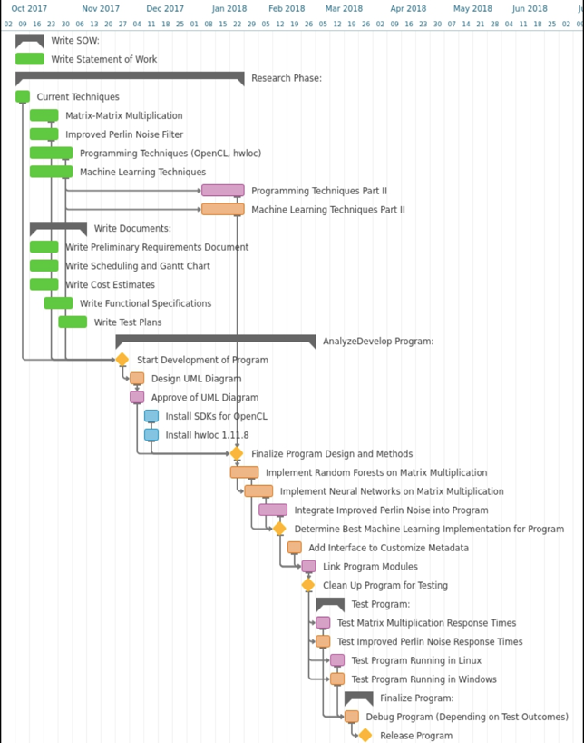
Original Gantt Chart

Slide 5
Project Goals
Original Goals (Vague Goals):
Improve the parallel capabilities of heterogeneous systems to reduce computation time
The program must exhibit some form of “intelligence”
Cost based model (Monetary Lease Cost, Bandwidth Cost, Execution Time Cost)
Evolved Goals (Better Defined Goals):
Build OpenCL program with Matrix Multiplication and find optimal OpenCL kernels
Use Random Forest to generate a prediction model for kernel execution time based on kernel parameters
The average prediction accuracy for the Random Forest is 70% or greater
Execution time based model

Slide 6

Background – Open Computing Language (OpenCL)
(Advantages) OpenCL Kernel Portability
Wide Industry Support
(The Problem) Performance Portability
Common issue in heterogeneous programming
Both OpenCL and CUDA experiences issues with performance portability on their kernels
(The Solution) Kernel Auto Tuning
Empirical Tuning
Performance Model Tuning
Machine Learning Tuning

Slide 7
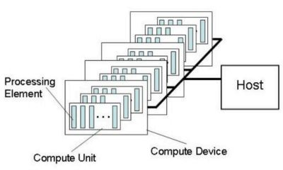
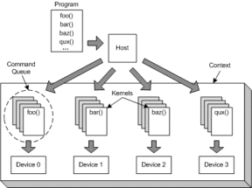
OpenCL - Platform Model
OpenCL is structured by:
Context
Command Queues
Programs
Kernels
Host
Device
OpenCL Host Code:
Responsible for setting up the environment in which to run the kernel
OpenCL Device Code (Kernels):
The actual program that you want to run on a targeted device or range of devices

Slide 8
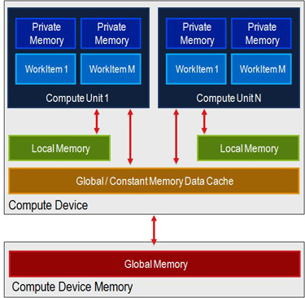
OpenCL - Memory Model
OpenCL uses the following memory types:
Global Memory
Local Memory
Constant Memory
Private Memory
OpenCL will map certain memories to physical hardware in the device
The memory bandwidth is dependent on the type of device
This project uses Global and Local Memory as kernel parameters

Slide 9
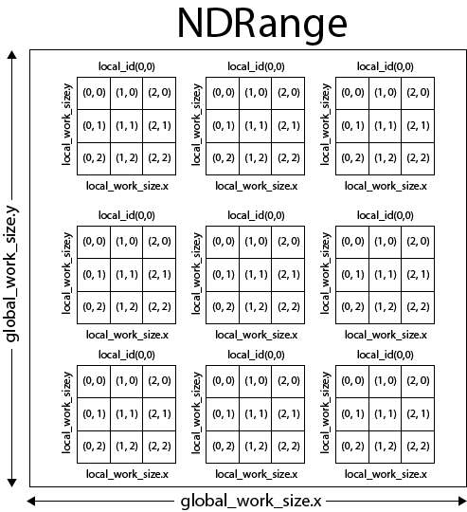
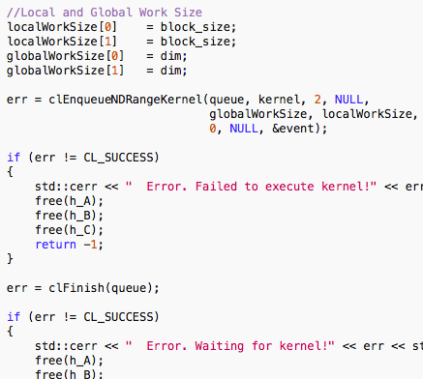
OpenCL - Execution Model
The OpenCL host program manages the execution of the kernels
This project uses Global Work Size and Local Work Size as kernel parameters

Slide 10
OpenCL Implementation
Kernel Parameter Space
Global Work Size (Matrix Dimension)
{1, 2, 4, 8, 16, 32, 64, 128, 256, 512}
Local Work Size (Block Size)
{1, 2, 4, 8, 16}
OpenCL Local Memory
OpenCL Global Memory
The Kernel
Single Precision Matrix Multiplication
Constrained to square matrices
The Kernel code will not change
The values chosen in the parameter space will affect the performance of the kernel

Slide 11
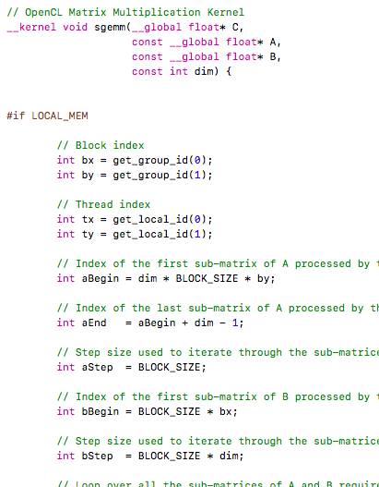
OpenCL Implementation - The Kernel
Matrix Multiplication
The executed matrix dimensions:
1x1, 2x2, 4x4, 8x8, 16x16, 32x32, 64x64, 128x128, 256x256, 512x512
The dimensions of the matrices affect the global work size.
When kernels execute, the host program has a function to obtain event profiling information of the kernel start and end time.
The difference is the execution time of the kernel

Slide 12
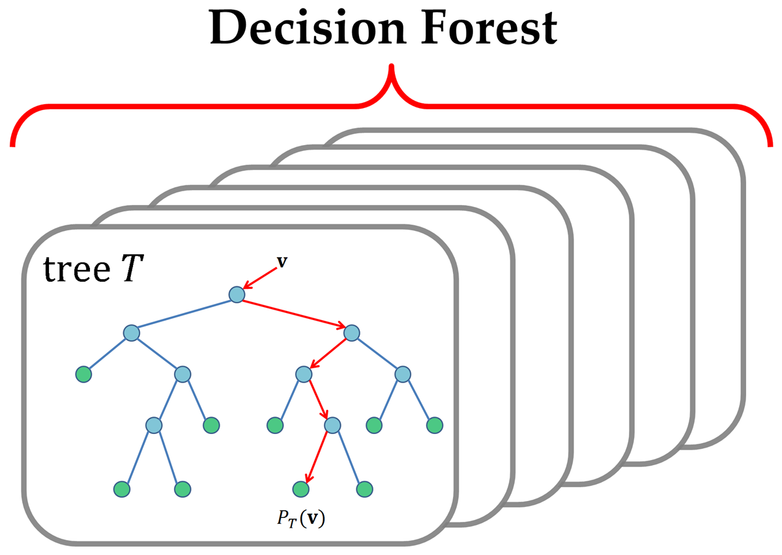
Machine Learning Implementation - Random Decision Forests
Random Decision Forest
Collection of Random Decision Trees
Nonlinear
No need for normalization
Normalization could smooth out the nonlinear nature of the model
Python with Scikit Learn
Train Test Splitter
Random Forest Regressor

Slide 13
Project Build Overview
C/OpenCL Component
The host code was written in C
The kernel code was written in a .cl file which is loosely based off of C99
Kernel executes and the host code reports the start and finish time of the kernel
The kernel results are compared with another matrix multiplication result on the CPU to check for errors.
Results are stored in CSV file
Python Component
The CSV dataset is read into the Python script
Scikit-Learn’s Train Test Splitter breaks the dataset into a training and testing set (50/50 split)
Scikit-Learn’s Random Forest Regressor builds a prediction model based on the training data.
Matplotlib used to generate plots of the raw data and the machine learning processed data.

Slide 14
Test Environment
The success of our project depends on the results obtained by multiple computers with different hardware. We executed our program on the following devices:
Intel i5 CPU | OSX 10.13.3
Intel i7 CPU | OSX 10.13.3
Intel HD Graphics 4000 GPU
Intel Iris 1536 MB Graphics GPU

Slide 15
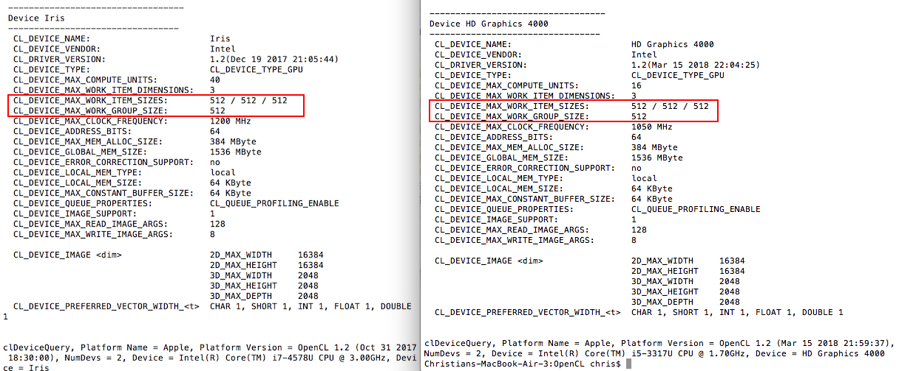
Hardware Limitations - GPUs

Slide 16
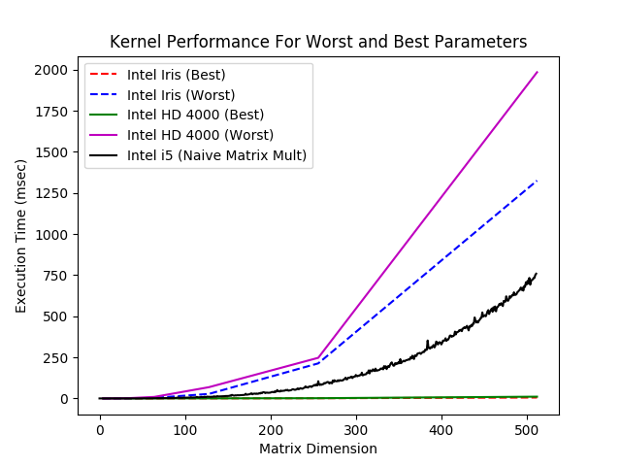
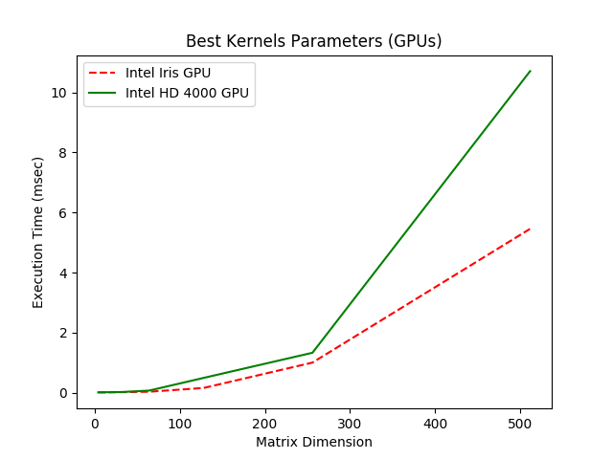
Results - OpenCL Kernel Performance

Slide 17
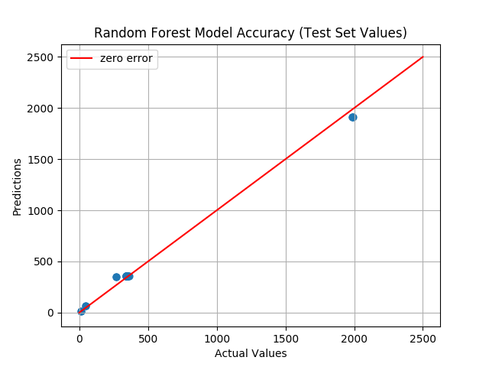
Results - Random Forest Prediction Model
Concerns:
Three kernel parameters limiting our dataset
Only three parameters due to limitations of OpenCL and our hardware
While the prediction model on an average of 100 executions is 95%, the results might be due to test set being similar to the training set
We cannot guarantee the success of our Random Forest Model due to our limited dataset
Because of this we switched to empirical based methods to find the best and worst kernels - exhaustive search of the dataset

Slide 18
Further Discussion
Our problem was to try to find:
Global minimum (best runtime)
For problems with complex features and large datasets of billions of combinations:
Local maxima and local minima are present throughout the samples
The machine learning might pick up these local values
How to solve this?
Use Neural Networks and Random Forest together
One to track the runs and perform interpolation
Another to find the global minimum amongst all the runs
Outside the scope of this project, but good to consider for the future

Slide 19
Conclusions and Future Work
Our Results Have Demonstrated That:
Optimizing OpenCL Kernels is beneficial to reduced computing cost
OpenCL Kernels can be tuned for different devices with near optimal performance
Random Forest machine learning needs more tests before we can say with confidence that is it truly accurate
Vulkan Compute
OpenCL is moving into this new API
The current version of this program will need to be redesigned with Vulkan Compute for any future related work
Possible Future Work
Improve the accuracy of predictions
Finding more kernel parameters to increase the kernel dataset
More matrix dimensions to test
More devices to test
Move to a cost based model
Additional Kernel Parameters
Texture Memory
Loop Unrolling
Different Kernels
Convolution
Fourier Transform
Perlin Noise

