Slide 1
Hyperparameter Analysis of Deep Neural Networks Breaking Physical Unclonable Functions
Qinzi Li
Abschlussvortrag zur Bachelorarbeit
Aufgabensteller: Prof. Dr. Peer Kröger
Betreuer: Nanni Schüler, Prof. Dr. Dr. Ulrich Rührmair
Datum des Vortrags: 16.12.2021

Slide 2
Contents
1. Physical Unclonable Functions (PUFs)
2. Main Result
3. Experiments
3.1 Influence of PUF-related Parameters
3.2 Influence of Neural Network-related Parameters
3.3 Optimizer
4. Comparison with Mursi’s network
5. Initialization Problem
6. Future Work

Slide 3
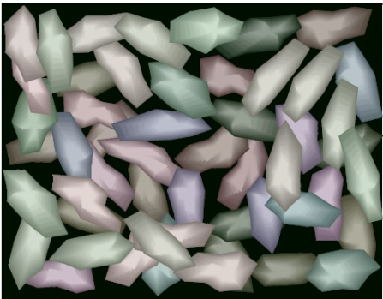
Physical Unclonable Functions (PUFs)
PUF
(= disordered, unclonable physical system S)
Responses R_{i}
(R_{i} is a function of the applied challenge C_{i} and the specific disorder in S)
External stimuli/ Challenges C_{i}
(C_{i} , R_{i}): Challenge-response pairs (CRPs) of the PUF
S
[1]
[1] Ulrich Rührmair’s presentation. Brief Intro: Various Strong PUF Candidates. presented to the audience in 06.2021, 2021.

Slide 4
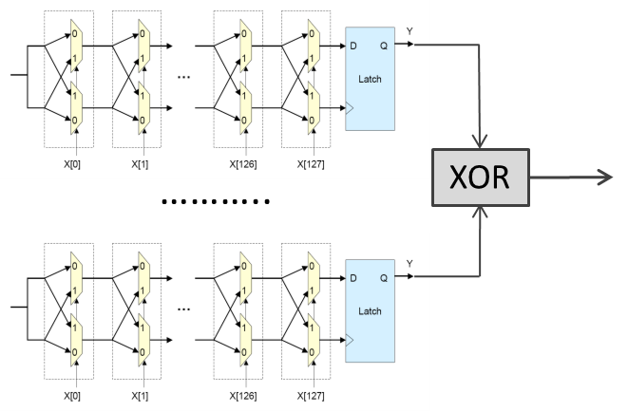
XOR Arbiter PUFs
X[1]=0
X[126]=1
k-Arbiter PUFs
[1]
[1] Ulrich Rührmair’s presentation. Brief Intro: Various Strong PUF Candidates. presented to the audience in 06.2021, 2021.

Slide 5
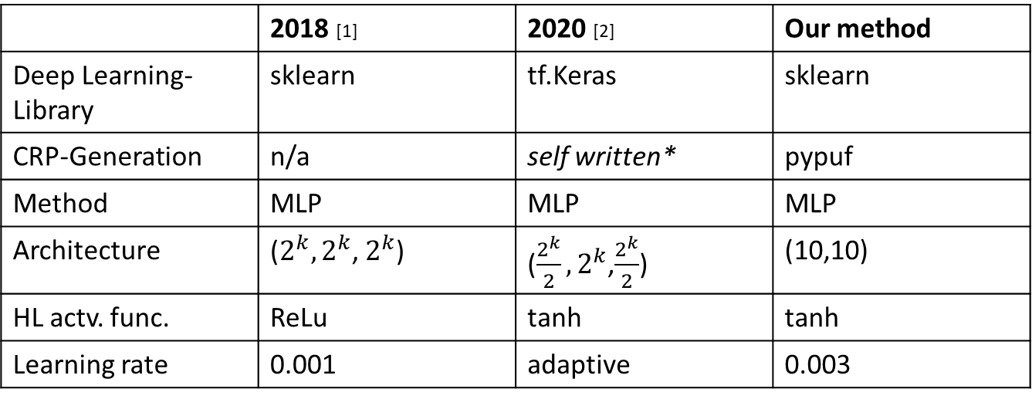
Main Result
 | 2018 [1] | 2020 [2] | Our method
Deep Learning-Library | sklearn | tf.Keras | sklearn
CRP-Generation | n/a | self written* | pypuf
Method | MLP | MLP | MLP
Architecture | ($2^{k},2^{k}$, $2^{k}$) | ($\frac{2^{k}}{2},2^{k}$,$\frac{2^{k}}{2}$) | (10,10)
HL actv. func. | ReLu | tanh | tanh
Learning rate | 0.001 | adaptive | 0.003
*: later found faulty by Wisiol et al. in 2021.[3]
[1] Aseeri, A.O.; Zhuang, Y.; Alkatheiri, M.S. A Machine Learning-based Security Vulnerability Study on XOR PUFs for Resource-Constraint Internet of Things 2018.
[2] K.T. Mursi, B. Thapaliya: A Fast Deep Learning Method for Security Vulnerability Study of XOR PUFs. 2020
[3] Wisiol, Nils et al. “Neural-Network-Based Modeling Attacks on XOR Arbiter PUFs Revisited.” IACR Cryptol. ePrint Arch. 2021 (2021): 555.

Slide 6
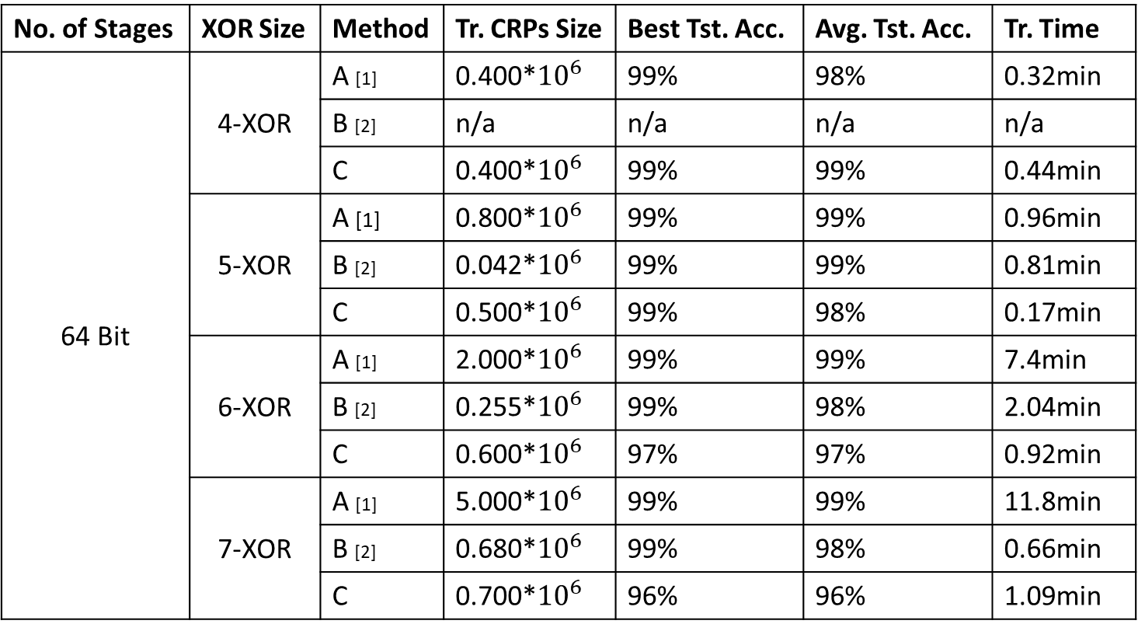
Main Result
No. of Stages | XOR Size | Method | Tr. CRPs Size | Best Tst. Acc. | Avg. Tst. Acc. | Tr. Time
64 Bit | 4-XOR | A [1] | 0.400*${10}^{6}$ | 99% | 98% | 0.32min
 |  | B [2] | n/a | n/a | n/a | n/a
 |  | C | 0.400*${10}^{6}$ | 99% | 99% | 0.44min
 | 5-XOR | A [1] | 0.800*${10}^{6}$ | 99% | 99% | 0.96min
 |  | B [2] | 0.042*${10}^{6}$ | 99% | 99% | 0.81min
 |  | C | 0.500*${10}^{6}$ | 99% | 98% | 0.17min
 | 6-XOR | A [1] | 2.000*${10}^{6}$ | 99% | 99% | 7.4min
 |  | B [2] | 0.255*${10}^{6}$ | 99% | 98% | 2.04min
 |  | C | 0.600*${10}^{6}$ | 97% | 97% | 0.92min
 | 7-XOR | A [1] | 5.000*${10}^{6}$ | 99% | 99% | 11.8min
 |  | B [2] | 0.680*${10}^{6}$ | 99% | 98% | 0.66min
 |  | C | 0.700*${10}^{6}$ | 96% | 96% | 1.09min
[1] Aseeri, A.O.; Zhuang, Y.; Alkatheiri, M.S. A Machine Learning-based Security Vulnerability Study on XOR PUFs for Resource-Constraint Internet of Things 2018.
[2] K.T. Mursi, B. Thapaliya: A Fast Deep Learning Method for Security Vulnerability Study of XOR PUFs. 2020

Slide 7
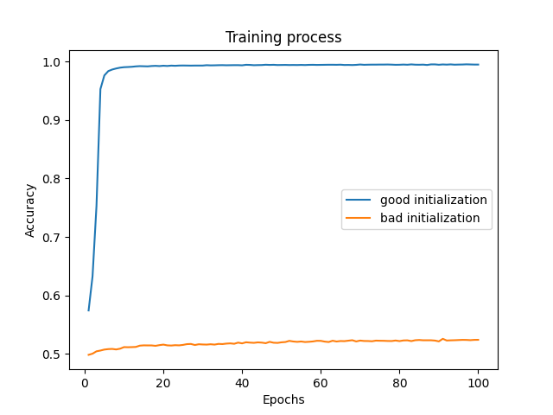
Training Process

Slide 8
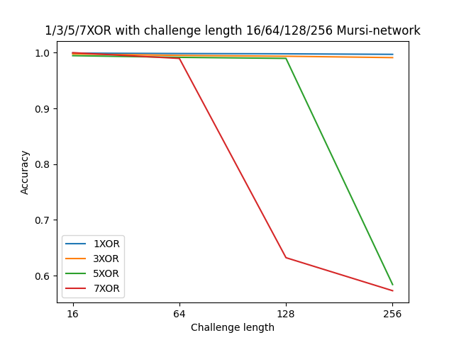
Challenge Length

Slide 9
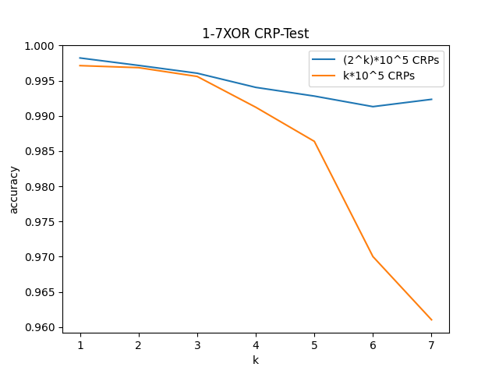
Number of CRPs

Slide 10
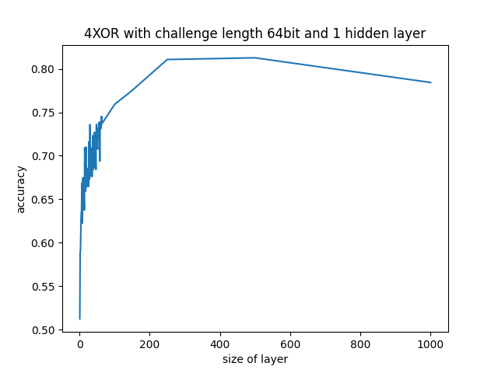
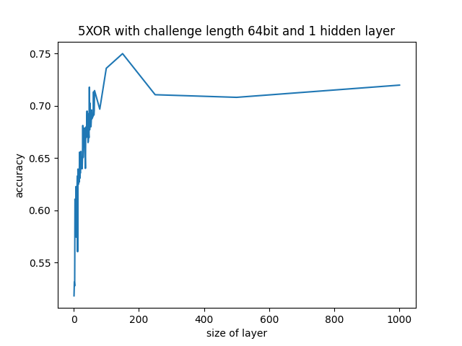
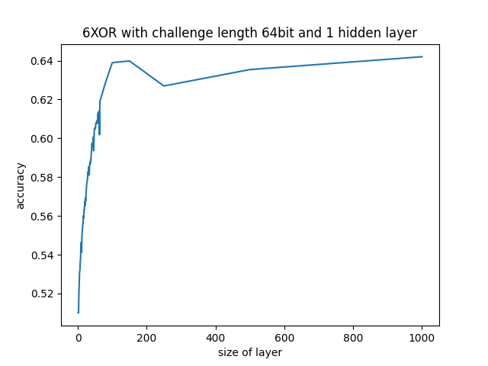
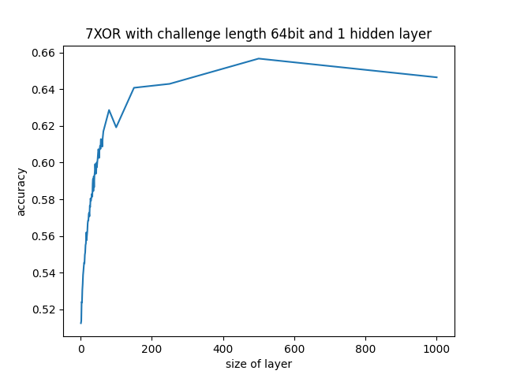
Number of Neurons

Slide 11
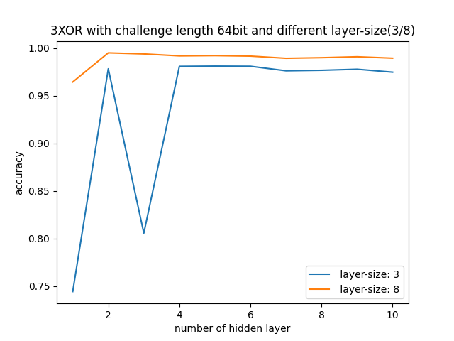
Number of Hidden Layers

Slide 12
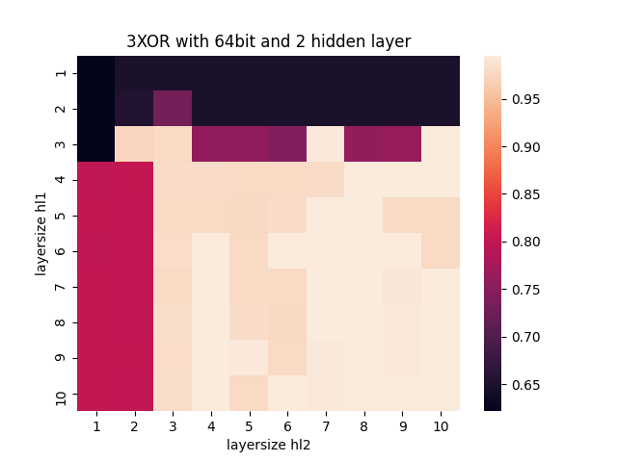
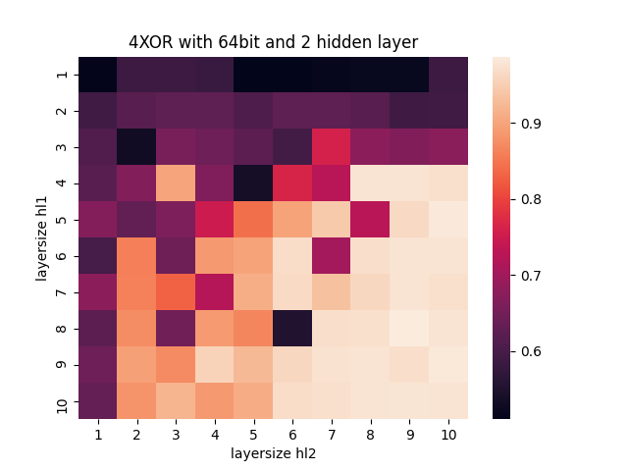
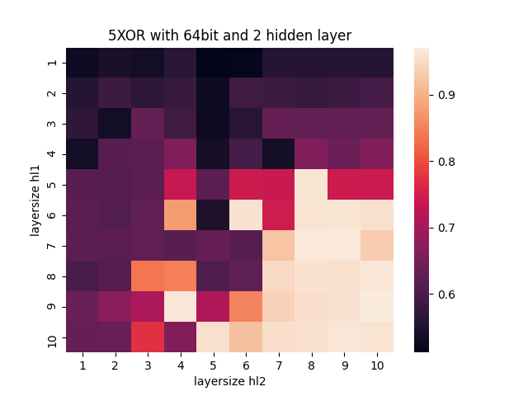
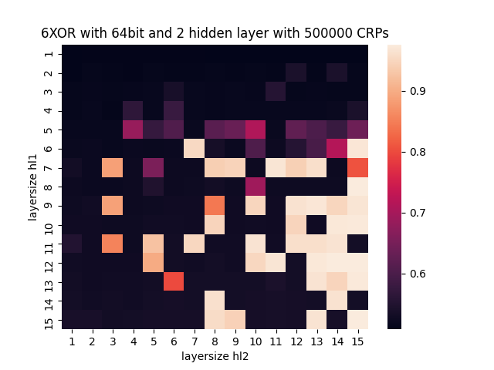
Number of Hidden Layers

Slide 13
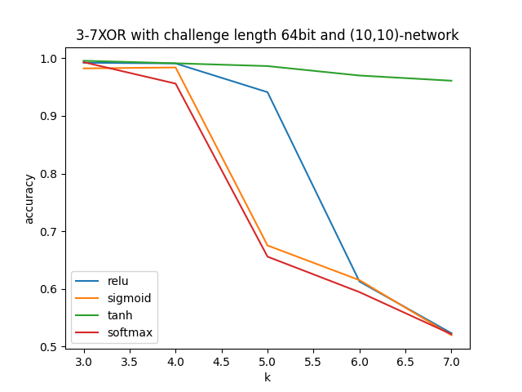
Activation Function

Slide 14
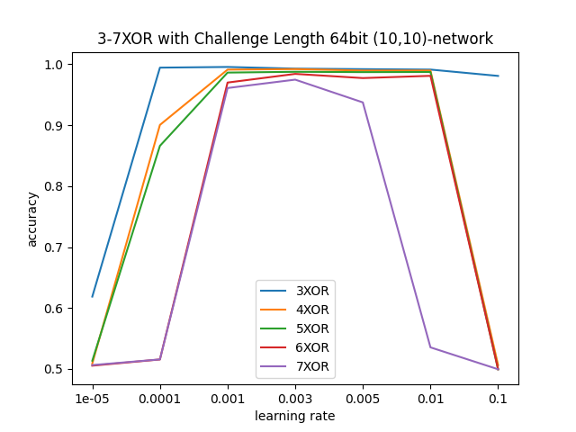
Learning Rate

Slide 15
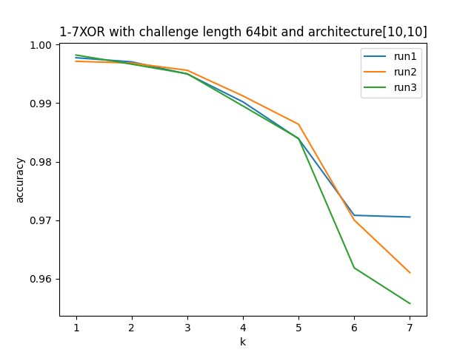
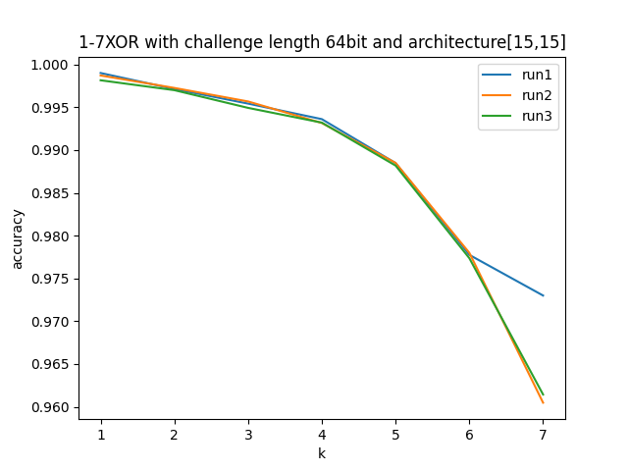
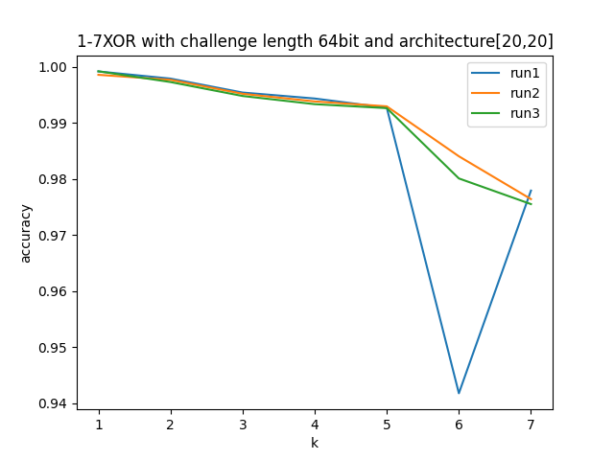
Network Architecture

Slide 16
Optimizer
 | Optuna |  |  |  |  | Manual
 | 3-XOR | 4-XOR | 5-XOR | 6-XOR | 7-XOR | 3-XOR | 4-XOR | 5-XOR | 6-XOR | 7-XOR
Number of CRPs | 210843 | 421017 | 490218 | 455615 | 1014874 | 300000 | 400000 | 500000 | 600000 | 700000
Number of layers | 2 | 3 | 3 | 3 | 2 | 2 | 2 | 2 | 2 | 2
Architecture | (78,34) | (65,81,8) | (73,99,89) | (53,71,90) | (163,60) | (10,10) | (10,10) | (10,10) | (10,10) | (10,10)
HL actv. Func. | tanh | ReLu | tanh | tanh | tanh | tanh | tanh | tanh | tanh | tanh
Learning rate | 0.0005 | 0.0006 | 0.0002 | 0.0008 | 0.0006 | 0.003 | 0.003 | 0.003 | 0.003 | 0.003
Accuracy | 0.9989 | 0.9936 | 0.9947 | 0.9933 | 0.9899 | 0.9956 | 0.9912 | 0.9864 | 0.9700 | 0.9610

Slide 17
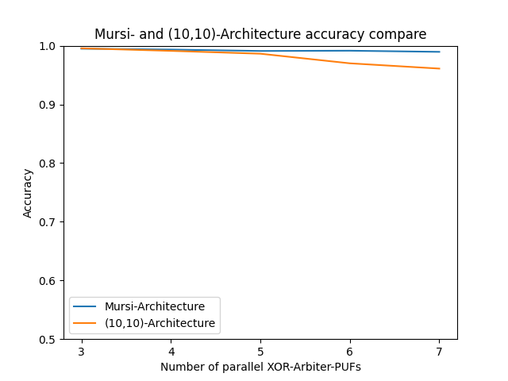
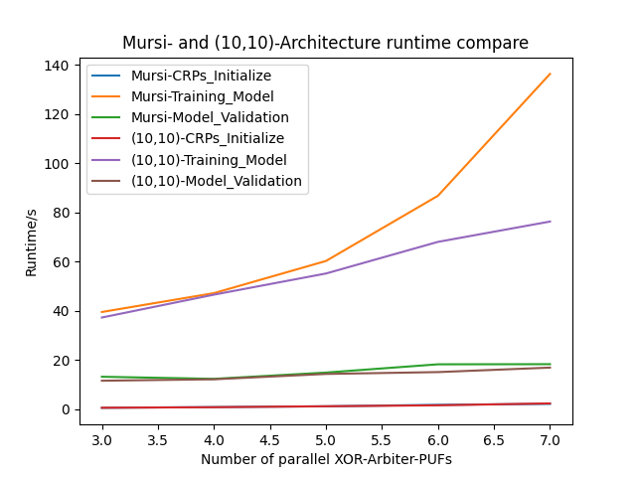
Comparison with Mursi’s

Slide 18
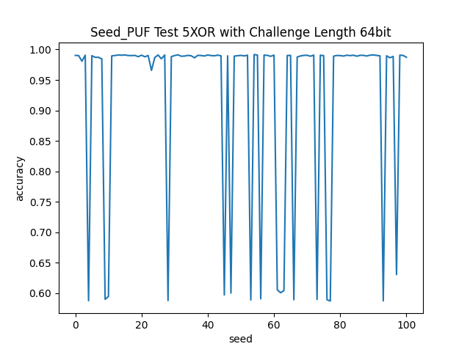
Initialization Problem

Slide 19
Future Work
1. (10,10,10)-network
2. Stable intialization

Slide 20
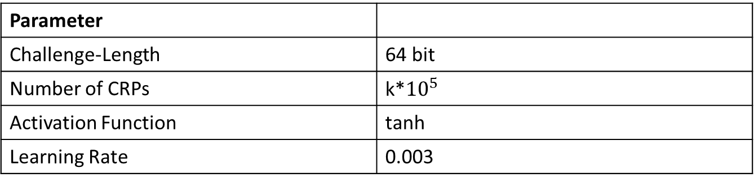
Danke für Ihre Aufmerksamkeit!
Main result: (10,10)-network for 1/2/3/4/5/6/7-XOR, faster and simpler than Mursi’s
Parameter
Challenge-Length | 64 bit
Number of CRPs | k*${10}^{5}$
Activation Function | tanh
Learning Rate | 0.003

Slide 21
References
1. Ulrich Rührmair’s presentation. Brief Intro: Various Strong PUF Candidates. presented to the audience in 06.2021, 2021
2. Aseeri, A.O.; Zhuang, Y.; Alkatheiri, M.S. A Machine Learning-based Security Vulnerability Study on XOR PUFs for Resource-Constraint Internet of Things. 2018.
3. K.T. Mursi, B. Thapaliya: A Fast Deep Learning Method for Security Vulnerability Study of XOR PUFs. 2020.
4. Wisiol, Nils et al. “Neural-Network-Based Modeling Attacks on XOR Arbiter PUFs Revisited.” IACR Cryptol. ePrint Arch. 2021 (2021): 555.

