Slide 1
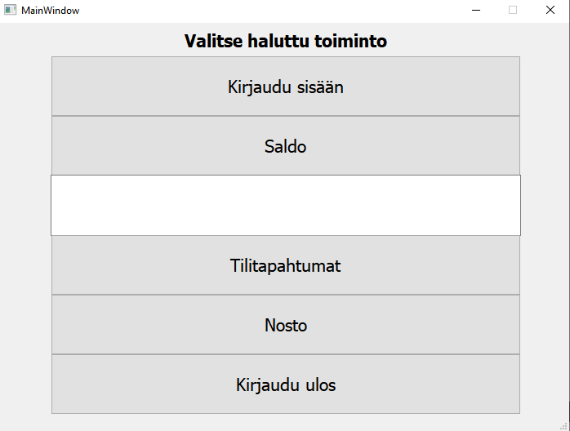
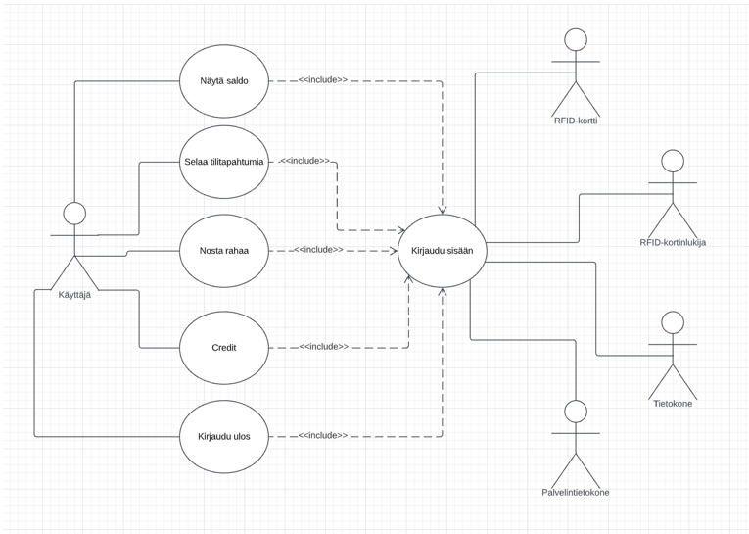
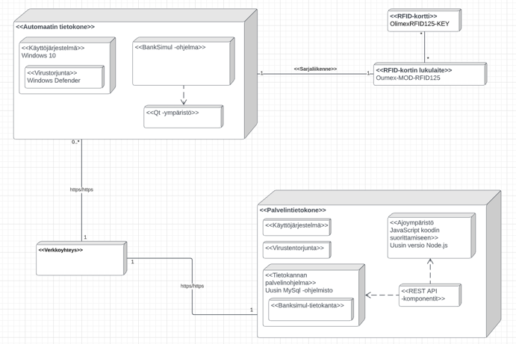
Bank Simulator
Matias Kauranen, Antti Kurkinen, Arttu Kääriäinen, Juhani Koski, TVT21SPL
Information Technology, Device and Product Design
Introduction
The focus of this project was to make a Bank Simulator, which could be used through a Qt widget based application connected to a database, and to learn skills required to develop such programs.
See the figure 1 below for the deployment diagram.
Objectives
The basic aims included a debit account, protected by a PIN code and a card ID. The user could ”withdraw” 20,40,50 or 100 euros and check the account balance.
The system is controlled through a Qt widget application, which is connected to a database.
The secondary aims were to make a credit account, that the user could withdraw any amount they wished for and that the REST API included all the CRUD operations.
FIGURE 1. The Deployment diagram
Methods
The microcontroller used in the project was the STM32 Nucleo-64. Purpose of the MCU was to simulate a RFID reader. When the card ID and password were correct the user could access the ATM main menu. (See the figure 3 on the right.)
The user could then check account balance, history, withdraw cash or log out.
All the actions then will be updated to the database.
FIGURE 2. The Use Case Diagram
Results
The user could login to the application via database and check the account balance from the database. The user could access account history and withdraw cash menus and log out.
FIGURE 3. The Main Menu
Conclusions
Bank simulator was a moderate success. It taught a lot about programming, however time ran out and not all features could be implemented.
References
1. Qt:
Source: https://www.qt.io/
2. STM32 Nucleo-64 datasheet Source:https://www.st.com/resource/en/user_manual/dm00105823-stm32-nucleo64-boards-mb1136-stmicroelectronics.pdf
Software Application Project
ECTS Credits: 15
Date of Publication: 2022, Spring
Instructor: Teemu Leppänen

