Slide 1
Networking Primer
How does your computer get to
http://www.google.com?

Slide 2
Outline
OSI Model
TCP/IP Stack
Link Layer
Internet Layer (IPv4 vs IPv6)
  ipconfig / ifconfig
  ARP
  DNS
Transport Layer
  TCP vs UDP
Application Identification
  Common Ports
Encapsulation
LAN vs WAN
Wireshark

Slide 3
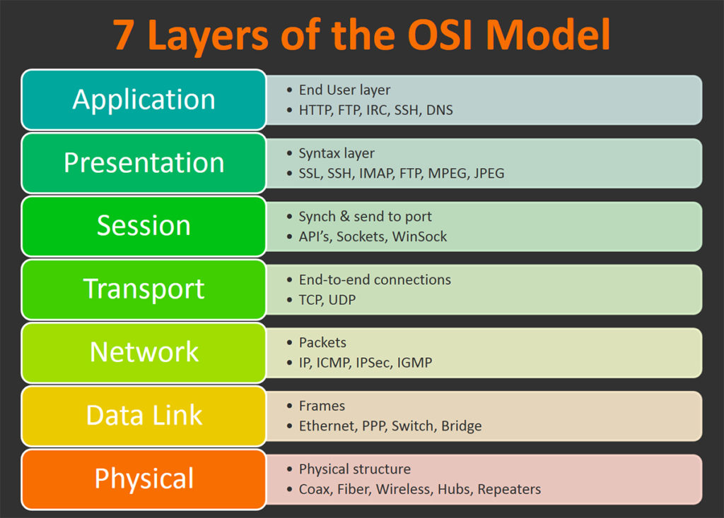
OSI

Slide 4
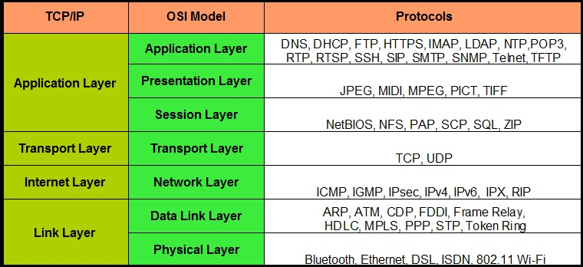
TCP/IP

Slide 5
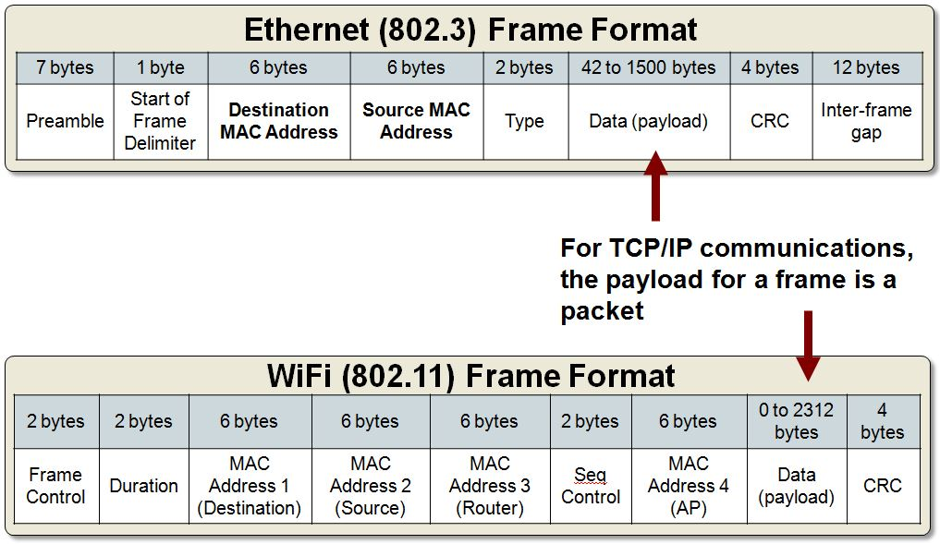
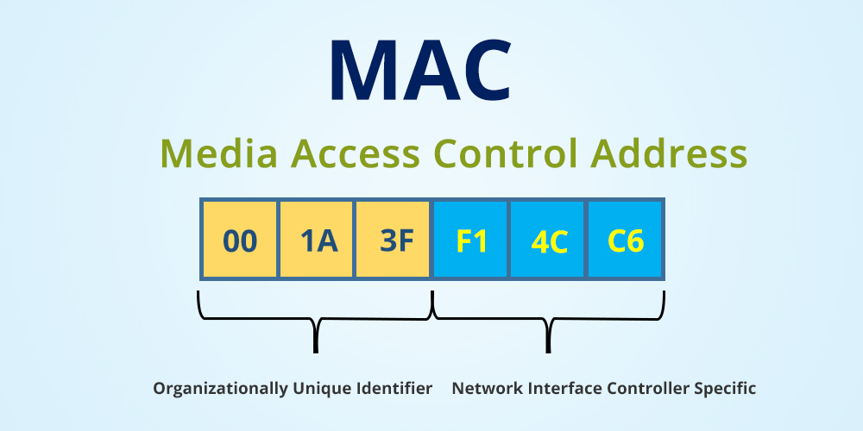
Link Layer
Dependent on the network hardware
Physically identify network card

Slide 6
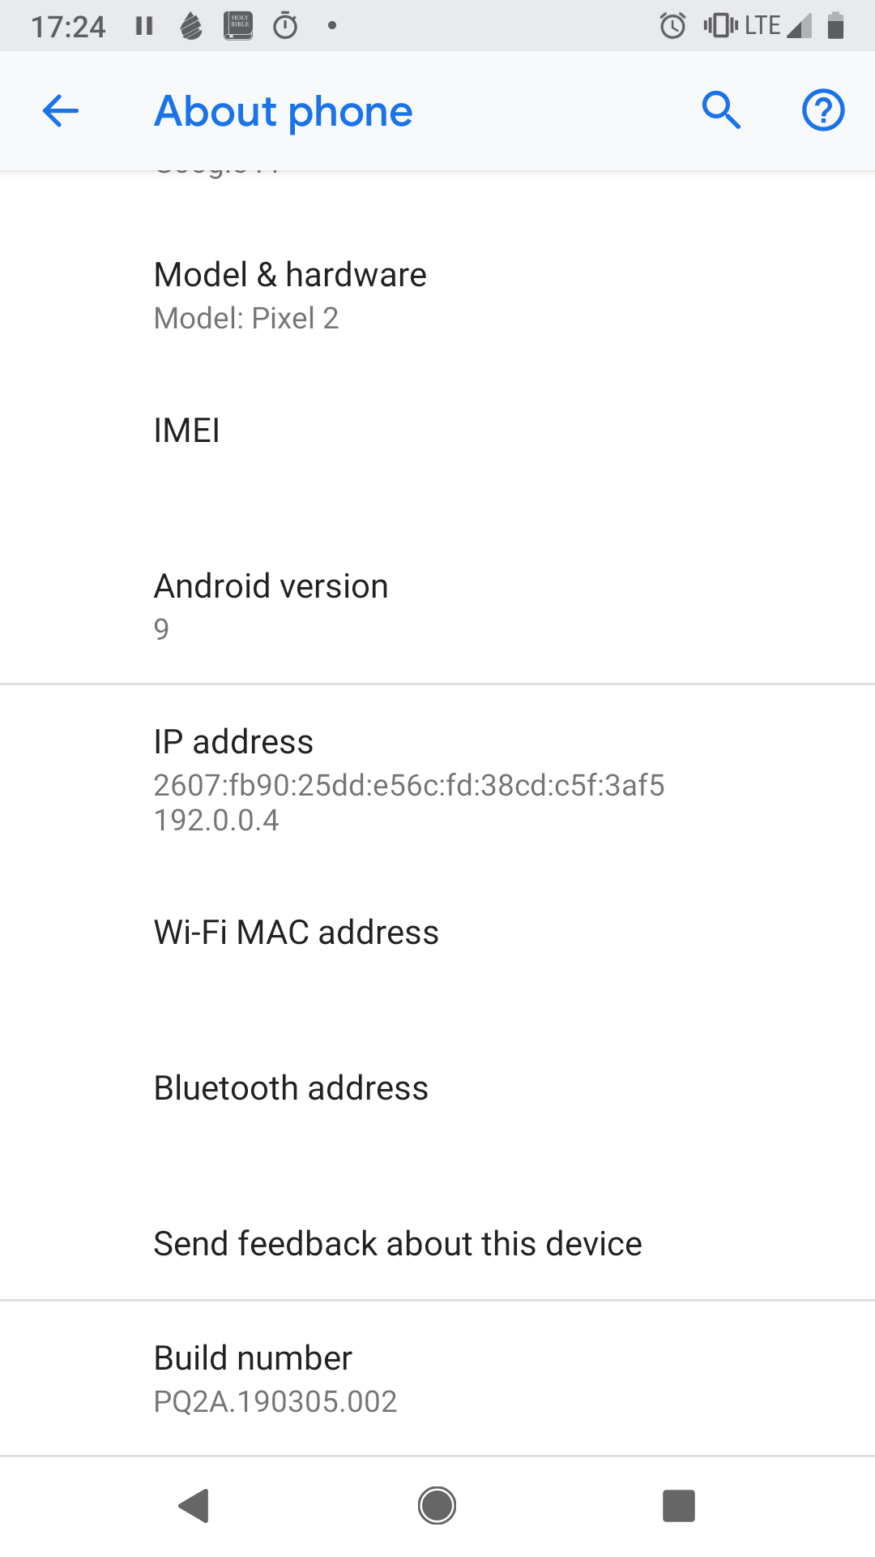
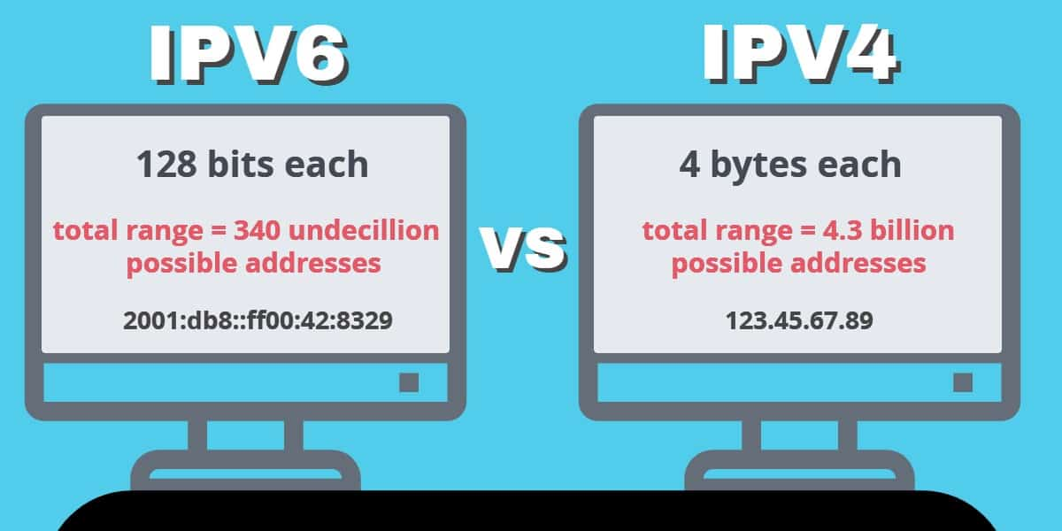
Internet Layer
IP is the most prevalent protocol
Address is a virtual address

Slide 7
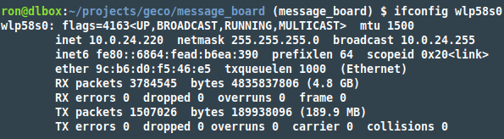
ipconfig / ifconfig
ipconfig – Windows
ifconfig – Unix like systems
Being replaced by ip address

Slide 8

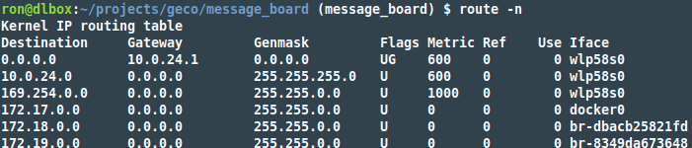
ARP
Address Resolution Protocol

Slide 9
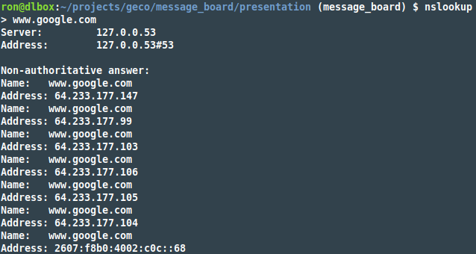
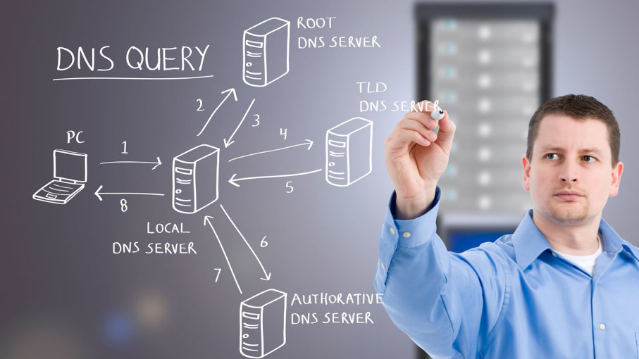
DNS
Domain Name System
Domain name → IP address

Slide 10

Transport Layer
Two main protocols in use:
  TCP – Transport Control Protocol
    Reliable
  UDP – User Datagram Protocol
    Unreliable but fast

Slide 11
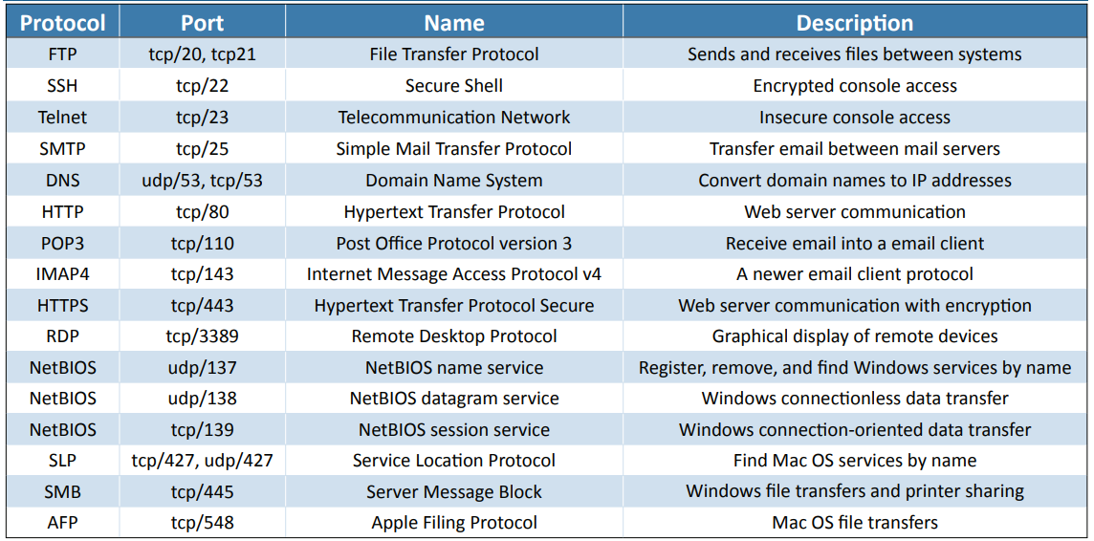
Application Identification
Port numbers typically identify the application

Slide 12
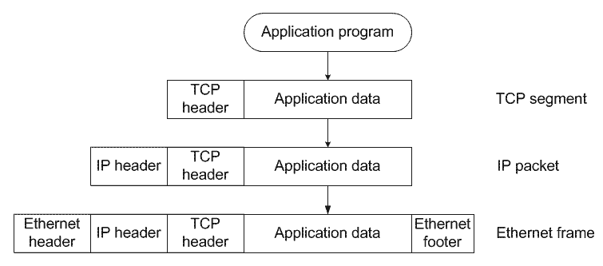
Encapsulation
Application Data → Segment / Datagram → Packet → Frame
  TCP header adds sequence numbers, source port, destination port, etc
  IP header adds source IP, destination IP, etc
  Ethernet header adds source MAC, destination MAC, FCS, etc.

Slide 13
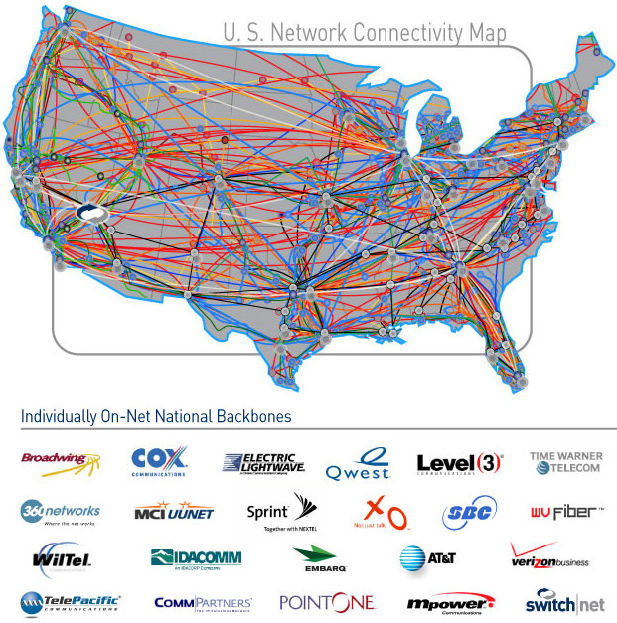
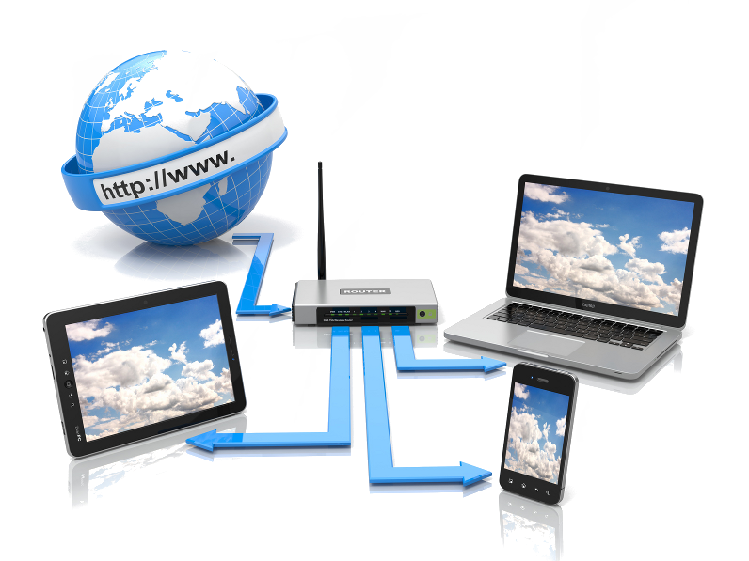
LAN vs WAN
LAN – Local Area Network
WAN – Wide Area Network

Slide 14
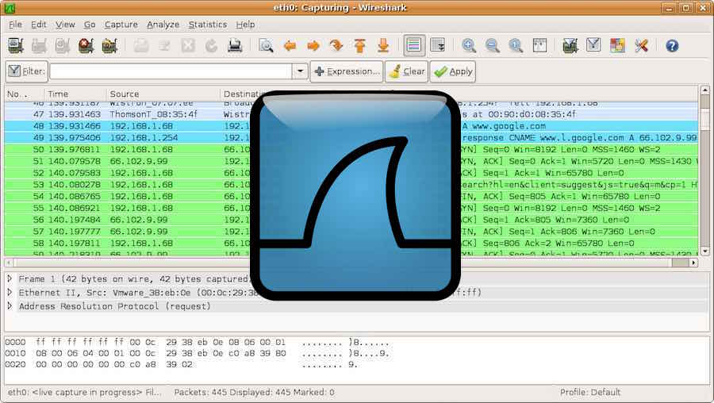
Wireshark
Allows for the easy capture and exploration of network traffic

