Slide 1


Introduction to Software Requirements Specification (SRS)
Programming Fundamentals – Year 11

Slide 2
Learning Objectives
Define what an SRS is and explain its importance.
Understand different types of software requirements.
Learn about the characteristics of a good SRS.
Discuss the role of SRS in the software engineering lifecycle.
Hands-on activity: Create basic requirements using GitHub and the Hugo website generator

Slide 3
What is a System Requirements Specification (SRS)?
A formal document detailing what a software system must do.
Forms a contract between the customer and the software team.

Slide 4
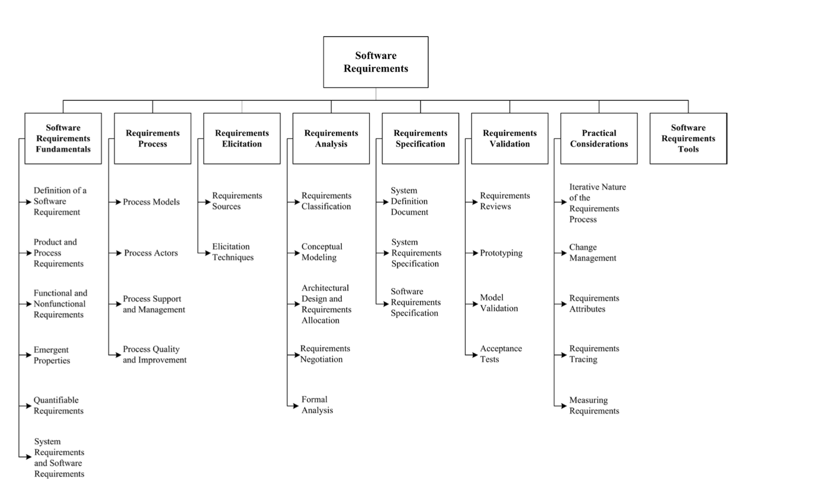
SRS in Context
Used by software engineering teams to define project boundaries.
Ensures developers build what the customer expects.
Breakdown of Topics for the Software Requirements
IEEE Computer Society. (2014). Guide to the Software Engineering Body of Knowledge (SWEBOK v3).

Slide 5
Scenario: Building Software for a School
Example: Creating a School Event Management System.
What features would be required?

Slide 6
Understanding Software Requirements
Requirements describe what the software shall do and how it will must perform.
In the context of an SRS:
“shall” indicates a requirement that is mandatory and must be implemented
“must” conveys a similarly strong imperative for essential requirements, while
“should” suggests a recommended, but not compulsory, feature or behaviour.
Functional Requirement Example:
“The system shall allow students to register for events.”
Non-Functional Requirement Example:
“The system shall handle at least 500 users simultaneously.”

Slide 7
Types of Requirements
Functional: Specific functions the system must perform.
Non-Functional: Performance, usability, and security aspects.
Security: Measures to protect data and user privacy.
System: Hardware, software, network infrastructure, and other environmental requirements necessary for the software’s operation

Slide 8
Where Do Requirements Come From?
Stakeholders, business needs, regulations, and standards.
Security: Government Standard
Australian Cyber Security Centre (ACSC) Information Security Manual (ISM)
https://www.cyber.gov.au/resources-business-and-government/essential-cyber-security/ism
Software engineering environment prepares requirements for project use. See:
https://brokenhill-h.polemos.ai/workbooks/standards/ism/

Slide 9
Workbooks: Documenting Requirements
Tools like GitHub to keep a version-controlled record of requirements.
Markdown makes it easy to collaborate and track changes.
Web frameworks like Hugo (https://gohugo.io/) simplify display of requirements across team.
Use tools such as Pandoc (https://pandoc.org) to convert text and web material into formal Word and PDF documents
Software Engineering projects use Workbooks to organise and track project artefacts.
Let us review the courses online workbook https://brokenhill-h.polemos.ai/

Slide 10
Characteristics of a Good SRS
Correct
Unambiguous
Complete
Consistent
Ranked
Verifiable
Traceable: (REST) Web systems greatly simplify this.
Use “shall” or “must” statements to define .

Slide 11
Example Requirement Statement
ID: REQ-001
Title: User Authentication
Description: “The system must allow users to log in using a username and password.”
Acceptance Criteria: Users can log in with valid credentials.Traceable: (REST) Web systems greatly simplify this.
Use “shall” or “must” statements to define .

Slide 12
What is Traceability?
The ability to track each requirement throughout its lifecycle.
Essential for ensuring all requirements are implemented and tested.
This includes:
Why the requirement
Planning to implement the requirement
Where the requirement is met
How the requirement is tested
Let us review the tooling.

Slide 13
Common Mistakes to Avoid
Designs in specification
Vague statements
Keep project management constraints separate
”Desireaments” – Unrealistic or unnecessary personal requirements (e.g. I desire a Ferrari as my first car)

Slide 14
Where Does SRS Fit in SDLC
Planning: Defines scope and requirements.
Estimation, Costing & Negotiation: Defines scope and requirements.
Construction: Guides the development process.
Testing: Ensures the final product meets requirements.
Acceptance: SRS is a key item in getting paid to complete a project
Getting Paid

Slide 15
Hands-On Activity: Write Your Own Requirement
Create a functional, non-functional, and security requirement for a simple system.
Use the SRS template in the Hugo site.

Slide 16
Summary & Next Steps
Today, we covered what an SRS is, its types, characteristics, and how to document requirements
Homework: Refine your requirements and check in to GitHub.

