Slide 1
GRADE 10 · IB MYP YEAR 5 INTEGRATED SCIENCES · UNIT 1
Chemical Models & Energy in Reactions
Sub-unit 1 · Periodic Table, Electron States & Bond Energy as the Foundation for Biological & Environmental Chemistry
🎯 Summative Assessment Alignment: Criterion B (Inquiring & Designing) & Criterion C (Processing & Evaluating)
Unit 1 · Chemical Models & Energy in Reactions · Grade 10 MYP 5 Sciences · OIS SCI 10.ABC-DS.1–6
Notes:
TEACHER FACILITATION NOTES (SLIDE 1):
• Purpose: Welcome students to Sub-Unit 1. Set the intellectual tone for MYP 5 (Grade 10).
• Key Message: Emphasize that chemistry explains energy transformations in biology (digestion) and environment (acid rain).
• Timing: 3-5 minutes introductory framing.

Slide 2
UNIT OVERVIEW
Curriculum Scope & Target Learning Outcomes
Target Academic Standards (OIS I.SCI)
📌 10.ABC-DS.1: Outermost Electron States & Trends
Construct & revise explanations for acid-base and displacement outcomes based on valence electrons and periodic trends.
📌 10.ABC-DS.2: Neutralization & Bond Energy Models
Model how H+ and OH- neutralization breaks/forms bonds, releasing net energy (ΔH = ΣBonds_broken - ΣBonds_formed).
📌 10.ABC-DS.3: Characteristic Reactions of Acids & Bases
Predict products of acids with metals, bases, and carbonates, plus bases with ammonium salts (NH3 gas).
📌 10.ABC-DS.4: Indicators, pH Scale & [H+] Ions
Compare [H+] concentrations using litmus, phenolphthalein, methyl orange, universal indicator, and digital probes.
📌 10.ABC-DS.5: Volumetric Titrations & Stoichiometry
Perform precision titrations using burettes and pipettes; calculate unknown solution concentrations.
📌 10.ABC-DS.6: Conservation of Mass in Reactions
Use balanced equations & molar mass to prove mass conservation during acid-carbonate gas evolution.
Inquiry Pedagogy & Assessment
🧠 Visual Thinking Routines (Harvard Project Zero):
• See-Think-Wonder: Digestive pH & chemical homeostasis.
• Claim – Support – Question: Acid reactivity and single displacement.
• Zoom In: Macroscopic neutralization → atomic valence shells.
• Red Light, Yellow Light, Green Light: Experimental error analysis.
• Generate – Sort – Connect – Elaborate: Master concept synthesis.
🤝 Collaborative Jigsaw Activity:
• Peer expert groups investigating Group 1, Group 2, and Group 17 displacement kinetics.
🎯 Final Summative Assessment:
• Criterion B: Designing an enthalpy of neutralization calorimeter experiment.
• Criterion C: Processing experimental thermochemical data, identifying deliberate anomalies, calculating ΔH_neut, and evaluating method limitations.
Unit 1 · Chemical Models & Energy in Reactions · Grade 10 MYP 5 Sciences · OIS SCI 10.ABC-DS.1–6
Notes:
TEACHER FACILITATION NOTES (SLIDE 2):
• Walk students through the 6 standards. Highlight how these standards progress logically from valence electrons to thermochemical calorimetry.

Slide 3
MYP FRAMEWORK
Statement of Inquiry & Guiding Questions
“Models of atomic electron configuration and chemical bond energy allow scientists to predict reaction dynamics and engineer solutions for environmental and biological energy transformations.”
KEY CONCEPT
RELATED CONCEPTS
GLOBAL CONTEXT
Change
Chemical reactions represent fundamental reconfigurations of matter and electron transfer.
Energy · Models · Evidence
Quantifying enthalpy changes and using sub-microscopic bonding models backed by empirical data.
Scientific & Technical Innovation
How understanding acid-base neutralization drives medicine (antacids) and industrial green chemistry.
FACTUAL
Which subatomic particles determine whether an element displaces another or donates a proton?
CONCEPTUAL
How does the breaking and forming of chemical bonds govern whether an acid reaction releases or absorbs thermal energy?
DEBATABLE
Can simple laboratory models adequately predict and mitigate complex environmental chemical crises like ocean acidification?
Unit 1 · Chemical Models & Energy in Reactions · Grade 10 MYP 5 Sciences · OIS SCI 10.ABC-DS.1–6
Notes:
TEACHER FACILITATION NOTES (SLIDE 3):
• Statement of Inquiry: Ask students to identify how digestive antacids and industrial limestone scrubbers connect to 'Energy, Models, Evidence'.

Slide 4
LEARNING EXPERIENCE
Interactive Digital Simulations & Video Library
Click any button during lessons to launch interactive simulations and video models
Interactive Simulations (PhET & Virtual Chem)
Video Demonstrations & Pre-Lab Briefings
🧪 PhET: Acid-Base Solutions (Standard 10.ABC-DS.4)
Investigate how strong vs weak acids dissociate. Compare [H3O+] vs [OH-] equilibrium concentrations.
🔥 PhET: Energy Forms and Changes (Standard 10.ABC-DS.2)
Track thermal energy transfer into surrounding water during bond restructuring.
⚖️ ChemCollective: Virtual Acid-Base Titration Lab (Standard 10.ABC-DS.5)
Standardize unknown HCl using 0.100 M NaOH with phenolphthalein indicator. Practice reading meniscus.
⚛️ PhET: Reactants, Products & Leftovers (Standard 10.ABC-DS.6)
Simulate limiting reagents and mass conservation during gas evolution.
🎥 Video 1: Single Displacement & The Activity Series (L2)
Observe electron transfer between zinc/magnesium and copper(II) sulfate solutions under high magnification.
🎥 Video 2: Characteristic Acid Gas Tests (L3–L4)
The 'Squeaky Pop' test for H2, Limewater effervescence for CO2, and damp red litmus for NH3 gas.
🎥 Video 3: Analytical Titration Technique & Error Avoidance (L7)
Step-by-step masterclass: rinsing burettes, removing air bubbles, detecting faint pink endpoint.
🎥 Video 4: Coffee-Cup Calorimetry of Neutralization (L11–L12)
Measuring temperature evolution ΔT to calculate molar enthalpy ΔH_neut.
🧪 LAUNCH PhET: Acid-Base Solutions
🔥 LAUNCH PhET: Energy Forms & Bonds
⚖️ LAUNCH ChemCollective Titration
Unit 1 · Chemical Models & Energy in Reactions · Grade 10 MYP 5 Sciences · OIS SCI 10.ABC-DS.1–6
Notes:
TEACHER FACILITATION NOTES (SLIDE 4):
• Pre-Lab Instructions: All 3 buttons at the bottom are clickable and launch the virtual labs directly in Chrome.
• Ensure students test PhET Acid-Base Solutions before Lesson 6.

Slide 5
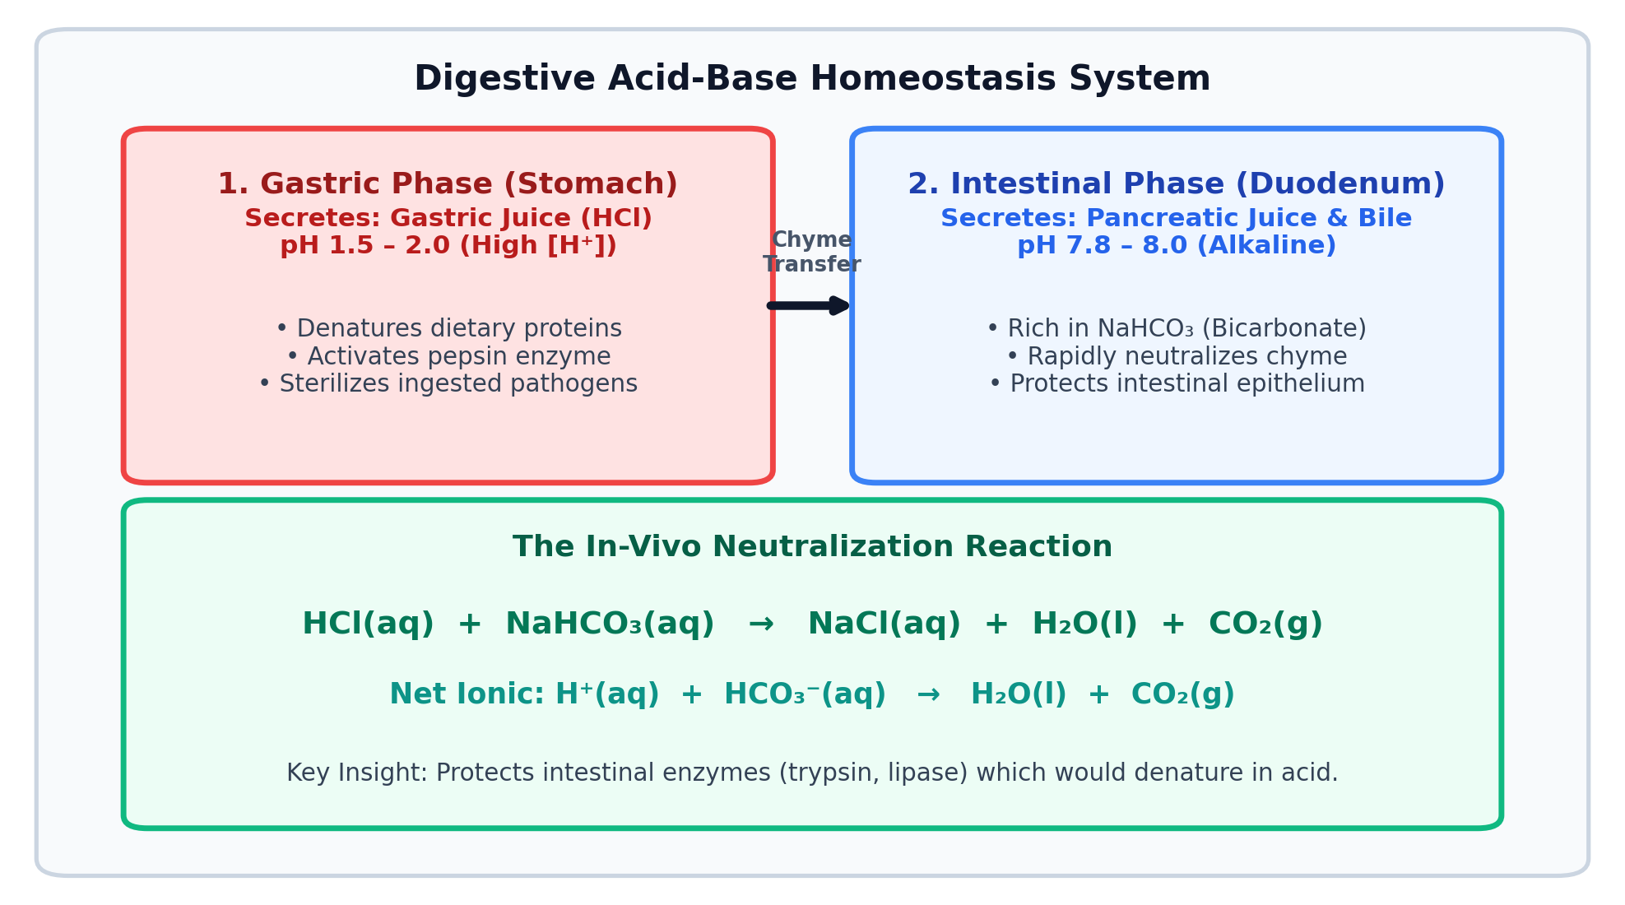
VISUAL THINKING ROUTINE
See – Think – Wonder: Digestive Chemistry & Acid Homeostasis
Routine: Observe the phenomenon, make inferences, and generate testable questions
Inquiry Prompts & Observations
👁️ What do you SEE?
• Gastric juice has pH 1.5 – 2.0 (concentrated HCl).
• Pancreatic juice rapidly raises pH to 7.8 – 8.0 in the duodenum.
💭 What do you THINK is happening?
• Pancreas secretes bicarbonate (NaHCO₃) to neutralize acid:
HCl(aq) + NaHCO₃(aq) → NaCl(aq) + H₂O(l) + CO₂(g)
• Protects intestinal enzymes (trypsin, lipase) from denaturing.
❓ What does it make you WONDER?
• How do commercial antacids chemically mimic this system?
• Does neutralizing stomach acid release thermal energy inside us?
Model Scientific Thinking: The stomach secretes HCl to denature proteins and kill pathogens. In the duodenum, sodium bicarbonate (NaHCO₃) neutralizes the acid: HCl + NaHCO₃ → NaCl + H₂O + CO₂. This chemical system maintains precise pH boundaries essential for enzyme kinetics.
Unit 1 · Chemical Models & Energy in Reactions · Grade 10 MYP 5 Sciences · OIS SCI 10.ABC-DS.1–6
Notes:
TEACHER FACILITATION NOTES (SLIDE 5):
• Protocol: Give students 2 minutes of silent writing for 'SEE'. Cold-call 3 students. Ensure they do NOT explain yet.
• Move to 'THINK' (3 mins pair talk): push toward ionic equations.
• Move to 'WONDER': collect questions for Criterion B.

Slide 6
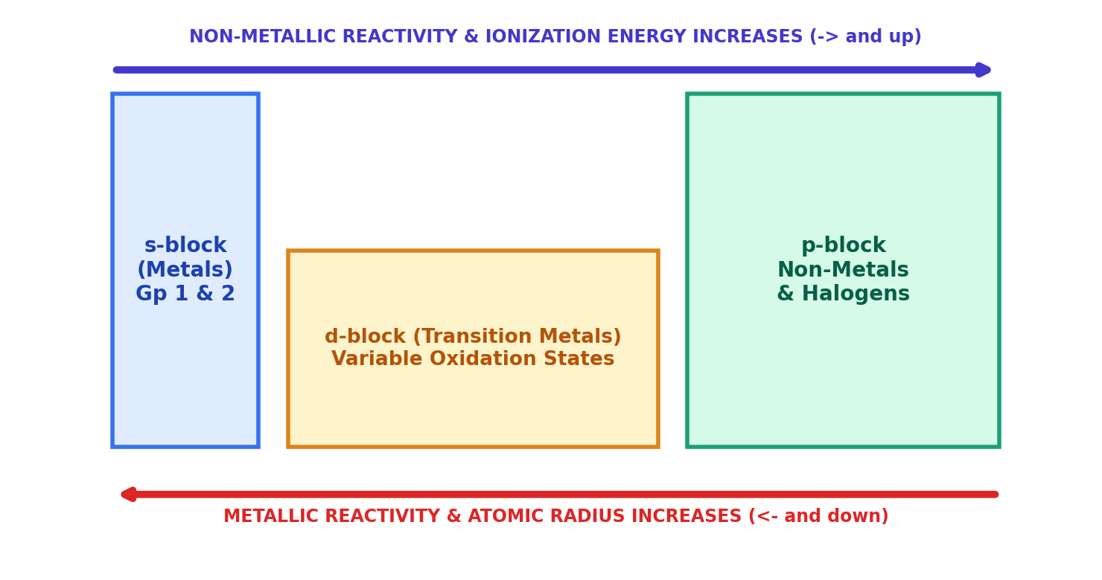
LESSON 1 · STANDARD 10.ABC-DS.1
Valence Electron States & Periodic Reactivity Trends
Inquiry: How do outermost electron configurations govern single displacement and acid reactivity?
Atomic Models & Electron Transfer Rules
🔑 Outermost Electrons Rule Reactivity:
• Chemical reactivity is determined by valence electrons (electrons in the highest energy level).
• Atoms react to achieve stable, low-energy noble gas configurations (full octet).
⚡ Metals (Cation Formers):
• Have 1, 2, or 3 valence electrons.
• React by losing electrons (oxidation): M(s) -> M^n+(aq) + n e-
• Low electronegativity and low first ionization energy.
⬇️ Down Group 1 & 2: Metallic Reactivity INCREASES
• Atomic radius increases; outer electrons occupy shells further from nucleus.
• Increased electron shielding weakens nuclear electrostatic pull.
• Valence electrons are lost far more easily (e.g. K > Na > Li).
➡️ Across a Period (Left to Right): Metallic Reactivity DECREASES
• Nuclear charge (protons) increases while shielding remains constant.
• Stronger electrostatic attraction pulls valence electrons closer, binding them tightly.
🧪 INTERACTIVE SIMULATION PhET: Build an Atom & Periodic Trends
Activity Series Rule: Zn(s) + 2HCl(aq) -> ZnCl2(aq) + H2(g) [REACTION]
Cu(s) + HCl(aq) -> NO REACTION (Cu has higher ionization energy than H!)
Unit 1 · Chemical Models & Energy in Reactions · Grade 10 MYP 5 Sciences · OIS SCI 10.ABC-DS.1–6
Notes:
TEACHER FACILITATION NOTES (SLIDE 6):
• Direct Instruction: Point to the embedded diagram showing the two opposing gradient arrows.
• Ask: 'Why does metallic character increase towards the bottom-left (Fr/Cs) while non-metallic character increases towards the top-right (F)?'
• Emphasize that ionization energy measures the energy needed to REMOVE an electron.

Slide 7
COLLABORATIVE LEARNING
Jigsaw Activity: The Great Electron & Reactivity Showdown
Format: 10 mins in Expert Groups -> 15 mins in Home Jigsaw Groups to synthesize
Group 1: Alkali Metals (Gp 1)
Group 2: Alk. Earth (Gp 2)
Group 3: Halogens (Gp 17)
Group 4: Transition Metals
👥 Expert Focus: Li vs Na vs K
• Electron config: [He]2s1, [Ne]3s1, [Ar]4s1.
• Analyze reaction vigor with water/acid.
• Explain why K reacts explosively while Li reacts steadily using atomic radius and shielding.
• Write ionic half-equations for electron loss: K -> K+ + e-.
👥 Expert Focus: Mg vs Ca
• Electron config: 2 valence electrons.
• Compare first + second ionization energies.
• Why does calcium displace H+ from cold water, but magnesium requires warm water or acid?
• Model electron transfer to form M2+ cations.
👥 Expert Focus: Cl2 vs Br2 vs I2
• Electron config: 7 valence electrons.
• Why does non-metal reactivity DECREASE down the group? (Opposite of metals!)
• Model halogen displacement:
Cl2(aq) + 2 KBr(aq) -> 2 KCl(aq) + Br2(aq)
• Which species is reduced?
👥 Expert Focus: Zn vs Fe vs Cu
• Variable valency and reactivity plateau.
• Investigate displacement of Cu2+ ions by Zinc granules (blue color fades, copper deposits).
• Explain why copper pipes are used for household plumbing instead of iron or zinc.
Unit 1 · Chemical Models & Energy in Reactions · Grade 10 MYP 5 Sciences · OIS SCI 10.ABC-DS.1–6
Notes:
TEACHER FACILITATION NOTES (SLIDE 7):
• Jigsaw Logistics: 10 mins expert study, 15 mins peer teaching. Call on a student from Group 4 to explain Group 1's trend!

Slide 8
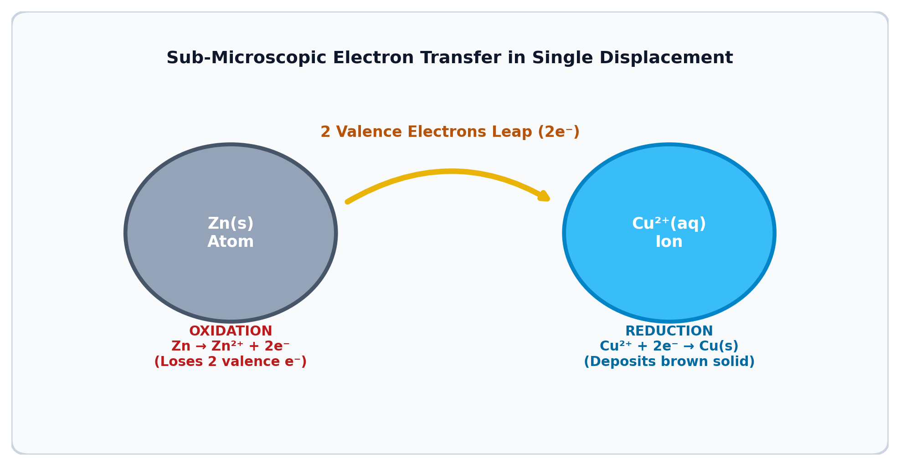
CHECK FOR UNDERSTANDING
Hinge Question 1: Predicting Single Displacement
Show me: 1–4 fingers on 3-2-1
A strip of solid Nickel (Ni) is placed into Copper(II) sulfate (CuSO₄). Nickel is above copper on the activity series. What is observed and what is the electron transfer?
1
No reaction occurs (copper is more electronegative).
2
Brown Cu solid deposits; Ni loses 2e⁻ to Cu²⁺ ions.
3
Nickel gains electrons, forming Ni²⁻ anions.
4
Sulfate ions transfer electrons directly to Nickel.
✔ Correct Answer: 2 (Brown copper solid forms; Ni loses 2e⁻ to Cu²⁺).
Diagnostic Rationale: Nickel has lower ionization energy and oxidizes: Ni(s) → Ni²⁺(aq) + 2e⁻. Dissolved Cu²⁺ ions accept these electrons and reduce: Cu²⁺(aq) + 2e⁻ → Cu(s). Spectator sulfate ions remain unchanged.
Unit 1 · Chemical Models & Energy in Reactions · Grade 10 MYP 5 Sciences · OIS SCI 10.ABC-DS.1–6
Notes:
TEACHER FACILITATION NOTES (SLIDE 8):
• Hinge Protocol: 30s think time, 3-2-1 show fingers. If >80% show '2', proceed; if not, re-teach oxidation/reduction half-equations.

Slide 9
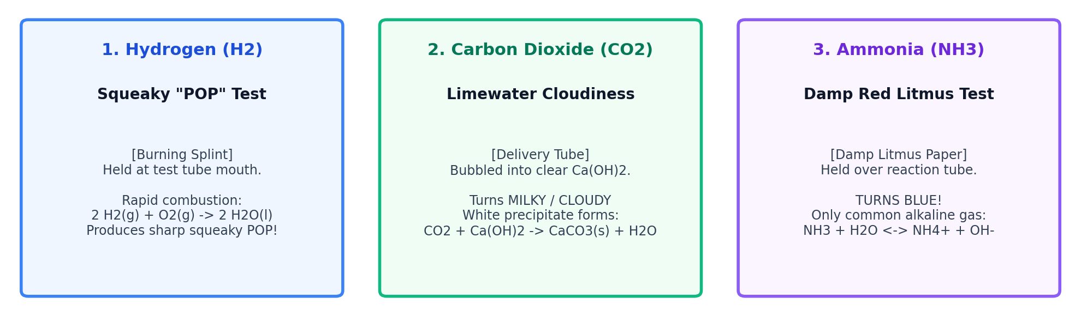
LESSON 2 · STANDARD 10.ABC-DS.3
Characteristic Reactions of Acids & Confirmation Gas Tests
Inquiry: How do acids behave predictably with metals, bases, and carbonates?
1. Acid + Metal
2. Acid + Base
3. Acid + Carbonate
Acid + Metal -> Salt + H2(g)
2 HCl(aq) + Zn(s) -> ZnCl2(aq) + H2(g)
Ionic: 2H+ + Zn -> Zn2+ + H2
Acid + Base -> Salt + H2O(l)
HCl(aq) + NaOH(aq) -> NaCl(aq) + H2O(l)
Net Ionic: H+(aq) + OH-(aq) -> H2O(l)
Acid + Carbonate -> Salt + H2O + CO2(g)
2 HNO3 + CaCO3 -> Ca(NO3)2 + H2O + CO2
Effervescent gas evolution
Unit 1 · Chemical Models & Energy in Reactions · Grade 10 MYP 5 Sciences · OIS SCI 10.ABC-DS.1–6
Notes:
TEACHER FACILITATION NOTES (SLIDE 9):
• Visual Bridge: The bottom diagram visually outlines the 3 required qualitative gas tests (H2 pop test, CO2 limewater cloudiness, NH3 damp red litmus).
• Have students sketch these 3 gas tests in their practical books.

Slide 10
LESSON 2 (CONT) · STANDARD 10.ABC-DS.3
Reactions of Bases with Ammonium Salts
Inquiry: What happens when an alkali reacts with an ammonium salt?
The Base-Ammonium Salt Reaction
Confirmation & Testing for Ammonia (NH3)
🧪 General Equation:
Base (Alkali) + Ammonium Salt -> Salt + Water + Ammonia Gas (NH3)
Chemical Mechanism:
• Ammonium ion (NH4+) is a weak conjugate acid.
• Hydroxide ions (OH-) from strong bases strip a proton (H+) from NH4+:
NH4+(aq) + OH-(aq) -> NH3(g) + H2O(l)
Key Example:
NaOH(aq) + NH4Cl(aq) --(heat)--> NaCl(aq) + H2O(l) + NH3(g)
Agricultural & Environmental Context:
• Why farmers must NEVER mix ammonium nitrate fertilizers with slaked lime (Ca(OH)2)—it releases nitrogen as volatile ammonia gas into the air, wasting expensive fertilizer!
🔬 Gas Confirmation Test:
1. Damp Red Litmus Paper Test:
• Hold a strip of damp red litmus paper near the mouth of the reaction tube.
• Result: Turns blue! (Ammonia is the ONLY common alkaline gas).
• Why must the paper be DAMP? Ammonia gas dissolves in water to produce hydroxide ions:
NH3(g) + H2O(l) <-> NH4+(aq) + OH-(aq)
2. Sensory / Odor Observation:
• Sharp, pungent, choking smell (smelling salts).
3. Dense White Smoke Test (Extension):
• Bring a glass rod dipped in concentrated HCl near NH3 gas:
• NH3(g) + HCl(g) -> NH4Cl(s) (dense white fumes of ammonium chloride).
Unit 1 · Chemical Models & Energy in Reactions · Grade 10 MYP 5 Sciences · OIS SCI 10.ABC-DS.1–6
Notes:
TEACHER FACILITATION NOTES (SLIDE 10):
• Live Microscale Demo: Heat 0.5g of ammonium chloride with 1 mL of 1M NaOH. Hold damp red litmus over it.
• Emphasize why dry litmus will fail.

Slide 11
INVESTIGATION
Inquiry Lab: 4 Rotating Characteristic Reaction Stations
Protocol: Groups of 3–4 rotate every 8 minutes. Predict -> Test -> Record -> Explain.
Station A: Acid + Metal
Station B: Acid + Carbonate
🧪 Reagents: Mg ribbon + 1.0 M HCl
📋 Action: Collect gas with inverted boiling tube; test with burning splint for pop sound.
⚗️ Target Equation: 2 HCl + Mg -> MgCl2 + H2
🧪 Reagents: Solid CaCO3 + 1.0 M HNO3
📋 Action: Deliver effervescing gas via delivery tube into limewater; observe cloudiness.
⚗️ Target Equation: 2 HNO3 + CaCO3 -> Ca(NO3)2 + H2O + CO2
Station C: Acid + Base
Station D: Base + Ammonium
🧪 Reagents: Solid CuO + 1.0 M H2SO4 (warm)
📋 Action: Warm black copper(II) oxide in dilute acid; observe blue copper sulfate solution.
⚗️ Target Equation: H2SO4 + CuO -> CuSO4 + H2O
🧪 Reagents: NH4Cl(s) + 1.0 M NaOH (gentle heat)
📋 Action: Hold damp red litmus paper over mouth; observe rapid shift to blue.
⚗️ Target Equation: NaOH + NH4Cl -> NaCl + H2O + NH3
Unit 1 · Chemical Models & Energy in Reactions · Grade 10 MYP 5 Sciences · OIS SCI 10.ABC-DS.1–6
Notes:
TEACHER FACILITATION NOTES (SLIDE 11):
• Safety: Goggles mandatory. Ensure water baths for Station C and good ventilation for Station D.

Slide 12
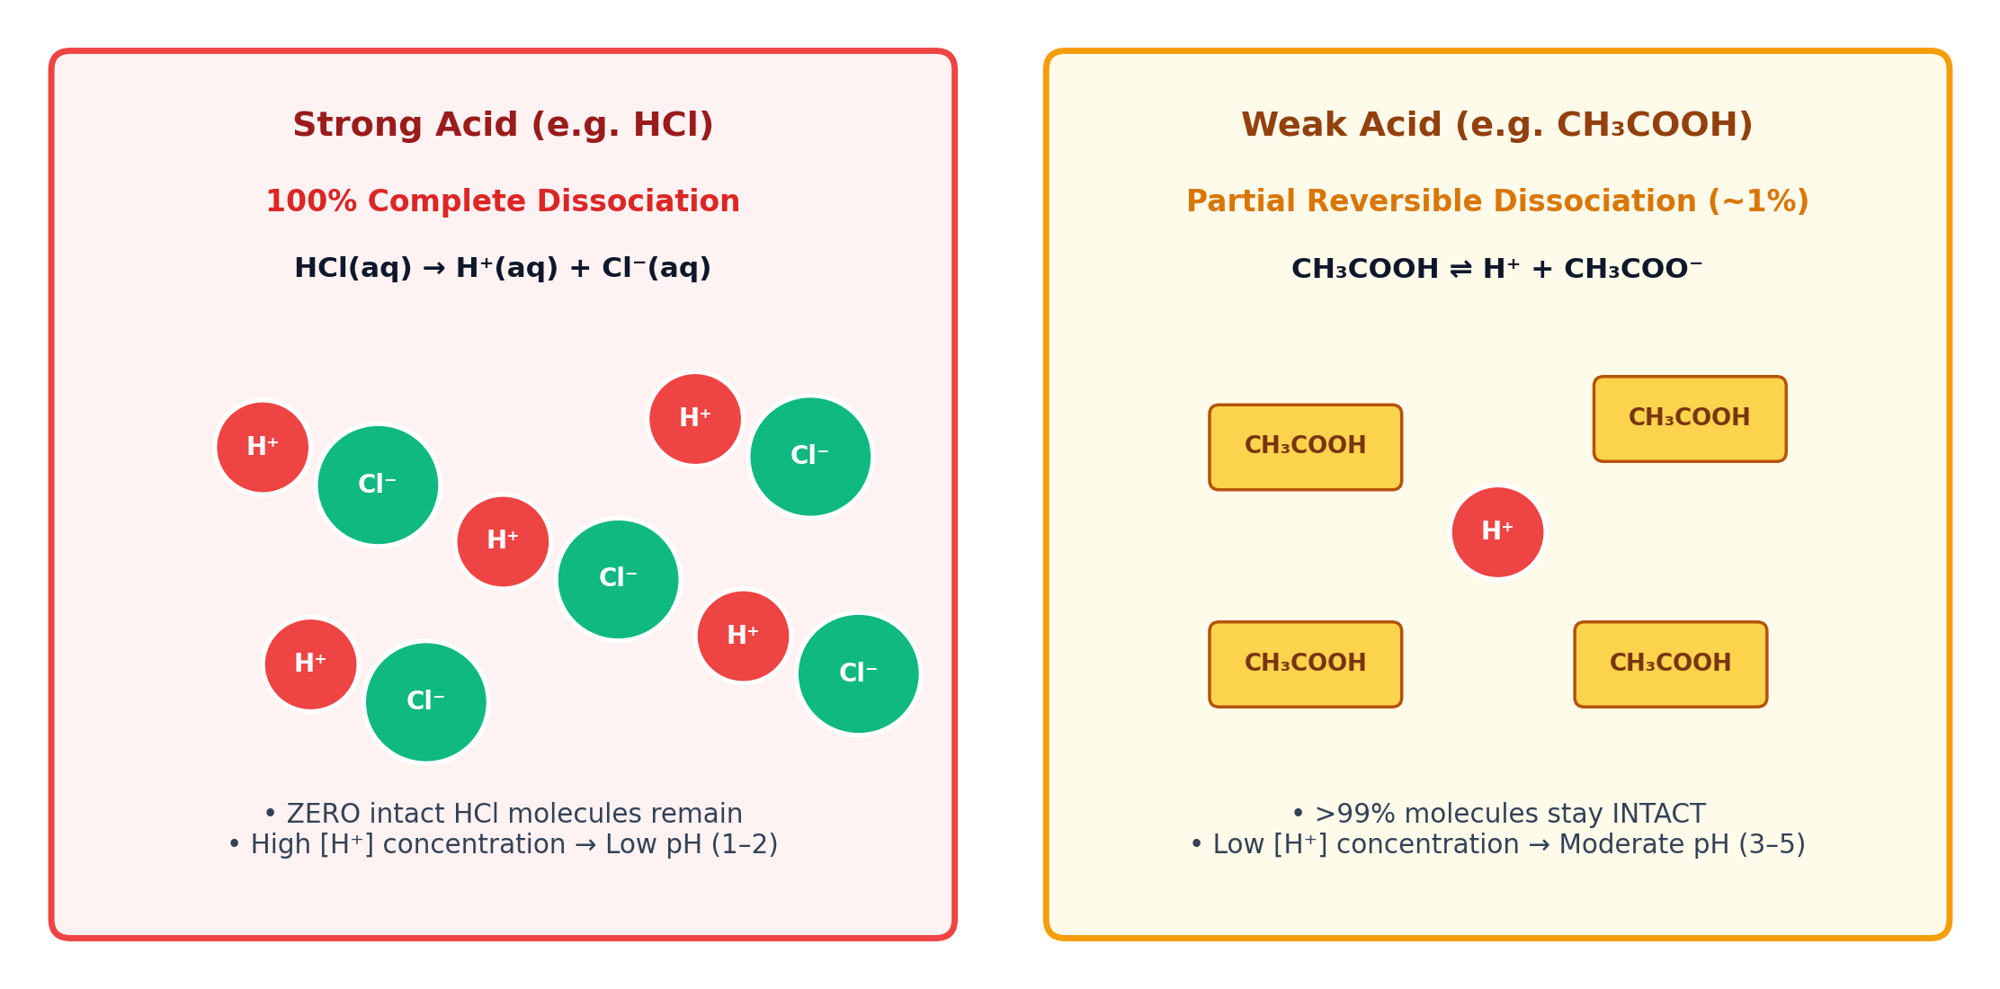
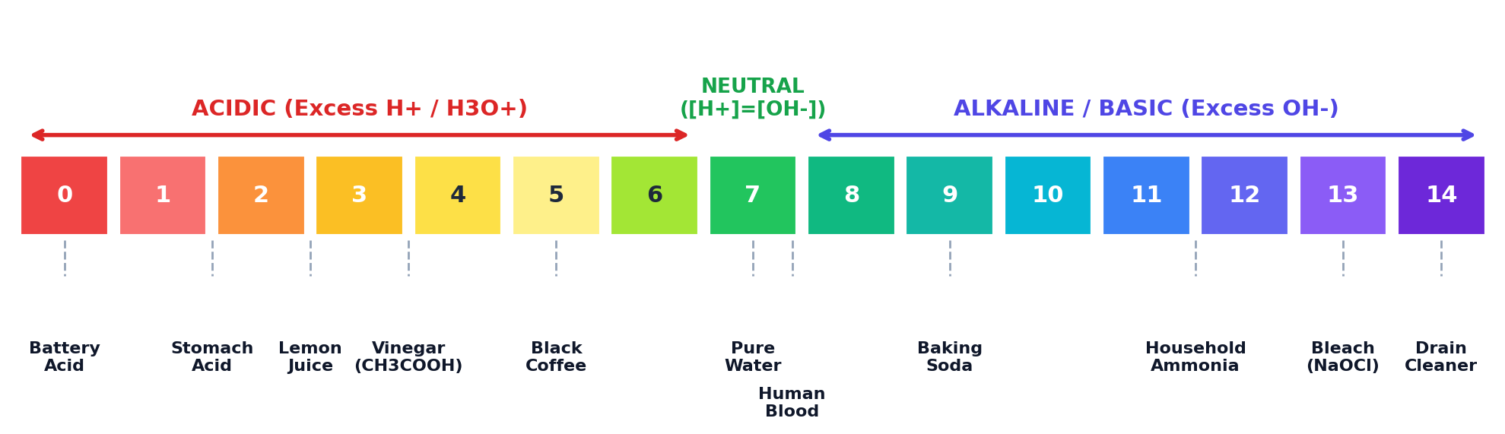
LESSON 3 · STANDARD 10.ABC-DS.4
The pH Scale, [H⁺] Concentration & Synthetic Indicators
Inquiry: How do indicators and the logarithmic pH scale measure hydrogen ion concentration?
Logarithmic Nature of pH & Indicators
• pH = -log₁₀[H⁺]. 1 pH unit shift = TEN-FOLD (10×) change in [H⁺]!
• pH 1 (Gastric juice) has 1,000,000× more H⁺ than neutral pH 7.
• Phenolphthalein: Colorless (pH < 8.2) → Faint Pink (pH 8.2 – 10.0).
• Litmus: Red (pH < 4.5) → Blue (pH > 8.3) | Methyl Orange: Red → Yellow.
Unit 1 · Chemical Models & Energy in Reactions · Grade 10 MYP 5 Sciences · OIS SCI 10.ABC-DS.1–6
Notes:
TEACHER FACILITATION NOTES (SLIDE 12):
• Visual Inspection: Point out the real-world benchmarks on the embedded pH diagram (battery acid to drain cleaner).
• Ask: 'Why is blood pH (7.4) slightly alkaline, and why does a drop to 7.2 cause medical acidosis?'

Slide 13
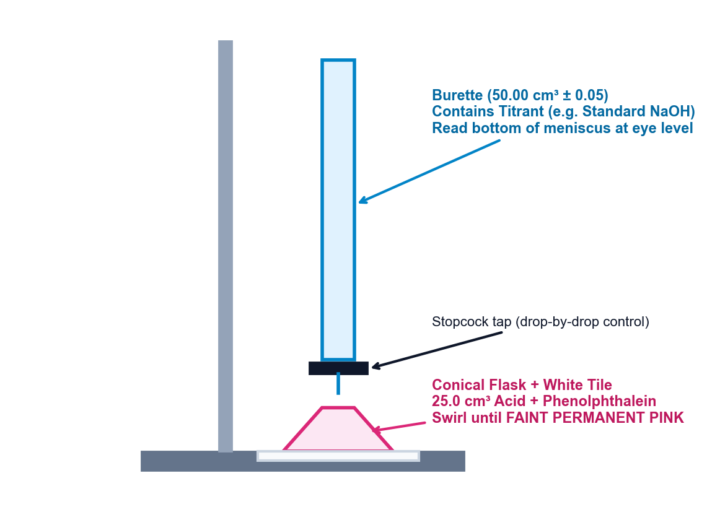
LESSON 4 · STANDARD 10.ABC-DS.5
Volumetric Analysis: Precision Acid-Base Titration Technique
Inquiry: How do analytical chemists determine the exact concentration of an unknown solution?
Volumetric Glassware & Procedural Rigor
🔬 Precision Glassware Specifications:
1. Class A Bulb Pipette (25.0 cm³ ± 0.03):
• Delivers single fixed volume of unknown acid.
• Rinse with deionized water, then rinse with the acid solution.
2. Precision Burette (50.00 cm³ ± 0.05):
• Delivers standard titrant drop-by-drop.
• Read bottom of meniscus at eye level (avoid parallax).
• All initial/final readings recorded to TWO decimal places.
• Ensure jet tip is filled and free of air bubbles!
📊 The Concordancy Rule:
• Rough trial excluded from average.
• Concordant titres must agree within ± 0.10 cm³.
• Mean Concordant Titre = Average of concordant trials only.
⚖️ VIRTUAL TITRATION LAB Launch ChemCollective Analytical Titration
Unit 1 · Chemical Models & Energy in Reactions · Grade 10 MYP 5 Sciences · OIS SCI 10.ABC-DS.1–6
Notes:
TEACHER FACILITATION NOTES (SLIDE 13):
• Apparatus Diagram: Walk through each labeled part of the titration rig (burette, stopcock, conical flask, white tile).
• Direct students to click the ChemCollective virtual lab button for interactive pre-lab homework.

Slide 14
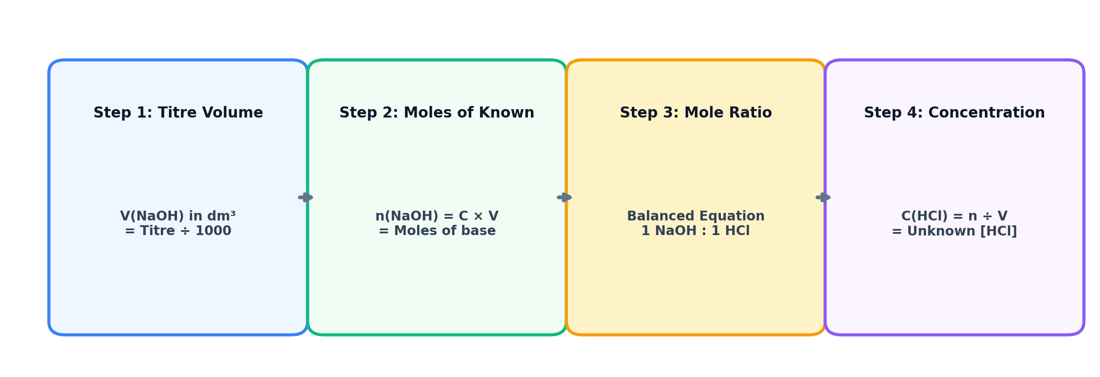
LESSON 4 (CONT) · STANDARD 10.ABC-DS.5
Mastering Titration Stoichiometry Calculations
Inquiry: Step-by-step mathematical algorithm to calculate unknown concentration
The 4-Step Analytical Algorithm
Problem: 25.0 cm³ of unknown HCl is neutralized by exactly 21.40 cm³ of 0.100 mol/dm³ standardized NaOH.
1. Balanced Equation: HCl(aq) + NaOH(aq) → NaCl(aq) + H₂O(l) [Mole Ratio 1 : 1]
2. Moles of Known (NaOH): n = C × V = 0.100 mol/dm³ × (21.40 ÷ 1000 dm³) = 0.002140 mol.
3. Mole Ratio: 1 : 1 ratio → n(HCl) = n(NaOH) = 0.002140 mol.
4. Concentration of Unknown: C = n ÷ V = 0.002140 mol ÷ (25.0 ÷ 1000 dm³) = 0.0856 mol/dm³.
Unit 1 · Chemical Models & Energy in Reactions · Grade 10 MYP 5 Sciences · OIS SCI 10.ABC-DS.1–6
Notes:
TEACHER FACILITATION NOTES (SLIDE 14):
• 4-Step Protocol: Have students copy this as an algorithm into their revision notes. Common error is forgetting to divide volume by 1000.

Slide 15
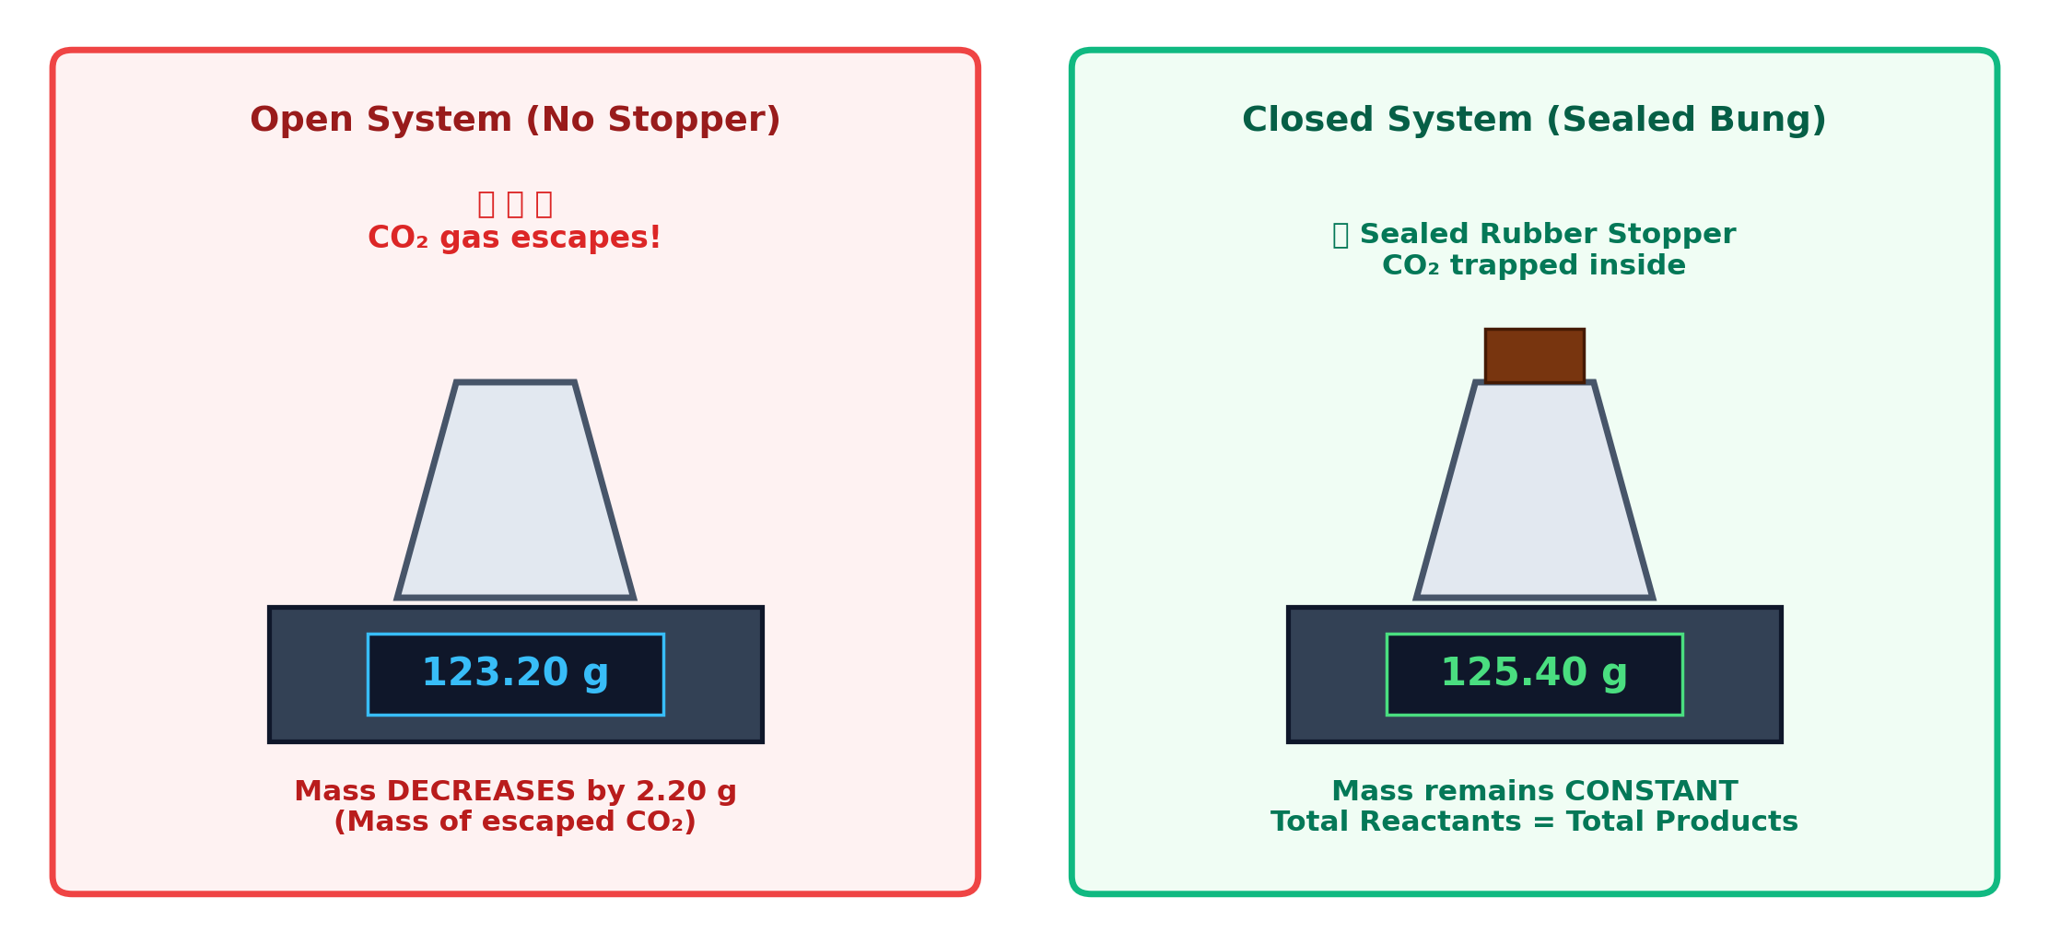
LESSON 5 · STANDARD 10.ABC-DS.6
Conservation of Mass & Gas Evolution Stoichiometry
Inquiry: Why does mass appear to decrease when an acid reacts with a carbonate in an open beaker?
Mathematical Molar Mass Verification
⚖️ The Law of Conservation of Mass:
Total mass of reactants = Total mass of products.
Reaction: CaCO₃(s) + 2HCl(aq) → CaCl₂(aq) + H₂O(l) + CO₂(g)↑
If 5.00 g of pure CaCO₃ reacts completely:
1. Molar Mass: M(CaCO₃) = 100.09 g/mol | M(CO₂) = 44.01 g/mol
2. Moles of CaCO₃: n = 5.00 ÷ 100.09 = 0.04996 mol
3. Mole Ratio 1 : 1 → Moles of CO₂ evolved = 0.04996 mol
4. Expected Mass of Escaped CO₂:
mass = n × M = 0.04996 mol × 44.01 g/mol = 2.20 g
🎯 Experimental Verification:
Open beaker reading drops by exactly 2.20 g as CO₂ escapes!
Unit 1 · Chemical Models & Energy in Reactions · Grade 10 MYP 5 Sciences · OIS SCI 10.ABC-DS.1–6
Notes:
TEACHER FACILITATION NOTES (SLIDE 15):
• Live Demo: Zero a balance with HCl and marble chips in an un-tipped test tube inside. Tip flask to mix, watch mass decrease live as CO2 escapes.

Slide 16
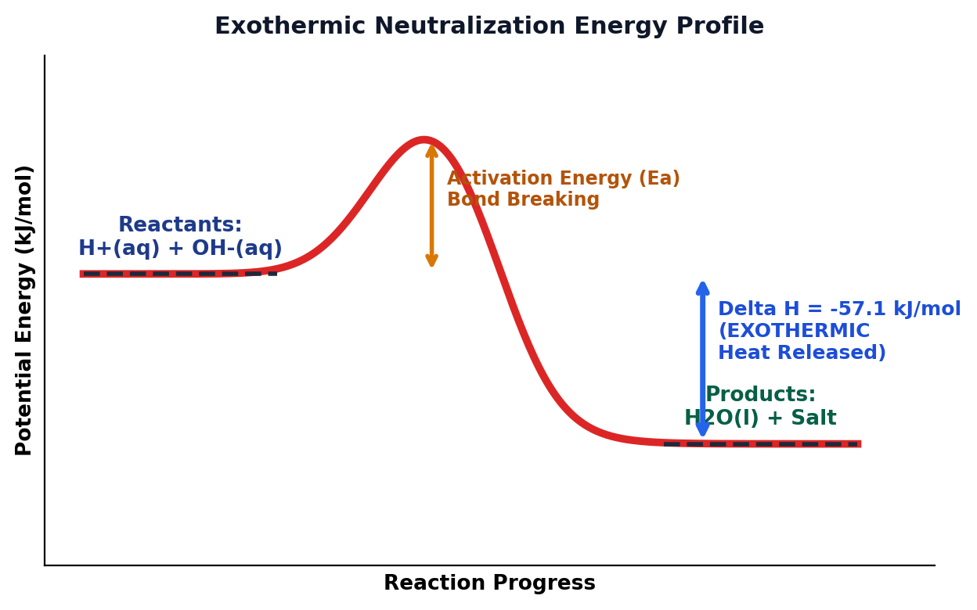
LESSON 6 · STANDARD 10.ABC-DS.2
Bond Energy Models & The Thermochemistry of Neutralization
Inquiry: Why does neutralization always release thermal energy?
Bond Energy Energetics & Constant ΔH
🔥 The Fundamental Energetic Rule:
1. Breaking chemical bonds REQUIRES energy (Endothermic, ΔH > 0).
2. Forming chemical bonds RELEASES energy (Exothermic, ΔH < 0).
Net Ionic Neutralization Reaction:
H+(aq) + OH-(aq) -> H2O(l) ΔH = -57.1 kJ/mol
Sub-Microscopic Mechanism:
• H+ and OH- ions collide to form strong covalent O-H bonds.
• More energy is released forming O-H bonds than was absorbed.
• Excess energy transfers as heat to surrounding water molecules (T rises!).
💡 Why Neutralization Enthalpy is Constant:
• When ANY strong acid neutralizes ANY strong alkali, ΔH ≈ -57.1 kJ/mol.
• Spectator ions (Na+, Cl-, K+, NO3-) do NOT participate in bonding!
• The ONLY real reaction occurring is: H+(aq) + OH-(aq) -> H2O(l).
🔥 INTERACTIVE SIMULATION PhET: Energy Forms & Bond Changes
Unit 1 · Chemical Models & Energy in Reactions · Grade 10 MYP 5 Sciences · OIS SCI 10.ABC-DS.1–6
Notes:
TEACHER FACILITATION NOTES (SLIDE 16):
• Diagram Analysis: Point out the activation energy hump Ea (bond breaking) and the downward arrow showing net exothermic energy release (Delta H = -57.1 kJ/mol).
• Students can launch the PhET simulation to visualize kinetic energy transfer.

Slide 17
CRITERION B SUMMATIVE
Summative Task Brief: Calorimetric Lab Investigation Design
Assessment: Criterion B (Inquiring & Designing) — Maximum Achievement Level 8
The Investigation Design Challenge
🎯 Research Scenario:
You are a chemical engineer tasked with determining the thermochemical efficiency of neutralization. You will independently design a complete scientific investigation to determine the relationship between reactant concentration and thermal energy release in a coffee-cup calorimeter.
📋 Criterion B Assessment Requirements (What You Must Produce):
1. Strand i (Problem / Question): Formulate a focused, testable research question with clear quantitative boundaries.
2. Strand ii (Hypothesis): Formulate a testable hypothesis and explain it with detailed scientific reasoning using bond energies and collision theory.
3. Strand iii (Variables): Clearly define the Independent Variable (with at least 5 values), Dependent Variable (with instrument resolution), and at least 3 Controlled Variables (with control methods and rationale).
4. Strand iv (Design & Safety): Design a clear, logical, step-by-step numbered method including:
• Labeled apparatus diagram (coffee-cup calorimeter, magnetic stirrer, digital thermometer).
• Comprehensive risk assessment (hazards of acids/bases, thermal burns, emergency protocols).
• Protocol ensuring sufficient data reliability (minimum 3 repeat trials per condition).
Unit 1 · Chemical Models & Energy in Reactions · Grade 10 MYP 5 Sciences · OIS SCI 10.ABC-DS.1–6
Notes:
TEACHER FACILITATION NOTES (SLIDE 17):
• Criterion B Task Brief: Supervised planning conditions. Differentiation: provide scaffolded planning matrices for Levels 1-4.

Slide 18
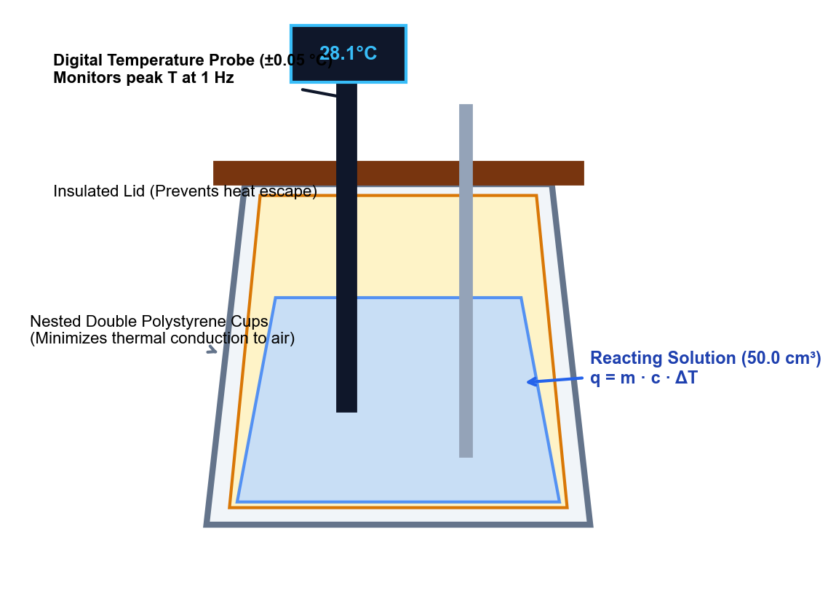
EXPERIMENT DEVELOPMENT
Criterion B Exemplar: Variables Matrix & Testable Hypothesis
Variables Matrix (MYP 5 Standard)
1. Independent Variable (IV): [HCl] Concentration
• 5 values: 0.20, 0.40, 0.60, 0.80, 1.00 mol/dm³ via serial dilution.
2. Dependent Variable (DV): Temperature Change (ΔT) & Heat (q)
• ΔT = T_max - T_initial (°C) logged using digital probe (±0.05 °C).
• Heat evolved: q = m · c · ΔT (where m = 50.0 g, c = 4.18 J/g·°C).
3. Controlled Variables (CV):
• Total solution volume: Fixed at 50.0 cm³ using bulb pipettes.
• Alkali: Fixed 1.00 M NaOH (excess).
• Calorimeter insulation: Nested double polystyrene cups with lid.
Exemplar Hypothesis: “If the concentration of HCl increases from 0.20 to 1.00 mol/dm³, then the temperature change (ΔT) will increase linearly, because more moles of H⁺ and OH⁻ ions react per unit volume to form water, releasing more thermal energy (q). However, the calculated molar enthalpy (ΔH) will remain constant at approx -57 kJ/mol because the net ionic bond-forming process (H⁺ + OH⁻ → H₂O) is fundamentally identical.”
Unit 1 · Chemical Models & Energy in Reactions · Grade 10 MYP 5 Sciences · OIS SCI 10.ABC-DS.1–6
Notes:
TEACHER FACILITATION NOTES (SLIDE 18):
• Highlight how the embedded calorimeter diagram matches the required labeled apparatus diagram for Criterion B Strand iv.

Slide 19
CRITERION C FOCUS
Criterion C Exemplar: Raw Data Table & Anomaly Screening
[HCl] / mol dm⁻³ (±0.02) | T_initial / °C (±0.05) | Trial 1: ΔT / °C | Trial 2: ΔT / °C | Trial 3: ΔT / °C | Mean ΔT / °C (±0.1)
0.20 | 21.50 | 1.30 | 1.35 | 1.25 | 1.30
0.40 | 21.50 | 2.65 | 2.70 | 2.60 | 2.65
0.60 | 21.55 | 3.95 | 4.00 | 3.90 | 3.95
0.80 | 21.50 | 5.25 | 1.80* | 5.35 | 5.30*
1.00 | 21.60 | 6.60 | 6.55 | 6.65 | 6.60
⚠️ Anomaly Screening & Justification (Criterion C Strand i):
At 0.80 mol/dm³ HCl, Trial 2 recorded ΔT = 1.80 °C, which severely diverges from Trial 1 (5.25 °C) and Trial 3 (5.35 °C). This outlier was caused by failure to seat the calorimeter lid immediately, allowing warm convection currents to escape before the sensor equilibrated. This value is flagged as anomalous and excluded from the mean: Mean ΔT = (5.25 + 5.35) ÷ 2 = 5.30 °C.
Unit 1 · Chemical Models & Energy in Reactions · Grade 10 MYP 5 Sciences · OIS SCI 10.ABC-DS.1–6
Notes:
TEACHER FACILITATION NOTES (SLIDE 19):
• Anomaly Management: Teach students that outliers must be explicitly flagged and justified, not quietly deleted.

Slide 20
EXPERIMENT EVALUATION
Evaluating Method Validity & Suggesting Improvements (Criterion C iv & v)
Routine: Red Light, Yellow Light, Green Light for Scientific Error Analysis
🔴 Red Light: Systematic Errors
🟡 Yellow Light: Limitations
🟢 Green Light: Specific Improvements
Major Flaws in Method Validity:
1. Heat Loss to Surroundings:
• The polystyrene cup is not a perfect insulator; heat escaped through the probe hole.
• Effect: Measured ΔT is systematically lower than true value -> calculated ΔH is less exothermic than -57.1 kJ/mol.
2. Heat Capacity of Solution:
• Assumed c = 4.18 J/g·°C and density = 1.00 g/cm³ like pure water. In reality, dissolved ions lower specific heat capacity.
Uncertainties & Experimental Noise:
1. Probe Thermal Lag:
• Digital probe had a 4-second response time; peak temperature cooled slightly while probe registered.
2. Room Temperature Fluctuations:
• Initial reactant temperatures varied by ± 0.3 °C between trials due to laboratory air conditioning cycles.
3. Incomplete Mixing:
• Manual swirling caused uneven temperature distribution inside the cup.
Realistic & Targeted Refinements:
1. Extrapolate Cooling Curve:
• Record temperature every 15s for 3 min before mixing, mix, then record cooling curve for 5 min. Extrapolate back to t = 0 to determine true instantaneous T_max.
2. Hardware Upgrade:
• Use a vacuum-jacketed silvered Dewar flask with a sealed magnetic stirrer.
3. Calibration:
• Pre-determine the calorimeter heat capacity (C_cal) using electrical heating.
Unit 1 · Chemical Models & Energy in Reactions · Grade 10 MYP 5 Sciences · OIS SCI 10.ABC-DS.1–6
Notes:
TEACHER FACILITATION NOTES (SLIDE 20):
• Criterion C Evaluation: Green light improvements must directly address Red light systematic errors.

Slide 21
CHECK FOR UNDERSTANDING
Hinge Question 2: Energetics of Dilution vs Volume
Show me: 1–4 fingers on 3-2-1
In an experiment, 25 cm³ of 1.0 mol/dm³ HCl is mixed with 25 cm³ of 1.0 mol/dm³ NaOH, producing a temperature rise of 6.5 °C. If the experiment is repeated using 50 cm³ of 1.0 mol/dm³ HCl and 50 cm³ of 1.0 mol/dm³ NaOH, what will the temperature rise be?
ΔT = 3.25 °C (half, because total solution volume is doubled).
ΔT = 6.5 °C (the same, because twice the heat heats twice the mass).
1
2
ΔT = 13.0 °C (double, because twice as many moles reacted).
ΔT = 0.0 °C (heat absorbed by extra water molecules).
3
4
✔ Correct Answer: 2 (ΔT = 6.5 °C).
Diagnostic Rationale: Twice as many moles react (2q heat), but twice the mass (100g vs 50g) is heated. Since ΔT = q ÷ (m·c), the factor of 2 cancels out: ΔT remains unchanged.
Unit 1 · Chemical Models & Energy in Reactions · Grade 10 MYP 5 Sciences · OIS SCI 10.ABC-DS.1–6
Notes:
TEACHER FACILITATION NOTES (SLIDE 21):
• Highly diagnostic question: proves whether students understand the formula Delta T = q / (m*c).

Slide 22
VISUAL THINKING ROUTINE
Generate – Sort – Connect – Elaborate: Master Concept Synthesis
Routine: Synthesize the 6 unit standards into an integrated conceptual network
1. Generate
2. Sort
3. Connect
4. Elaborate
📝 List Key Vocabulary:
• Valence electrons
• Activity series
• Single displacement
• Neutralization
• pH scale & [H+]
• Volumetric titration
• Concordant titre
• Conservation of mass
• Bond breaking (endo)
• Bond forming (exo)
• Enthalpy change (ΔH)
🗂️ Organize Hierarchically:
• Core Concept at Centre:
“Transformation of Energy & Matter in Acid Reactions”
• Sub-Branches:
Branch 1: Microscopic Models (Electrons & Periodic Trends)
Branch 2: Solution Reactions & Stoichiometry
Branch 3: Thermochemical Energy Changes
🔗 Draw Meaningful Links:
• Connect Valence Electrons -> Metal Activity in Acid Displacement.
• Connect [H+] Ion Concentration -> Logarithmic pH Scale.
• Connect Titration Equivalence Point -> Net Ionic Neutralization (H⁺ + OH⁻ -> H₂O).
• Connect Bond Making in Water -> Exothermic Enthalpy Release (ΔH < 0).
💡 Deepen with Examples:
• Add chemical equations to each link.
• Annotate where experimental uncertainties arise in lab measurements.
• Connect to the Global Context: How this knowledge allows engineers to neutralize acidic mine drainage using calcium carbonate slurry.
Unit 1 · Chemical Models & Energy in Reactions · Grade 10 MYP 5 Sciences · OIS SCI 10.ABC-DS.1–6
Notes:
TEACHER FACILITATION NOTES (SLIDE 22):
• End-of-unit Butcher Paper synthesis: 15 minutes paired mapping.

Slide 23
EXIT TICKET
Metacognitive Self-Assessment: Criteria B & C Mastery
Colour each standard: Green = Confident & Mastered · Amber = Nearly there · Red = Needs review
10.ABC-DS.1
I can explain displacement and acid-metal reactions using valence electrons, ionization energy, and the activity series.
10.ABC-DS.2
I can model neutralization as bond breaking and bond forming, calculating overall reaction enthalpy (ΔH = Σbroken - Σformed).
10.ABC-DS.3
I can write balanced equations and identify confirmatory gas tests for acid reactions with metals, bases, carbonates, and ammonium salts.
10.ABC-DS.4
I can compare [H+] concentrations using logarithmic pH scales and select appropriate indicators (phenolphthalein vs methyl orange).
10.ABC-DS.5
I can perform titration calculations using concordant titres (±0.10 cm³) and balanced mole ratios to find unknown concentrations.
10.ABC-DS.6 / Crit B & C
I can design a fair test (IV, DV, CVs), screen data for anomalies, calculate mean ΔT, and evaluate systematic calorimeter errors.
Unit 1 · Chemical Models & Energy in Reactions · Grade 10 MYP 5 Sciences · OIS SCI 10.ABC-DS.1–6
Notes:
TEACHER FACILITATION NOTES (SLIDE 23):
• Exit slip: Collect slips to see if small-group intervention is needed on DS.2 or DS.5.

Slide 24
KEY VOCABULARY
Academic Vocabulary & Command Terms Glossary
Valence Electrons
Electrons in the outermost shell that determine bonding, oxidation, and periodic reactivity trends.
Activity Series
An empirical ranking of metals in order of decreasing reactivity (ease of oxidation to cations).
Neutralization
The exothermic chemical reaction between an acid and a base to produce water and a dissolved salt.
Concordant Titres
Titration volumes delivered within ± 0.10 cm³ of each other, indicating high procedural precision.
Enthalpy Change (ΔH)
The net heat energy transferred during a chemical reaction at constant pressure (measured in kJ/mol).
Exothermic Reaction
A reaction where energy released during bond forming exceeds energy absorbed during bond breaking (ΔH < 0).
Limiting Reactant
The substance completely consumed first in a reaction, determining the theoretical yield of products.
Systematic Error
A reproducible inaccuracy inherent to experimental apparatus or design (e.g. calorimeter heat loss).
Unit 1 · Chemical Models & Energy in Reactions · Grade 10 MYP 5 Sciences · OIS SCI 10.ABC-DS.1–6
Notes:
TEACHER FACILITATION NOTES (SLIDE 24):
• Vocabulary Flashcard review before summative assessment.

