Slide 1

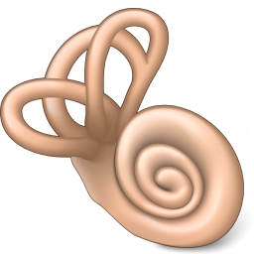
a
b
Generate 7mer insertion Cap2
otof
cre
pA
rep
pA
Clone into AAV RepCap plasmid in cis
Package and purify viral library
Administer into NHP inner ear
2-3 cycles
Collect DNA from the cochlea
Selectively recover sequences from Cre expressing cells
c
+ Cre
pA
- Cre
pA
Analyse output sequences using NGS

Slide 2
