Slide 1
Cross Lesson Materials: git and envs
Stem Pro Academy, 2022

Slide 2
Git Bash
Stem Pro Academy, 2022
First things first:
Pull today’s materials
git branch –a
Git pull –all
Git checkout –b lesson3 origin/

Slide 3

Stem Pro Academy, 2022
Git is an Open Source Distributed Version Control System
What is version? Change and time.
What is Open Source? Anyone(yes) can inspect, modify and enhance
What is Distributed? -- Spread over
To make use of this tool: Command Line

Slide 4

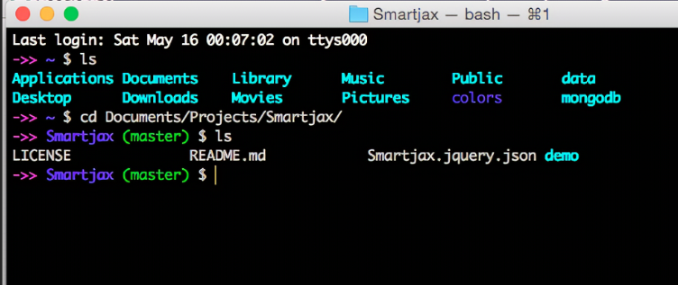


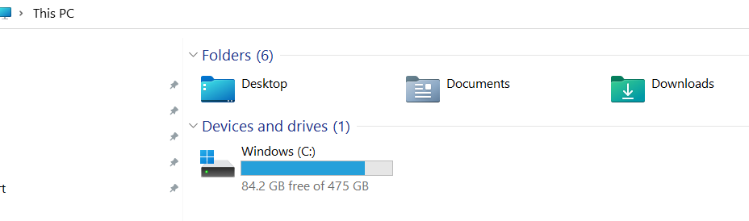
Git Bash
Stem Pro Academy, 2022
Remote Repositories
For Windows
MAC Terminal
Windows Command Prompt
Local Drive

Slide 5
Stem Pro Academy, 2022
Bash Commands Managing local files and directories
cd - # change to previous directory
cd ~ # go to user folder
cd .. # go to parent
pwd #current directory
mkdir # make directory
ls # list subdiretories
rm –r # remove the folder and all subs
cp onefile.txt anotherfolder
touch newfile.txt
Type exit to exit
For Mac：
To bash: bash
Clear screen: clear
To exit bash script: ctrl +X if at run time: ctrl+Z

Slide 6
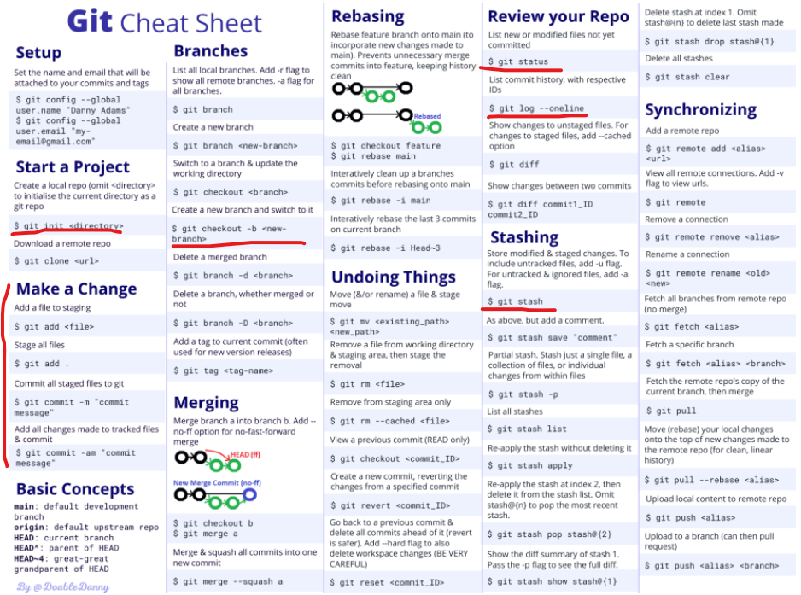
Stem
Pro
Academy,
2022

Slide 7
Stem Pro Academy, 2022
Little Quiz:
1. git == github?
2. Explain git to your classmate
3. Command to checkout a remote branch
Git checkout –b ds03 origin/Lessons

Slide 8
Stem Pro Academy, 2022

