Slide 1
Lesson 02
07/02/2022
Stem Pro Academy, 2022

Slide 2
What are we going to do today:
Stem Pro Academy, 2022

Slide 3
Decks Referenced:
CrossLesson_gitbash_basemip.pptx
CrossLesson_python.ipynb
CrossLesson_scraping_basemip.ipynb

Slide 4
Decks Referenced:
CrossLesson_gitbash_basemip.pptx
CrossLesson_python.ipynb
CrossLesson_scraping_basemip.ipynb

Slide 5
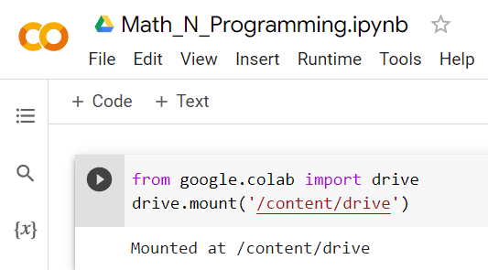
How do we do the lesson – Now and next two weeks
Stem Pro Academy, 2022
Github
basemip
Your google Drive
Drive:/colab notebooks/lessons
Open
Pull
Upload
Push
Your local drive
C:/basemip

Slide 6
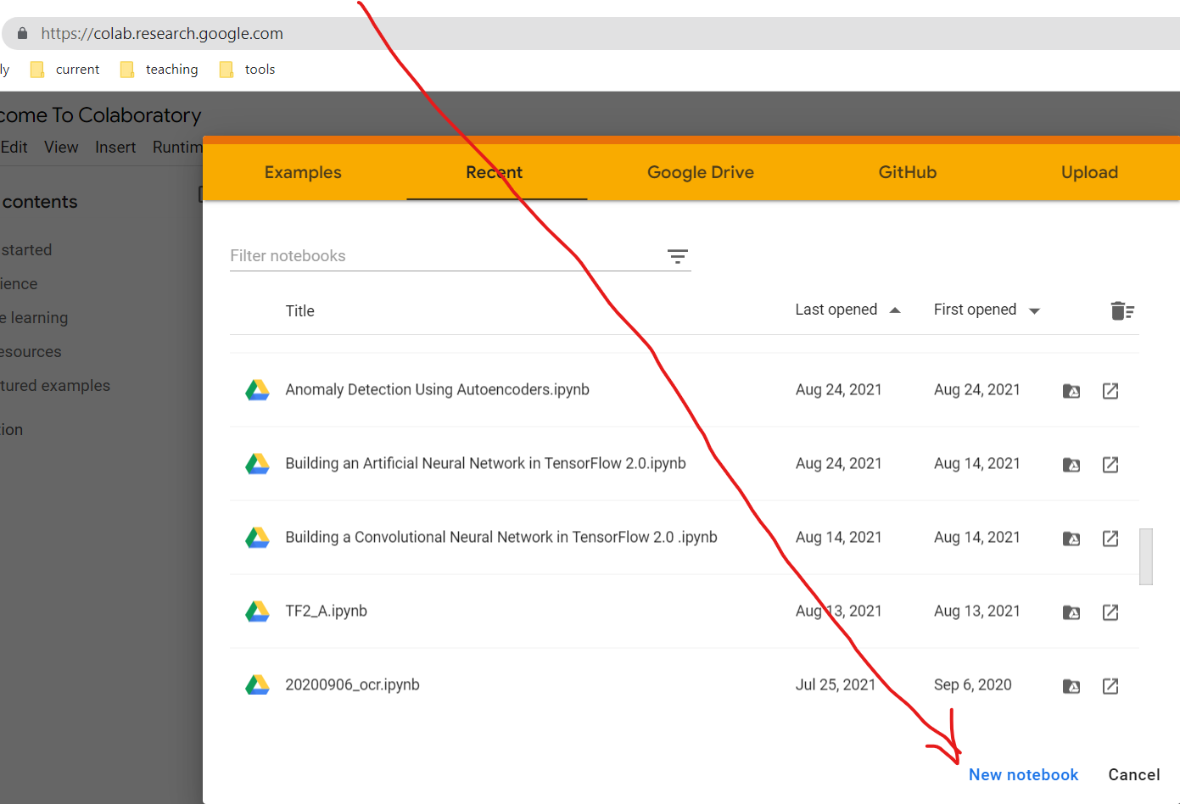
Go to https://colab.research.google.com
And Click
“New notebook”
What will this do?
If you are first time users of colab, it will create a folder in your google drive

Slide 7
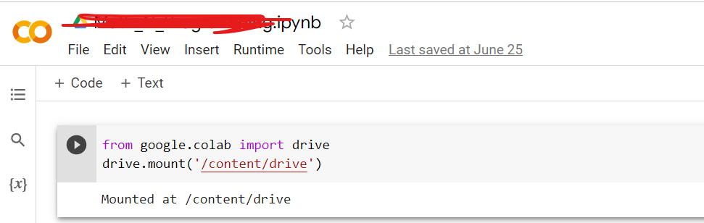
Stay at colab.research.google.com
After you click,
A new ipynb will open up.
On the very first “Cell”,
Type “
From google.colab import drive
drive.mount(‘/content/drive’)
Click the arrow on the left. It will ask for permission to connect your drive. Grant it. Now your google drive is mounted. Aka, Connected.

Slide 8
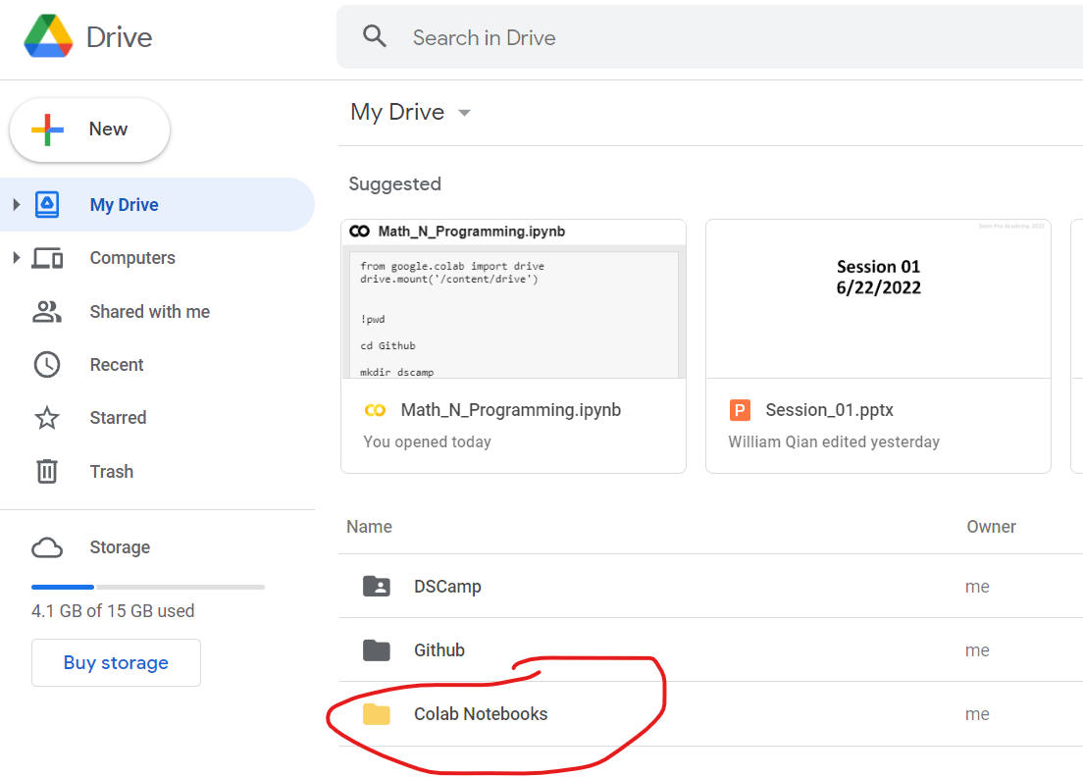
Go to https://drive.google.com/drive/u/0/my-drive
You should see
This:

Slide 9
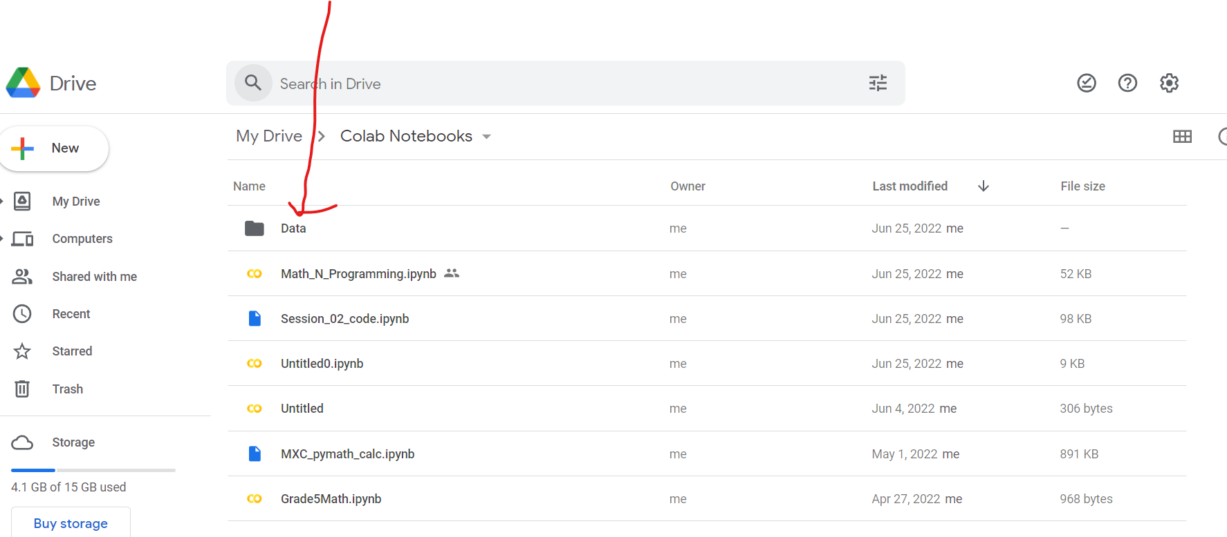
Stay with drive
Now, create a folder under your drive’s colab notebooks folder
Also upload the file you “pull” ed from our project rep.

Slide 11
Stay with drive
Click the file uploaded.
We are ready to go!

Slide 12



Objectives:
Stem Pro Academy, 2022
Programming and Math
AI and Math (key concepts)
Project and Implementation

Slide 13
Homework
Env Ready and Running. We have a short warm up. Let’s get ready by Saturday
  Tomorrow (6/23 tutoring at 5:30 PT)
2. Choose a university of your interests, read its Wiki Page (and its website if you have time)
  Write a short summary (<50 words)
3. Review Session_01_code.ipynb
  A: Summarize the python concepts that we learned today. E.g., “We learned list data type…”
  Bonus points to summarization with a daily life example.
  B. Choose a part to replicate (Part A, B, or C). E.g., you may choose to scrape a new page etc.
  Remember: same difficulty or more challenging one
All homework due in one week.
All homework in Jupyter notebook. For text content, use Markdown cells.

Slide 14
Survey and Feedback
Content:
Too easy
too hard
it is ok
Pace:
Too fast
too slow
it is ok
Homework:
Too much
I can handle more
it is ok
Other feedback:

