Slide 1
Welcome!
Thank You for Choosing Us for Your STEM Passion!
Roy Ma stemproaca@gmail.com admin@stempro.org
425-409-1805
Stem Pro Academy, 2022
https://us02web.zoom.us/j/6025429559?pwd=OUpkVjdXMjlxUDFsRktPdTFXNk96QT09' Meeting ID: 602 542 9559 Passcode: 686868

Slide 2
Stem Pro Academy, 2022
Data Science Foundation:
Math, Programming and AI

Slide 3
Stem Pro Academy, 2022
About Me:
From China, Studied in University of Toronto in Canada, ran a startup in Toronto, moved to the States over ten years ago. Now working as a data scientist.
As for myself, hiking is my favorite sport(?). If I couldn’t be reached, I am somewhere in the mountain.
TAs:
John, Anita, Elisa and Angus. John is a graduate of MIT, he was the IMO medalist. Elisa and Anita are raising seniors at CMU, and Angus is a high school raising senior.

Slide 4
Note:
Instead of getting env ready from the beginning, we will learn about development (i.e., Anaconda, git and repository) along the way. And most of them will be done during office hours.
Stem Pro Academy, 2022

Slide 5
What we are going to cover in the next 10 Sessions.
Stem Pro Academy, 2022

Slide 6
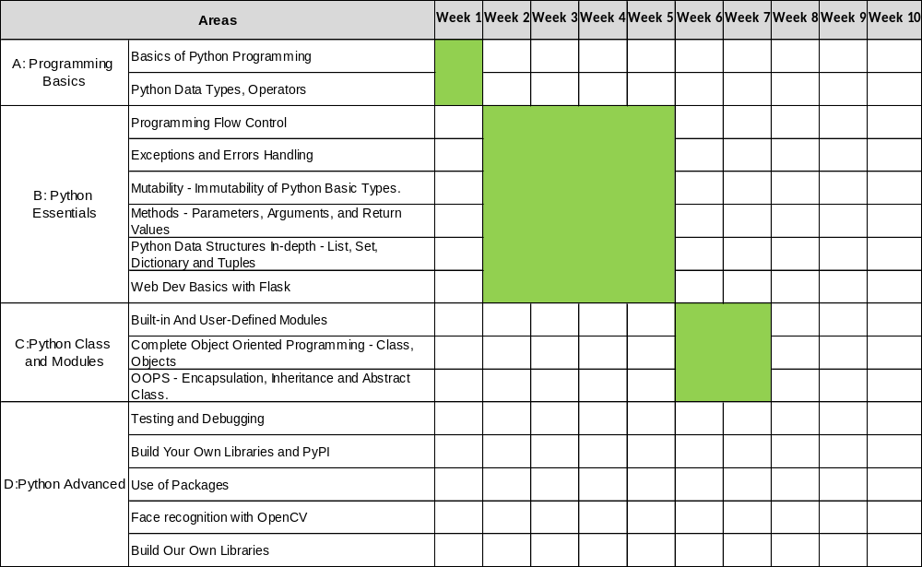
Dim1 – Programming and Math
Stem Pro Academy, 2022

Slide 7
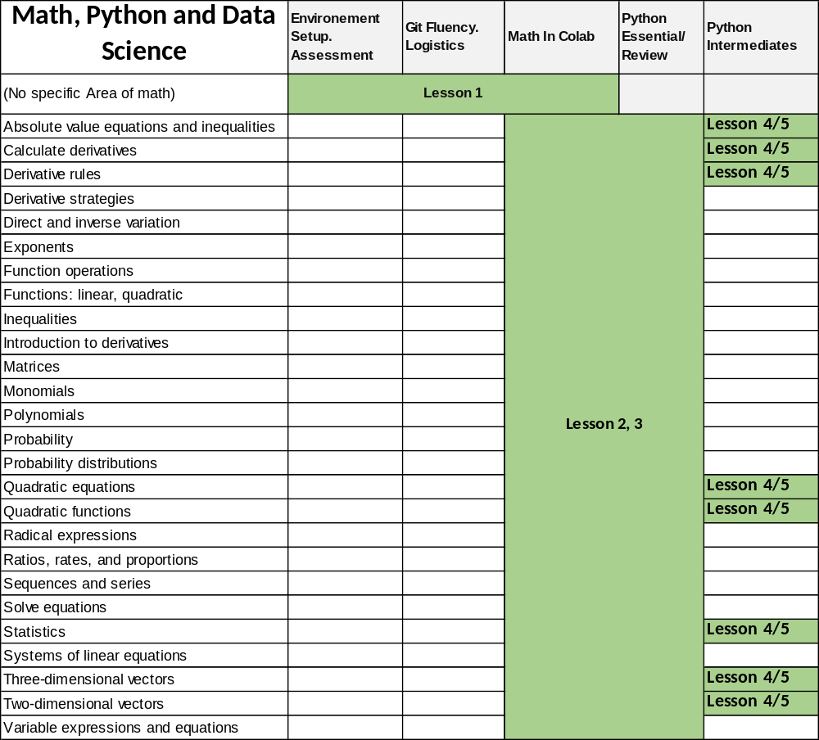
Dim2 – Math
First 5 Weeks will be math in Python intensive!

Slide 8
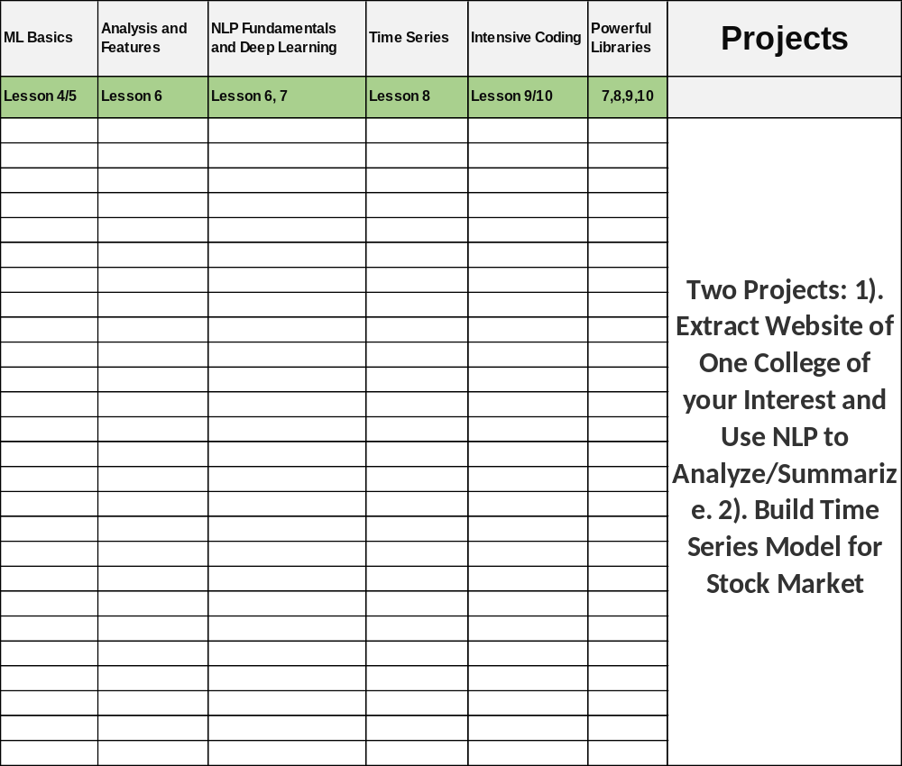
Dim2 – AI And Project
From 6th, focuses will be on and the two projects.

Slide 9
Research My Dream School!
01
About the Project
Scrape content from my dream college website, wiki pages of the school and use NLP to help me do research on this school
03
Project Stages
Scraping Content
Learn NLP
Produce Insights
02
Project Goals
Acquire Programming Skills
Deep Dive into the college I am interested in
04
Who Are the Users
My Self and My Friends
05
Timeline
Next 10 Lessons!
06
The Team
The Campers!
Stem Pro Academy, 2022

Slide 10
Stock Market Fun!
01
About the Project
Use stock market data to generate a linear model for stock price prediction
03
Project Stages
Acquire historical stock market data
Build linear models
02
Project Goals
Acquire Programming Skills
Deep Dive into Linear regression and math behind it
04
Who Are the Users
My Self and My Friends
05
Timeline
Next 10 Lessons!
06
The Team
The Campers!
Stem Pro Academy, 2022

Slide 11
Project Conventions and Principles
Stem Pro Academy, 2022
1 Learning Style: R3 -Receive, Review and Return
Receive: Learn and practice during lecture time
Review: Review and summarize what you have learnt, and
Return: Give challenge back with similar or more challenging questions
2 Homework
~ Two hours of additional hours of study/work per week.
Unless otherwise specified, homework due 11:59pm day prior to lecture day
Most homework is the “Return”, i.e.,, give back a challenge question of similar or more difficulty. Make sure you know the answer.
3 Logistics
~ Two hours of additional hours of study/work per week.
~ QA and Tutoring Time. 5:30 to 6:30 every Tuesdays and Thursdays
4 Grading
~ 5 point scale. Grade is based on the number of Returned Challenging Questions

Slide 12
Any Questions?
Stem Pro Academy, 2022

