Slide 1
Lesson 01
6/29/2022
Stem Pro Academy, 2022

Slide 2
What are we going to do today:
Stem Pro Academy, 2022

Slide 3
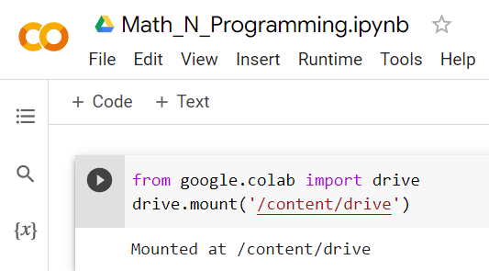
How do we do the lesson – Now and next two weeks
Stem Pro Academy, 2022
Github
basemip
Your google Drive
Drive:/colab notebooks/lessons
Open
Pull
Upload
Push
Your local drive
C:/basemip

Slide 4
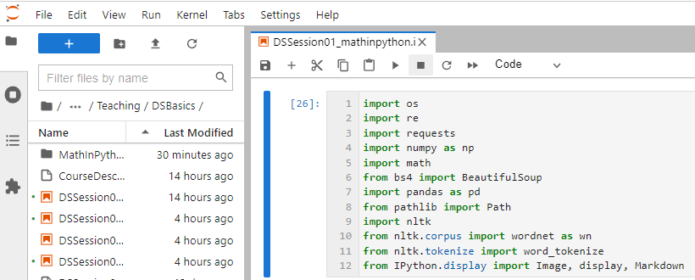
How do we do the lesson – After our Anaconda works
Stem Pro Academy, 2022
Github
basemip
Pull
Push
Work on your local computer
Your local drive
C:/basemip

Slide 5
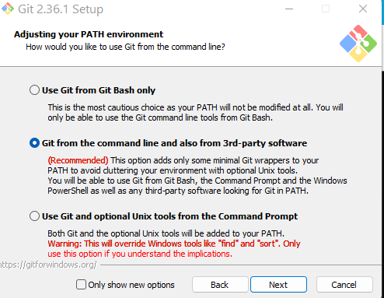

Environment: Git
1). Download
https://git-scm.com/download/win
Choose 64 bit
3). Take all the pre-chosen options, e.g.:
2). After downloading, you may see this in
Download folder. Double click to install
4). installed

Slide 6
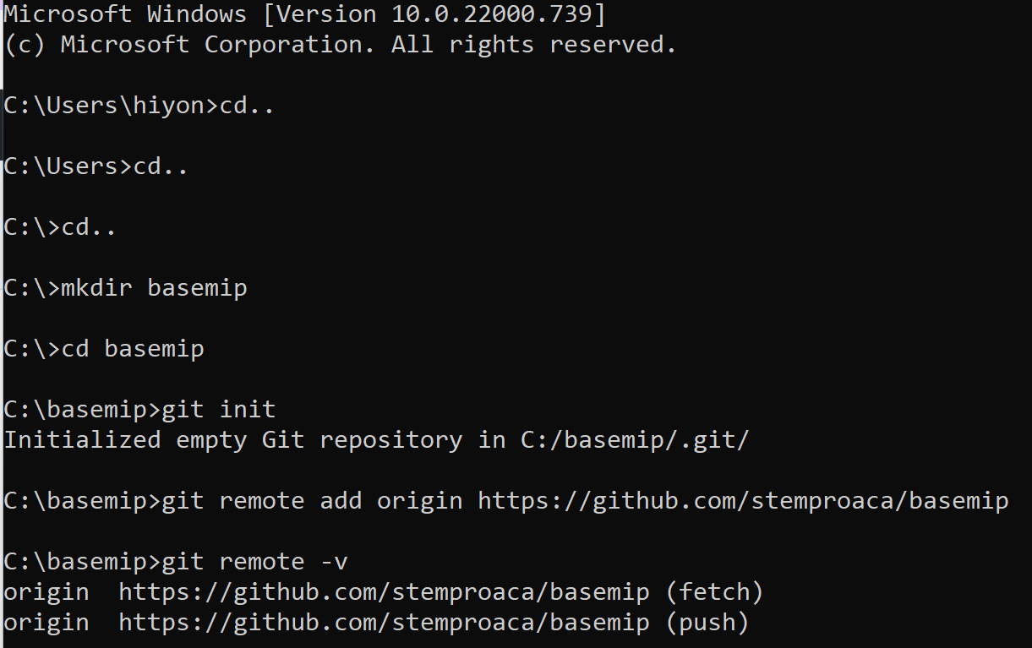
Environment: Connect to repo
Follow exactly the sequence below.
If you have D: drive, ideally install at D:
But C is ok

Slide 7
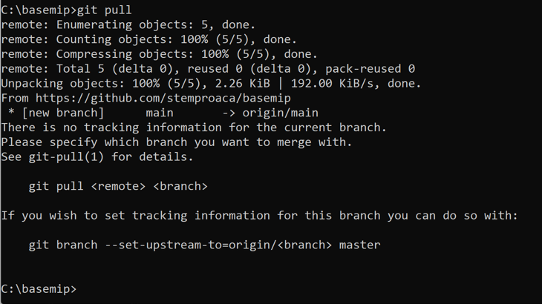
Environment: Connect to repo
Now you are connected with or repo.
Time to pull!
What is pull? Pull

Slide 8
Environment: Connect to repo
Lets stop here. Next lesson we will learn “checkout” , “do something” and push?

Slide 9
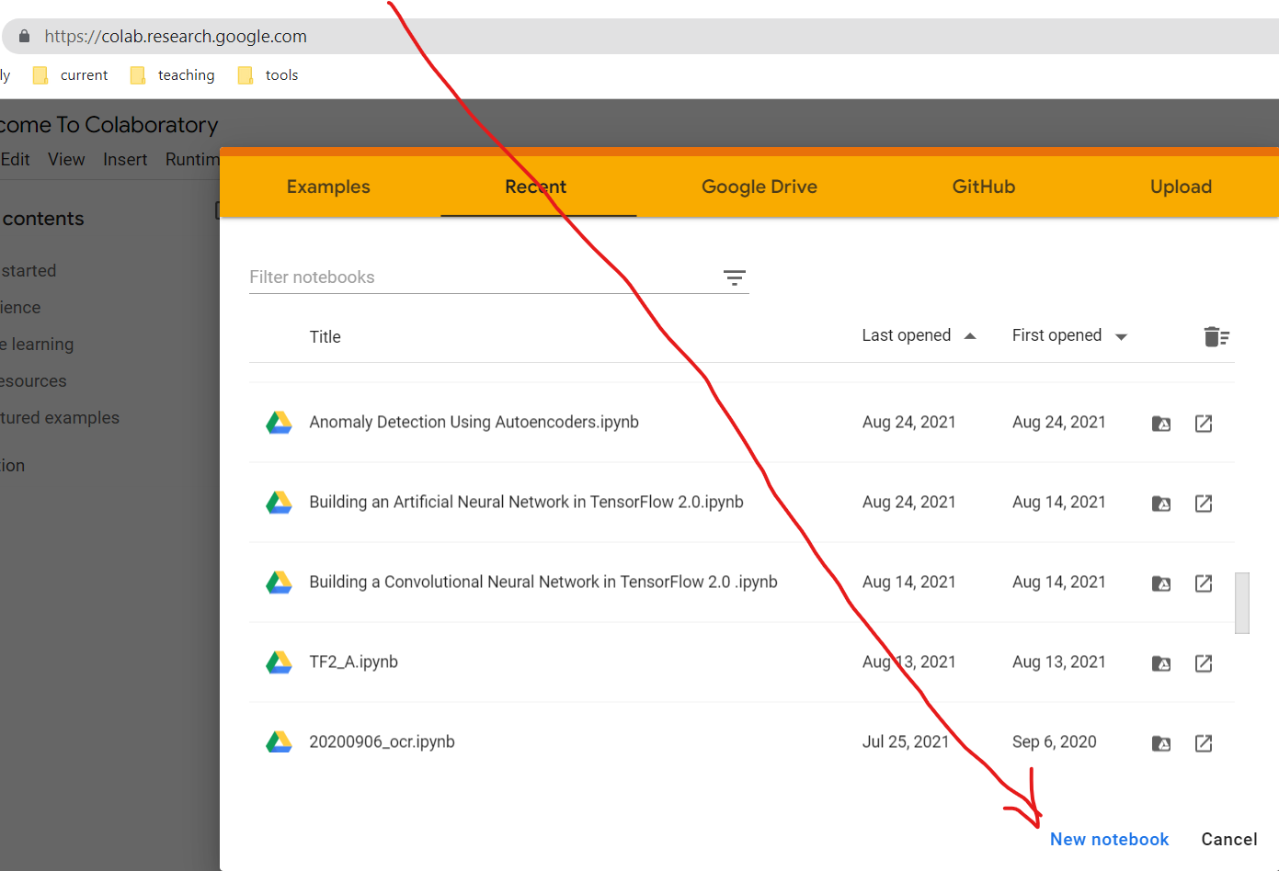
Go to https://colab.research.google.com
And Click
“New notebook”
What will this do?
If you are first time users of colab, it will create a folder in your google drive

Slide 10
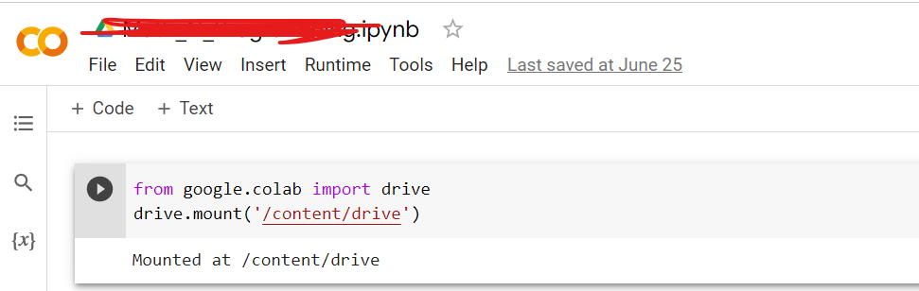
Stay at colab.research.google.com
After you click,
A new ipynb will open up.
On the very first “Cell”,
Type “
From google.colab import drive
drive.mount(‘/content/drive’)
Click the arrow on the left. It will ask for permission to connect your drive. Grant it. Now your google drive is mounted. Aka, Connected.

Slide 11
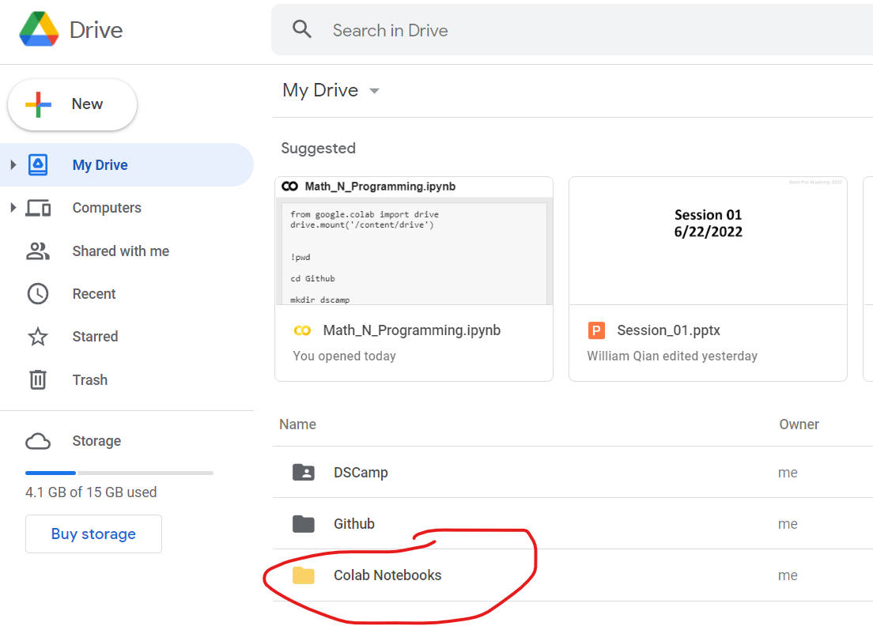
Go to https://drive.google.com/drive/u/0/my-drive
You should see
This:

Slide 12
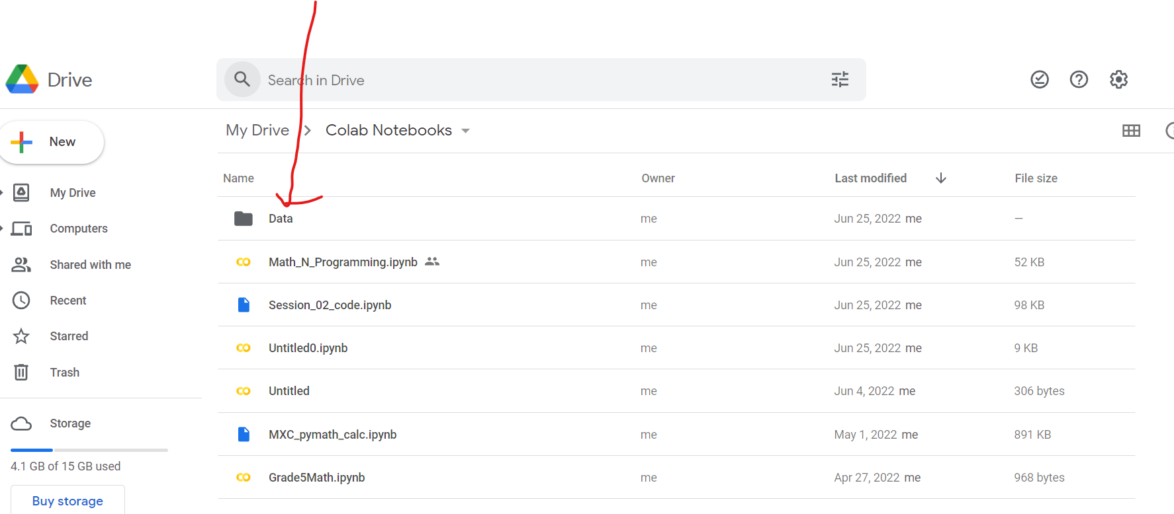
Stay with drive
Now, create a folder under your drive’s colab notebooks folder
Also upload the file you “pull” ed from our project rep.

Slide 13
Stay with drive
Click the file uploaded.
We are ready to go!

Slide 14



Objectives:
Stem Pro Academy, 2022
Programming and Math
AI and Math (key concepts)
Project and Implementation

Slide 15
Homework
Env Ready and Running. We have a short warm up. Let’s get ready by Saturday
  Tomorrow (6/23 tutoring at 5:30 PT)
2. Choose a university of your interests, read its Wiki Page (and its website if you have time)
  Write a short summary (<50 words)
3. Review Session_01_code.ipynb
  A: Summarize the python concepts that we learned today. E.g., “We learned list data type…”
  Bonus points to summarization with a daily life example.
  B. Choose a part to replicate (Part A, B, or C). E.g., you may choose to scrape a new page etc.
  Remember: same difficulty or more challenging one
All homework due in one week.
All homework in Jupyter notebook. For text content, use Markdown cells.

Slide 16
Survey and Feedback
Content:
Too easy
too hard
it is ok
Pace:
Too fast
too slow
it is ok
Homework:
Too much
I can handle more
it is ok
Other feedback:

