Slide 1
Cross Lesson Materials: git and envs
Stem Pro Academy, 2022

Slide 2
Git Bash
Stem Pro Academy, 2022
Git Bash is an application for Microsoft Windows environments which provides an emulation layer for a Git command line experience. Bash is an acronym for Bourne Again Shell. A shell is a terminal application used to interface with an operating system through written commands. Bash is a popular default shell on Linux and macOS.

Slide 3
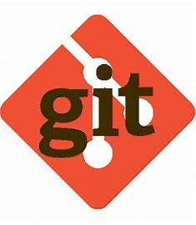
Stem Pro Academy, 2022
Git is an Open Source Distributed Version Control System
What is version? Change and time.
What is Open Source? Anyone(yes) can inspect, modify and enhance
What is Distributed? -- Spread over
To make use of this tool: Command Line

Slide 4

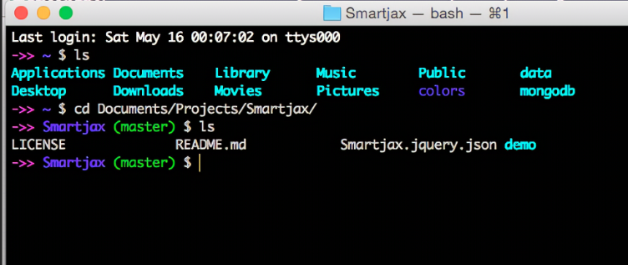


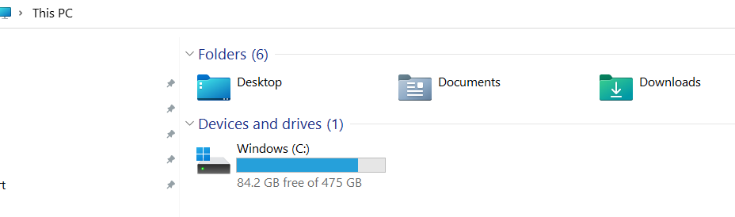
Git Bash
Stem Pro Academy, 2022
Remote Repositories
For Windows
MAC Terminal
Windows Command Prompt
Local Drive

Slide 5
Stem Pro Academy, 2022
Bash Commands Managing local files and directories
cd - # change to previous directory
cd ~ # go to user folder
cd .. # go to parent
pwd #current directory
mkdir # make directory
ls # list subdiretories
rm –r # remove the folder and all subs
cp onefile.txt anotherfolder
touch newfile.txt
Type exit to exit
For Mac：
To bash: bash
Clear screen: clear
To exit bash script: ctrl +X if at run time: ctrl+Z

Slide 6
Stem Pro Academy, 2022

Slide 7
Create a folder to be “tracked” ctrl + cmd + Q: for lock mac screen
Stem Pro Academy, 2022

Slide 8
Create a folder to be “tracked” ctrl + cmd + Q: for lock mac screen
Stem Pro Academy, 2022

