Slide 1
Session 07
07/13/2022
Stem Pro Academy, 2022

Slide 2
Stem Pro Academy, 2022
git checkout –b lesson07NAME origin/lessons_only

Slide 3
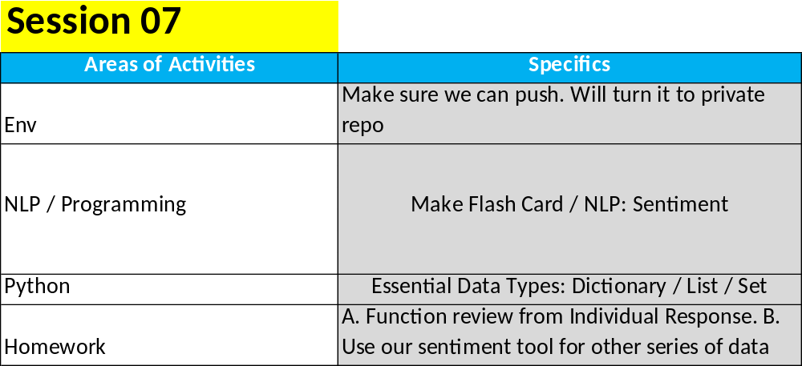
Objectives:
Stem Pro Academy, 2022

Slide 4
Stem Pro Academy, 2022
This lesson:
Checkout Lessons_only.
2. Programming/NLP: SAT words’ Flash Card. Sentiments at NLP
3. Python: Function sum up (1)
if your git is ready:
push to remote repo
if not:
email: stemproaca@gmail.com

Slide 5
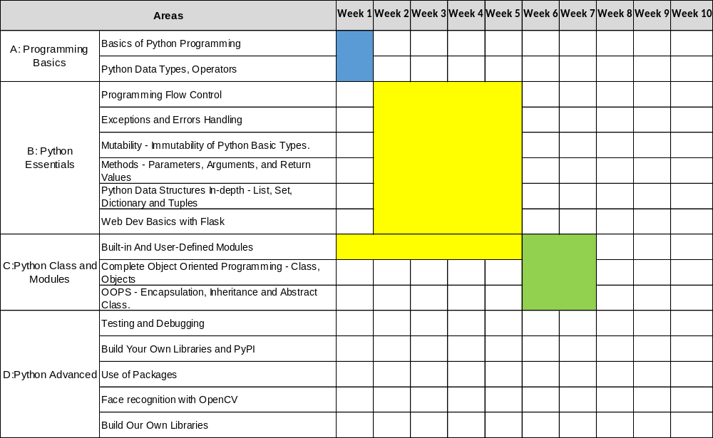
Stem Pro Academy, 2022
Programming and Math:

Slide 6
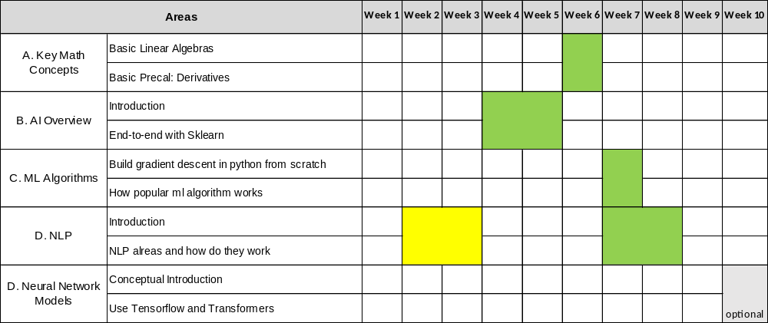
Stem Pro Academy, 2022
AI Line: Inactive today

Slide 7
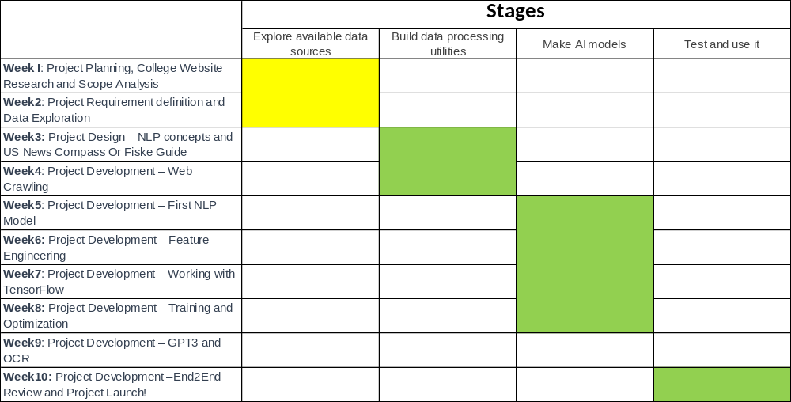
Stem Pro Academy, 2022
Project Line

Slide 8
Stem Pro Academy, 2022
Materials for today:
CrossLesson_nlp_scraping.ipynb
CrossLesson_Python_datatypes.ipynb

