Slide 1
Session 02 6/25/2022
Stem Pro Academy, 2022

Slide 2
Objectives:
Stem Pro Academy, 2022

Slide 3
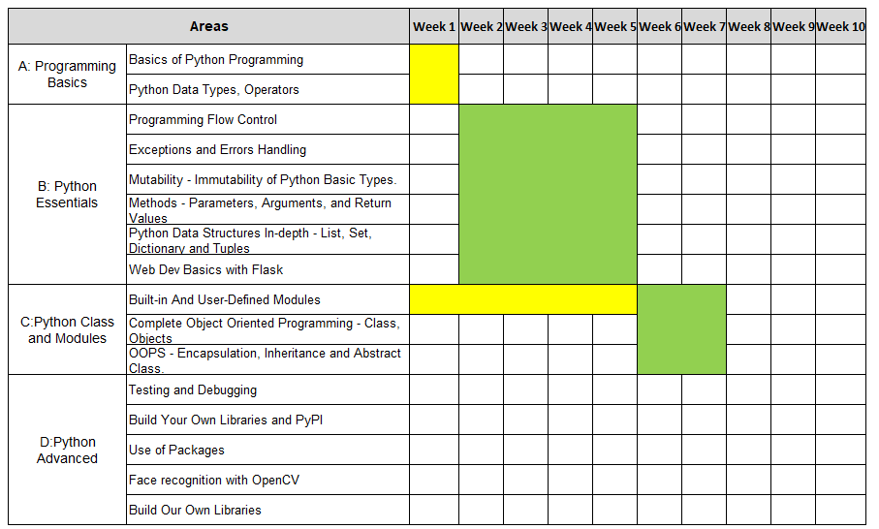
Stem Pro Academy, 2022
Programming and Math:

Slide 4
Stem Pro Academy, 2022
AI Line: Inactive today

Slide 5
Stem Pro Academy, 2022
Project Line

Slide 6
Stem Pro Academy, 2022
Go to Jupyter

Slide 7
Stem Pro Academy, 2022
Review and homework
Review python
homework: implement something similar/”more difficult”
2. Web scraping:
review 6000 codes.
homework: scrape another url, if ready
Homework due: July 5 (since 4th is holiday)
How to submit homework:
if your git is ready:
push to remote repo
if not:
email: stemproaca@gmail.com

