Slide 1
Session 01 6/22/2022
Stem Pro Academy, 2022

Slide 2
Activities:
Stem Pro Academy, 2022

Slide 3
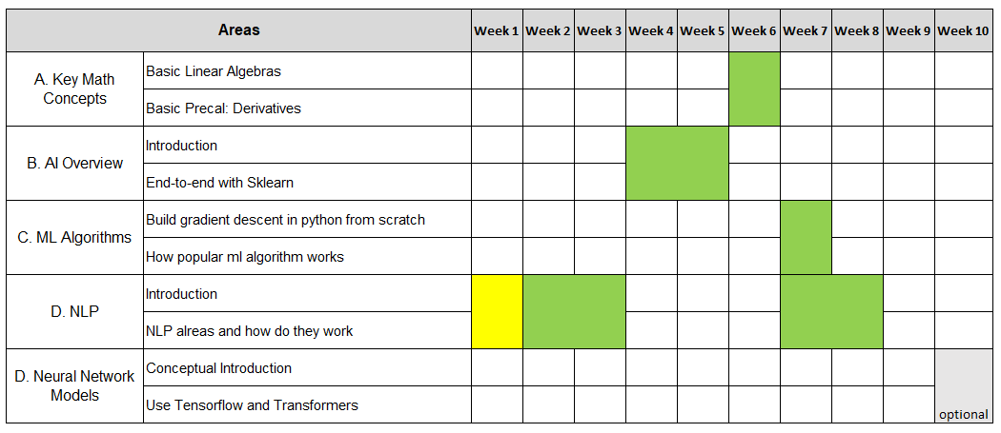
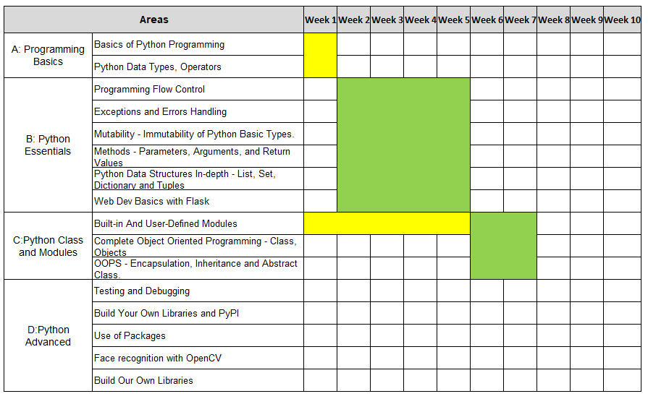
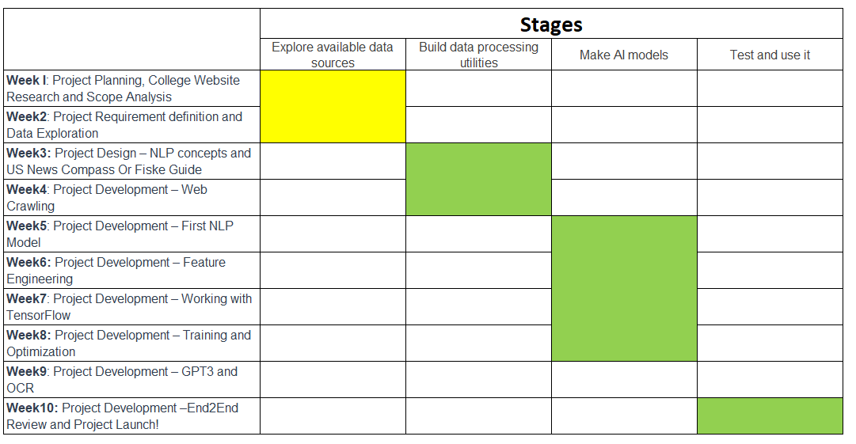
Objectives:
Stem Pro Academy, 2022
Programming and Math
AI and Math (key concepts)
Project and Implementation

Slide 4
How To Install Anaconda? Link Search internet for steps. Can someone show how to do it?
Install Anaconda

Slide 5
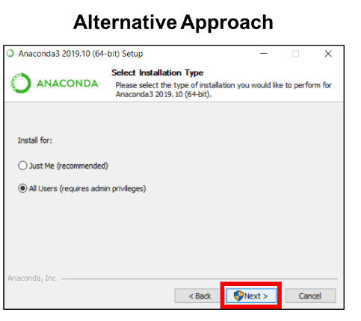
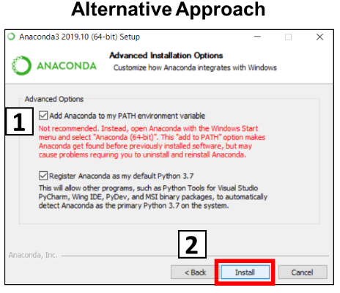
Notes: For Windows: Let choose the “All Users” when it prompts for “Install for”, and “Add Anaconda ..” when asks for “Advanced Options”.

Slide 6
Notes: For Mac OS: Link Download anaconda Go to Finder to continue installation To locate: usr/local/bin 1. go to Finder 2. Cmd + Shifit + G 3. type usr/local/bin launch pad: Ask Launch Pad from Siri upgrade anaconda will enable code

Slide 7

VS Code in becoming increasingly popular and powerful
Install VS Code
You may launch Anaconda to install vscode.

Slide 8
Notes: For Windows and MacOS: Link 1). When it asks for connection, choose openSSH, which provides secure encryption for both remote login and file transfer.
git

Slide 9
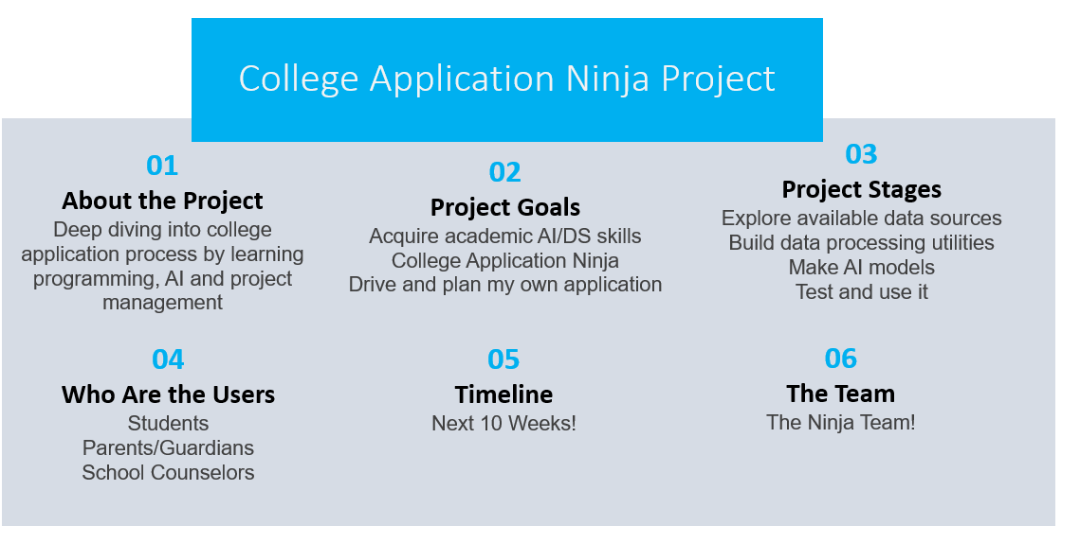
Project Line

Slide 10
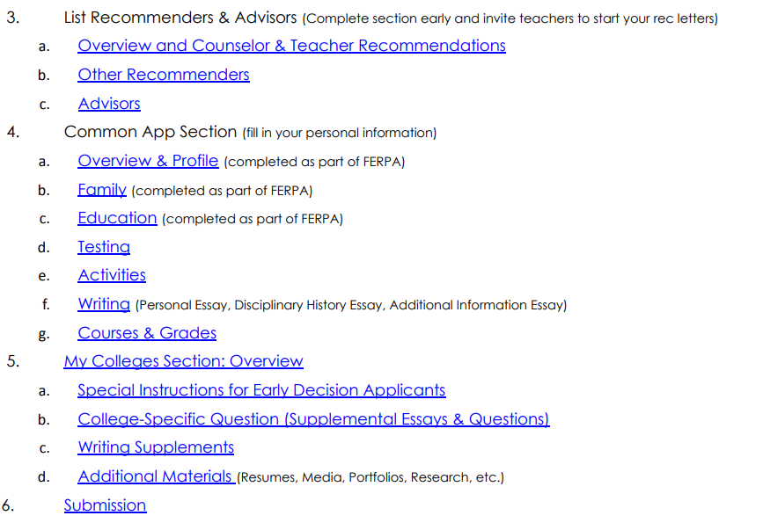
How Does Common App / Coalition App Looks Like
HowCoalitionApplookslike.pdf
HowCommapplookslike.pdf

Slide 11
College Characters
How would you describe the academic climate of your school?
learner-centered, knowledge- centered, assessment-centered, and community-centered
2. How would you rate the quality of instruction you have received? Structure, Explication, Stimulation, Validation, Instruction, Comprehension, Activation
3. Please suggest any special academic programs or learning opportunities that prospective students ought to know about. We’re thinking of anything from living/learning communities and study abroad to interesting undergraduate research opportunities. Have any of these been important to you?
Research, study abroad
4. How would you rate the quality of student support services, such as career advising and counseling services, that your school offers? Are any of these services particularly strong? Or weak?
Student Support
5. Describe the general character of students at your school. What do they have in common?
Typical Students
6. How diverse is the student body—racially, socioeconomically, geographically, and otherwise? Who might have a tough time fitting in? – Diversity racial, socioeconomically, geographically
Diversity, Racial, geography
7. How would you describe the political climate at your school? Are there any hot-button social or political issues?
Political Issues
8. Has your school taken any new steps to deal with the national issue of sexual assault? Are they effective? How would you rate campus safety in general?
Safety
9. Tell us about housing. How are the accommodations? Is there any trouble getting a room?
Housing
10. What about the dining facilities? How good are the meals? Are the provisions for special tastes and needs satisfactory?
Meals, food
11. Please describe the party culture on your campus. Do Greek organizations set the tone for social life? Are campus policies regarding alcohol effective?
Party Culture. Alcohol policies
12. Other than parties, what is the social life on campus like? Does the surrounding area offer a good social scene?
Campus Life
13. What are the annual festivals, athletic rivalries, or other traditions that make your school unique and interesting?
School Festivals, athletic, traditions
14. Like students themselves, every college and university has its own unique institutional personality that differentiates it from other schools. How would you characterize the special culture of your school?
Shared Goals & Vision, Collegiality, Lifelong Learning, Risk Taking Celebration and Humor
15. What is the biggest way that you’ve seen your school evolve since your first semester there?
Changing Direction/Trending
16. What are students’ biggest complaints about your school? Is there anything you would like to improve?
School Complains, weakness

Slide 12
College Essentials

Slide 13
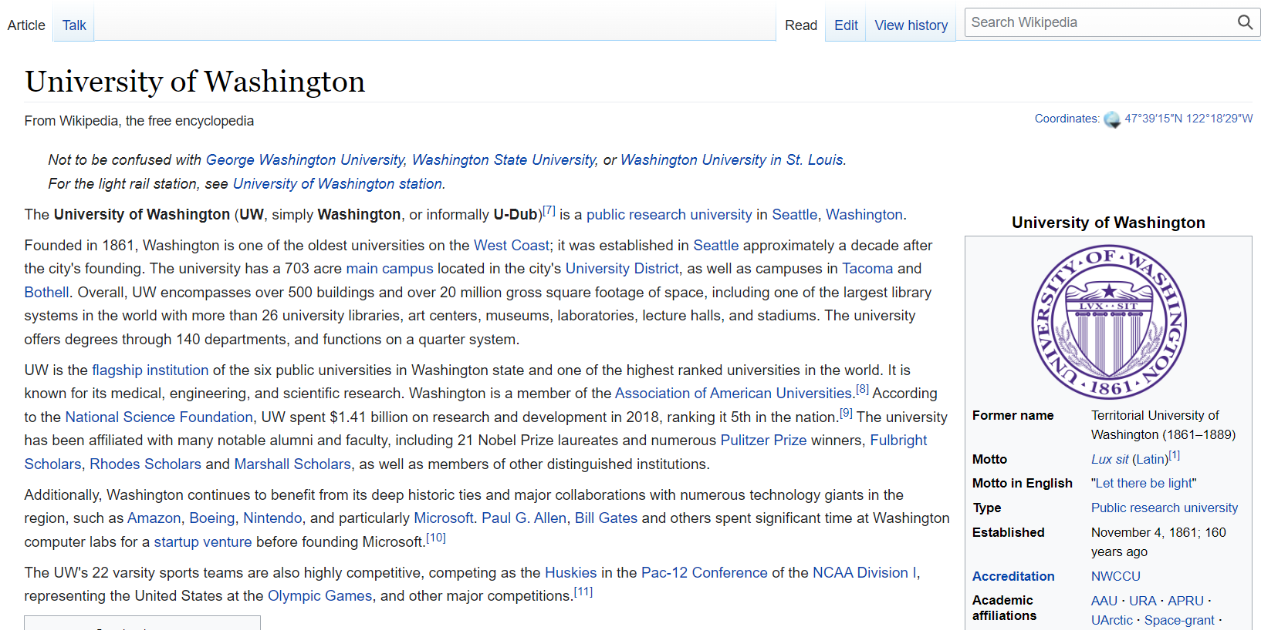
Wikis

Slide 14
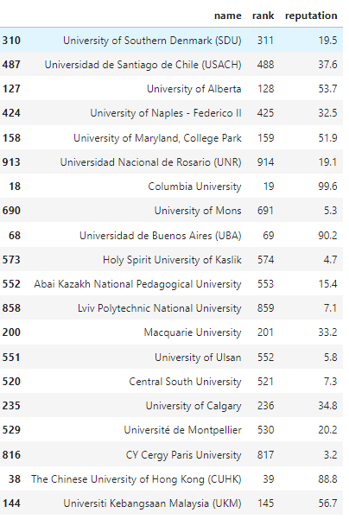
Ranking

Slide 15
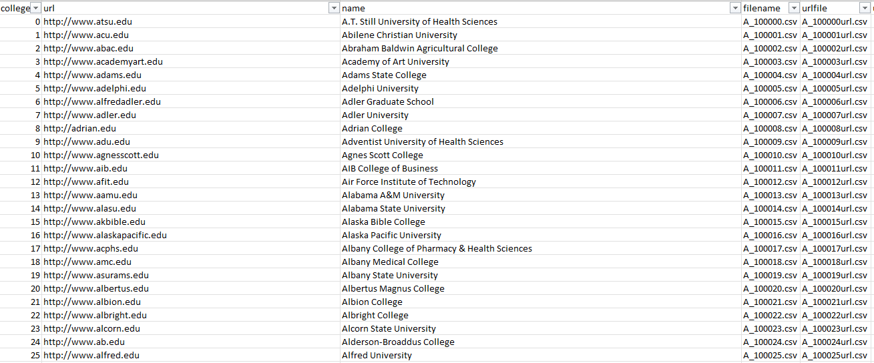
Web scraping for each universities. For this Camp, we will scrape a few for example

Slide 16
NLP Fundamentals
Syntax
Parsing
Determine the parse tree (grammatical analysis) of a given sentence. The grammar for natural languages is ambiguous and typical sentences have multiple possible analysesThere are two primary types of parsing, Dependency Parsing and Constituency Parsing. Dependency Parsing focuses on the relationships between words in a sentence (marking things like Primary Objects and predicates), whereas Constituency Parsing focuses on building out the Parse Tree using a Probabilistic Context-Free Grammar (PCFG). See also: Stochastic grammar.
Sentence breaking (also known as sentence boundary disambiguation)
Given a chunk of text, find the sentence boundaries. Sentence boundaries are often marked by periods or other punctuation marks, but these same characters can serve other purposes (e.g. marking abbreviations).
Stemming
The process of reducing inflected (or sometimes derived) words to their root form. (e.g. "close" will be the root for "closed", "closing", "close", "closer" etc.).
Word segmentation
Separate a chunk of continuous text into separate words
Terminology extraction
The goal of terminology extraction is to automatically extract relevant terms from a given corpus.

Slide 17
Semantics
Lexical semantics
What is the computational meaning of individual words in context?
Distributional semantics
How can we learn semantic representations from data?
Machine translation
Automatically translate text from one human language to another. This is one of the most difficult problems, and is a member of a class of problems colloquially termed "AI-complete", i.e. requiring all of the different types of knowledge that humans possess (grammar, semantics, facts about the real world, etc.) in order to solve properly.

Slide 18
Semantics
Named entity recognition (NER)
Given a stream of text, determine which items in the text map to proper names, such as people or places, and what the type of each such name is (e.g. person, location, organization). Although capitalization can aid in recognizing named entities in languages such as English, this information cannot aid in determining the type of named entity, and in any case is often inaccurate or insufficient. For example, the first letter of a sentence is also capitalized, and named entities often span several words, only some of which are capitalized.
Natural language generation
Convert information from computer databases or semantic intents into readable human language.
Natural language understanding

Slide 19
Semantics
Optical character recognition (OCR)
Given an image representing printed text, determine the corresponding text.
Question answering
Given a human-language question, determine its answer. Typical questions have a specific right answer (such as "What is the capital of Canada?"), but sometimes open-ended questions are also considered (such as "What is the meaning of life?"). Recent works have looked at even more complex questions.^{[16]}
Recognizing Textual entailment
Given two text fragments, determine if one being true entails the other, entails the other's negation, or allows the other to be either true or false.
Relationship extraction
Given a chunk of text, identify the relationships among named entities (e.g. who is married to whom).
Sentiment analysis (see also multimodal sentiment analysis)
Extract subjective information usually from a set of documents, often using online reviews to determine "polarity" about specific objects. It is especially useful for identifying trends of public opinion in the social media, for the purpose of marketing.
Topic segmentation and recognition
Given a chunk of text, separate it into segments each of which is devoted to a topic, and identify the topic of the segment.
Word sense disambiguation
Many words have more than one meaning

Slide 20
Discourse
Automatic summarization
Produce a readable summary of a chunk of text. Often used to provide summaries of text of a known type, such as research papers, articles in the financial section of a newspaper.
Coreference resolution
Given a sentence or larger chunk of text, determine which words ("mentions") refer to the same objects ("entities"). Anaphora resolution is a specific example of this task, and is specifically concerned with matching up pronouns with the nouns or names to which they refer. The more general task of coreference resolution also includes identifying so-called "bridging relationships" involving referring expressions. For example, in a sentence such as "He entered John's house through the front door", "the front door" is a referring expression and the bridging relationship to be identified is the fact that the door being referred to is the front door of John's house (rather than of some other structure that might also be referred to).
Discourse analysis
This rubric includes a number of related tasks. One task is identifying the discourse structure of connected text, i.e. the nature of the discourse relationships between sentences (e.g. elaboration, explanation, contrast). Another possible task is recognizing and classifying the speech acts in a chunk of text (e.g. yes-no question, content question, statement, assertion, etc.).

Slide 21
Speech
Speech recognition
Given a sound clip of a person or people speaking, determine the textual representation of the speech. This is the opposite of text to speech and is one of the extremely difficult problems colloquially termed "AI-complete" (see above). In natural speech there are hardly any pauses between successive words, and thus speech segmentation is a necessary subtask of speech recognition (see below). In most spoken languages, the sounds representing successive letters blend into each other in a process termed coarticulation, so the conversion of the analog signal to discrete characters can be a very difficult process. Also, given that words in the same language are spoken by people with different accents, the speech recognition software must be able to recognize the wide variety of input as being identical to each other in terms of its textual equivalent.
Speech segmentation
Given a sound clip of a person or people speaking, separate it into words. A subtask of speech recognition and typically grouped with it.
Text-to-speech
Given a text, transform those units and produce a spoken representation. Text-to-speech can be used to aid the visually impaired.^{[18]}

Slide 22
Programming and Math line
Explain how do you calculate:
1+1/2+1/4+……+1/128
What if 1+1/2+….+ 1/4294967296

Slide 23
Scraping At a Glance: SAT Words
If we installed Anaconda properly, we should be ready to go for this session
Coding Session
What about git?
Gradually move to git.

Slide 24
Homework
Env Ready and Running. We have a short warm up. Let’s get ready by Saturday
Tomorrow (6/23 tutoring at 5:30 PT)
2. Choose a university of your interests, read its Wiki Page (and its website if you have time)
Write a short summary (<50 words)
3. Review Session_01_code.ipynb
A: Summarize the python concepts that we learned today. E.g., “We learned list data type…”
Bonus points to summarization with a daily life example.
B. Choose a part to replicate (Part A, B, or C). E.g., you may choose to scrape a new page etc.
Remember: same difficulty or more challenging one
All homework due in one week.
All homework in Jupyter notebook. For text content, use Markdown cells.

Slide 25
Survey and Feedback
Content:
Too easy
too hard
it is ok
Pace:
Too fast
too slow
it is ok
Homework:
Too much
I can handle more
it is ok
Other feedback:

