Slide 1
Predictive Maintenance Kafka with Docker Similating Sensors Data for RUL Kafka 简介及RUL Kafka 模拟传感器数据

Slide 2

Apache Kafka Introduction: Kafka 简介
One of the Inventors, Jay Kreps chose to name the software after the author Franz Kafka because it is "a system optimized for writing", and he liked Kafka's work.
Franz Kafka is famous for his short stories.
作为发明者之一，Jay Kreps 选择以作者 Franz Kafka 的名字命名该软件，因为它是“一个为写作而优化的系统”，并且他喜欢 Kafka 的作品。弗朗茨·卡夫卡以其短篇小说而闻名。

Slide 3
Overview 要点
Apache Kafka 是一个分布式事件存储和流处理平台
快速
可扩展
耐用
分散式
Apache Kafka is a distributed event store and stream-processing platform
Fast
Scalable
Durable
Distributed

Slide 4
Kafka adoption and use cases / 应用例子：
LinkedIn：活动流、运营指标、数据总线
400 个节点，18k 个主题，220B 消息/天（峰值 3.2M 消息/秒），2014 年 5 月
Netflix：实时监控和事件处理
Twitter：作为他们 Storm 实时数据管道的一部分
Spotify：日志传输（从 4 小时缩短到 10 秒），Hadoop
loggly：日志收集和处理
Mozilla：遥测数据
Airbnb、思科、Gnip、InfoChimps、Ooyala、Square、优步……
LinkedIn: activity streams, operational metrics, data bus
400 nodes, 18k topics, 220B msg/day (peak 3.2M msg/s), May 2014
Netflix: real-time monitoring and event processing
Twitter: as part of their Storm real-time data pipelines
Spotify: log delivery (from 4h down to 10s), Hadoop
Loggly: log collection and processing
Mozilla: telemetry data
Airbnb, Cisco, Gnip, InfoChimps, Ooyala, Square, Uber, …

Slide 5
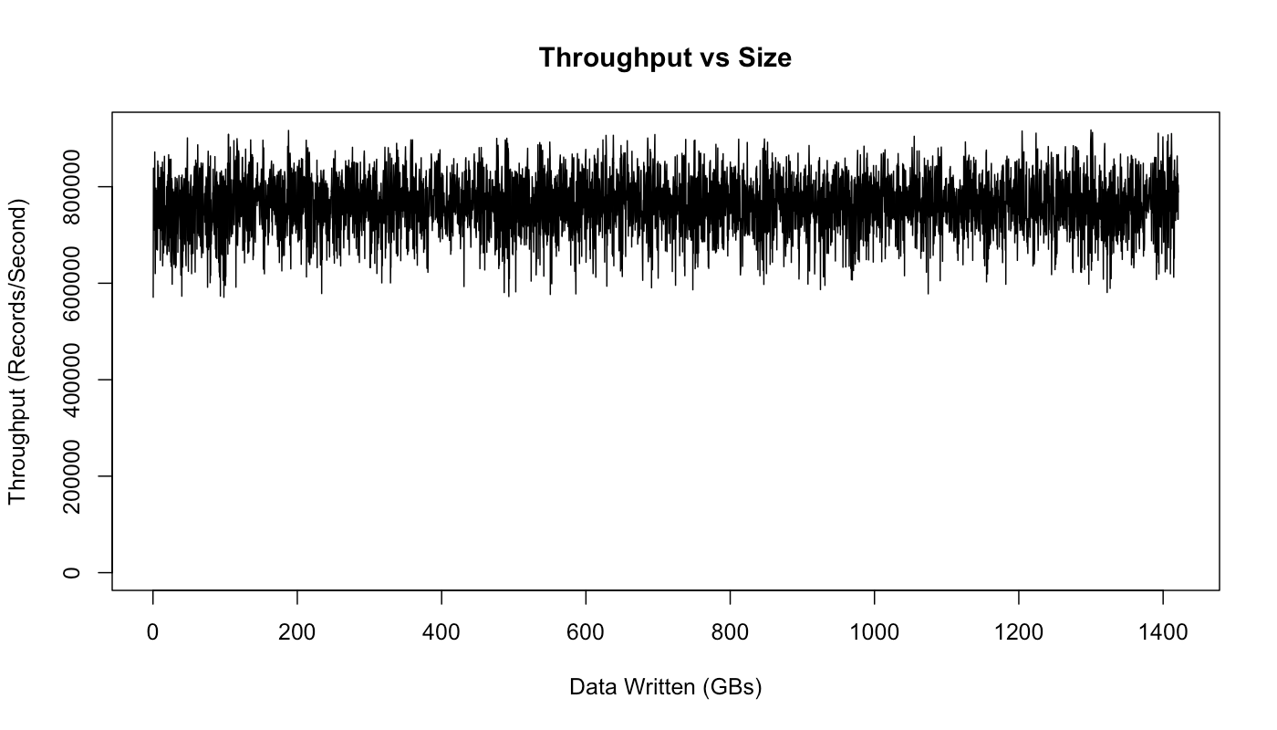
How fast is Kafka / 有多快?
“在 3 台廉价机器上高达 200 万次写入/秒”
在 3 台不同的机器上使用 3 个生产者，3 个异步复制
只有 1 个生产者/机器，因为 NIC 已经饱和
随着存储数据的增长保持吞吐量
测试配置与上面的 2M 写入/秒略有不同。
“Up to 2 million writes/sec on 3 cheap machines”
Using 3 producers on 3 different machines, 3x async replication
Only 1 producer/machine because NIC already saturated
Sustained throughput as stored data grows
Slightly different test config than 2M writes/sec above.

Slide 6
Why is Kafka so fast / 为什么这么快?
Fast writes:
While Kafka persists all data to disk, essentially all writes go to the page cache of OS, i.e. RAM.
Fast reads:
Very efficient to transfer data from page cache to a network socket
Linux: sendfile() system call
Combination of the two = fast Kafka!
Example (Operations): On a Kafka cluster where the consumers are mostly caught up you will see no read activity on the disks as they will be serving data entirely from cache.
快速写入：
虽然 Kafka 将所有数据持久化到磁盘，但基本上所有写入都会进入操作系统的页面缓存，即 RAM。
快速阅读：
将数据从页面缓存传输到网络套接字非常有效
Linux: sendfile() 系统调用
两者的结合 = 快速的卡夫卡！
示例（操作）：在消费者大部分被赶上的 Kafka 集群上，您将看不到磁盘上的任何读取活动，因为它们将完全从缓存中提供数据。

Slide 7
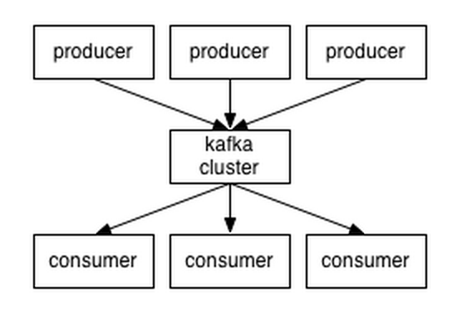
A first look / 框架
The who is who
Producers write data to brokers.
Consumers read data from brokers.
All this is distributed.
The data
Data is stored in topics.
Topics are split into partitions, which are replicated.
角色
生产者将数据写入经纪人。
消费者从经纪人那里读取数据。
所有这些都是分布式的。
数据
数据存储在主题中。
主题被分成多个分区，这些分区被复制。

Slide 8
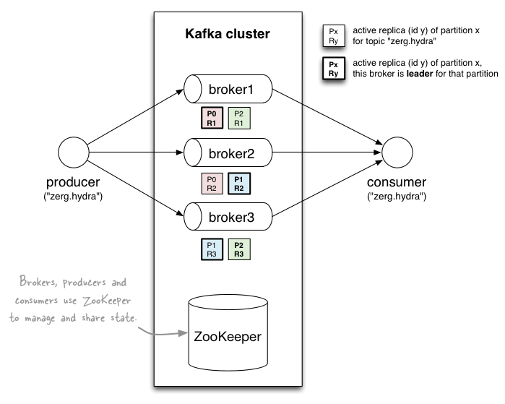
A first look / 框架
broker: 竞技
cluster: 簇
producer: 生产者
consumer: 消费者
zookeeper: 动物园管理员

Slide 9
Topics / 分类主题
主题：向其发布消息的提要名称
Topic: feed name to which messages are published
Example: “zerg.hydra”
Kafka prunes “head” based on age or max size or “key”
Producer A1
Kafka topic
Producer A2
…
…
new
Producer An
Older msgs
Newer msgs
Producers always append to “tail”
(think: append to a file)
Broker(s)

Slide 10
Topics / 分类主题
Consumer group C1
Consumers use an “offset pointer” to
track/control their read progress
(and decide the pace of consumption)
Consumer group C2
Producer A1
Producer A2
…
…
new
Producer An
Older msgs
Newer msgs
Producers always append to “tail”
(think: append to a file)
Broker(s)

Slide 11
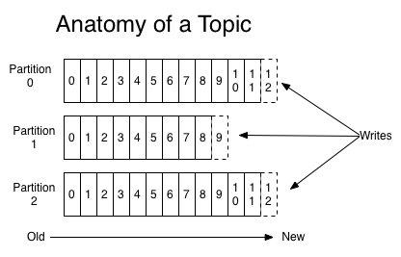
Partitions / 分区
A topic consists of partitions.
Partition: ordered + immutable sequence of messages that is continually appended to
主题由分区组成。
分区：有序+不可变的消息序列，不断附加

Slide 12
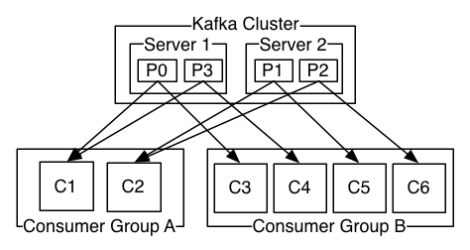
Partitions / 分区
#主题的分区是可配置的
#partitions 确定最大消费者（组）并行度。(通过 builder.setSpout(,,N) 实现 Storm 的 KafkaSpout 的并行性)
#partitions of a topic is configurable
#partitions determines max consumer (group) parallelism
cf. parallelism of Storm’s KafkaSpout via builder.setSpout(,,N)
Consumer group A, with 2 consumers, reads from a 4-partition topic
Consumer group B, with 4 consumers, reads from the same topic

Slide 13
Partition offsets / 分区偏移量
Offset: messages in the partitions are each assigned a unique (per partition) and sequential id called the offset
Consumers track their pointers via (offset, partition, topic) tuples
Consumer group C1
偏移量：分区中的每个消息都分配了一个唯一的（每个分区）和顺序 ID，称为偏移量
消费者通过（偏移量、分区、主题）元组跟踪他们的指针

Slide 14
Replicas of a partition / 分区的副本
Replicas: “backups” of a partition
They exist solely to prevent data loss.
Replicas are never read from, never written to.
They do NOT help to increase producer or consumer parallelism!
Kafka tolerates (numReplicas - 1) dead brokers before losing data
LinkedIn: numReplicas == 2 → 1 broker can die
副本：分区的“备份”
它们的存在仅仅是为了防止数据丢失。
从不读取副本，从不写入副本。
它们无助于提高生产者或消费者的并行性！
Kafka 在丢失数据之前容忍 (numReplicas - 1) 个丢失的 broker
LinkedIn：numReplicas == 2 → 1 经纪可以丢失

Slide 15
Apache Kafka Installation / Kafka 安装

Slide 16
Apache Kafka Installation / Kafka 安装及应用
Option1: Installation on local machine

Slide 17
Apache Kafka Installation / Kafka 安装及应用
Option1: Installation on local machine
There are many help files for Installation, so far I found this one to be the most direct and effective:
安装的帮助文件很多，目前我觉得这个是最直接有效的：
https://www.geeksforgeeks.org/how-to-install-and-run-apache-kafka-on-windows/
https://kafka.apache.org/

Slide 18
Apache Kafka Installation / Kafka 安装及应用
Option2: Kafka Docker

Slide 19
Option 2: Kafka Docker
follow the following steps (if “weixiuai in D:/ drive, then cd d:/weixiuai 照下列步骤：
cd c:/weixiuai
mkdir kafka
cd kafka
git clone https://github.com/wurstmeister/kafka-docker.git
cd kafka-docker

Slide 20
Option 2: Kafka Docker
follow the following steps (if “weixiuai in D:/ drive, then cd d:/weixiuai 照下列步骤：
code .
(visual studio code will pop up)
create a new file called docker-compose-expose.yml. copy and paste the content in next page. 创建一个名为 docker-compose-expose.yml 的新文件。 复制并粘贴下一页的内容

Slide 21
Option 2: Kafka Docker
version: '2' services: zookeeper: image: wurstmeister/zookeeper:3.4.6 ports: - "2181:2181" kafka: image: wurstmeister/kafka ports: - "9092:9092" expose: - "9093" environment: KAFKA_ADVERTISED_LISTENERS: INSIDE://kafka:9093,OUTSIDE://localhost:9092 KAFKA_LISTENER_SECURITY_PROTOCOL_MAP: INSIDE:PLAINTEXT,OUTSIDE:PLAINTEXT KAFKA_LISTENERS: INSIDE://0.0.0.0:9093,OUTSIDE://0.0.0.0:9092 KAFKA_INTER_BROKER_LISTENER_NAME: INSIDE KAFKA_ZOOKEEPER_CONNECT: zookeeper:2181 KAFKA_CREATE_TOPICS: "topic_test:1:1" volumes: - /var/run/docker.sock:/var/run/docker.sock

Slide 22
Option 2: Kafka Docker
follow the following steps (if “weixiuai in D:/ drive, then cd d:/weixiuai 照下列步骤：
docker-compose -f docker-compose-expose.yml up
(build docker)
important! if port already occupied, run as admin:
重要！ 如果端口已被占用，以管理员身份运行：
net stop winnat
net start winnat

Slide 23
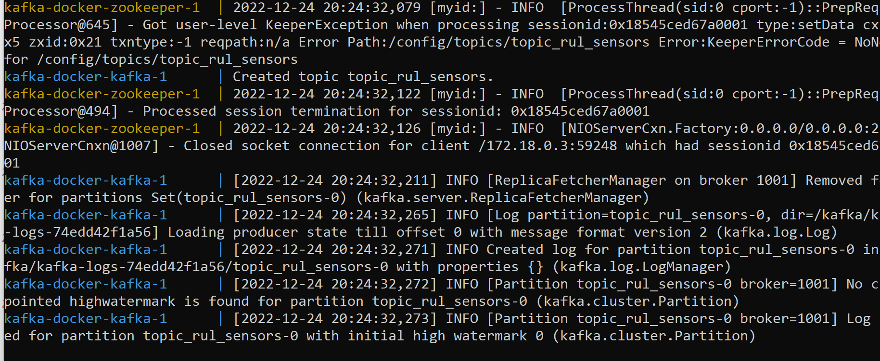
Option 2: Kafka Docker
if successfully started, the following will show:
to stop, open a new terminal and run / 停止的话，打开一个新终端并运行 :
docker-compose stop

Slide 24
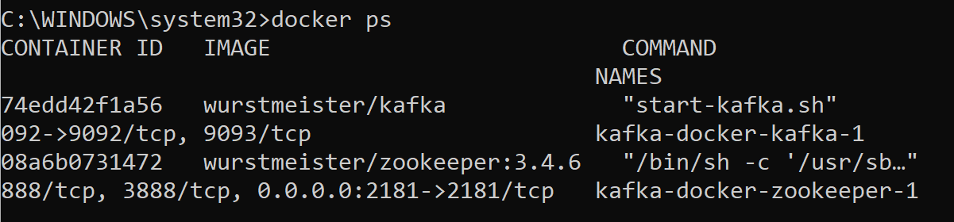
Option 2: Kafka Docker
Kafka docker is On Now: simulate / 我们现在来模拟信号：

Slide 25
Option 2: Kafka Docker
first install kafka python 安装:
pip install kafka-python

Slide 26
Option 2: Kafka Docker
then follow the following steps / 照一下步骤:
add three files:
producer.py
consumer.py
sensors_simulator.py

Slide 27
Option 2: Kafka Docker
producer.py
from time import sleep
from json import dumps
from kafka import KafkaProducer
from sensors_simulator import get_rand
producer = KafkaProducer(
bootstrap_servers=['localhost:9092'],
value_serializer=lambda x: dumps(x).encode('utf-8')
)
sensors = [f"sensor{i}" for i in range(1,22)]
for j in range(9999):
print("Iteration", j)
data = {sensor: get_rand(sensor) for sensor in sensors}
producer.send('topic_test', value=data)
sleep(0.5)

Slide 28
Option 2: Kafka Docker
sensor_simulator.py (one file; piece together. 要拼起来）
# generate the distributions from train data
import random
distributions = {'sensor1': {'mean': 518.67,
'max': 518.67,
'min': 518.67,
'std': 6.537151601226413e-11,
'distribution': 'cauchy'},
'sensor2': {'mean': 642.6809335466046,
'max': 644.53,
'min': 641.21,
'std': 0.5000532700606122,
'distribution': 'gamma'},
'sensor3': {'mean': 1590.5231186079204,
'max': 1616.91,
'min': 1571.04,
'std': 6.131149519690787,
'distribution': 'chi2'},
'sensor4': {'mean': 1408.9337816877514,
'max': 1441.49,
'min': 1382.25,
'std': 9.000604780543735,
'distribution': 'gamma'},
'sensor5': {'mean': 14.620000000000001,
'max': 14.62,
'min': 14.62,
'std': 3.3947001929194767e-12,
'distribution': 'cauchy'},
'sensor6': {'mean': 21.60980320876352,
'max': 21.61,
'min': 21.6,
'std': 0.0013889849127070525,
'distribution': 'powerlaw'},
'sensor7': {'mean': 553.367711211284,
'max': 556.06,
'min': 549.85,
'std': 0.885092257663408,
'distribution': 'norm'},
'sensor8': {'mean': 2388.0966516407348,
'max': 2388.56,
'min': 2387.9,
'std': 0.0709854788909189,
'distribution': 'gamma'},
'sensor9': {'mean': 9065.242940720276,
'max': 9244.59,
'min': 9021.73,
'std': 22.08287952506627,
'distribution': 'cauchy’},
'sensor10': {'mean': 1.3,
'max': 1.3,
'min': 1.3,
'std': 4.660829215684185e-13,
'distribution': 'cauchy'},
'sensor11': {'mean': 47.54116814502448,
'max': 48.53,
'min': 46.85,
'std': 0.2670873986396874,
'distribution': 'gamma'},
'sensor12': {'mean': 521.4134700208425,
'max': 523.38,
'min': 518.69,
'std': 0.7375533922097044,
'distribution': 'norm’},
'sensor13': {'mean': 2388.0961523920314,
'max': 2388.56,
'min': 2387.88,
'std': 0.07191891569858286,
'distribution': 'lognorm'},
'sensor14': {'mean': 8143.752722117202,
'max': 8293.72,
'min': 8099.94,
'std': 19.076175975953127,
'distribution': 'cauchy'},
'sensor15': {'mean': 8.44214558189133,
'max': 8.5848,
'min': 8.3249,
'std': 0.03750503795196683,
'distribution': 'gamma'},
'sensor16': {'mean': 0.030000000000000013,
'max': 0.03,
'min': 0.03,
'std': 1.5564316238059236e-14,
'distribution': 'expon'},
'sensor17': {'mean': 393.2106538703892,
'max': 400.0,
'min': 388.0,
'std': 1.5487630246142414,
'distribution': 'gamma'},
'sensor18': {'mean': 2388.0,
'max': 2388.0,
'min': 2388.0,
'std': 0.0,
'distribution': 'chi2'},
'sensor19': {'mean': 100.0,
'max': 100.0,
'min': 100.0,
'std': 0.0,
'distribution': 'chi2'},
'sensor20': {'mean': 38.816270660656286,
'max': 39.43,
'min': 38.14,
'std': 0.18074642787366235,
'distribution': 'exponpow'},
'sensor21': {'mean': 23.289705360864716,
'max': 23.6184,
'min': 22.8942,
'std': 0.10825087474491232,
'distribution': 'exponpow'}}
def get_rand(sensor, N = 200):
n = random.randint(1, N)
return distributions[sensor]["min"] + (distributions[sensor]["max"] - distributions[sensor]["min"])*n/N

Slide 29
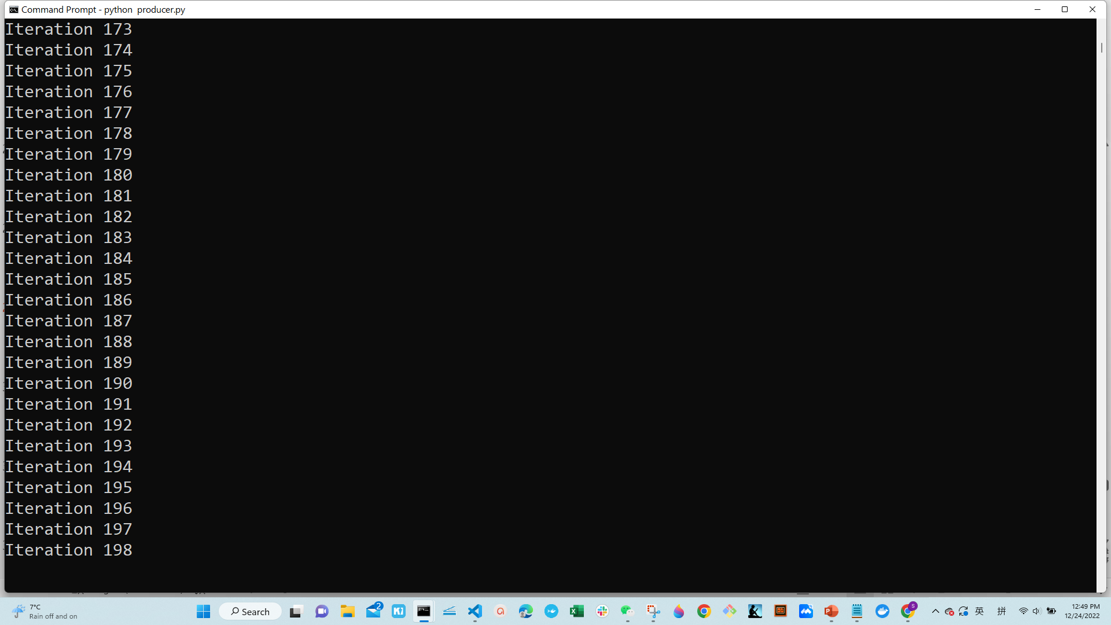
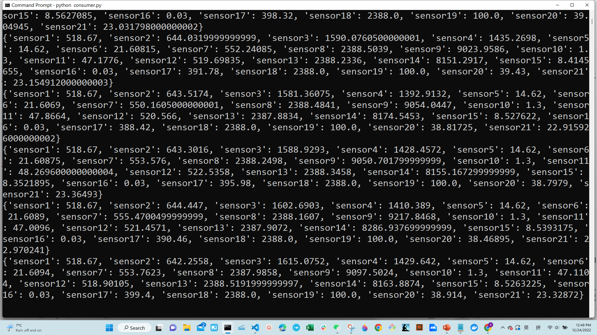
Option 2: Kafka Docker
open a terminal for producer and run:
python producer.py
open another terminal for producer and run:
python consumer.py

