Slide 1
Weixiu AI Containerization
Lesson 16

Slide 2
Now That:
Understand the problem to solve
We know how to analyze our data
We know how figure out which features matter
We know how to train and test our models
Now what?

Slide 3


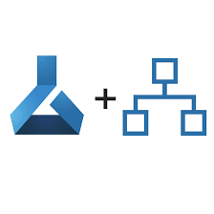
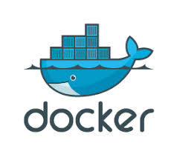
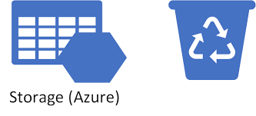

End – End Flow
Simulate sensors topics
Containerization

Slide 4
Docker!
Containerization

Slide 5
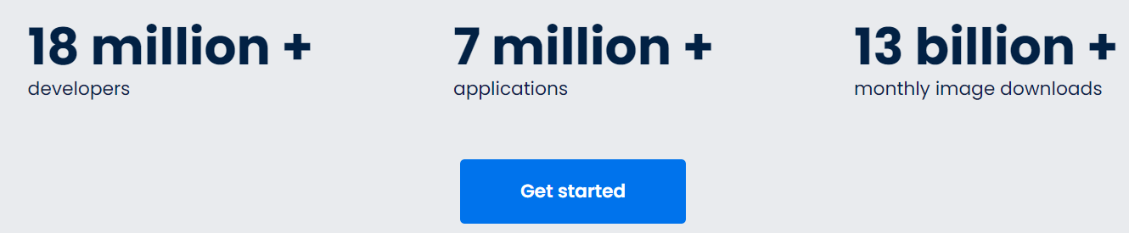
Containerization - Docker
https://www.docker.com/

Slide 6

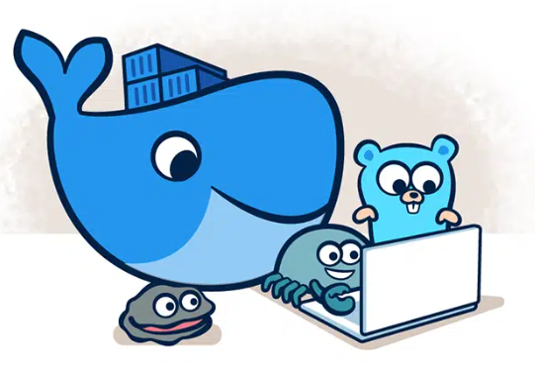

Containerization - Docker
https://www.docker.com/
Docker Promise:
Build
Share
Run

Slide 7
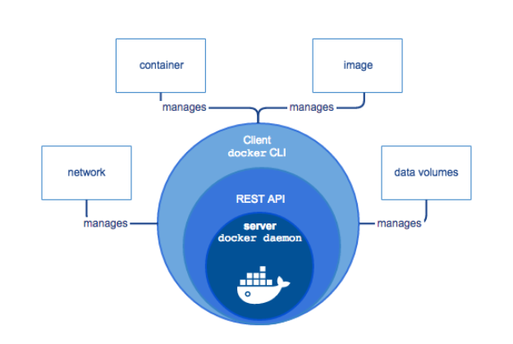
Containerization - Docker
https://www.docker.com/
Image Source: https://docs.docker.com

Slide 8
Containerization - Docker
What is docker?
First why do we need docker? what problem it wants to solve and what improvement it brings?
Developers’ nightmare:
it works on my computer!
But not yours
{whys – missing libs/dependencies, different versions; conflicts between programs in different computers; different running programs in the computer; different OS and versions etc. }
Docker’s Promise: “Build, Share, and Run”
什么是docker?
首先我们为什么需要docker？ 它要解决什么问题，带来什么改进？
开发者的噩梦：
它适用于我的电脑！
但不是你的{为什么——缺少库/依赖项，不同的版本； 不同计算机上的程序之间的冲突； 计算机中不同的运行程序； 不同的操作系统和版本等。}
Docker 的承诺：“构建、共享和运行”

Slide 9
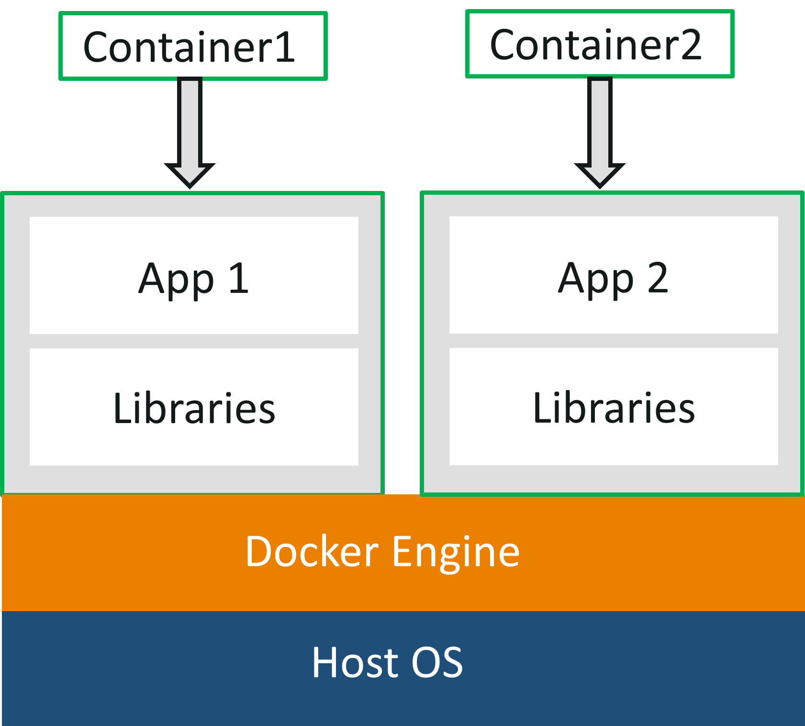
Containerization - Docker
More Technical like:
Docker is a platform which packages an application and all its dependencies together in the form of containers. This containerization aspect ensures that the application works in any environment.
you can see in the diagram, each and every application runs on separate containers and has its own set of dependencies & libraries. This makes sure that each application is independent of other applications, giving developers surety that they can build applications that will not interfere with one another.
So a developer can build a container having different applications installed on it and give it to the QA team. Then the QA team would only need to run the container to replicate the developer’s environment.
更多技术点说法：
Docker 是一个将应用程序及其所有依赖项以容器的形式打包在一起的平台。 这个容器化方面确保应用程序可以在任何环境中工作。
你可以在图中看到，每个应用程序都在单独的容器上运行，并且有自己的一组依赖项和库。 这确保了每个应用程序都独立于其他应用程序，让开发人员确信他们可以构建不会相互干扰的应用程序。
因此，开发人员可以构建一个装有不同应用程序的容器，并将其交给 QA 团队。 然后 QA 团队只需要运行容器来复制开发人员的环境。

Slide 10
Containerization - Docker
Key: Docker File, Image and Container
Dockerfile: A Dockerfile is a text document which contains all the commands that a user can call on the command line to assemble an image. So, Docker can build images automatically by reading the instructions from a Dockerfile. You can use docker build to create an automated build to execute several command-line instructions in succession.
Docker Image: In layman terms, Docker Image can be compared to a template which is used to create Docker Containers. So, these read-only templates are the building blocks of a Container. You can use docker run to run the image and create a container.
Docker Images are stored in the Docker Registry. It can be either a user’s local repository or a public repository like a Docker Hub which allows multiple users to collaborate in building an application.
Docker Container: It is a running instance of a Docker Image as they hold the entire package needed to run the application. So, these are basically the ready applications created from Docker Images which is the ultimate utility of Docker.

Slide 11
Docker Demo
Key: Docker File, Image and Container
Dockerfile: A Dockerfile is a text document which contains all the commands that a user can call on the command line to assemble an image. So, Docker can build images automatically by reading the instructions from a Dockerfile. You can use docker build to create an automated build to execute several command-line instructions in succession.
Docker Image: In layman terms, Docker Image can be compared to a template which is used to create Docker Containers. So, these read-only templates are the building blocks of a Container. You can use docker run to run the image and create a container.
Docker Images are stored in the Docker Registry. It can be either a user’s local repository or a public repository like a Docker Hub which allows multiple users to collaborate in building an application.
Docker Container: It is a running instance of a Docker Image as they hold the entire package needed to run the application. So, these are basically the ready applications created from Docker Images which is the ultimate utility of Docker.
关键：Docker 文件、镜像和容器
Dockerfile：Dockerfile 是一个文本文档，其中包含用户可以在命令行上调用以组装图像的所有命令。 因此，Docker 可以通过读取 Dockerfile 中的指令自动构建镜像。 您可以使用 docker build 创建自动构建以连续执行多个命令行指令。
Docker Image：通俗地说，Docker Image 可以比作用于创建 Docker 容器的模板。 因此，这些只读模板是容器的构建块。 您可以使用 docker run 来运行图像并创建容器。
Docker 镜像存储在 Docker 注册表中。 它可以是用户的本地存储库，也可以是像 Docker Hub 这样的公共存储库，它允许多个用户协作构建应用程序。
Docker 容器：它是 Docker 镜像的运行实例，因为它们包含运行应用程序所需的整个包。 因此，这些基本上是从 Docker Images 创建的现成应用程序，这是 Docker 的最终实用程序。

Slide 12
Docker Demo
关键：Docker 文件、镜像和容器
Dockerfile：Dockerfile 是一个文本文档，其中包含用户可以在命令行上调用以组装图像的所有命令。 因此，Docker 可以通过读取 Dockerfile 中的指令自动构建镜像。 您可以使用 docker build 创建自动构建以连续执行多个命令行指令。
Docker Image：通俗地说，Docker Image 可以比作用于创建 Docker 容器的模板。 因此，这些只读模板是容器的构建块。 您可以使用 docker run 来运行图像并创建容器。
Docker 镜像存储在 Docker 注册表中。 它可以是用户的本地存储库，也可以是像 Docker Hub 这样的公共存储库，它允许多个用户协作构建应用程序。
Docker 容器：它是 Docker 镜像的运行实例，因为它们包含运行应用程序所需的整个包。 因此，这些基本上是从 Docker Images 创建的现成应用程序，这是 Docker 的最终实用程序。

Slide 13
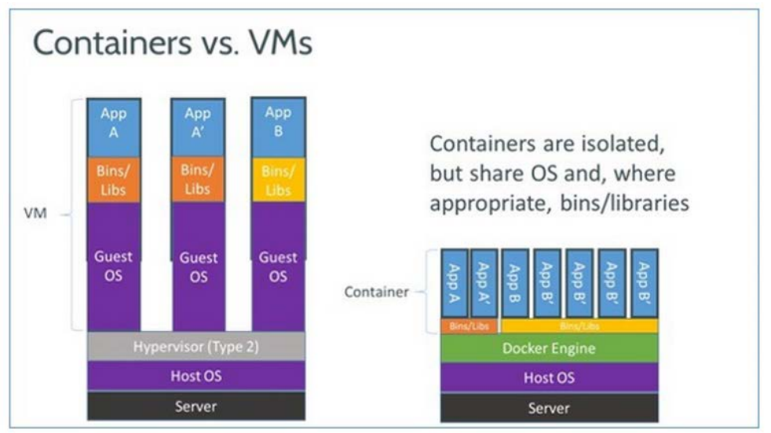
Docker vs VM

Slide 14
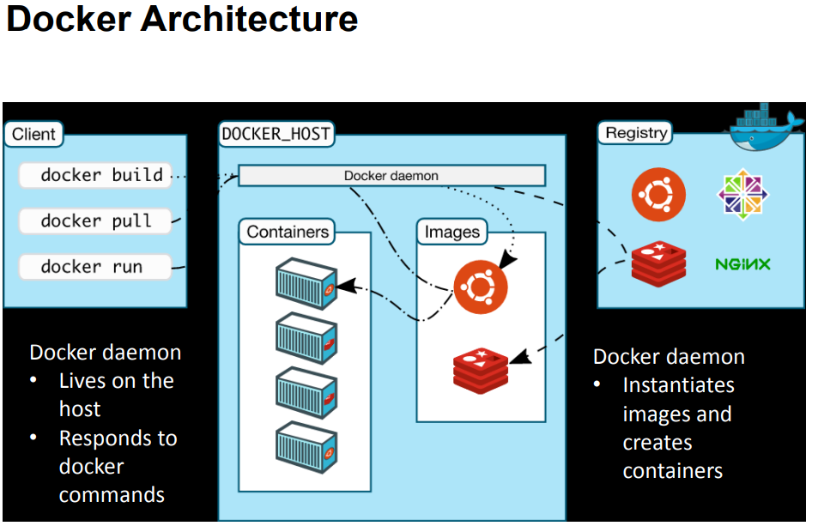
Docker Illustration

Slide 15
Hands-On: Let’s build a simple docker image and upload it!
Containerization

Slide 16
Hands-On: Let’s build a simple docker image and upload it!
First
get our handle dirty
(有计算机的同学：
check dockers for desktop
用 cmd 或 gitbash
docker run –-rm –ti python:slim /bin/sh
or (bash)

Slide 17
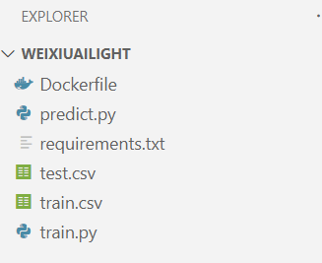
Hands-On: Let’s build a simple docker image and upload it!
now
our mini image for Weixiu AI
(project weixiuailight)

Slide 18
Hands-On: Let’s build a simple docker image and upload it!
Copy/Paste command for your exercise! 用到的命令，方便拷贝粘贴
docker run docker-model python3 inference.py
--volume //c/Users/kale/my_project:/home/project
docker run –-rm –-volume //c/weixiuailight/model:/home/model -ti weixiuailight-img /bin/sh
docker build -t weixiuailight-img -f Dockerfile .
docker build -t weixiuailight-img -f Dockerfile .
docker rm containerid
docker rmi imageid
docker run -–rm -ti weixiuailight-img /bin/sh
docker stop $(docker ps -q) # only on bash
docker rm $(docker ps -aq) # only on bash
################ docker hub
docker login
docker tag weixiuailight-img stempro/weixiuai:latest
docker push stempro/weixiuai
################ azure cr
docker login weixiuai.azurecr.io weixiuai pw：xxxxxxx
docker tag weixiuailight-img weixiuai.azurecr.io/weixiuai:v1
docker push weixiuai.azurecr.io/weixiuai:v1

Slide 19
docker container prune
docker system prune -a
docker rmi
docker rm
docker attach
docker stats
docker pause
docker start/stop/kill/unpause
docker logs weixiuai_container ## will list what actions/commands
data management:
docker volume create v-weixiuai
docker volume list
docker volume ls
docker run --mount source=v-weixiuai,destination=/home/data weixiuailight-img
docker volume rm v-weixiuai
docker volume prune
docker cp eager_moore /home/scripts /var/lib/docker/volumes/v-weixiuai/_data
\\wsl.localhost\docker-desktop
"\\wsl.localhost\docker-desktop\var\lib"
docker cp eager_moore:/home/scripts \\wsl.localhost\docker-desktop\var\lib]docker\volumes\v-weixiuai\_data
network:
docker run -d -p 5000:5000 training/webapp python app.py
docker run -d -p 127.0.0.1:5000:5000 training/webapp python app.py
docker run -d -p 127.0.0.1:5000:5000/udp training/webapp python app.py
check which port for the container:
docker port weixiuai
container interconnection
bridge – User-defined bridge networks, multiple containers on the same host to communicate.
host – Host networks, best when network stacks not to be isolated from the docker host.
overlay – Overlay networks, different hosts to communicate
macvlan – Macvlan networks, best when migrating from a VM setup or containers need to look like physical hosts.
Network plugins – Third-party network plugins allow you to integrate Docker with specialized network stacks.
docker network create -d bridge my-bridge-nwk
docker run -it --rm --name busybox1 --network my-bridge-nwk busybox sh
Hands-On: Let’s build a simple docker image and upload it!
Copy/Paste command for your exercise! 用到的命令，方便拷贝粘贴

Slide 20
Hands-On: Let’s build a simple docker image and upload it!
Copy/Paste command for your exercise! 用到的命令，方便拷贝粘贴
Docker compose – multiple image
service and project
Docker-compose commands cheatsheet
docker-compose up
docker-compose down
docker-compose ps
docker-compose bundle
docker-compose config
docker-compose events
docker-compose logs
docker-compose port
docker-compose pull
docker-compose push
docker-compose version
docker-compose build
docker-compose start
docker-compose stop
docker-compose pause
docker-compose unpause
docker-compose exec
docker-compose help
docker-compose kill
docker-compose restart
docker-compose rm
docker-compose top
docker-compose run
Docker-compose examples
docker-compose.yml example
Building – from Dockerfile or image
Ports binding
Command and Entrypoint
Volume – Storage mapping
Environment variables
Dependencies – dependent services
Labels
DNS Servers
https://jstobigdata.com/docker-compose-cheatsheet/

Slide 21
Hands-On: Let’s build a simple docker image and upload it!
Copy/Paste command for your exercise! 用到的命令，方便拷贝粘贴
docker secret
only works swarm. single container doesn’t work
docker swarm init
docker secret create s-weixiuai –
after enter the scret, ctrl+D
or docker secret create my_secret /path/to/secret/file
https://docs.docker.com/engine/reference/commandline/secret_create/
docker service
https://jstobigdata.com/docker-compose-cheatsheet/

Slide 22
Docker cheatsheet
https://dockerlabs.collabnix.com/docker/cheatsheet/

Slide 23
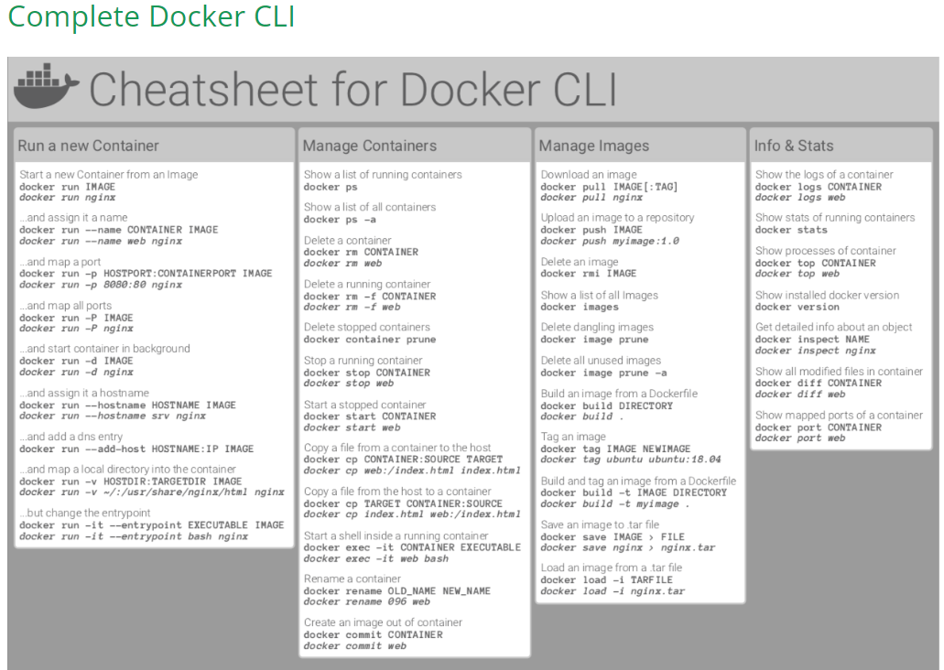
Docker
Help

Slide 24
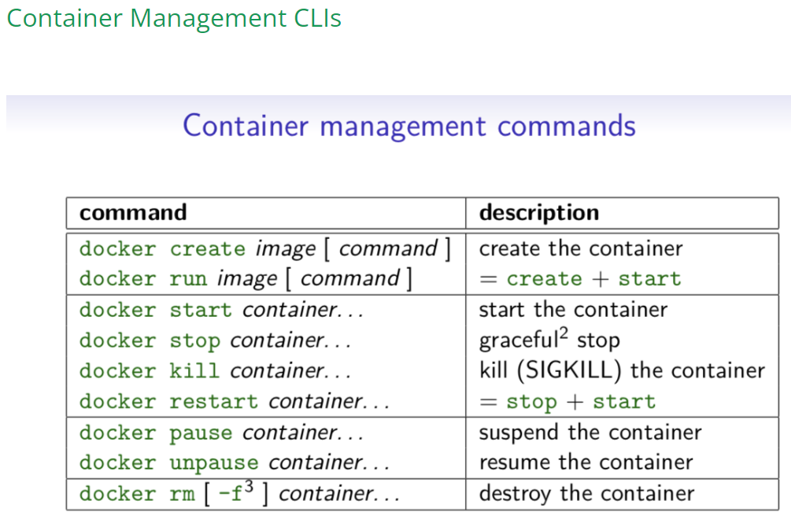
Docker
Help

Slide 25
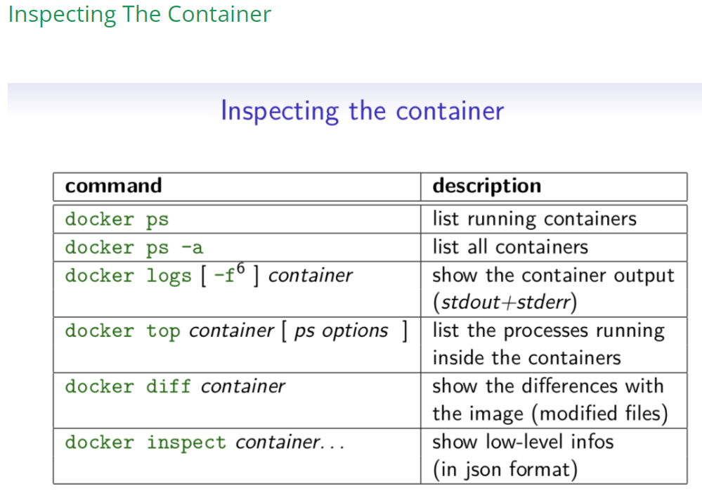
Docker
Help

Slide 26
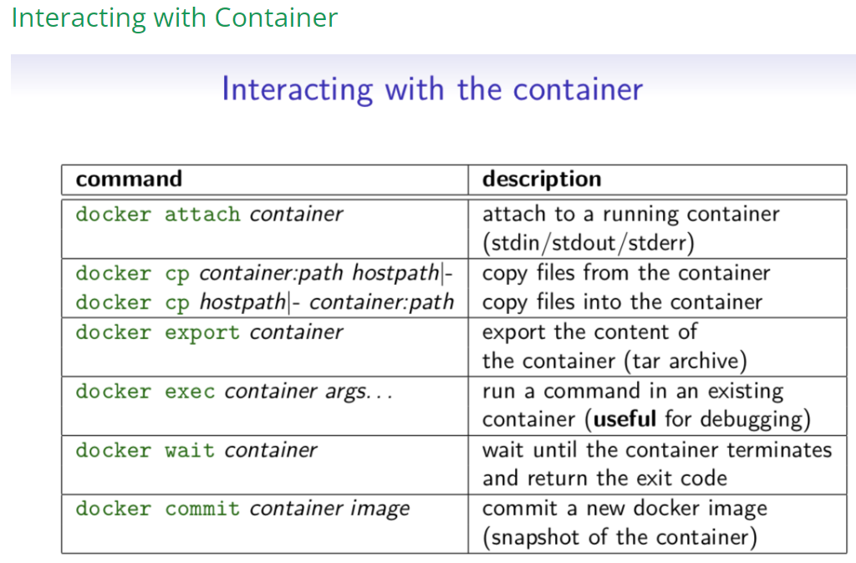
Docker
Help

Slide 27
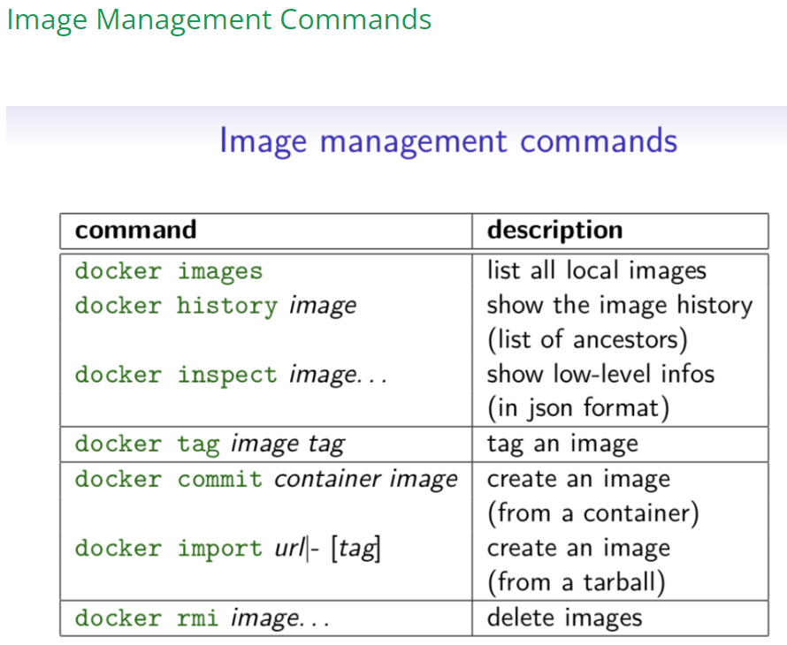
Docker
Help

Slide 28
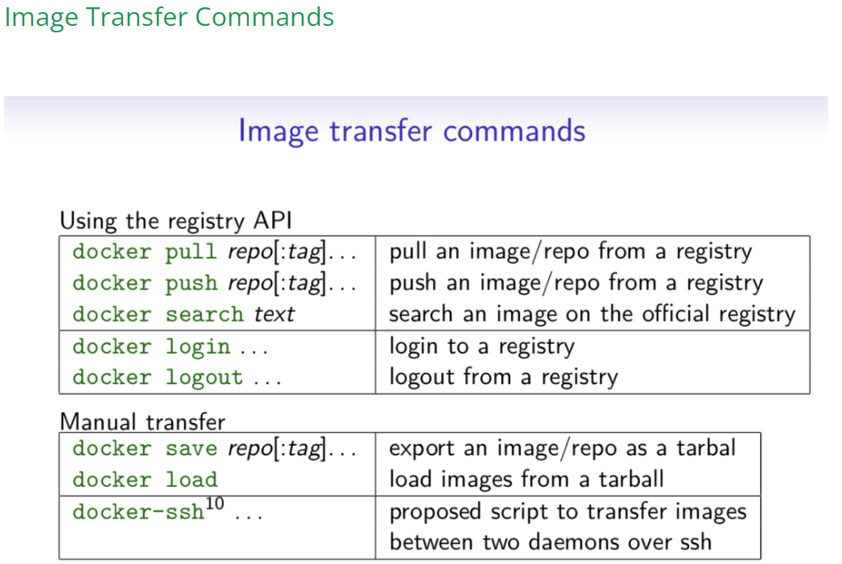
Docker
Help

Slide 29
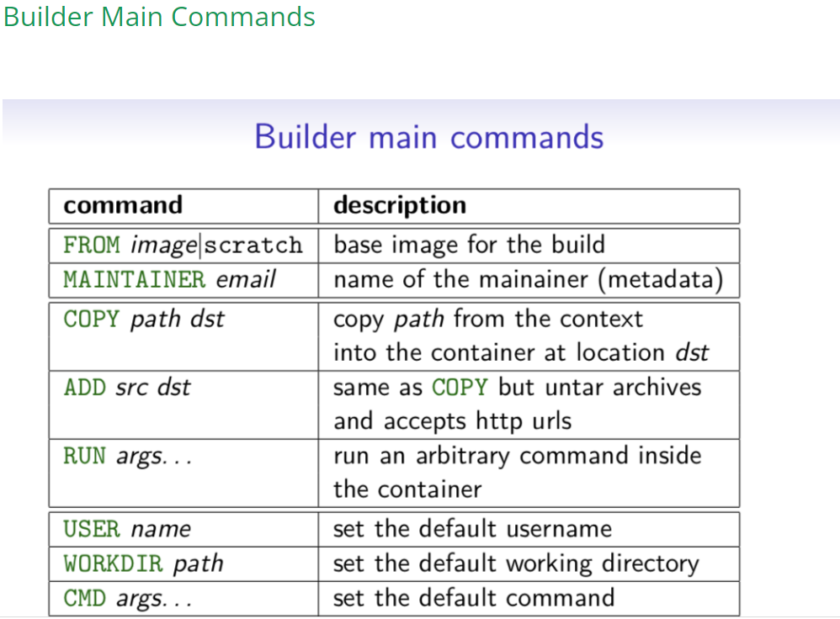
Docker
Help

