Slide 1
Good Morning!
老师同学们早上好！
Please follow the following steps to get today’s content
请执行以下命令下载课堂内容：
in git bash (用 gitbash)
cd /c
cd pdm
git stash
git pull –a
git checkout –b weixiuai origin/weixiuai

Slide 2
AAFIE, 2022
Curriculum / 课程安排

Slide 3
12/25/2022 Welcome Back!
Pmd Logistics / 预备
AAFIE, 2022
Cellphone users, please use the following link:
用手机的同学，请参照：
https://github.com/stemproaca/pdm/tree/weixiuai
第一节：8:30-9:15
第二节： 9:20-10:05
第三节： 10:15-11:00
第四节： 11:05-11:50

Slide 4
12/25/2022 Before we start: Any Questions? 有什么问题和建议？
Pmd Logistics / 预备
AAFIE, 2022

Slide 5
12/25/2022 Today/今天： Last Lesson. 最后一堂课 Kafka Exams and Arrangement 目标：学习 Docker 和 Kafka
Pmd Logistics / 预备
AAFIE, 2022

Slide 6
12/25/2022 Decks for today 今天用到的文本： Kafka_Simulation.pptx Summary.pptx Suppliment_Distributions.ipynb
Pmd Logistics / 预备
AAFIE, 2022

Slide 7
Docker ML
Download and install docker for windows
https://docs.docker.com/desktop/install/windows-install/
make sure to choose WSL 2 backend WSL – Windows Subsystem for Linux
You need to register and get a Docker ID
You can sign in to docker hub
docker run --rm -p 8888:8888 jupyter/scipy-notebook
# --rm means it will be deleted after the process
docker ps
# list running containers
docker exec -ti container_id bash
# ssh to running container – ssh: secure shell

Slide 8
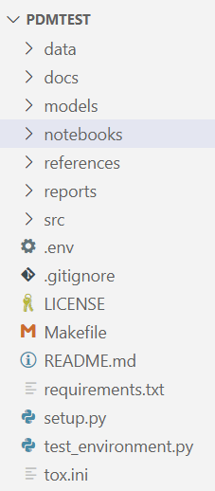
Cookie Cutter
https://github.com/drivendata/cookiecutter-data-science
steps:
a. $> pip install cookiecutter
b. $> cookiecutter -c v1 https://github.com/drivendata/cookiecutter-data-science
-c: v1 v2 is coming soon
c. $> pip install -r requirements.txt
for detailed step by step: refer to url above
tox.ini: tox is for testing the project against different env and configuration (version)
docker: from https://hub.docker.com/r/civisanalytics/datascience-python

Slide 9
Q & A

