Slide 1
Git setup
请按照以下的步骤设置 git
Please follow the following steps to set up git on your local drive
git: 主要益处是版本控制和协作开发
Two major benefits of git are source version control and development collaborations

Slide 2
1. Download git 下载git
Download from：
下载网址
https://git-scm.com/downloads

Slide 3
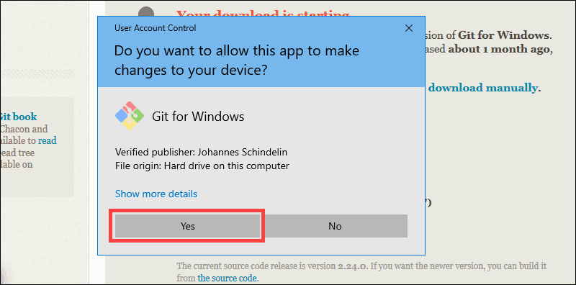
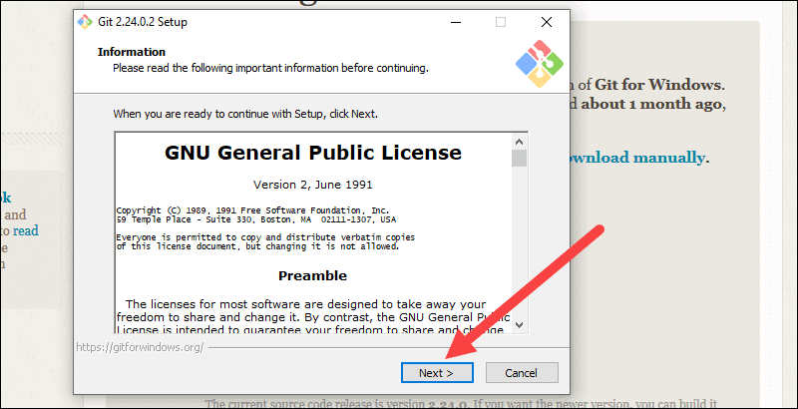
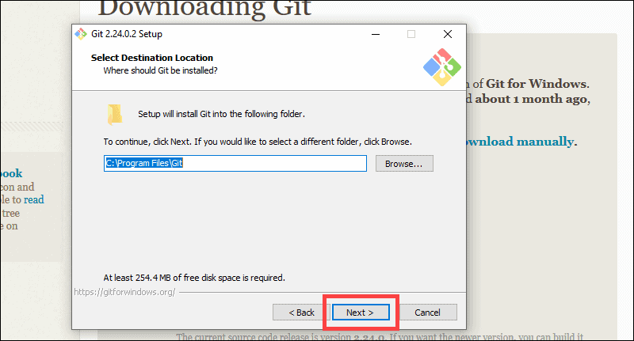
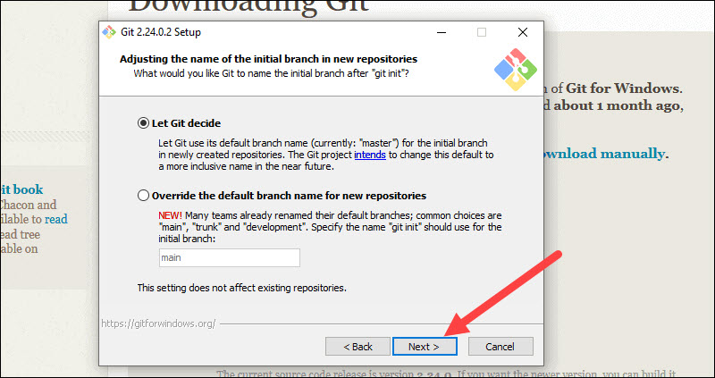
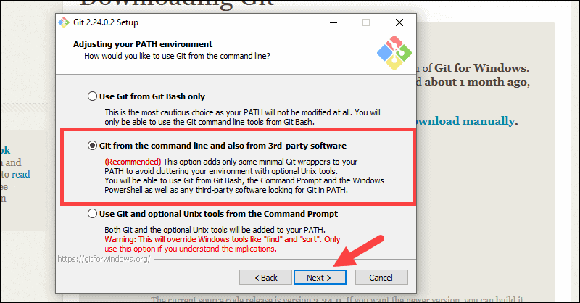
2. Start installation after download 下载后开始安装
Take all the pre-selections, e.g. / 接受预选项， 比方说：

Slide 4
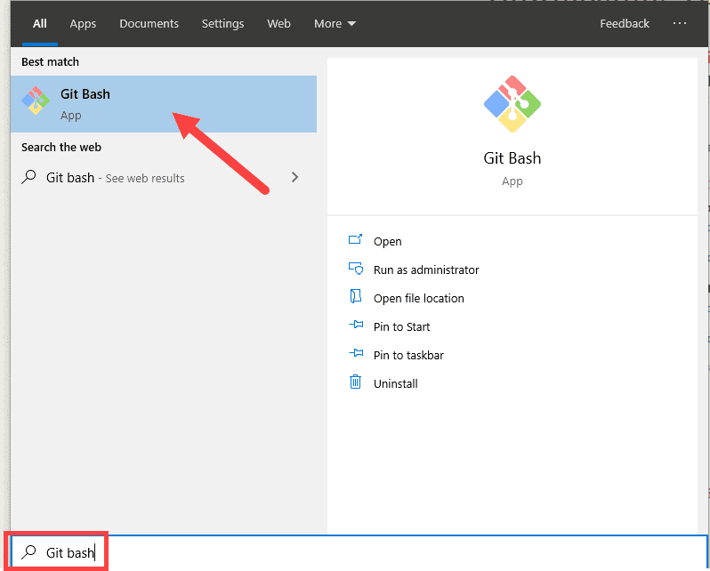
3. After installation, Git Bash should show up in program list. 安装完成后，Git Bash 会出现在应用程序单

Slide 5
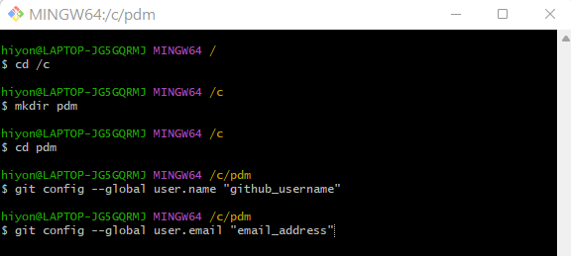
4. Now follow the follow steps to initialize git 请执行以下步骤：
Please note:
Github_username and email_address are your github username and the QQ email address you’ve given me./github_username 和email_address 是你们的github 用户名和提供给我的QQ 邮箱

Slide 6
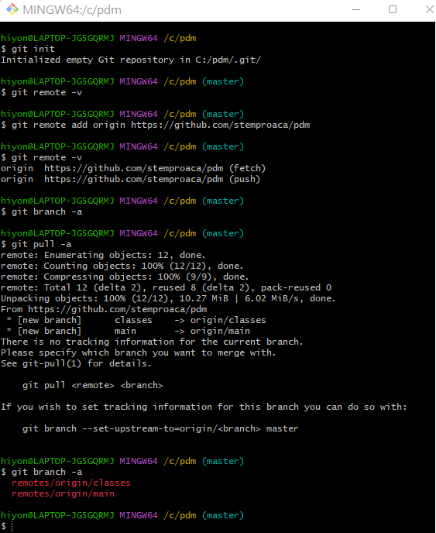
5. Now follow the follow steps to add our pdm repo 请执行以下步骤加入pdm 库：
Our repo address is / 我们的源库地址：
https://github.com/stemproaca/pdm
Delete the folder and start over again if you encounter any error. / 如果出错，删掉pdm 文件夹重来
If you are able to see the following, it means you are all set! / 最后一步应该能看到：
$ git branch -a
remotes/origin/classes
remotes/origin/main

Slide 7
5. Now follow the follow steps to add our pdm repo 请执行以下步骤加入pdm 库：
Our repo address is / 我们的源库地址：
https://github.com/stemproaca/pdm
左图的指令：
请按以下顺序执行：
cd /c
cd pdm
git init
git remote –v
git remote add origin https://github.com/stemproaca/pdm
git remote –v
git pull –a

