Slide 1
9/03/2022 Welcome Back!
Pmd Logistics / 预备
AAFIE, 2022
第一节：8:30-9:15
第二节： 9:20-10:05
第三节： 10:15-11:00
第四节： 11:05-11:50

Slide 2
9/03/2022 Before we start: Any Questions?
Pmd Logistics / 预备
AAFIE, 2022
第一节：8:30-9:15
第二节： 9:20-10:05
第三节： 10:15-11:00
第四节： 11:05-11:50

Slide 3
Pmd Logistics / 预备
First Things First / 对号入座

Slide 4
Pmd Logistics / 预备
Thank you for participating! You Rock!
谢谢参与！
Called and Responded for 8/27 / 8/26课积极参与奖：
Yaping/Yangli/ guanghao/jingyi. 对不起，没有对应名字。
上节课回答问题但是我遗漏的话，请补充

Slide 5
Pmd Logistics / 预备
Thank you for participating! You Rock!
谢谢参与！
Called and Responded for 9/03 / 本节课积极参与奖：

Slide 6
Pmd Logistics / 预备
Thank you for participating：
https://github.com/stemproaca/pdm/blob/classes/ExcellentParticipations.xlsx

Slide 7
9/03/2022 Today/今天： 1. Review 8/27. Quiz. (复习/小测试） --- 10 min/分钟 2. Conda Environment Setup (Conda 环境建立/测试）--- 45 min/分钟 3. Git Setup. Git practice. 建立Git, Git 练习 --- 60 -120 min/分钟 4. Predictive Maintenance Part I / 智能维护， 第一部分 --- 30 min/分钟 5. Team up / Datasets 分组/数据包 --- 20 min/分钟 6. Q n A. 问答 --- 20 min/分钟
Pmd Logistics / 预备
AAFIE, 2022
第一节：8:30-9:15
第二节： 9:20-10:05
第三节： 10:15-11:00
第四节： 11:05-11:50

Slide 8
9/03/2022 Review/In-Class Quiz /小测试: 多选。智能制造和下面那些领域有关： 1. AI/Machine Learning/人工智能 2. Augmented Reality/Virtual Reality/增强现实 3. Automation/Robotics/自动化机器人 4. Additive Manufacturing/Hybrid Manufacturing：增材制造, 3D 打印 5. Big Data Analysis: 大数据 6. Cloud Computing： 云计算 7. CNC Machining：数控制造 8. Design for Manufacturing：制造设计 9. IoT/Edge Computing：物联网 10. Simulation/Digital Twin：企业数字映射/模拟 11. Make Use of both Equipment and Environmental Sensor Data：利用设备和厂房环境感知数据
Pmd Logistics / 预备
AAFIE, 2022

Slide 9
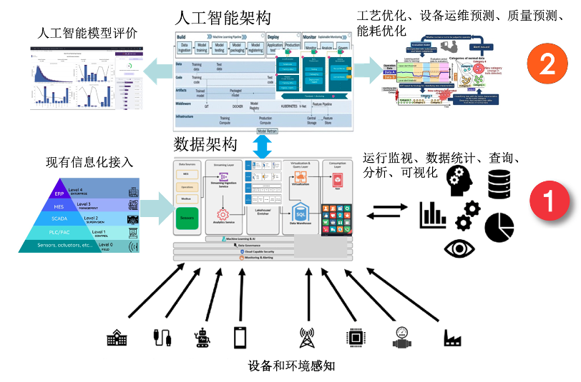
制造行业数智平台

Slide 10
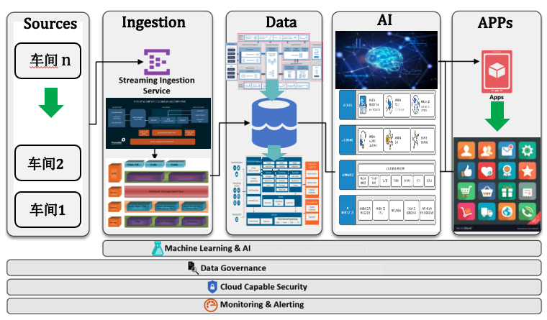
制造行业数智平台
通过能源和⼯艺优化降低制造成本，成为简单的APP开发

Slide 11
Smart Manufacturing Use Cases/智能制造应用
AAFIE, 2022
Agile Production/敏捷制造
Agile production refers to the ability of the manufacturing unit to dynamically change the product schedule and execution according to the demand within the shift/day of operations根据产品/产量需求以及车间设备状况等等，动态调整生产计划
Predictive Maintenance
/预测性维护
工艺参数的优化
Process parameters optimization with AI
Product Design/产品设计
智慧产品研发
Using Reinforcement Learning in AI for product design

Slide 12
Anaconda Setup / 安装Anaconda
AAFIE, 2022
Any questions?
Virtual Env （虚拟环境）
pip check

Slide 13
GitHub
AAFIE, 2022
github_steps.pptx

Slide 14
Git
AAFIE, 2022
git_setup.pptx

Slide 15
Git branches
AAFIE, 2022
Let’s follow these conventions / 约定俗成:
Every team has its own branch. 每个组用自己的分支
2. All teams use the same class branch. 上课内容用同一个分支

Slide 16
Git branches
AAFIE, 2022
Three Key Commands / 三个重要指令行:
# fetch class content. 课堂内容：
git checkout –b classes origin/classes
# fetch your own team’s branch. 项目内容
2. git checkout –b team_z origin/team_z #例子
# for class content, if you made changes,
3. git stash #保存临时备份

Slide 17
Git branches
AAFIE, 2022
For team branch, use the following commands to push changes: 用以下主要指令和远程库保持沟通：
# 获取源库跟新
1. git pull origin team_z
2. git status
3. git add .
4. git commit –m “describe changes”
5. git pull origin team_z

Slide 18
Predictive Maintenance 预测性维护
AAFIE, 2022
Crucial Benefits of PdM / 预测性维护对企业的益处
Holistic Management System / 整体管理：
Implementing Predictive Maintenance becomes a value add-on in the management and execution of inventory, machine and labour operations in manufacturing. Predictive Maintenance solution facilitates a single entity for locating in real-time, the performance and condition of equipment in manufacturing along with data on supply chain and labour to predict stock requirements to ensure optimized resource utility.
实施预测性维护成为制造中库存、机器和人工操作的管理和执行的附加值。预测性维护解决方案有助于单个实体实时定位制造中设备的性能和状况以及供应链和劳动力数据，以预测库存需求，以确保优化资源利用率。

Slide 19
Predictive Maintenance 预测性维护
AAFIE, 2022
Crucial Benefits of PdM / 预测性维护对企业的益处
Automated Scheduling of Maintenance / 维护计划自动化
Software that offers Predictive Maintenance run based on artificial intelligence and analytics to advance prediction that supports generating valuable insights. These analytics prompt automated scheduling of service/maintenance based on machine usage, and performance statistics. It also enables automated job assignments and timeline management.
提供基于人工智能和分析的预测性维护运行的软件，以推进支持生成有价值见解的预测。这些分析会根据机器使用情况和性能统计信息自动安排服务/维护。它还支持自动化的工作分配和时间线管理。

Slide 20
Predictive Maintenance 预测性维护
AAFIE, 2022
Crucial Benefits of PdM / 预测性维护对企业的益处
Safety and Compliance/ 提高安全性
Predictive Maintenance facilitates not only machine/asset maintenance but also ensures to notify/reminders on parameters concerning the safety of machines and operators. It helps companies prioritize the health of machines as well as workers’ safety along with sustaining compliance..
预测性维护不仅有助于机器/资产维护，而且还确保通知/提醒有关机器和操作员安全的参数。它可以帮助公司优先考虑机器的健康和工人的安全，同时保持合规性

Slide 21
Predictive Maintenance 预测性维护
AAFIE, 2022
Crucial Benefits of PdM / 预测性维护对企业的益处
Optimize Workflow/ 优化流程
Without elaborate insights on high productive hours, labour and machine availability, it is difficult to optimize production workflows. Employing predictive maintenance will provide insightful data on various machine parameters that suffice to optimize workflow.
如果没有对高生产时间、劳动力和机器可用性的详细了解，就很难优化生产工作流程。采用预测性维护将提供有关足以优化工作流程的各种机器参数的有见地的数据

Slide 22
Team up / Datasets / 分组，数据包
AAFIE, 2022
Why Team? 为啥要分组
Team Spririts 团队
Mimic Actual Working（job) Environment 工作环境很少单干
相互学习: Learn From Each Other

Slide 23
Team up / Datasets / 分组，数据包
AAFIE, 2022
Team Up!
Ideally 4. 4 人组
1- 4 works as well. 1-4 OK

Slide 24
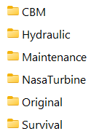
Team up / Datasets / 分组，数据包
AAFIE, 2022
Six Data Sets To Choose From/ 六个数据包，任选一个：

Slide 25
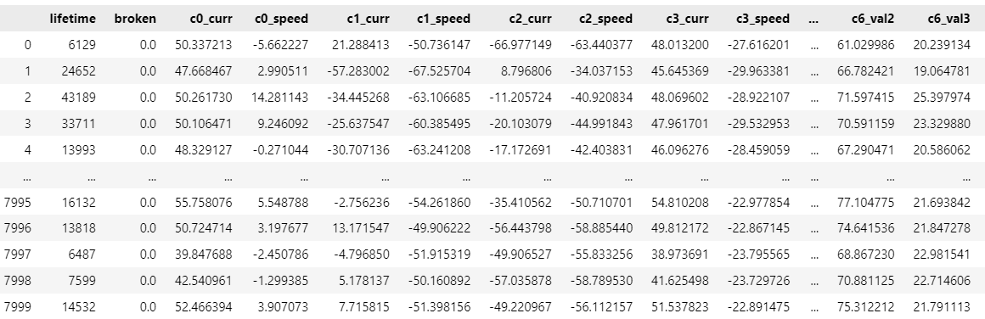
Team up / Datasets / 分组，数据包
AAFIE, 2022
E.g Survival Data/ 例子：

Slide 26
Team up / Datasets / 分组，数据包
AAFIE, 2022
E.g Survival Data/ 例子：
Next Week Browse All Datasets
下星期查看/分析所有6个数据包。

Slide 27
Q & A

