Slide 1


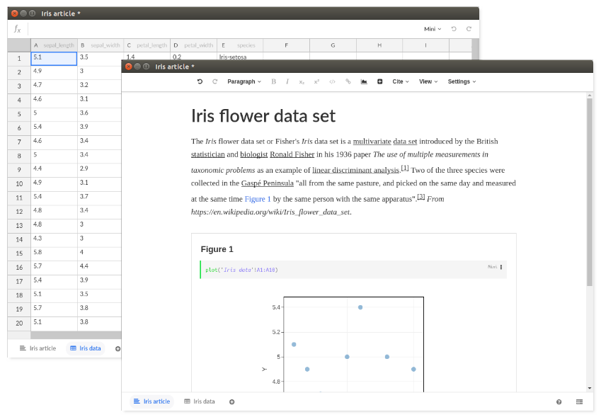

Living documents for reproducible research
Connecting code profficiency with domain expertise
User-friendly interfaces with interactive and fully reproducible code written in R, Python, SQL (and more)
Collaborative environment and easy sharing through Stencila Hub
Open source
Community-driven
http://stenci.la
hello@stenci.la

