Slide 1

Detecting Outliers in Financial Transactions
A Data Analytics Approach for Identifying Unusual Financial Transactions
Presented by: Stenet Sylvia V

Slide 2

Financial Transaction Analysis
Financial institutions process thousands of transactions daily. Most follow normal patterns — but some transactions carry unusually high or low values, known as outliers.
Outliers Can Occur Due To:
The Challenge
Identifying these transactions manually becomes increasingly difficult as transaction volume grows. Organizations need a data-driven approach to detect unusual transactions and support timely investigation.
Fraud
Data entry errors
System issues
Rare but legitimate transactions

Slide 3


The Business Problem
Problem Statement
A bank processes a large number of financial transactions every day. Some transactions may differ significantly from normal behaviour. These unusual transactions may:
Indicate potential fraudulent activity
Result from data entry or system errors
Affect financial analysis and forecasting
Increase financial and operational risk
Require manual investigation
Traditional rule-based methods may miss important anomalies or generate too many false alerts.
Objective
To identify abnormal transaction patterns, reduce unnecessary alerts, and provide actionable information for risk awareness and decision-making.

Slide 4


Analytical & Business Solutions
Five key solutions to address outlier detection and transaction risk management:
1
2
3
Investigate High-Risk Transactions
Strengthen Fraud Prevention
Correct Data & System Errors
Review transactions identified as highly unusual
Verify with customer or department
Escalate confirmed suspicious transactions
Introduce additional verification for high-risk transactions
Set suitable transaction limits
Improve fraud prevention controls
Investigate outliers caused by incorrect data
Correct inaccurate records
Improve data validation and system controls
4
5
Improve Risk Monitoring & Alerts
Act on Legitimate Outliers
Establish automated alerts for unusual transactions
Prioritize high-risk transactions
Maintain investigation records
Identify unusual transactions that are legitimate
Update customer transaction profiles
Reduce repeated false alerts

Slide 5

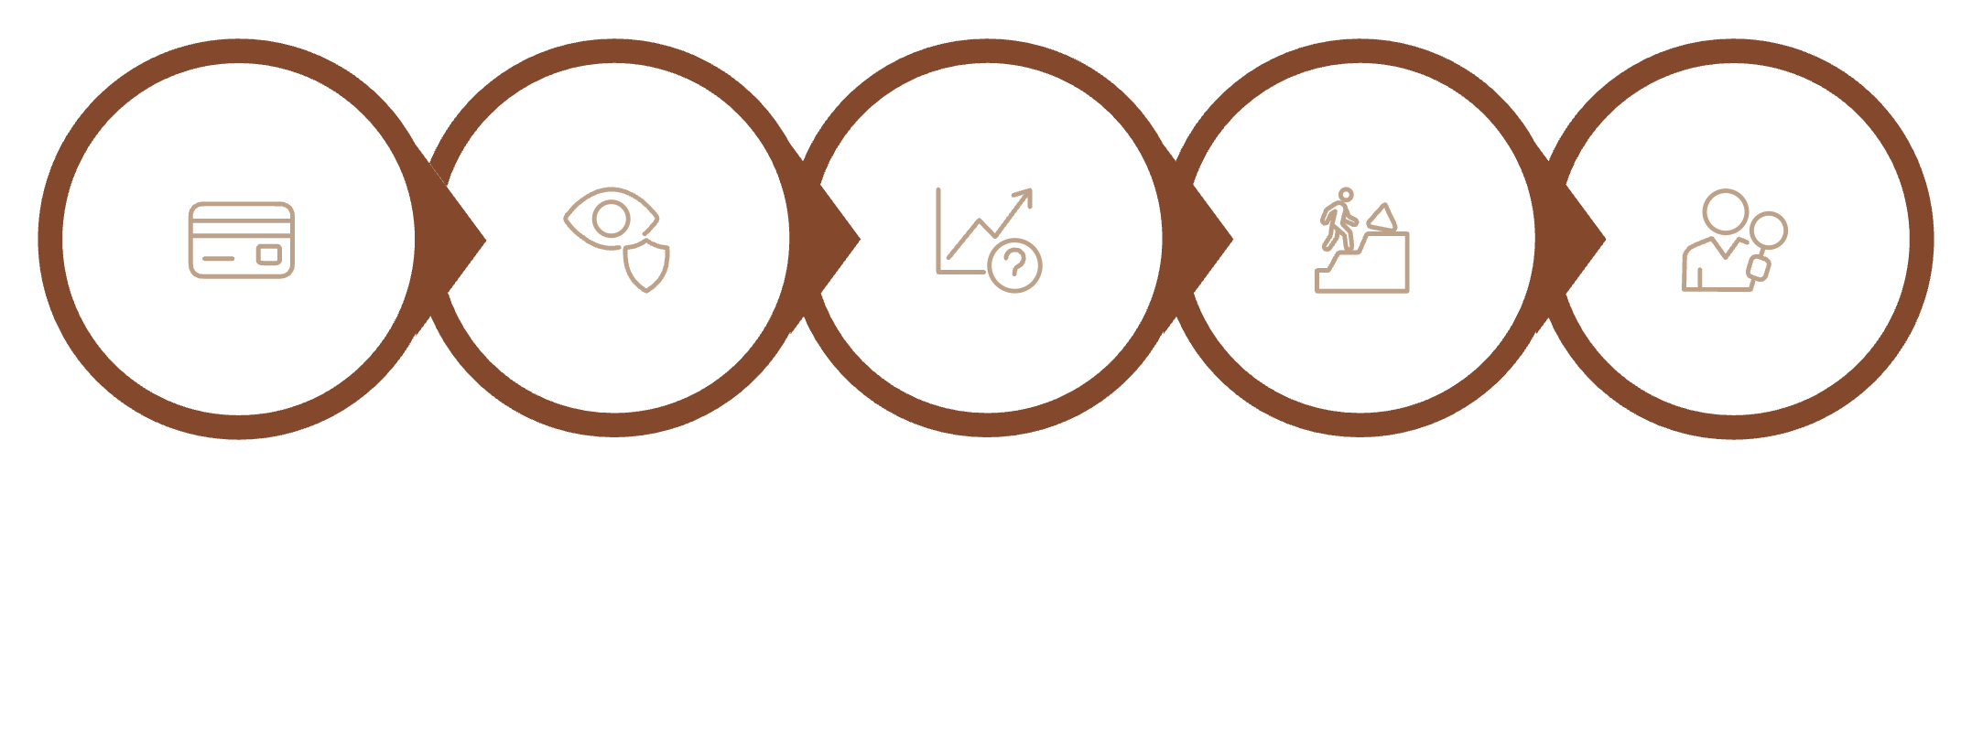
Solution Implementation
How the organization implements solutions through a structured, end-to-end process:
Automated Transaction Monitoring
Risk-Based Investigation
Additional Verification
Connect transaction data to a monitoring system. Automatically check new transactions against normal patterns and generate alerts for unusual activity.
Classify alerts as Low, Medium, or High Risk. Review medium-risk transactions and immediately investigate high-risk transactions.
Request additional customer authentication when required. Verify suspicious transaction details. Hold or restrict transactions until verification is complete.
Data & System Controls
Continuous Monitoring
Introduce validation checks during transaction entry. Prevent invalid amounts and dates. Maintain accurate customer transaction records.
Review previous alerts and investigation results. Identify false alerts, improve thresholds, and continuously update the system based on changing transaction behaviour.
Transaction
Monitoring
Outlier
Risk
Investigate

Slide 6
Dataset & Methodology
Dataset Overview
A financial transaction dataset was created for this analysis, with intentionally introduced data-quality problems to demonstrate the full cleaning process.
4,080
14
Total Rows
Total Columns
Transaction records
Data attributes
Data Specifications
Format: CSV
Data Type: Financial Transaction Data
Purpose: Data cleaning, exploratory analysis, and outlier detection
Cleaning Tool: Python / Pandas

Slide 7
Financial Transaction Dataset
The dataset contains 14 attributes describing each financial transaction:
s.no
Field
Description
s.no
Field
Description
1
Transaction_ID
Unique identification number
8
Transaction_Amount
Monetary value of the transaction
2
Customer_ID
Identifies the customer
9
Merchant_Name
Merchant associated with the transaction
3
Customer_Name
Name assigned to the customer
10
Payment_Method
UPI, card, NEFT, etc.
4
Account_Number
Customer's account identifier
11
City
Location of the transaction
5
Transaction_Date
Date the transaction occurred
12
State
State associated with the transaction
6
Transaction_Time
Time the transaction occurred
7
Transaction_Type
Debit, credit, transfer, or withdrawal
13
Device_Type
Device or channel used
14
Transaction_Status
Successful, failed, or pending

Slide 8
Data Cleaning
Why Cleaning is Necessary: The raw dataset contains errors and inconsistencies. Cleaning is essential before performing outlier detection — poor-quality data produces misleading results.
1
Identify Missing Values
2
Handle Missing Values
3
Remove Duplicates
Detect null or empty fields in the dataset
Fill or remove records with missing data appropriately
Eliminate exact duplicate transaction entries
4
Check Duplicate IDs
5
Correct Invalid Dates
6
Fix Negative Amounts
Ensure each transaction has a unique identifier
Fix date format errors and impossible date values
Validate that amounts are positive or correctly signed
7
Standardize Text
8
Remove Extra Spaces
9
Correct Spelling Errors
Ensure consistent formatting across all text fields
Trim leading and trailing whitespace throughout
Fix misspelled merchant and customer names
10
Validate Status Values
11
Validate Data Types
12
Validate Outlier Values
Ensure status values are from the approved list only
Confirm each column has the correct data type
Check for extreme values that may be data errors

Slide 9
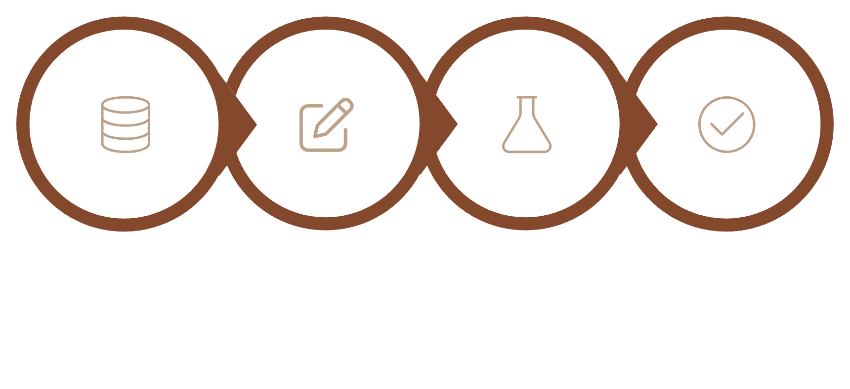
Data Quality Transformation
Before Cleaning
After Cleaning
Missing values
Duplicate transactions
Invalid dates
Negative amounts
Spelling mistakes
Extra spaces
Inconsistent values
Incorrect data formats
Consistent data
Valid transaction records
Correct formats
Reduced duplication
Fewer data-quality errors
Reliable dataset for analysis
Raw Dataset
Cleaning
Validation
Reliable Dataset
"Clean data is essential because outlier detection performed on incorrect data may identify data errors instead of genuine unusual transactions."

Slide 10

Expected Business Impact & Conclusion
The Challenge
The Solution
Large transaction volumes make manual outlier detection difficult. Outliers may result from fraud, errors, system issues, or legitimate activity.
A structured data-driven approach helps identify and investigate unusual transactions while improving risk monitoring, fraud prevention, data quality, and decision-making.
Key Takeaway
Outliers are not automatically fraud — they are transactions that require further investigation. Continuous monitoring reduces false alerts and adapts to changing patterns.

