Slide 1
K.I.S.S. Random Date Generator
TEAM: DJ Gilmore, Eric NuaneS, Luis (Fernando) Cely, Stenio PEreira

Slide 2






Description
Keep it simple stupid (K.I.S.S. – Random Date Generator)
Randomly generates date ideas for dining, music, events, and movies
Powered by Yelp!, Eventful, Absolute Vodka, TMDB, Spotify, & Amazon
Firebase, HTML5, CSS3, API, Bootstrap, Plugins, OAuth (authorization)
How it works…
Individual ideas – dining or event
Complete date – dining, drink idea, movie and event
Linked to Amazon to search gift ideas

Slide 3
Roles
D.J. Gilmore
Random Movie Selector & “Spinner App“
TMDB API
Eric Nuanes
Random Dinner Selector & Front-End Templates
Zomato API (team decided to use Yelp!)
Fernando Cely
Random Drink, Music, and Event Selector
Absolut Vodka, Spotify, & Eventful API
Stenio Pereira
Random Dinner Selector
Yelp API

Slide 4











Site Structure
USERS
LINK
APIs

Slide 5
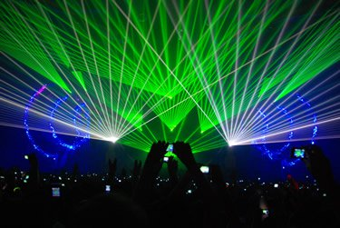
Site Demo
ADD SITE LINK

Slide 6
Appendix - Core Requirements
Must uses at least two APIs
Must use AJAX to pull data
Must utilize at least one new library or technology that we haven’t discussed
Must have a polished frontend / UI
Must meet good quality coding standards (indentation, scoping, naming)
Must NOT use alerts, confirms, or prompts (look into modals!)
Must have some sort of repeating element (table, columns, etc)
Must use Bootstrap or Alternative CSS Framework
Must be Deployed (GitHub Pages or Firebase)
Must have User Input Validation

