Slide 1
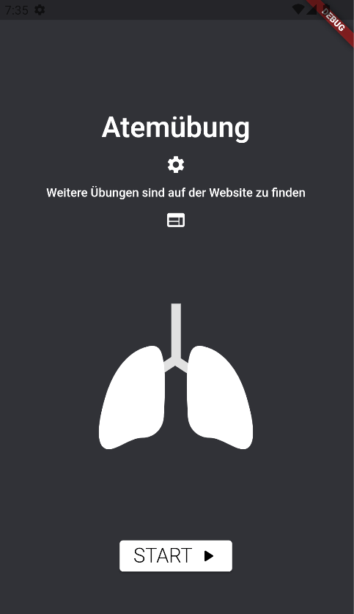
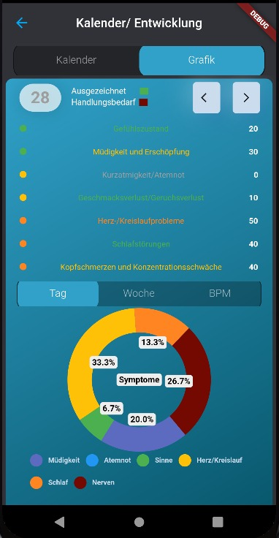
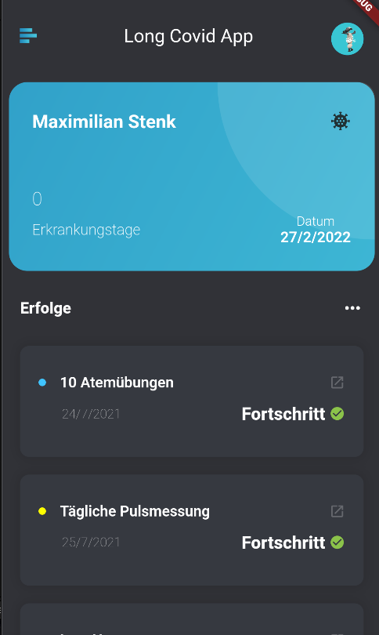
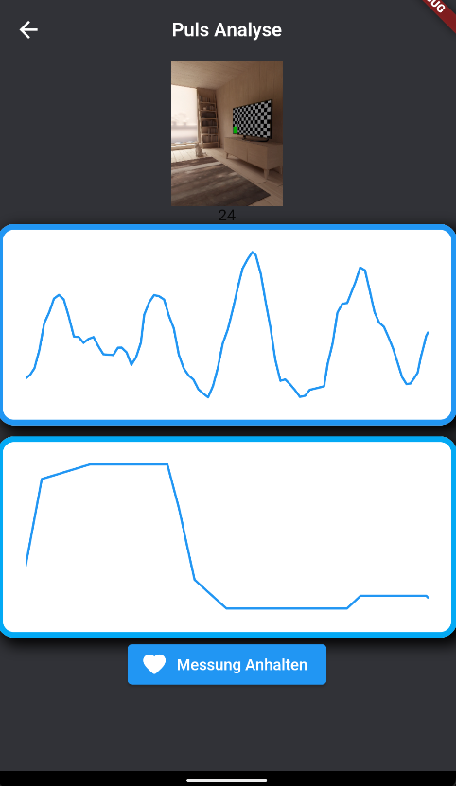
Studiengang eHealth
Long Covid App Maximilian Gritsch, Jan Stenk, B.Sc. Betreuer: DI Dr. Sten Hanke
BACKGROUND AND OBJECTIVES
As the pandemic progresses, it is becoming increasingly apparent that some patients will suffer long-term health consequences from covid infection, even in mild/unnoticed courses. This clinical picture is called Long Covid. An app will allow Long Covid symptoms to be recorded and exercises to be provided to assist patients in recovery.
RESEARCH DESIGN / METHODOLOGY
WHO and RKI publications were used to analyze the most common symptoms. Some exercises mapping these symptoms through measurable values were implemented in the app.
RESULTS / DISCUSSION
The app offers patients functions to analyze and monitor the most frequently occurring symptoms (breathing exercises, pulse measurement, symptom tracking). In addition, patients can fill out a daily questionnaire and receive feedback on their emotional and physical health status. Using a digital diary, this data is stored and displayed graphically. Thus, the patient can track his or her recovery progress on a daily basis.
PERSPECTIVES/IMPLICATIONS
A webapp would remove the barrier of having a functional smartphone. Furthermore, interfaces could be programmed to allow physicians quick access to the data they require.
Fig.1: Breathing Exercise
Fig. 2: Digital Diary
Fig. 3: Dashboard
Fig. 4: Pulse Meter
References
Gesundheitliche Langzeitfolgen Covid. Robert Koch Institut . (n.d.). Retrieved March 22, 2022, at https://www.rki.de/SharedDocs/FAQ/NCOV2019/FAQ_Liste_Gesundheitliche_Langzeitfolgen.html
World Health Organization. (n.d.). A clinical case definition of post covid-19 condition by a Delphi Consensus, 6 October 2021. World Health Organization. Retrieved March 22, 2022, at https://www.who.int/publications/i/item/WHO-2019-nCoV-Post_COVID-19_condition-Clinical_case_definition-2021.1
eHealth (Master) Studiengangsleitung: robert.mischak@fh-joanneum.at

