Slide 1
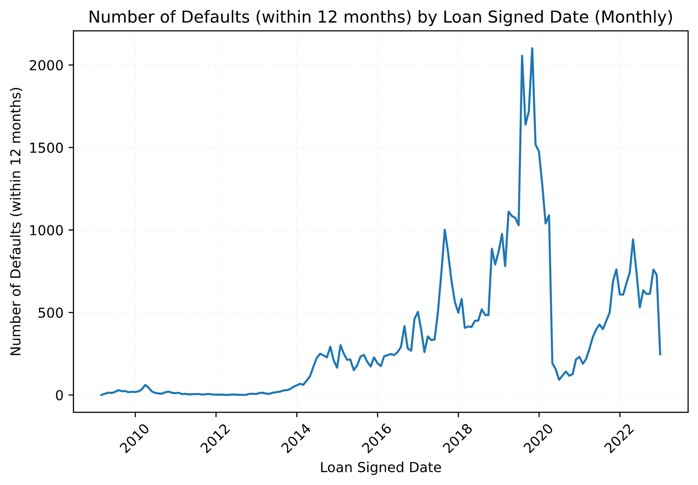
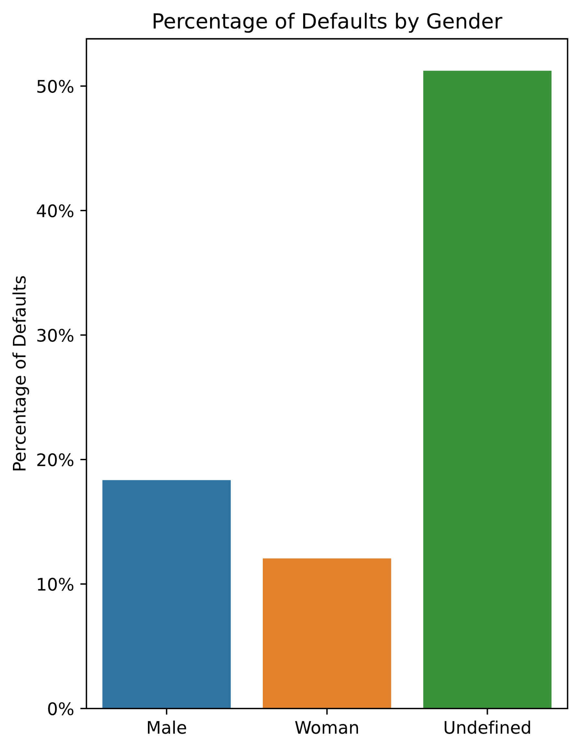
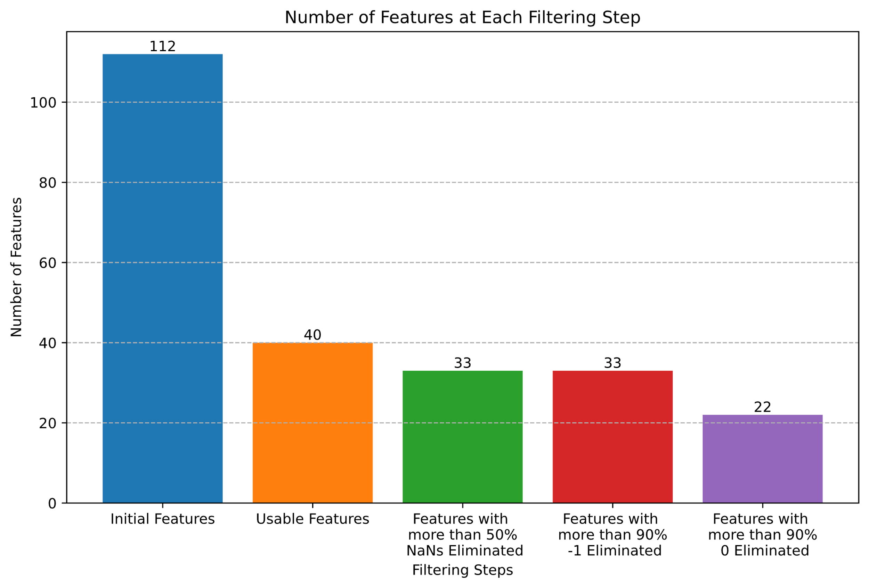
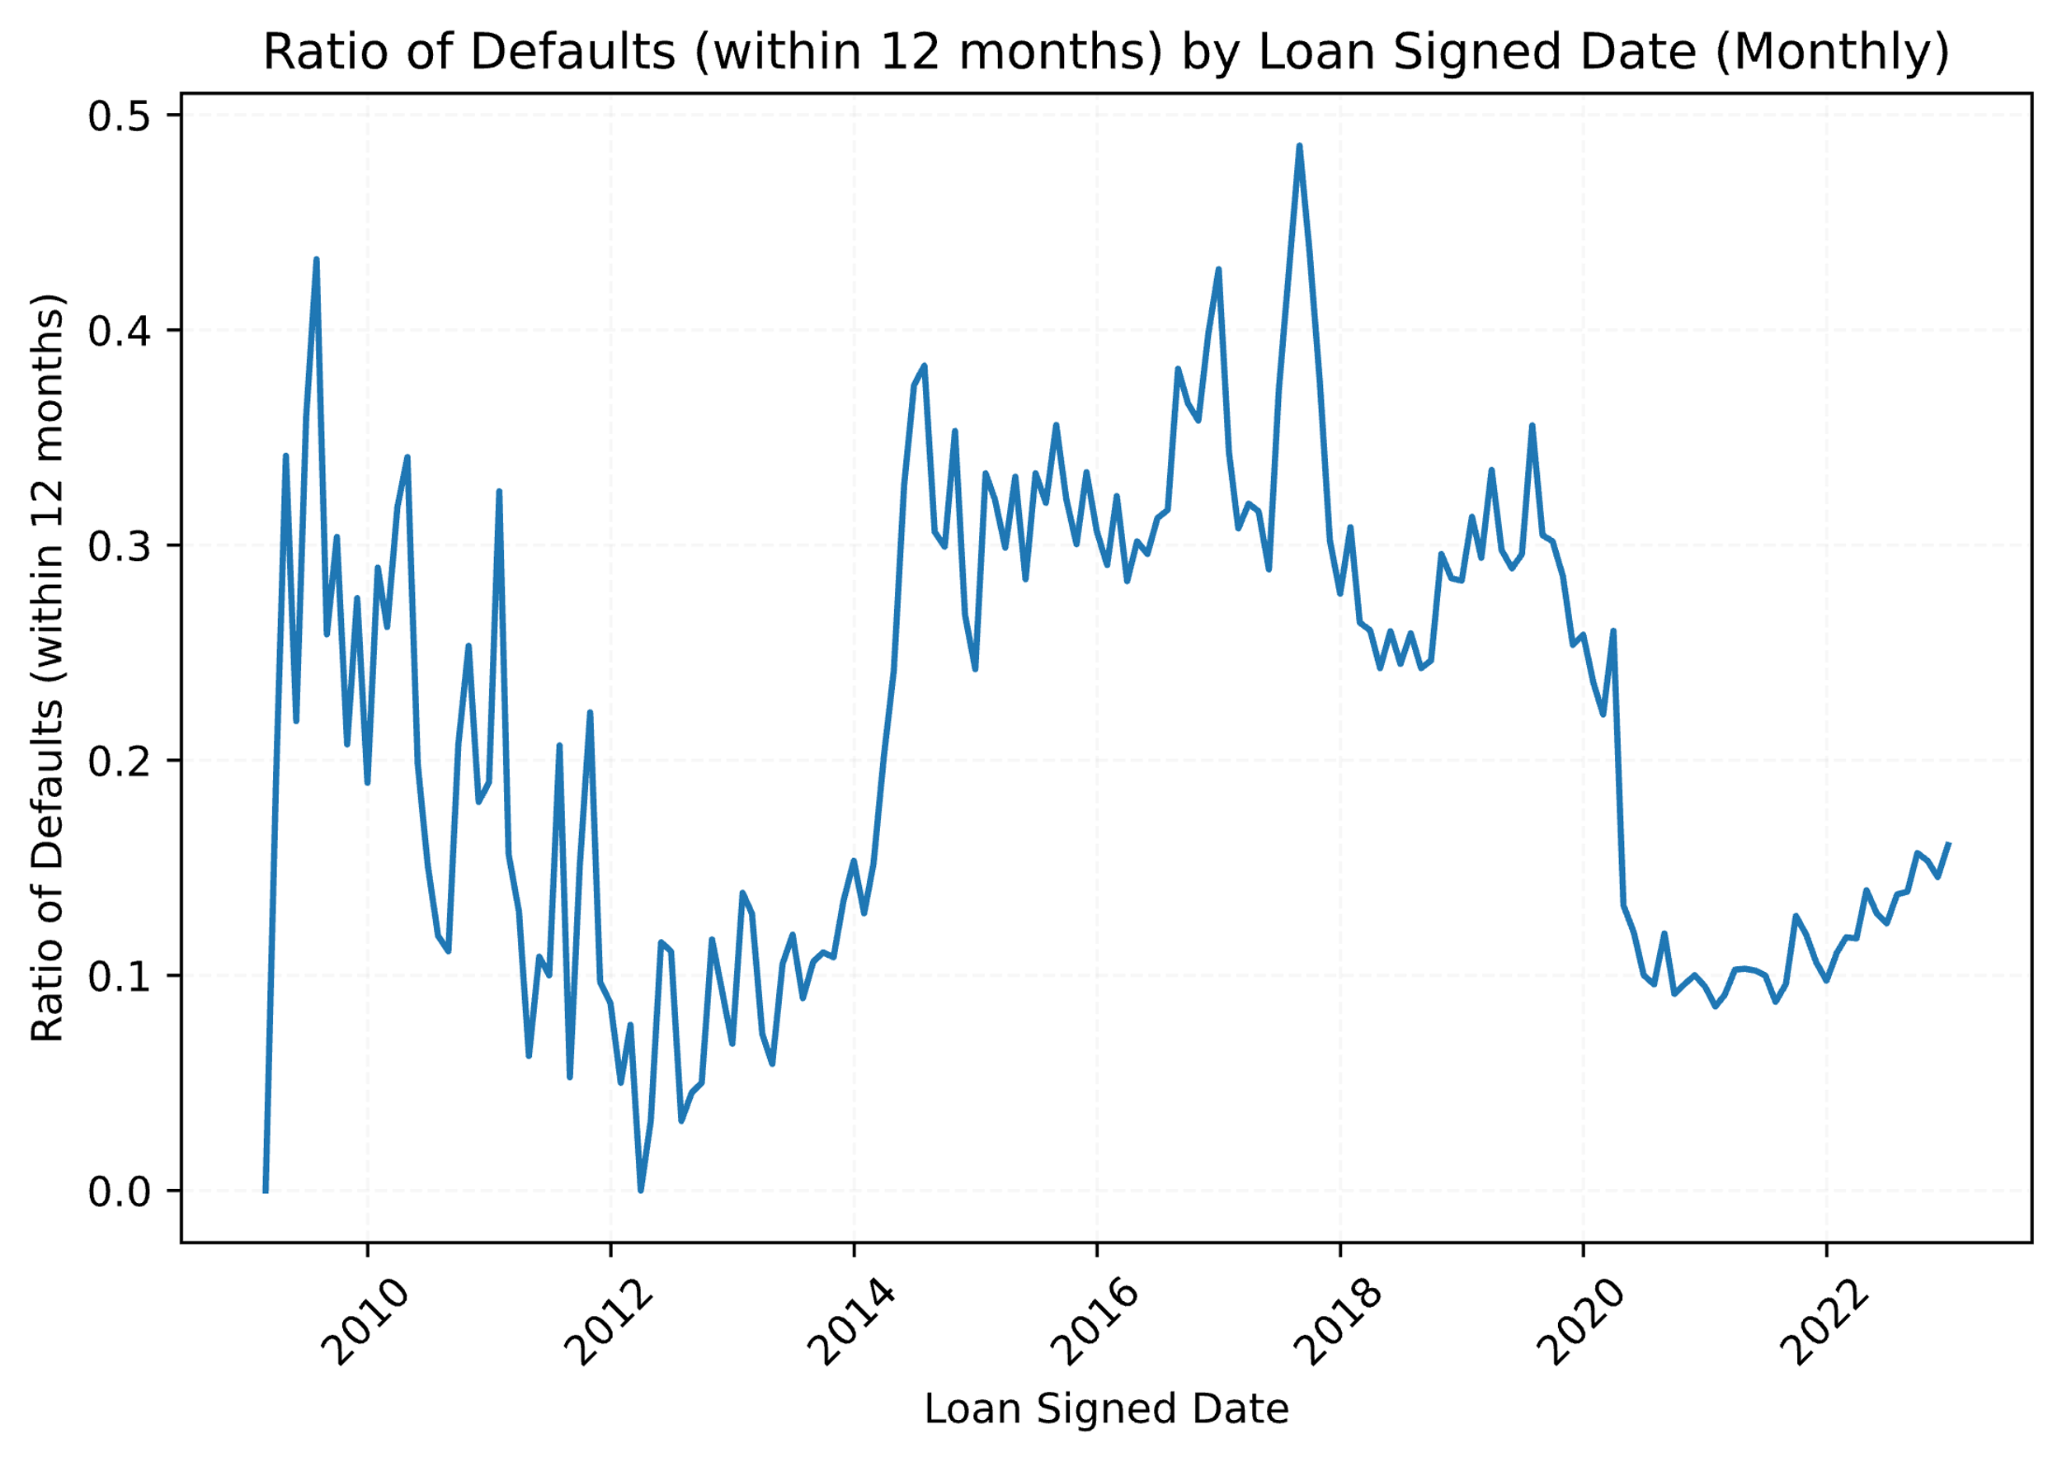
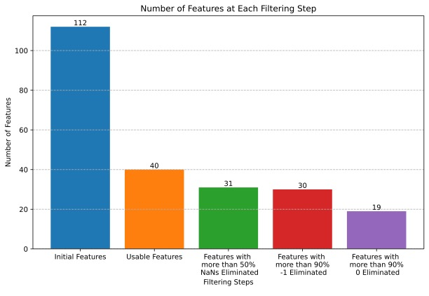
Predicting Defaults within 12 months of getting a loan
Author: Sten Raak
University of Tartu, Institute of Mathematics and Statistics
Introduction
Analysis
In the dynamic landscape of financial markets, predicting loan defaults is a critical aspect of risk management. Leveraging the Bondora public dataset, which provides comprehensive insights into borrower behavior, one can construct predictive models to forecast defaults within a 12-month horizon. Such models not only enhance the efficiency of lending institutions in managing risk but also empower investors to make informed decisions, ensuring a more secure and stable financial environment.
In 2020, loan defaults initially decreased amidst global economic challenges. However, as the year progressed, defaults rebounded, reflecting the complex interplay of economic dynamics and evolving borrower behaviors.
As an example, the significance of identity verification becomes evident as individuals with undefined gender exhibit a default rate exceeding 50%, contrasting with significantly lower rates among those with defined gender. Precise identity confirmation seems to minimize financial risks and promotes equitable and effective lending practices.
Feature selection
From an initial 112 features in the dataset, we picked out 40 critical variables through a selection process (relevant features when applying for a loan). We excluded seven due to over 50% missing values and 11 with over 90% zeroes. This refinement ensures our dataset is relevant for effective predictive modeling, emphasizing relevance and information richness.
Yet, this trend isn't entirely mirrored when examining the default ratio concerning all loans signed in a given month. Despite the initial decline in defaults, the overall proportion relative to the total loans signed appears to present a more nuanced perspective on the evolving landscape.
Model
Conclusion
Employing an XGBClassifier for default prediction demonstrated strong overall performance with an AUC of 0.798. Despite this, precision for predicting defaults was observed at 0.39, suggesting a nuanced balance between sensitivity and precision in the model's predictive capabilities. The accuracy was 0.75 and an overall weighted average f1-score was 0.78.
In the realm of financial markets, predicting defaults within 12 months is crucial for risk management. Leveraging the Bondora dataset, we pruned the features from 112 to 40.
Using an XGBClassifier, our model exhibited a fair performance with a cross-validated AUC and a test set AUC. However, precision for predicting defaults was 0.39, emphasizing the need for more data related to the customer (for example bank statement data or gambling).
This analysis underscores the importance of informed decision-making in navigating financial complexities.
 | Precision | Recall
Not default | 0.92 | 0.77
Default | 0.39 | 0.67

