Slide 1
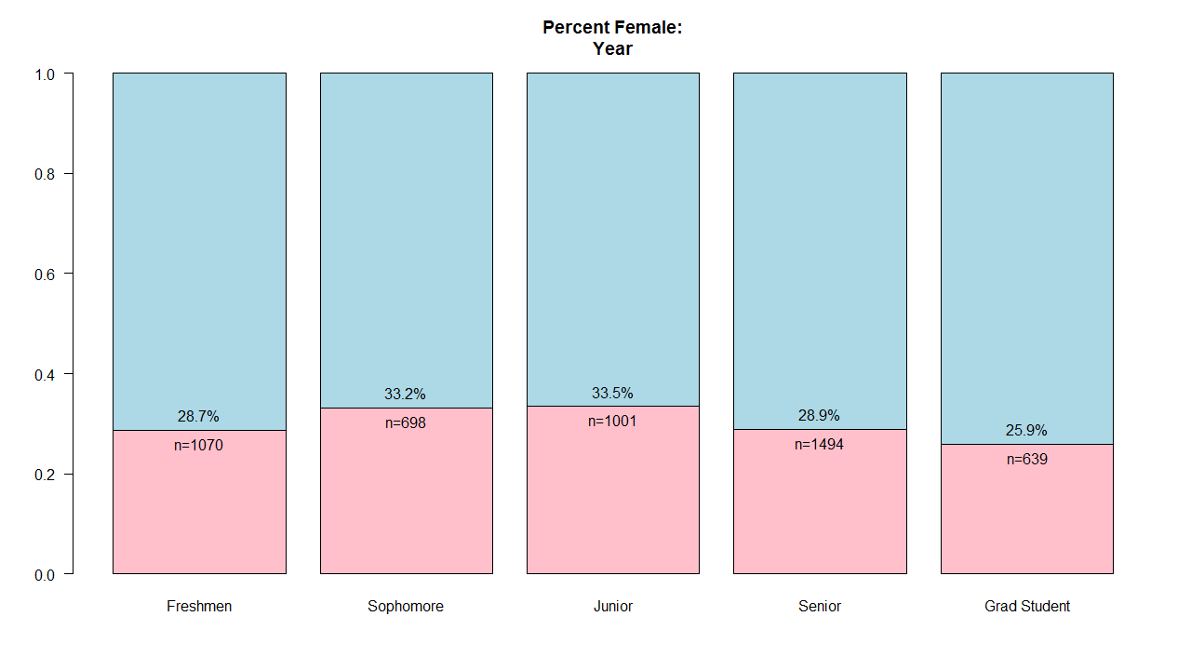
RPI Gender Breakdown Estimate https://github.com/stensonowen/RPI_ratio

Slide 2
Overview
      Python Scraping
      Statistics
      Plotting in R

Slide 3
Python Scraping
Data courtesy of Rensselaer Directories
Python's Requests library used for download
  Session object necessary to follow redirects
Takes about 15 minutes
Gathers about 10,000 entries
Relevant functions: get_by_index(n), parse(html), extract(data), fetch(n)
Demo

Slide 4
Statistics
Name data from ssa.gov/oact/babynames
Data in the form “<Name>,<[M|F]>,<Count>”
Data from '93-'97 gives 37k names, 18M people
Count[i] and sum(Count) give
“<Name>,M,<CountM>” and “<Name>,F,<CountF>” give
Bayes' Theorem gives

Slide 5
Plotting
Generic barplot() in R
Function annotated_barplot() automatically plots subsets of the results, and formatting can be optionally specified

Slide 6
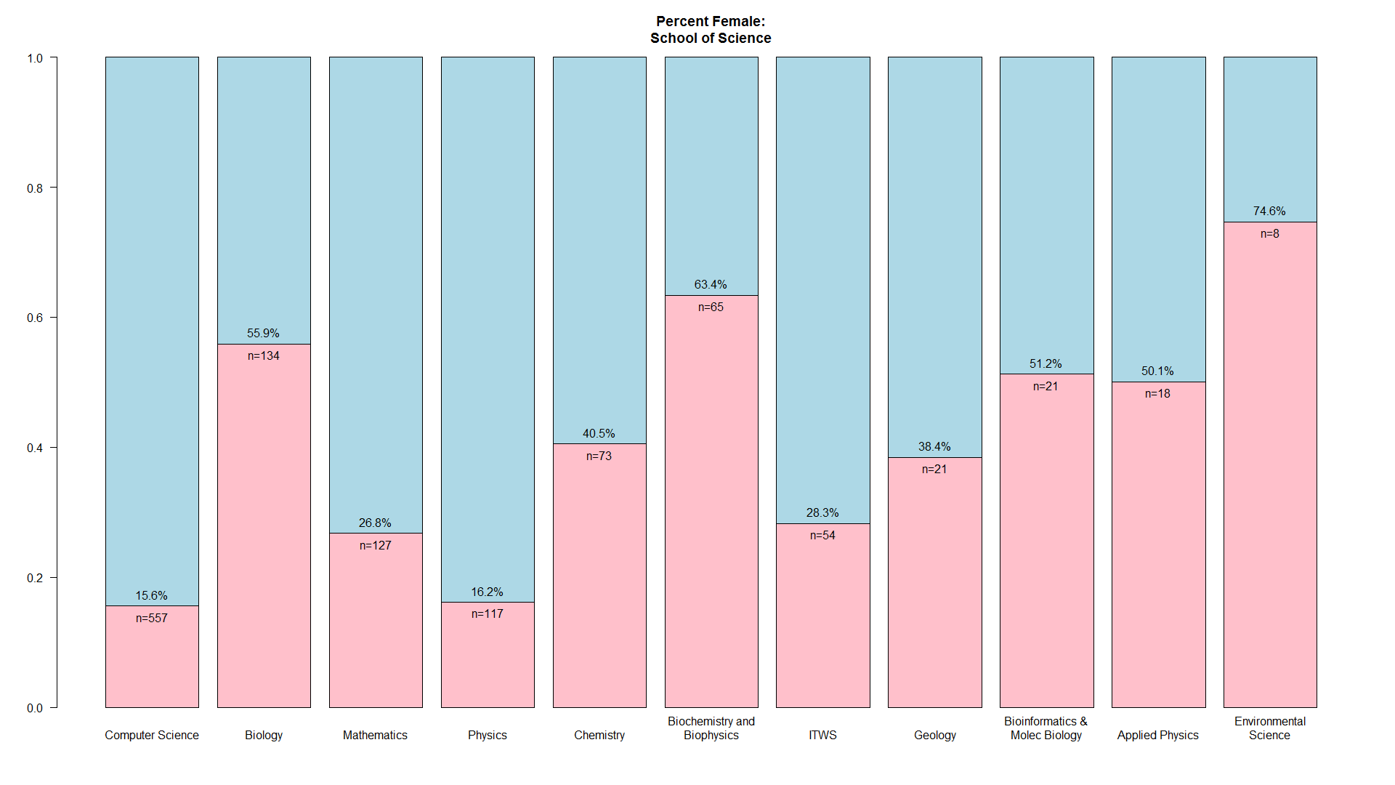
Example: School of Science

Slide 7
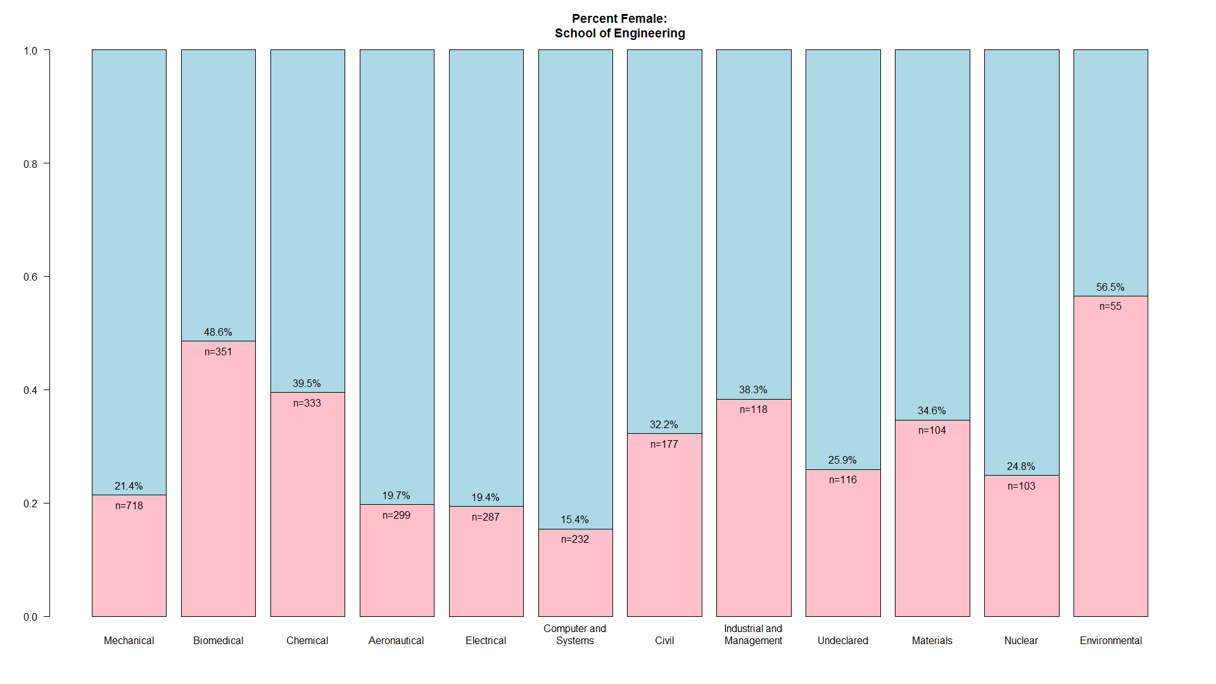
Example: School of Engineering

Slide 8
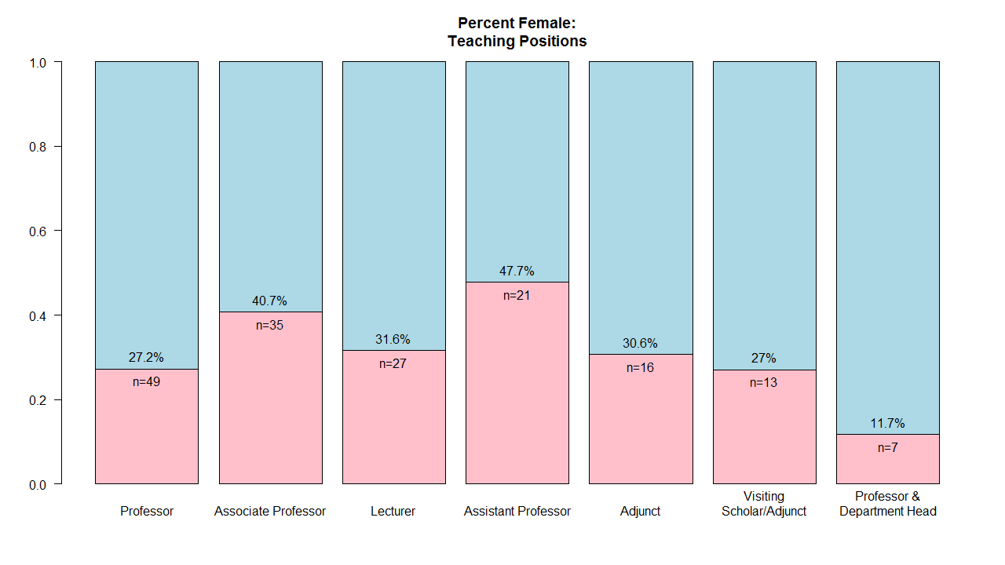
Example: Teaching Positions

Slide 9
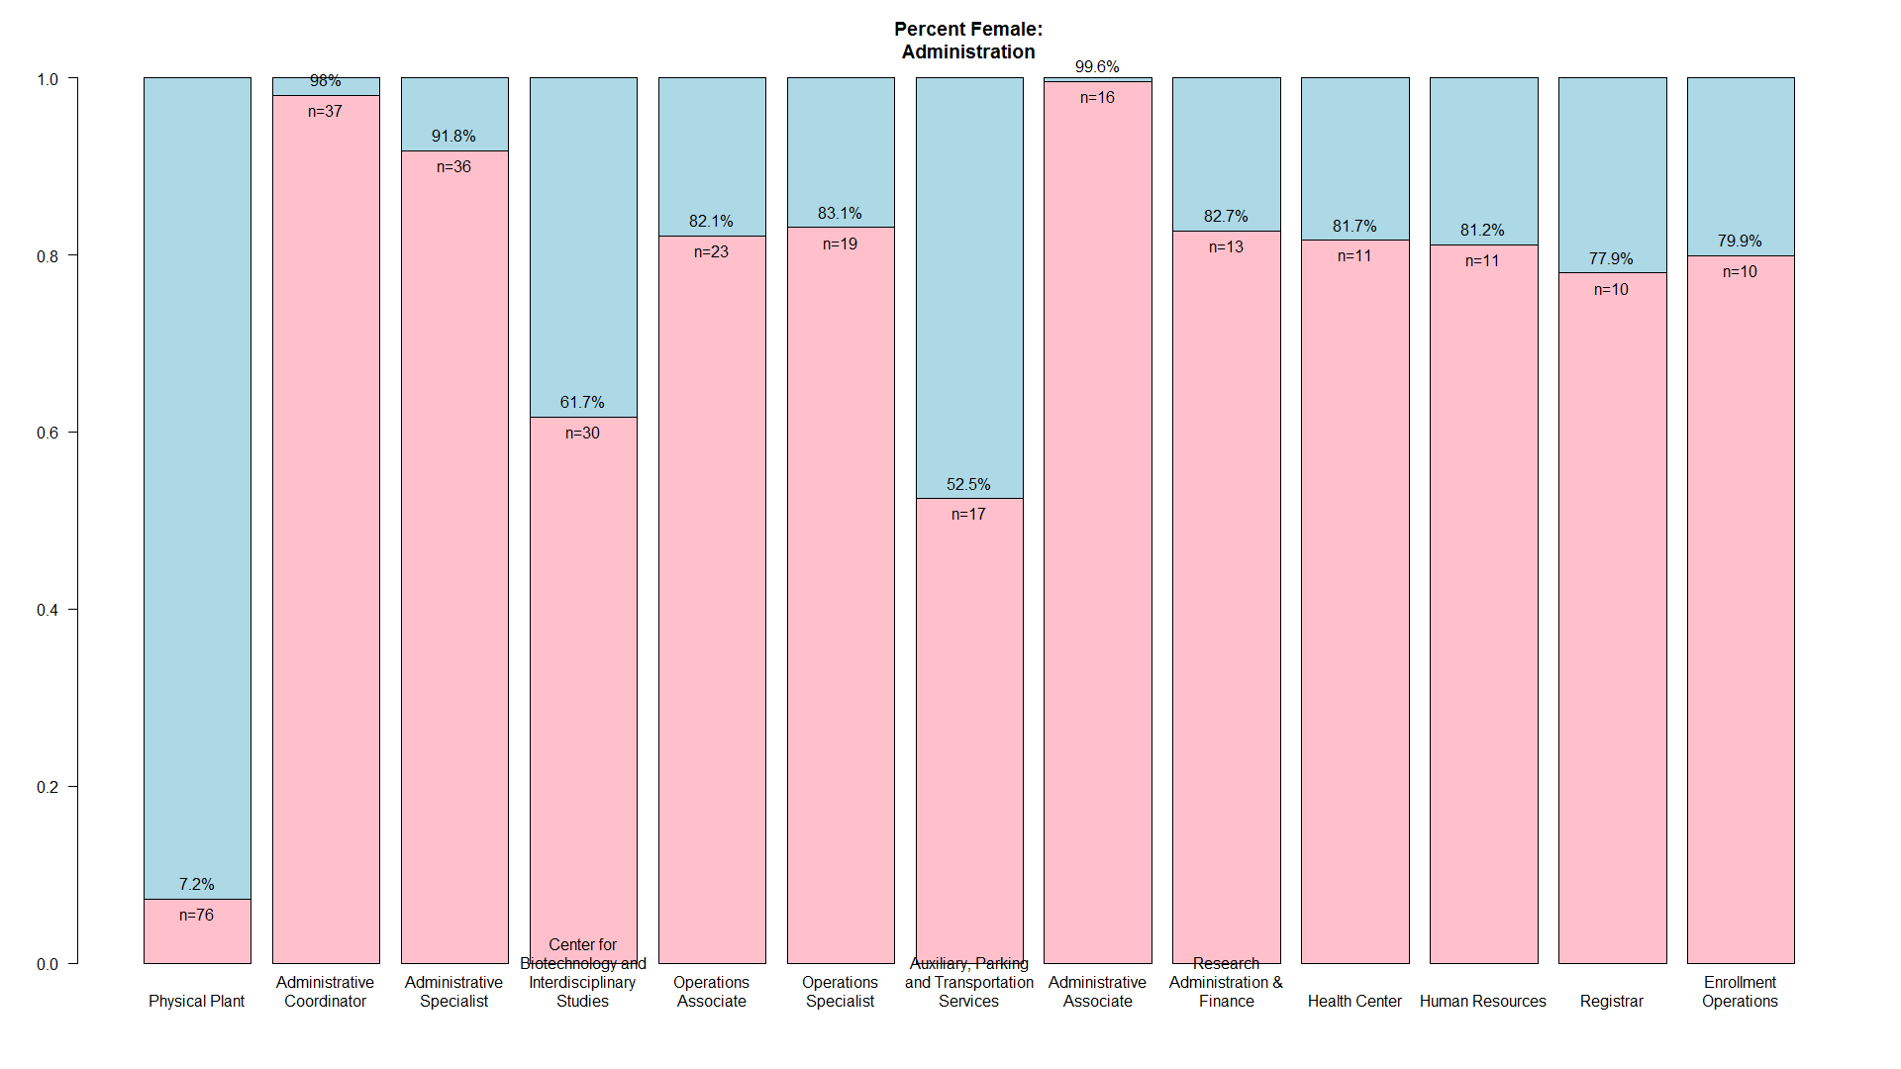
Example: Administration

Slide 10
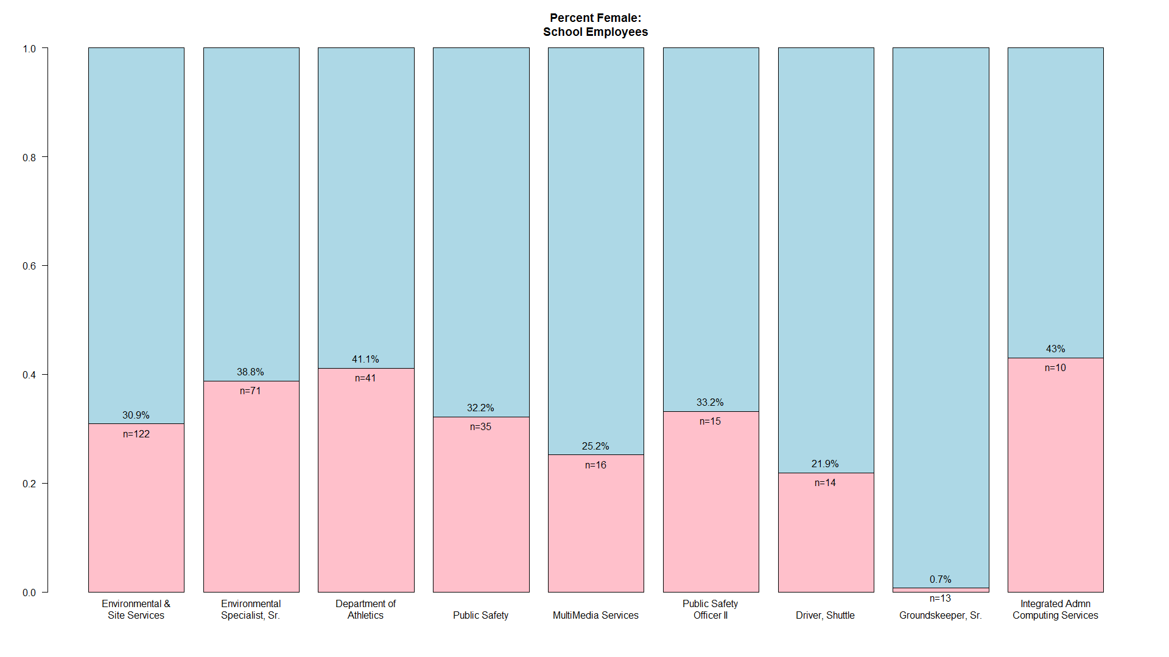
Example: Employees

Slide 11
For More:
Slides and more images at https://github.com/stensonowen/RPI_ratio
More data in results.csv file
More student data at https://rpidirectory.appspot.com/

