Slide 1
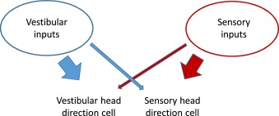
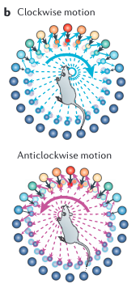
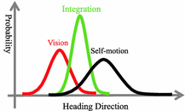
Head direction
Ring attractor + conjunctive cells (provide angular velocity input)
upstream angular velocity-responsive cells
Dudchenko et al 2019 ( 2 HD populations)
Doesnt seem to be any talk of HD conjunctive cells in the experimental literature so far
Sun et al 2018
HD updated by environmental cues - small cue conflict leads to cue integration and large cue conflict to WTA
Bassett et al 2018
during development at least corners stabilise HD cells - coincides with whisking development
Fits with : absolute preferred firing directions can change following disorientation but constant relative to each other

Slide 2
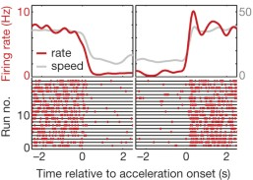
Rowland et al 2016 REVIEW
Head direction cell + speed cell -> conjunctive grid cell? (2D attractor)
Kropff et al
get speed conjunctive cells both with border, HD and GCs
Speed calls make up 15% of all MEC cells across all layers
short range excitation and long range inhibition (mexican hat connectivity) produce grid
Grid modules contain grid cells of that same scale and orientation -> each module may be individual attractor network

Slide 3
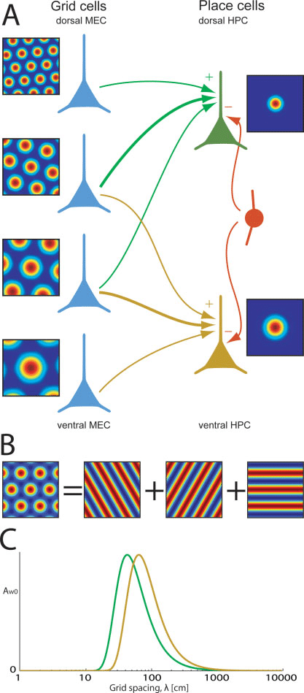
Dudchenko et al
Dorsal
Ventral
Sharply tuned
Broadly tuned

Slide 4
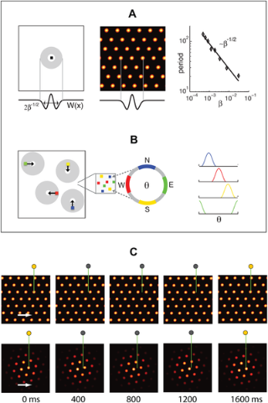
Burak et al 2009 suggests:
In small groups of GCs each gets specific head direction input and has asymetrical connections to move activity packet around network but itself does not have directional firing
Model periodic networks (twisted torus) and aperiodic where new grid fields are generated as a result of inhibition from surrounding cells
** periodic easier to start with
Spiking models are noisy because spikes are discrete events and periodic model performs better

Slide 5
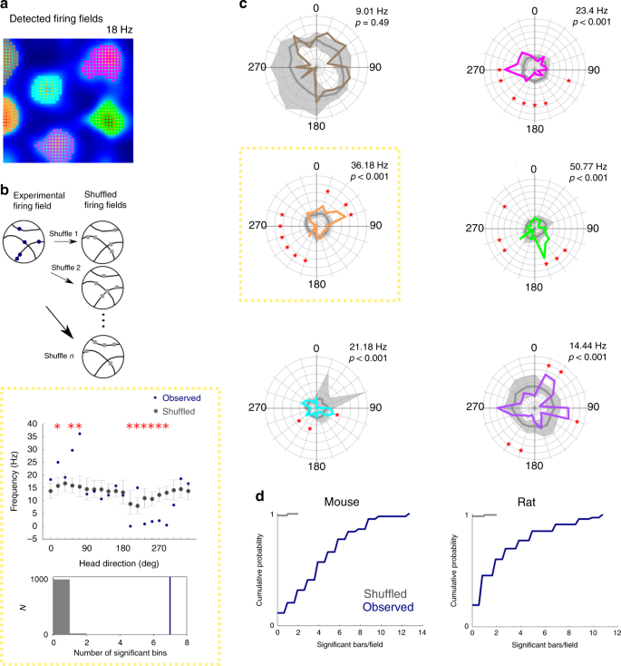
Gerlei 2020
Each firing field of GC has directional preference - sum leads to non-directional grid cell
Combination of conjunctive grid cells with different firing frequencies in different field can lead to this

Slide 6
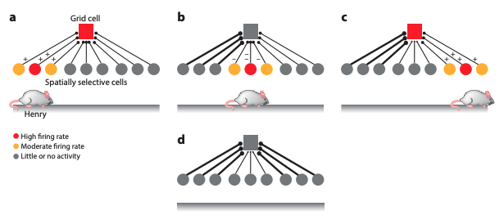
Solstad 2006
place field could be generated from many grid fields with different spacings
the number of GCs required to produce a single place field increases with the size of the arena
Castro et al 2014
Can get grid pattern out of PC activity
Grid cell firing is tied to one place cell at a time - must escape that cells field (conneciton function of distance to field center) for another cell to take control
PC compete for control of grid cell - favors efficient packing (looses hexagonal structure at large scales)
HD and PC emerge before GCs in development
NO PATH INTEGRATION REQUIRED - but we want to use GCs for path integration...
Guanella et al 2007
Alternativly PC input to GCs corrects for path integration errors
PCs provide allothetic info (encode unique points in the environment eg salient points etc)
Succest hebbian synapses between PC and GCs - learn associations between correlated activity - path integration error leads to mismatch
(assums PC are product of boundaries and visual landmarks)

Slide 7
Boundary effects on grid cells:
If walls move the grids will expand or contract (Barry et al. 2007, Stensola et al. 2012)
Walls cause rotation and deformation of the grid (shearing) (modle in Stensola et al. 2015)
'grid patterns are deformed by forces from the borders of the environment whose strength decreases with distance from the walls'
in environments with multiple conpartments get fractured grid -> new map for each compartment (Derdikman et al. 2009) -> caused by interacting sheer forces from walls -> with experience of the environement the maps merge (Carpenter et al. 2015)
Two classes for excitatory projection neurons - both can be grid cells:
pyramidal cells
stelate cells: only in layer II (where grid cells most abundant)
superficially branching dendrites
strong hyperpolarization-activated current
only 50% of stellate cells are grid cells

Slide 8
