Slide 1
URLpay

Slide 2
Description
Send online cash, quick and easy!

Slide 3


Problem
ugh, I drank for Kairi’s money last night...
hey, I think I owe u €20 for last night.
yh
can u give me ur bank account no?
here u go.
EE909900123456789012
Taivo
[doing bank stuff]
Kairi
thx, done.

Slide 4
Solution
ugh, I drank for Kairi’s money last night...
hey, I think I owe u €20 for last night.
here’s ur money:
urlpay.com/30b95fd27233b953739efc06
great, thx.
Taivo
Kairi

Slide 5
Problem
Overhead on accounts & details
Private bank info

Slide 6
DEMO
Notes:
MVP back-end – girl in back-end.

Slide 7
Metrics
CTR on TW links/affiliate sites
% of visits converted
% of sent payments received

Slide 8
Early adopters
Tech-savvy
20-something
Medium income
Dines/drinks out with friends

Slide 9
Market
P2P national transfers
Freelancers >1B $
Classified ads >10B $
Notes:
We are somewhat like BitCoin – if you have the link, you have the money.

Slide 10
Competition
SnapCash
Facebook payments
Notes:
Both need users/registration, we don’t. We are quicker, have low costs and have better privacy.

Slide 11
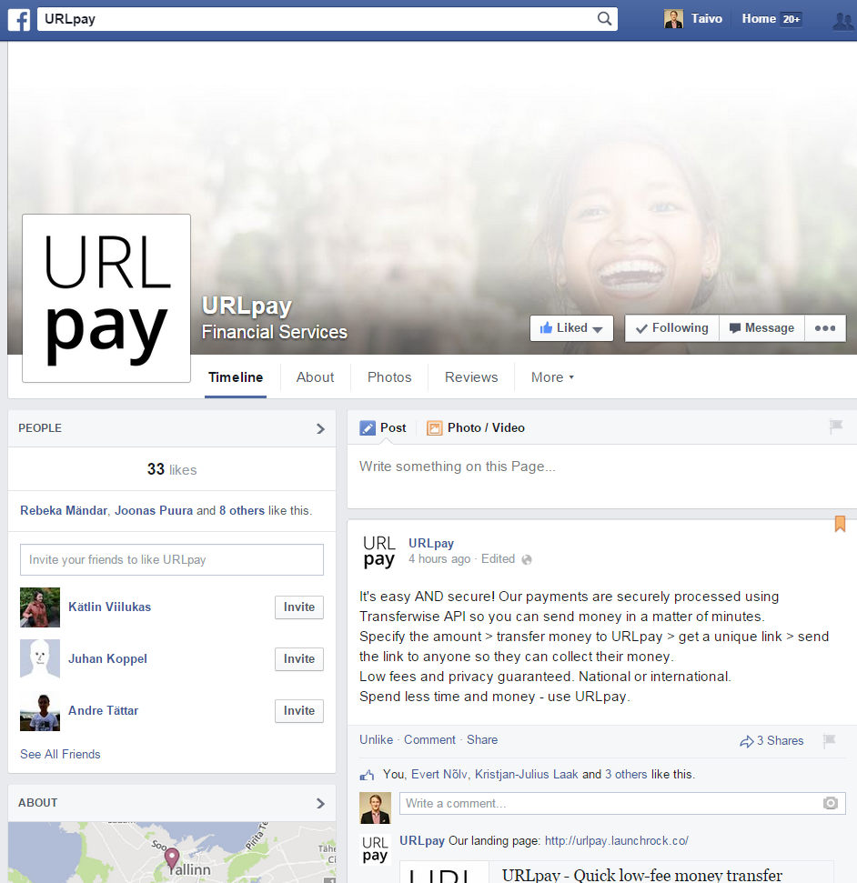
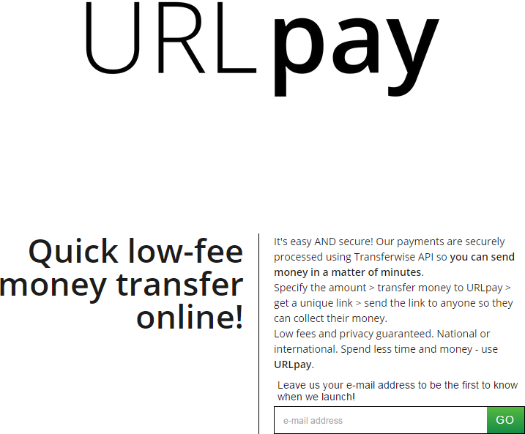
Idea validation

Slide 12
HIRING
Lead backend operator (Lasnamäe)

