Slide 1
Redux 8 April 2019

Slide 2
Lecturing is a mysterious process by which the contents of the note-book of the professor are transferred through the instrumentation of the fountain-pen to the note-book of the student without passing through the mind of either.
– Edwin E. Slosson

Slide 3
Topics
What is Redux
Redux Middleware
Async Flow in Redux
Advanced Redux – redux-observable

Slide 4
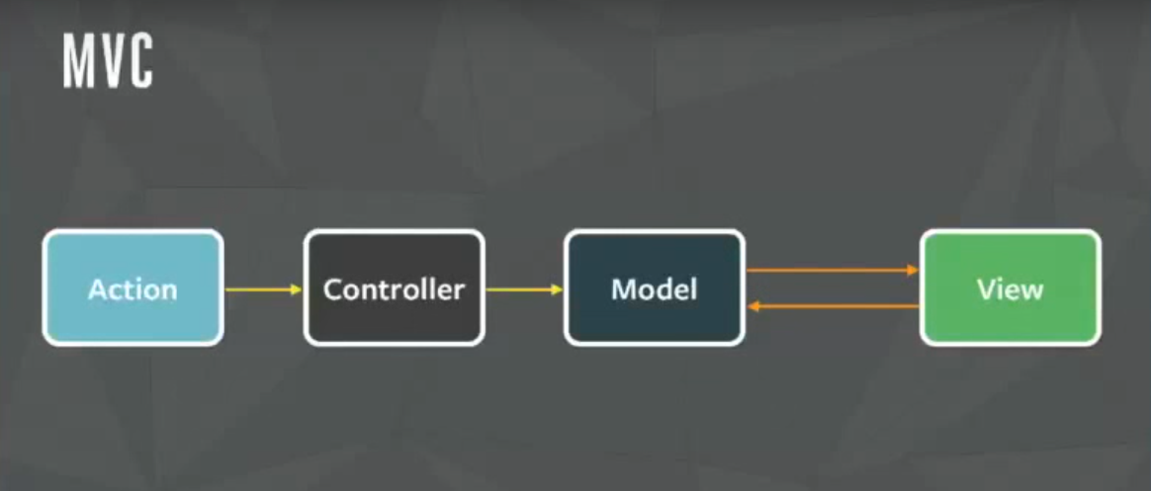
What is Redux
What’s MVC?
Source: Facebook

Slide 5
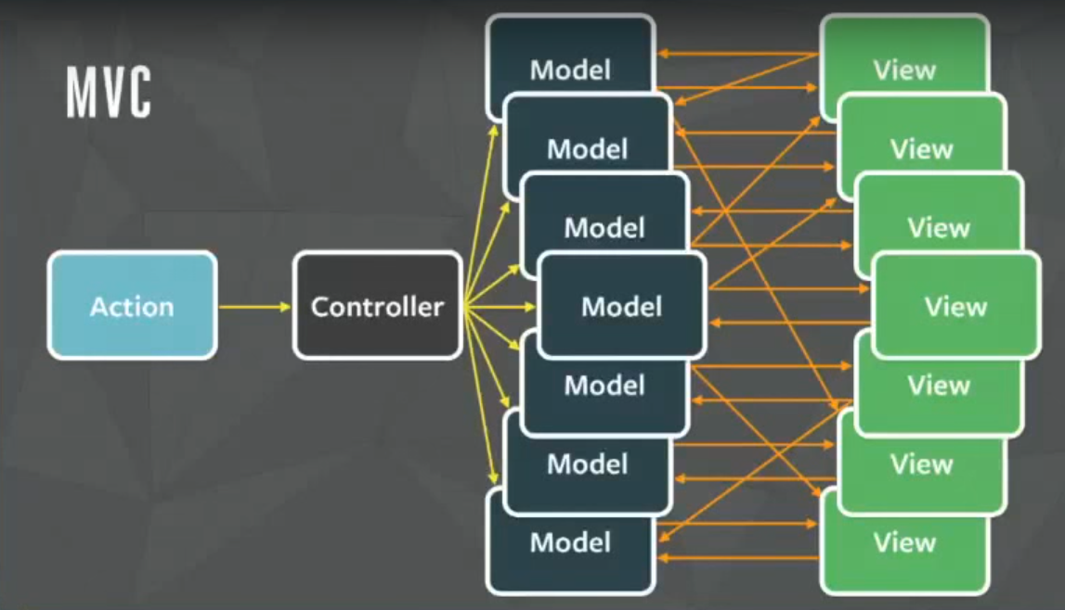
What is Redux
What’s wrong with MVC?
Source: Facebook

Slide 6
What is Redux
Next generation of design pattern – Flux
Flux is a concept, just like MVC
Redux is by far most popular implementation (with a slight variation) of Flux

Slide 7
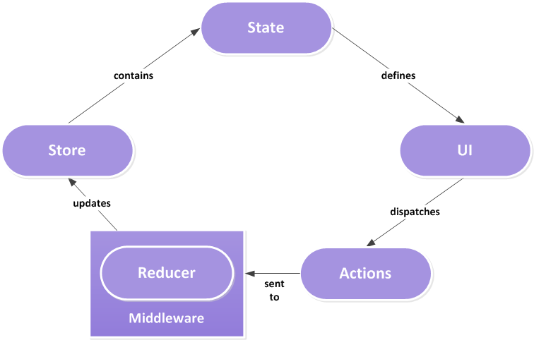

What is Redux

Slide 8
What’s in Redux
Action – plain JavaScript object with "type" attribute
Action creator – a function that returns an action
Reducer – a function to do aggregation
Takes in current state and action
Return next state
Must be a pure function
Store – where state lives

Slide 9
Demo

Slide 10
Redux middleware

Slide 11
Redux middleware
Similar to middleware in ExpressJS
Similar to javax.servlet.Filter or @WebFilter in Java
The 2 abovementioned examples wrap around a web endpoint with the capability to intercept or manipulate request/response

Slide 12
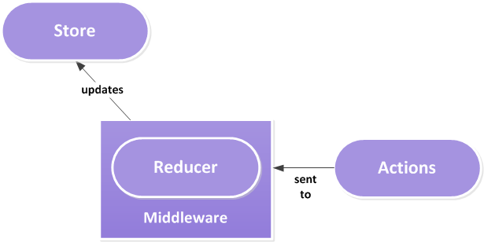
Redux middleware
A quick recap of middleware

Slide 13
Demo

Slide 14
Async Flow in Redux

Slide 15
Async flow in Redux
Redux is synchronous
Just like MVC
function fetchInsurance(id) {
doSomething();
fetch(`http://host/insurances/${id}`)
.then(resp => resp.json())
.then(body => {
updateUI(body);
});
setLoading(true);
}

Slide 16
Async flow in Redux
Side effects happen in a middleware
Instead of dispatching action, we dispatch a function that will dispatch an action
The inner function being dispatched will be resolved by the middleware
There is where redux-thunk comes to saviour

Slide 17
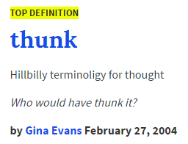
💡Fun fact
What’s thunk?
Jokes aside, thunk is a function that’s returned by another

Slide 18
Thunk example
Scenario 1
function fx() {
return 1 + 2;
}
const x = fx(); // x = 3

Slide 19
Thunk example
Scenario 2
const fx = () => () => 1 + 2;
// semantic for
function fx() {
return function () {
return 1 + 2;
}
}
const x = fx()(); // x = 3
// semantic for
const expr = fx();
const x = expr(); // x = 3

Slide 20
redux-thunk
store.dispatch(fetchInsurance(id));
function fetchInsurance(id) {
return function (dispatch) {
fetch(`http://host/insurances/${id}`)
.then(resp => resp.json())
.then(body =>
dispatch({
'type': 'LOAD_INSURANCE’,
'payload': body
})
);
}
}

Slide 21
Redux Observable

Slide 22
Q & A

