Slide 1

What is Ethereum?
Presented by: [Name] @[twitter handle]
Part of the Ethereum 101 Series: www.ethereum101.org

Slide 2
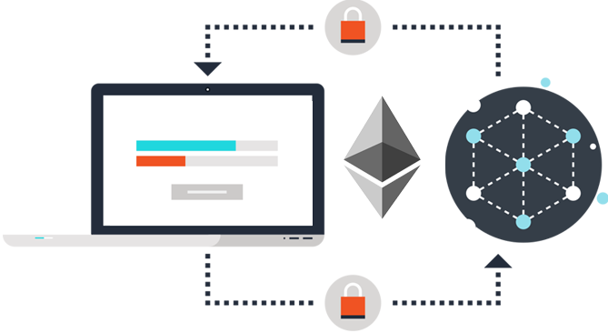
Ethereum is a platform that makes it possible for any developer to build and publish next-generation distributed applications.

Slide 3
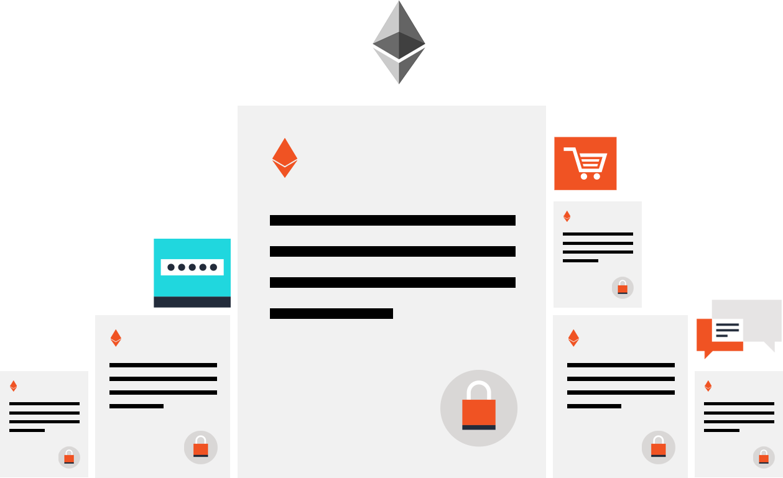
Code-based contracts are the main building blocks of Ethereum.
Notes:
Ethereum’s primary programming language is a javascript-like language called Solidity. Complete list of languages: Solidity: Javascript-like language.
Serpent: Python-like language. Mutan: C-like language.
LLL: Lisp-like language. All other languages are implemented in LLL.

Slide 4
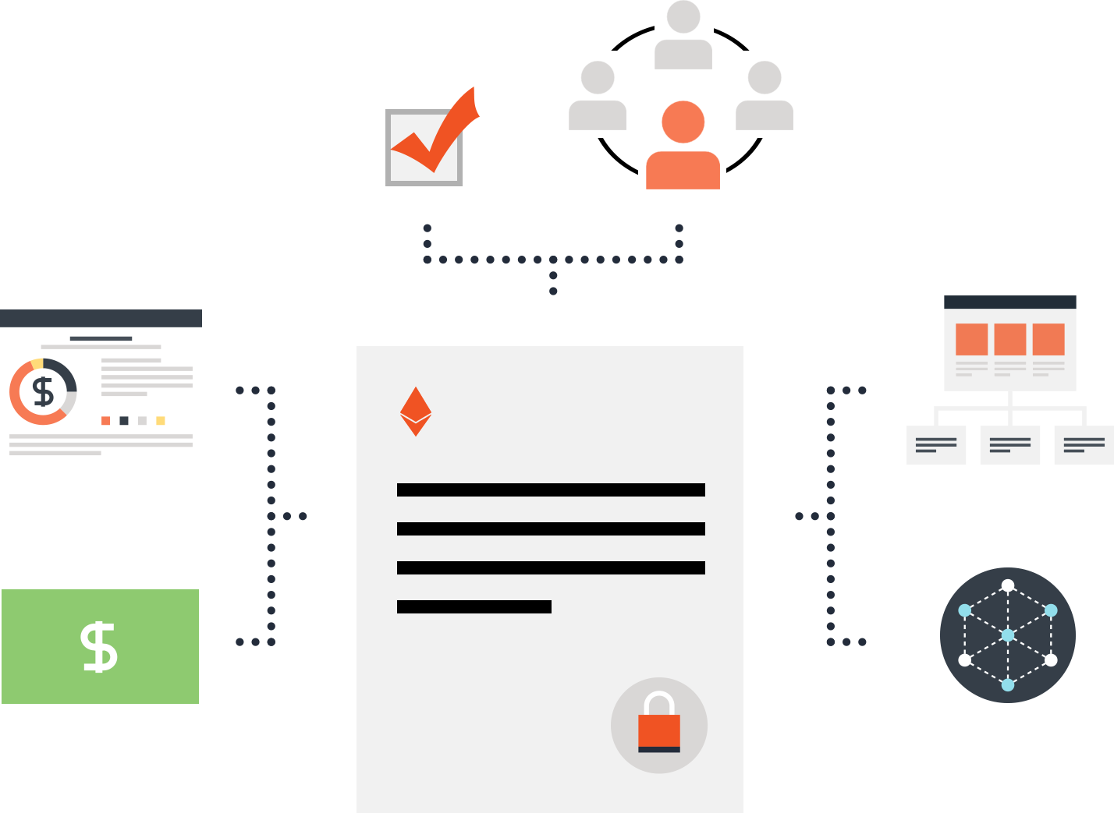
Contracts can be used to build currencies, financial derivatives, voting systems, decentralized organizations, data feeds, title registries and thousands of other applications.

Slide 5
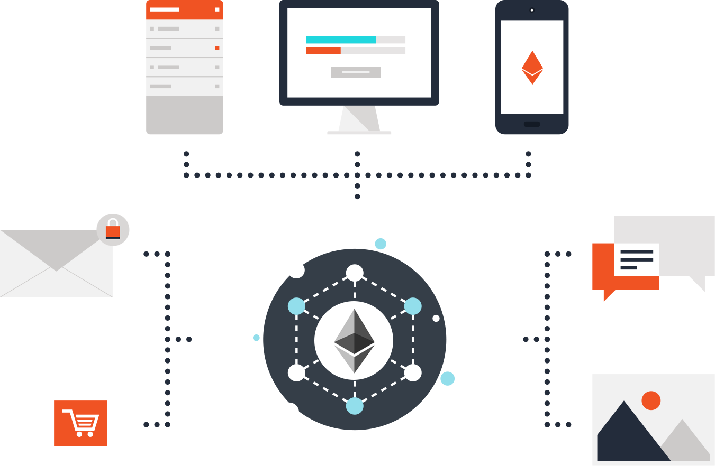
Ether is Ethereum's cryptofuel. It is a type of digital token that powers the applications on the decentralized network.

Slide 6
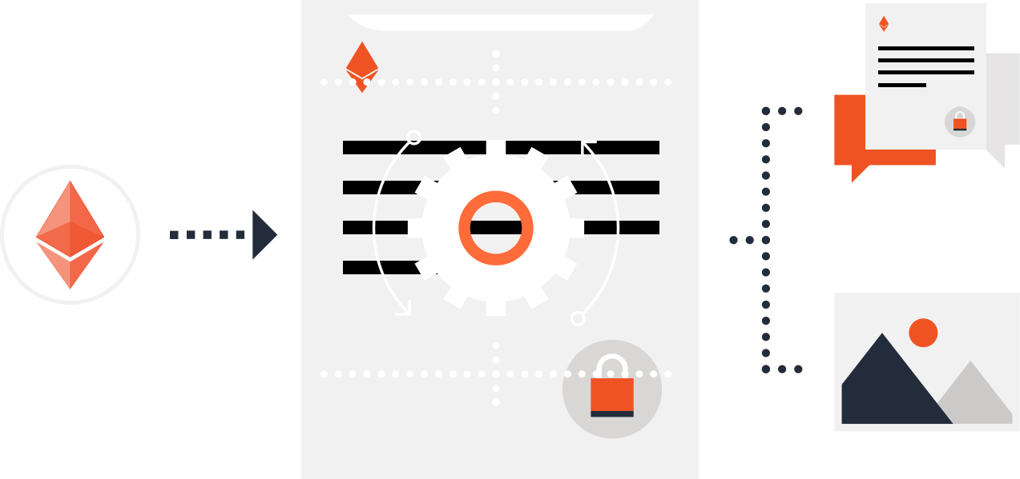
Sending a transaction to a contract causes its code to execute. Contracts can store data, send transactions and interact with other contracts.

Slide 7
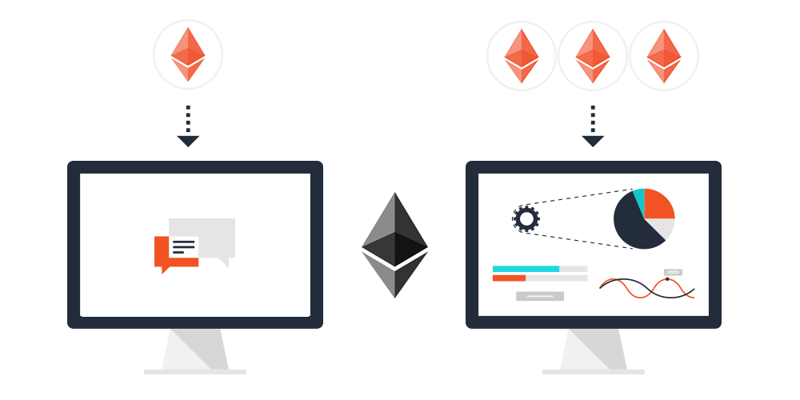
The more computation a transaction requires the more ether it consumes.

Slide 8

Mist is the Ethereum client. It allows decentralized applications built for Ethereum to be used like any other web application.

Slide 9
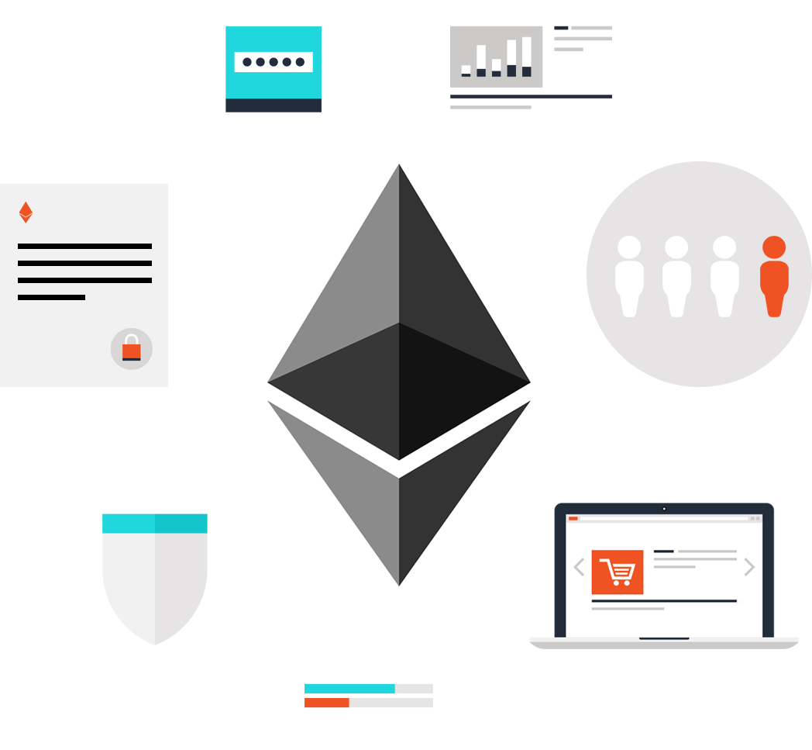
Ethereum can be used to codify, decentralize, secure and trade almost anything.

