Slide 1
2019 Canadian Election tweets
Sentiment 140: Modelling Results

Slide 2
Sentiment 140
1. Cleanup

Slide 3
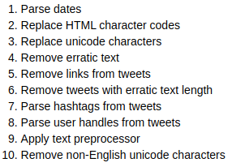
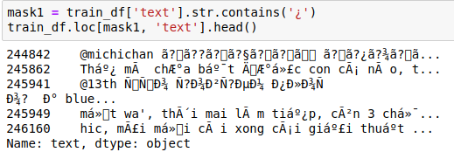
Cleanup: consistency
Correcting text for consistency

Slide 4
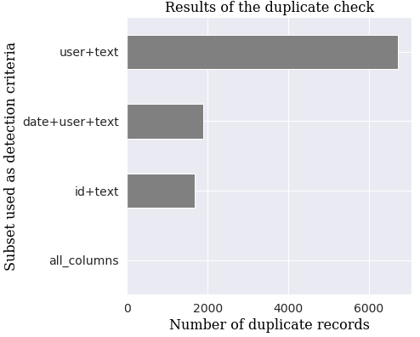
Cleanup: duplicates
Duplicated mislabelled tweets
Duplicated posts

Slide 5
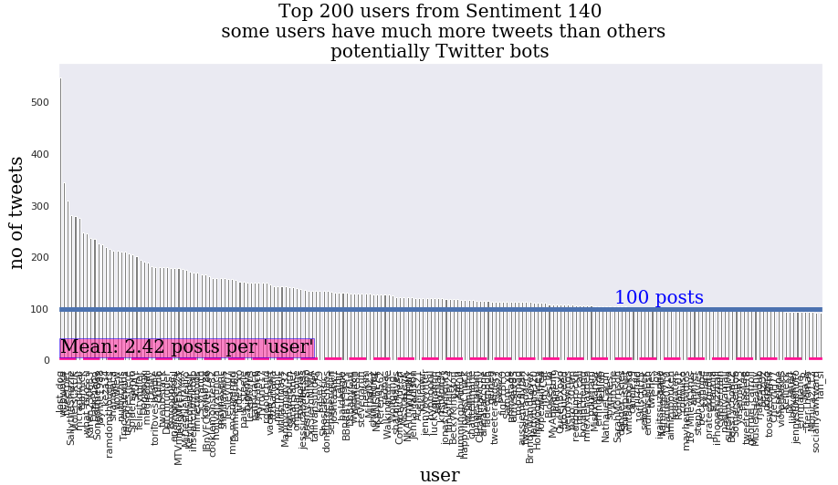
Cleanup: tweeter bots

Slide 6
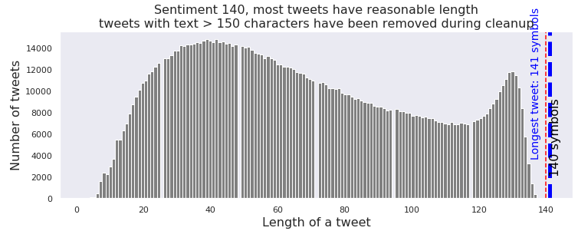
Cleanup: sanity check

Slide 7
Sentiment 140
2. EDA

Slide 8
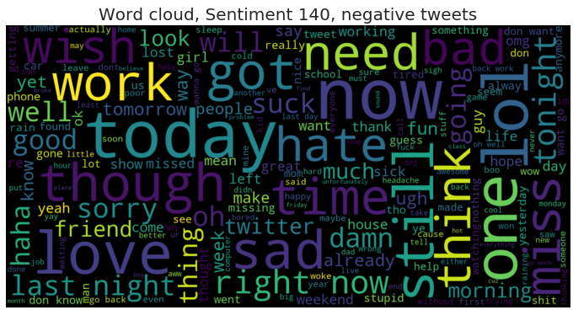
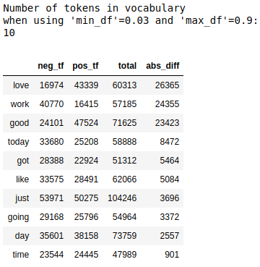
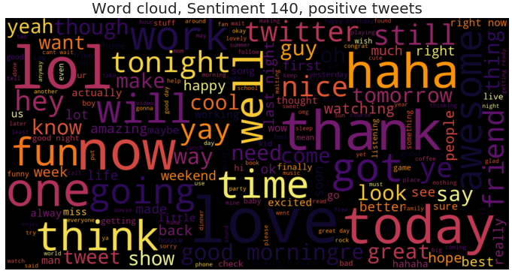
EDA: TFM and word clouds

Slide 9
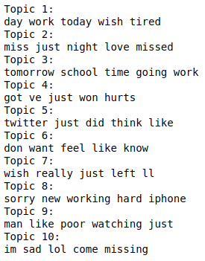
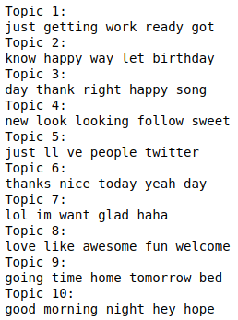
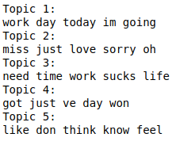
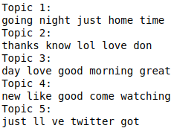
EDA: Latent Dirichlet Allocation
Negative tweets
Positive tweets

Slide 10
Sentiment 140
3. Grid search of text vectorization hyperparameters

Slide 11




Text vectorization
Tokenization
Porter stemmer
Snowball stemmer
Lancaster stemmer
Vectorization hyperparameters:
ngram range
(1,1), (1,2), (1,3)
stop words
Term freq / TF-IDF

Slide 12
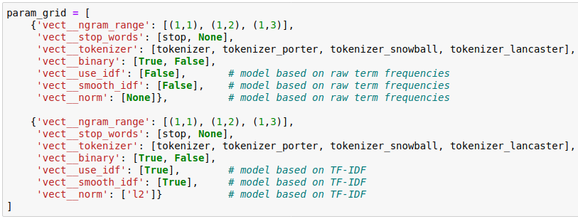
Grid search: parameter grid
Parameter grid used for grid search

Slide 13
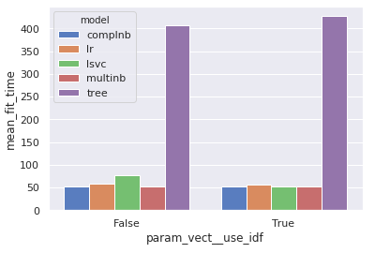
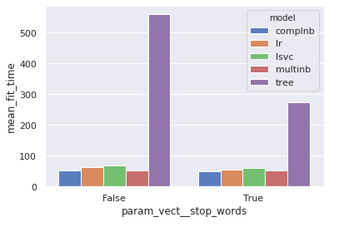
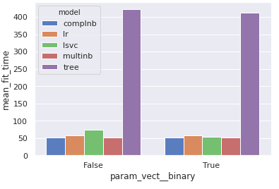
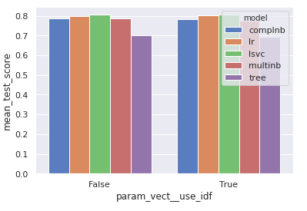
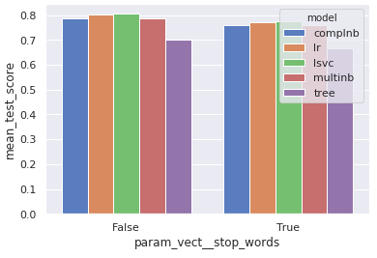
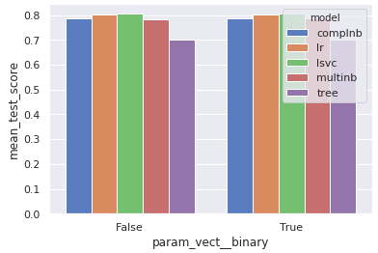
Grid search results: vectorization
Term freq / TF-IDF
stop words
binary

Slide 14
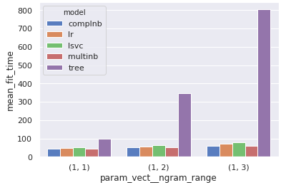
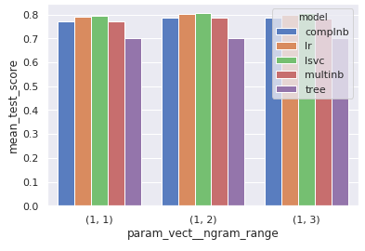
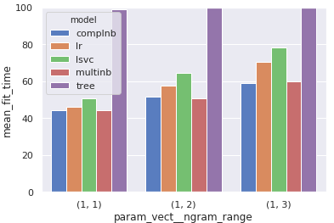
Grid search results: vectorization
ngram range
Accuracy
Fit time

Slide 15
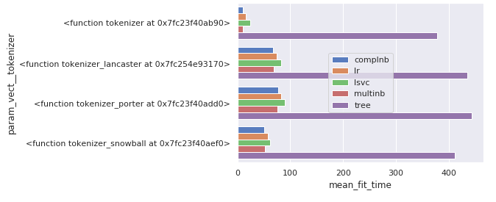
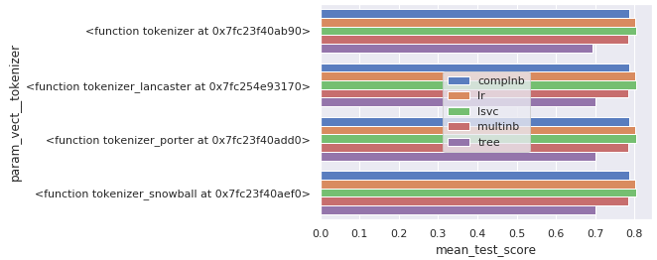
Grid search results: vectorization

Slide 16
Sentiment 140
4. Tuning hyperparameters
of classifiers

Slide 17
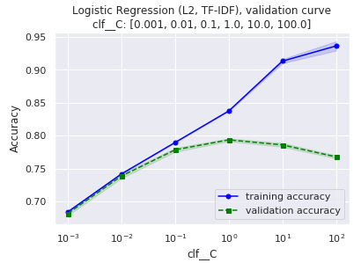
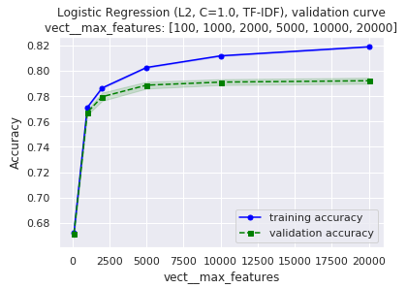
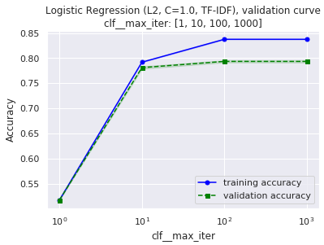
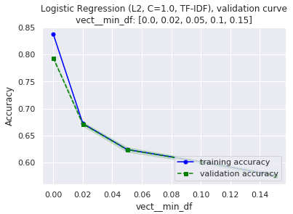
Logistic regression (L2 penalty)

Slide 18
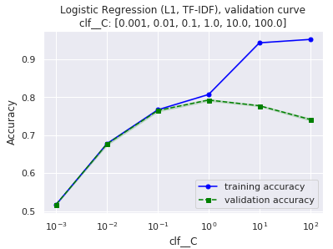
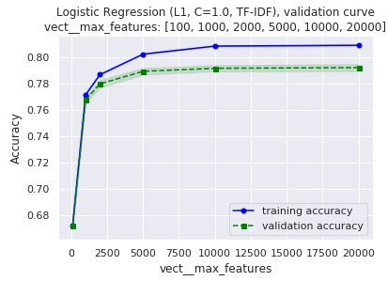
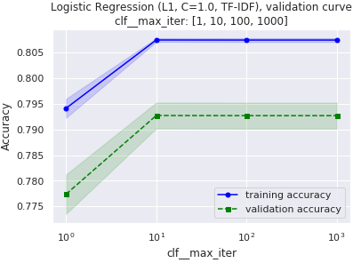
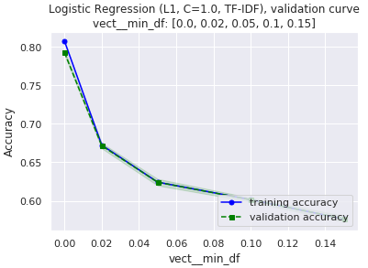
Logistic regression (L1 penalty)

Slide 19
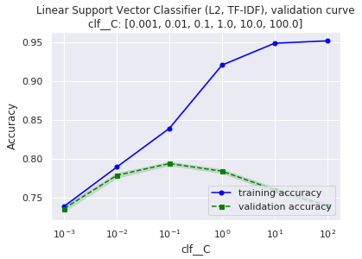
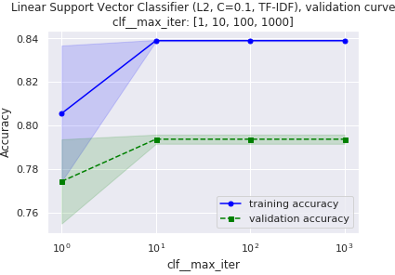
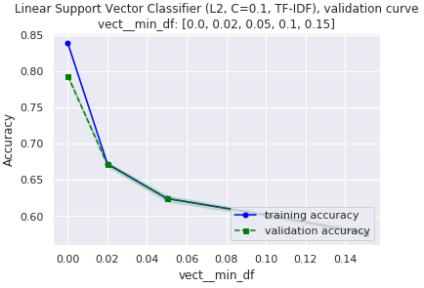
Linear SVC (L2 penalty)

Slide 20
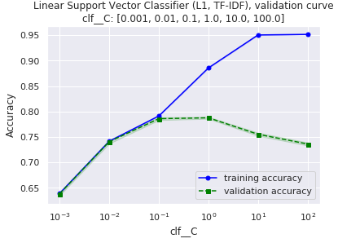
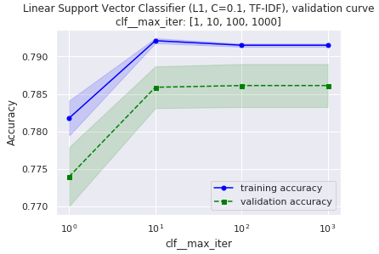
Linear SVC (L1 penalty)

