Slide 1
Yelp dataset
Results: ingestion, EDA, modeling
Prepared by: Stepan Oskin
Date: October 31st, 2019

Slide 2
Section 1
Word clouds from Yelp reviews

Slide 3
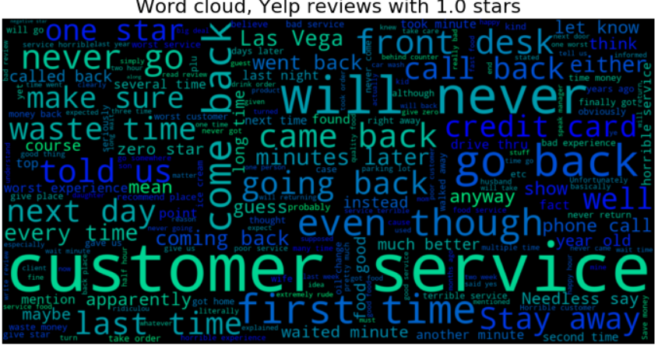

Slide 4
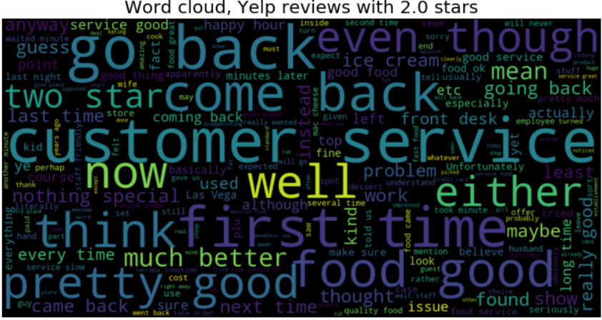

Slide 5
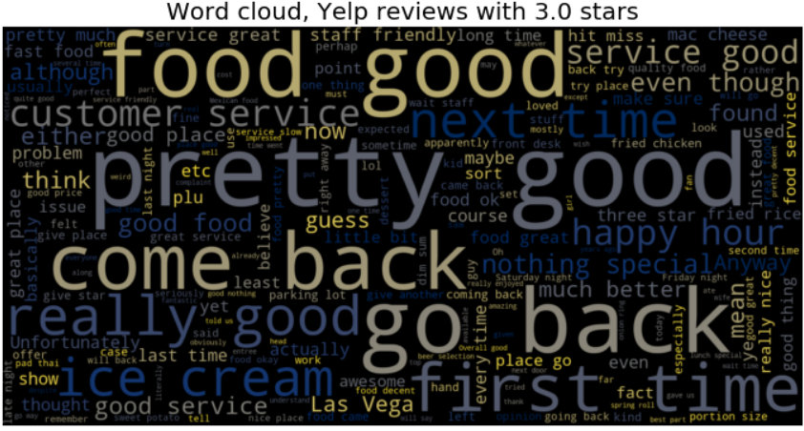

Slide 6
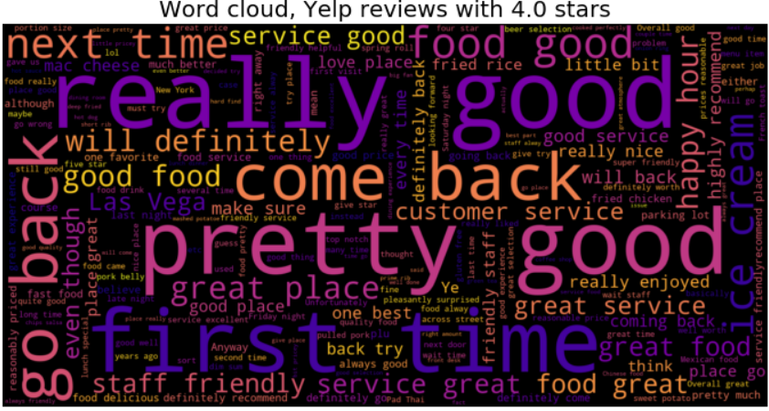

Slide 7
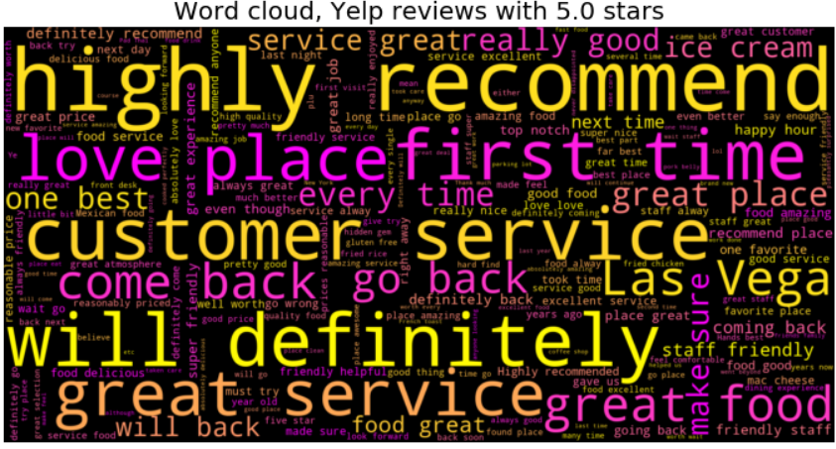

Slide 8
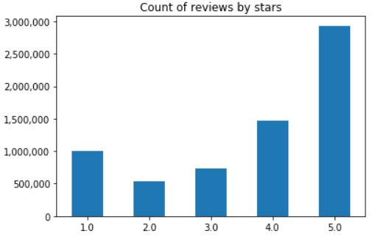
EDA findings
It’s all about customer service
Much more positive reviews, most are 5-star

Slide 9
Section 2
Modeling results: predicting rating from review text

Slide 10
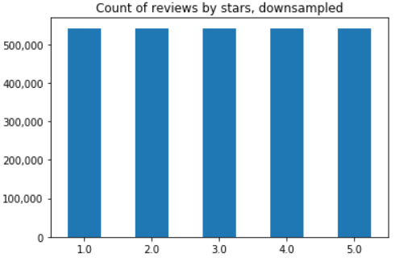
Dealing with class imbalance
To address target class imbalance, majority classes were downsampled

Slide 11
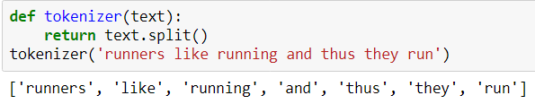

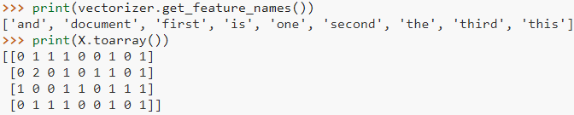
Text vectorization
Tokenization
Term frequency (bag-of-words), unigrams

Slide 12
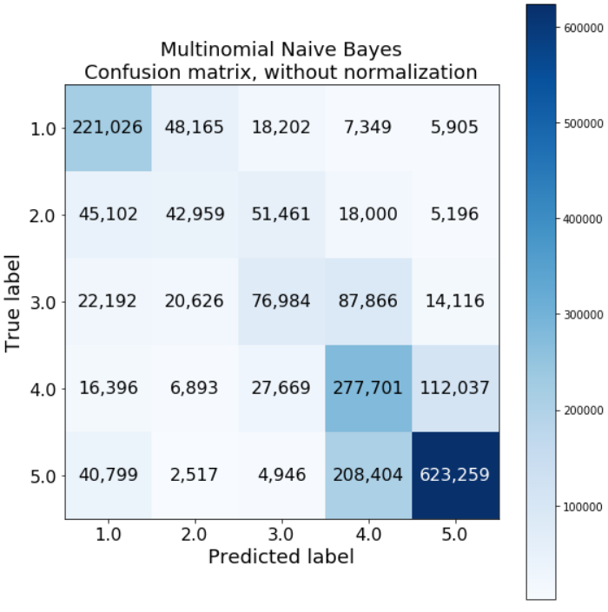
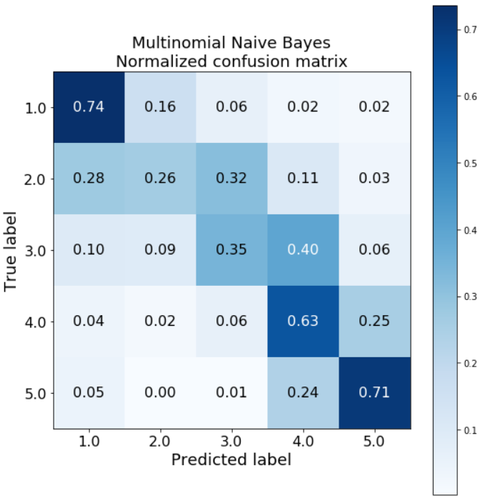
Modeling results: confusion matrix

