Slide 1
Yelp dataset
Results: ingestion, EDA, modeling
Prepared by: Stepan Oskin
Date: October 31st, 2019

Slide 2
Section 1
Q1: Data ingestion

Slide 3
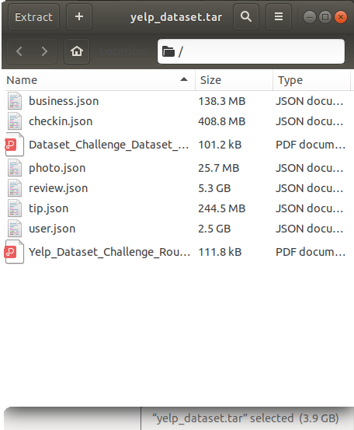
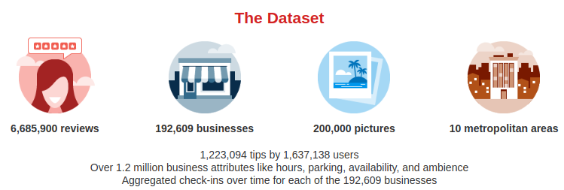
Data ingestion: Yelp dataset
Yelp dataset consists of related
JSON files
https://www.yelp.com/dataset

Slide 4
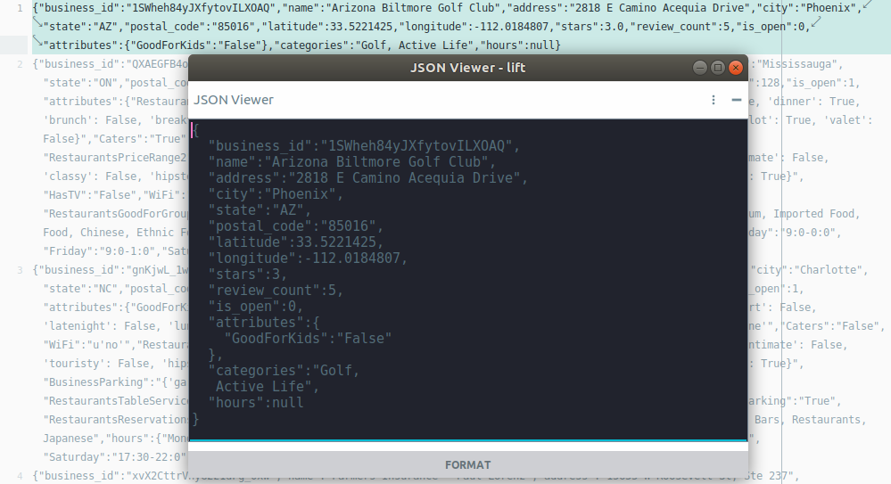
Yelp dataset characteristics
JSON
file
format
Sample of Yelp dataset: section of file business.json

Slide 5
Yelp dataset characteristics
Related entities (e.g, businesses and reviews, reviews and users, etc.)

Slide 6
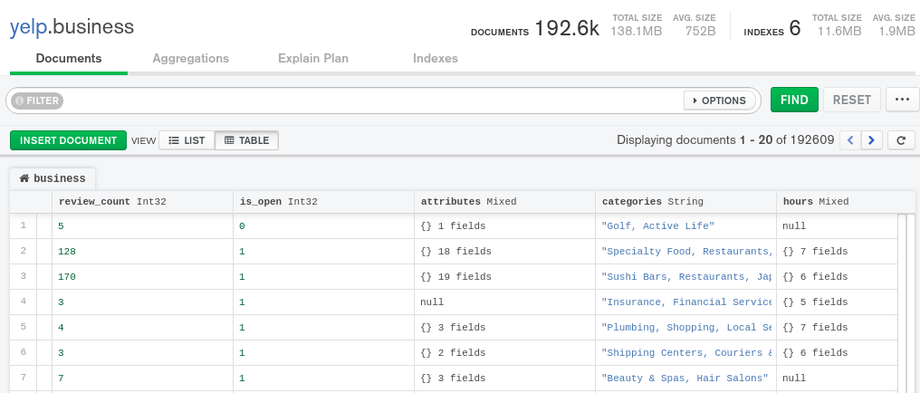
Yelp dataset characteristics
Varying and nested attributes (e.g., file “business.json”)

Slide 7
Data ingestion: Yelp dataset
Characteristics of Yelp dataset:
JSON file format
Related entities (e.g, businesses and reviews, reviews and users, etc.)
Varying and nested attributes (e.g., file “business.json”)
Queries require joining data (e.g., “business” and “review”)

Slide 8
Data ingestion: SQL or NoSQL?
Yelp dataset consists of related JSON files
Varying and nested attributes (e.g., file “business.json”)
Queries require joining data (e.g., “business” and “review”)
NoSQL: “pay the price” on the read, fast ingestion, less flexibility in writing queries on joined tables
SQL: “pay the price” on the write, slow ingestion (schema needs to be derived, INSERT statements need to be composed), fast and efficient queries on joined tables

Slide 9
Data storage: PostgreSQL database
PostgreSQL database has been chosen for data storage
Yelp dataset is relational in nature, questions require joining tables -- relational database is a good fit
PostgreSQL: high stability, ease of accessbility in cloud providers (AWS, Google Cloud, etc), open source
psycopg2 python driver: actively maintained, thread-safe

Slide 10
Section 2
Q2-Q7: Analytics

Slide 11
Section 3
Word clouds from Yelp reviews

Slide 12
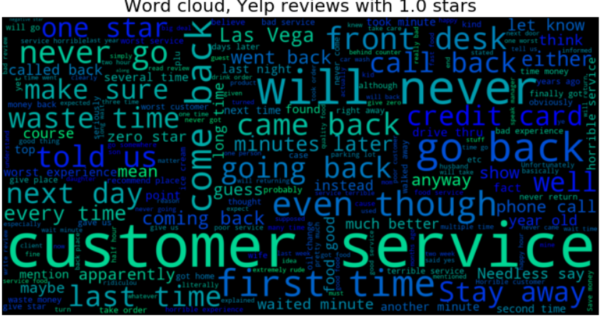

Slide 13
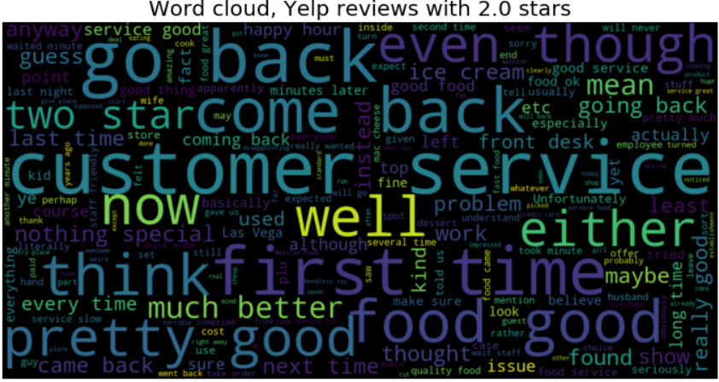

Slide 14
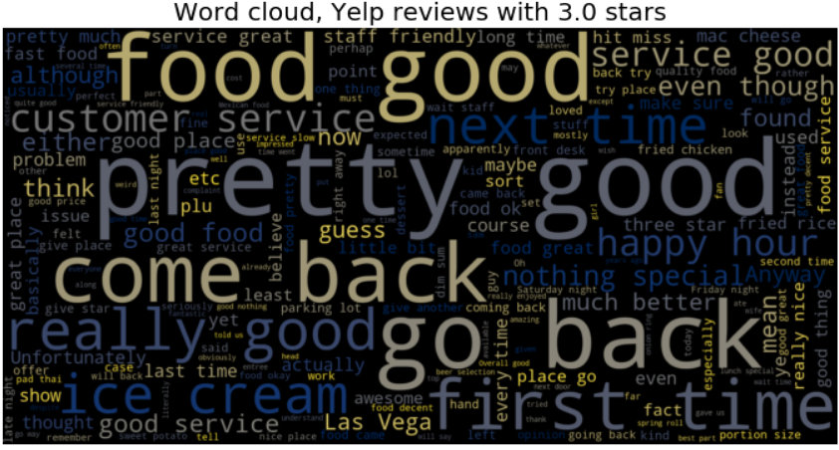

Slide 15
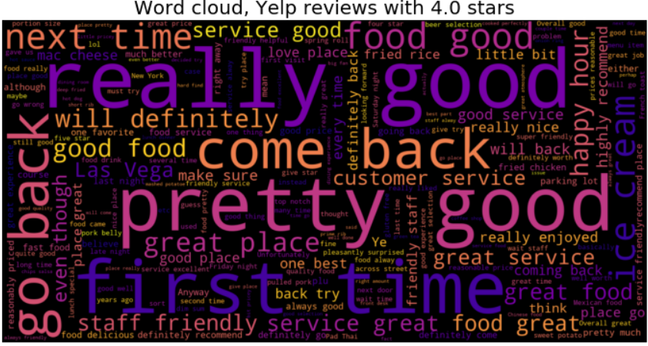

Slide 16
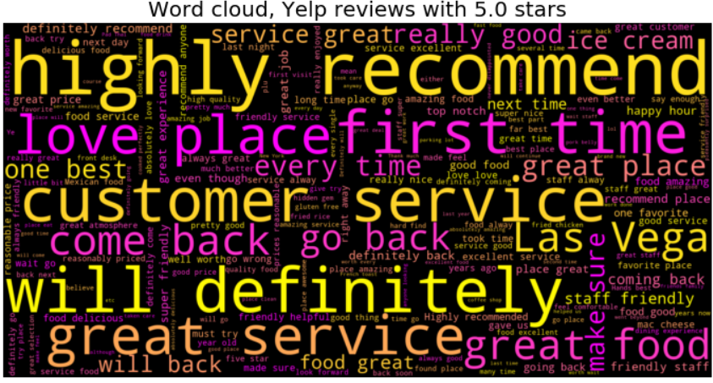

Slide 17
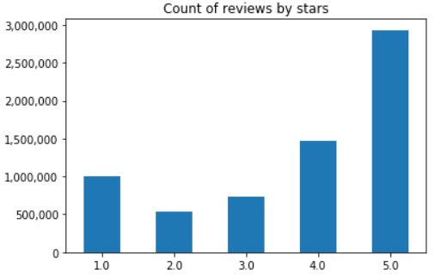
EDA findings
It’s all about customer service
Much more positive reviews, most are 5-star

Slide 18
Section 4
Modeling results: predicting rating from review text

Slide 19
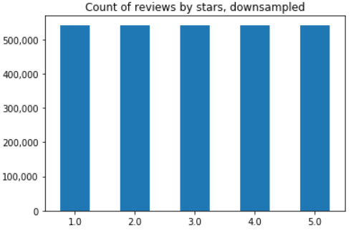
Dealing with class imbalance
To address target class imbalance, majority classes were downsampled

Slide 20
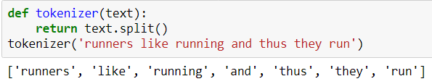

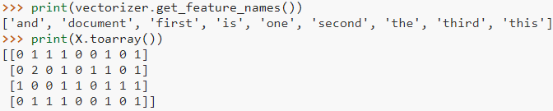
Text vectorization
Tokenization
Term frequency (bag-of-words), unigrams

Slide 21
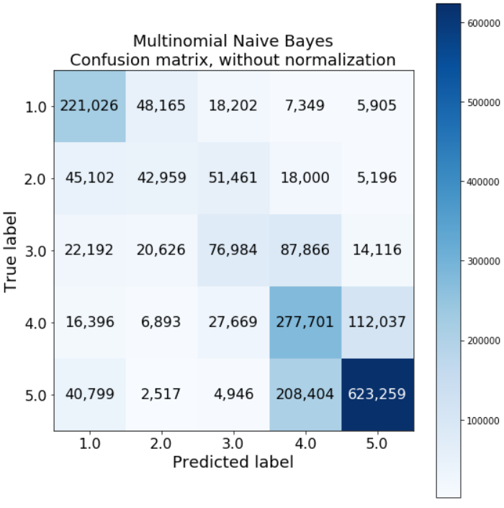
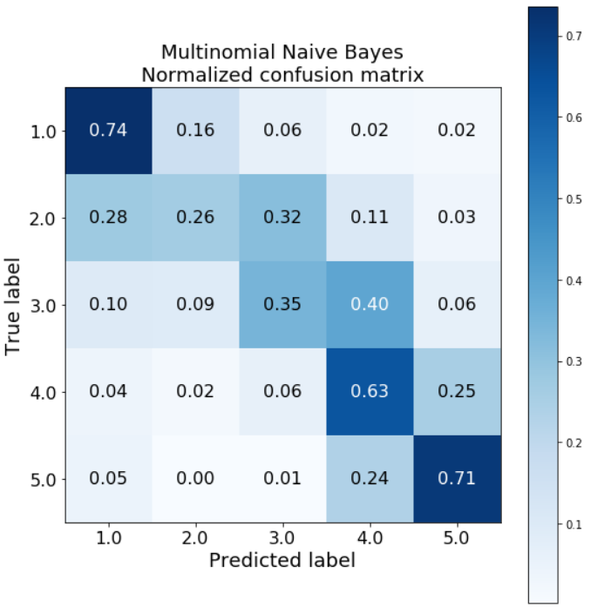
Modeling results: confusion matrix

