Slide 1
Yelp dataset
Results: ingestion, EDA, modeling
Prepared by: Stepan Oskin
Date: October 31st, 2019

Slide 2
Section 1
Data ingestion

Slide 3
Data storage: PostgreSQL database
PostgreSQL database has been chosen for data storage
Yelp dataset is relational in nature, questions require joining tables -- relational database is a good fit
PostgreSQL: high stability, ease of accessbility in cloud providers (AWS, Google Cloud, etc), open source
psycopg2 python driver: actively maintained, thread-safe

Slide 4
Section 3
Word clouds from Yelp reviews

Slide 5
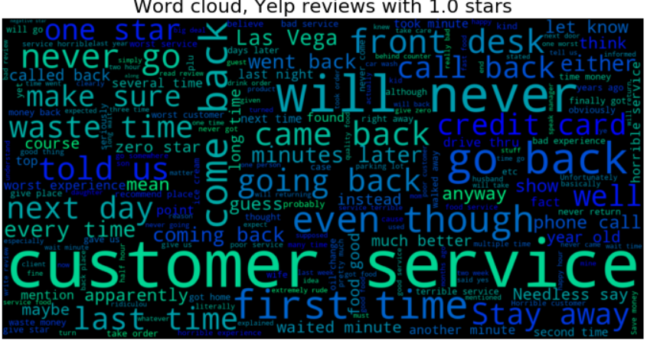

Slide 6
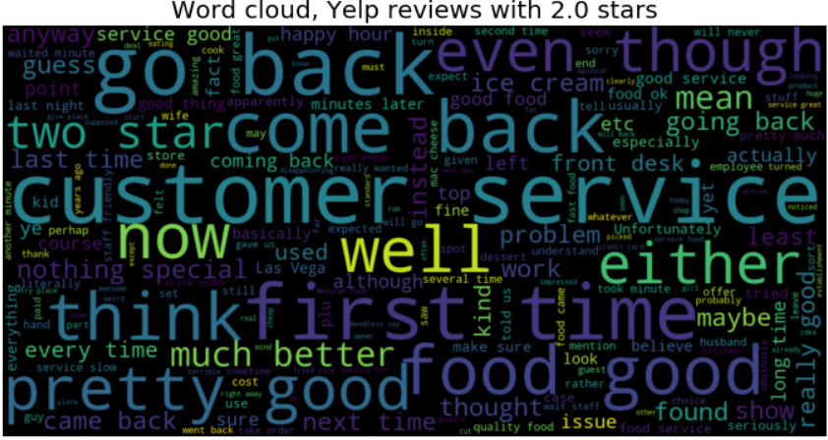

Slide 7
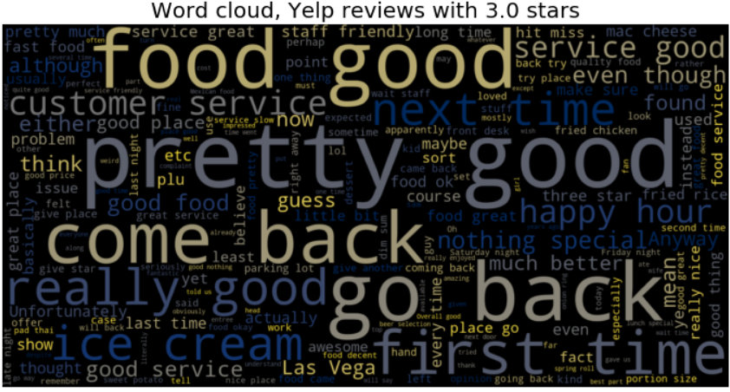

Slide 8
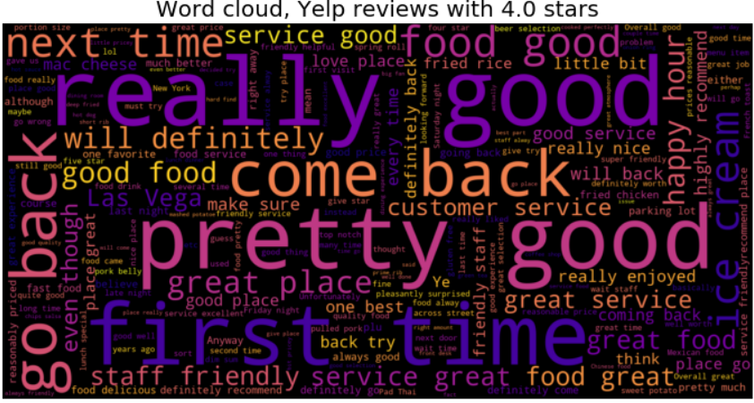

Slide 9
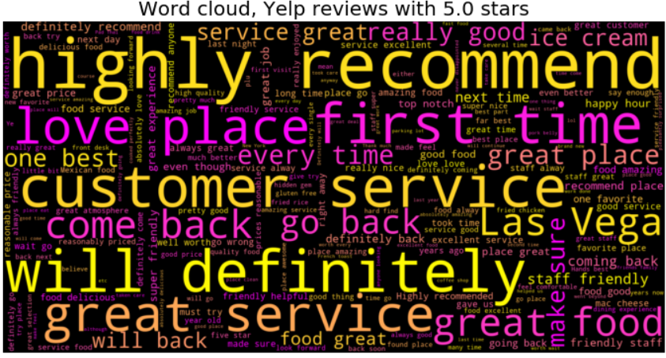

Slide 10
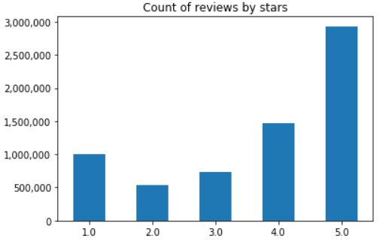
EDA findings
It’s all about customer service
Much more positive reviews, most are 5-star

Slide 11
Section 4
Modeling results: predicting rating from review text

Slide 12
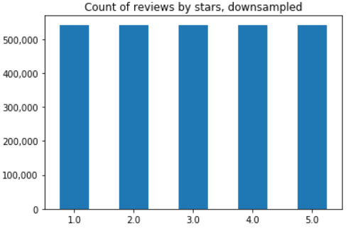
Dealing with class imbalance
To address target class imbalance, majority classes were downsampled

Slide 13
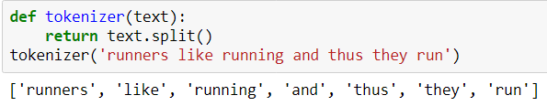

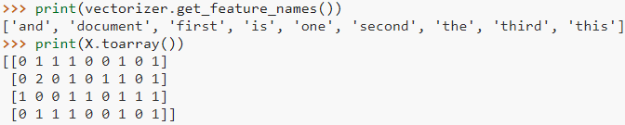
Text vectorization
Tokenization
Term frequency (bag-of-words), unigrams

Slide 14
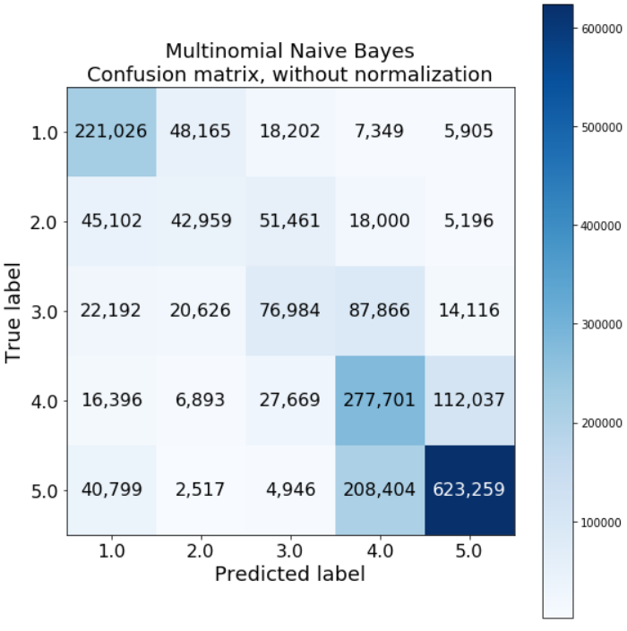
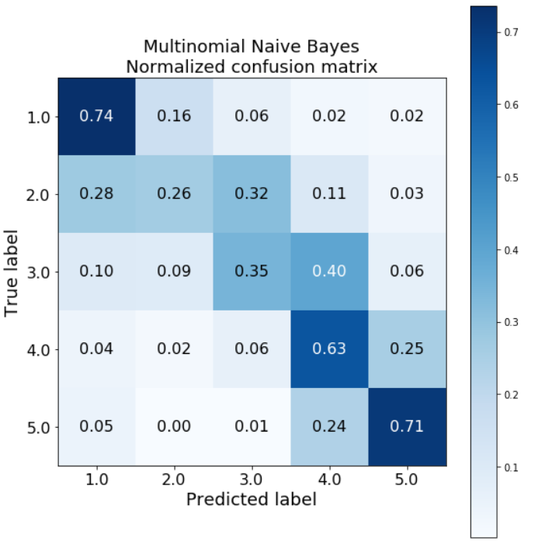
Modeling results: confusion matrix

