Slide 1
Yelp dataset
Results: ingestion, EDA, modeling
Prepared by: Stepan Oskin
Date: October 31st, 2019

Slide 2
Section 1
Word clouds from Yelp reviews

Slide 3
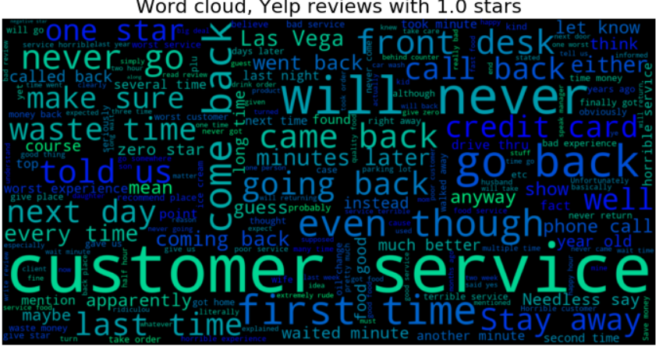

Slide 4
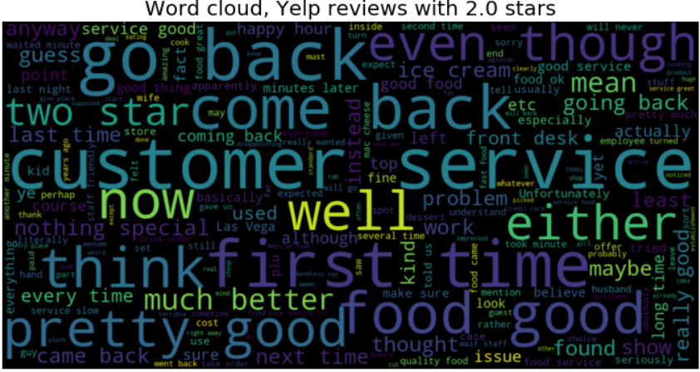

Slide 5
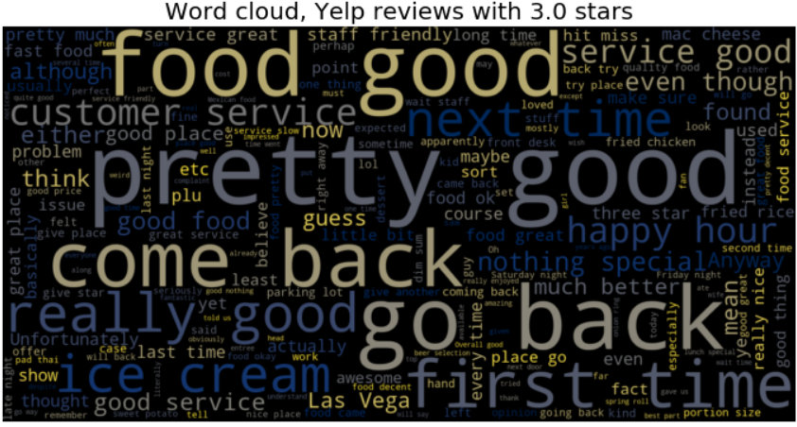

Slide 6
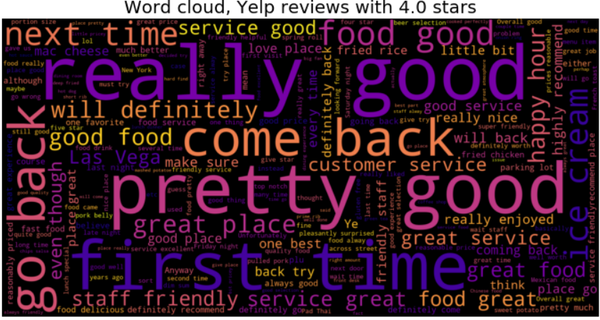

Slide 7
