Slide 1
Yelp dataset
Results: ingestion, EDA, modeling
Prepared by: Stepan Oskin
Date: October 31st, 2019

Slide 2
Section 1
Q1: Data ingestion

Slide 3
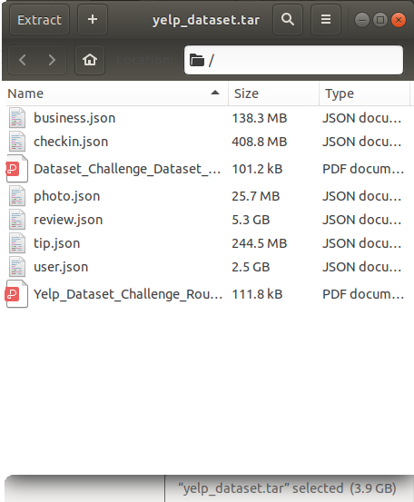
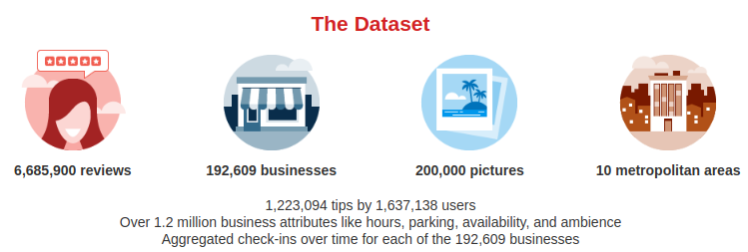
Data ingestion: Yelp dataset
Yelp dataset consists of related
JSON files
https://www.yelp.com/dataset

Slide 4
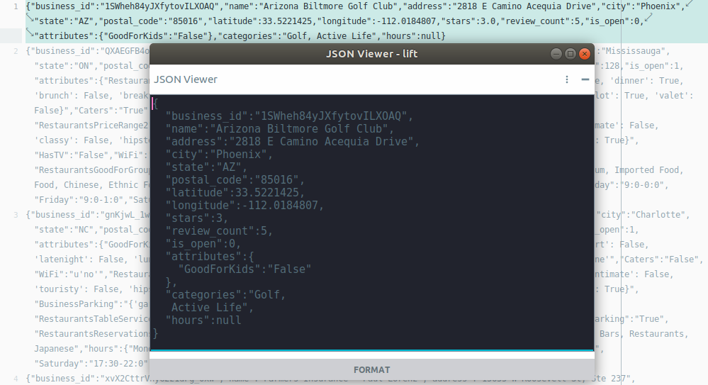
Yelp dataset characteristics
JSON
file
format
Sample of Yelp dataset: section of file business.json

Slide 5
Yelp dataset characteristics
Related entities (e.g, businesses and reviews, reviews and users, etc.)

Slide 6
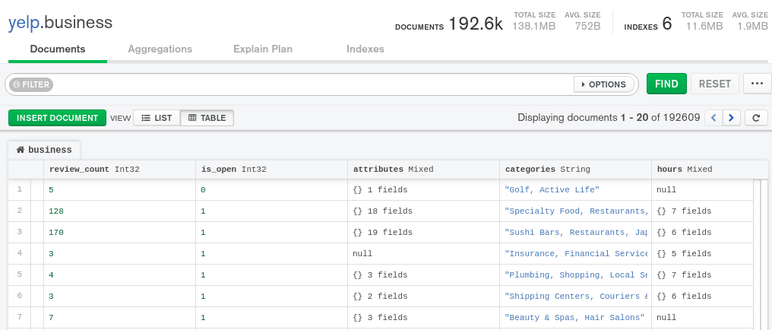
Yelp dataset characteristics
Varying and nested attributes (e.g., file “business.json”)

Slide 7

Data ingestion: Yelp dataset
Queries require joining data (e.g., “business” and “review”)
Review
Business
pk: business_id
fk: business_id
name: Mon Ami Gabi
user_id: review
user_id: review
...

Slide 8


Data ingestion: SQL or NoSQL?
SQL
“pay the price” on the write
slower ingestion
need schema
fast and efficient queries on joined tables
NoSQL
“pay the price” on the read
fast and flexible ingestion
less flexibility in writing queries on joined tables

Slide 9
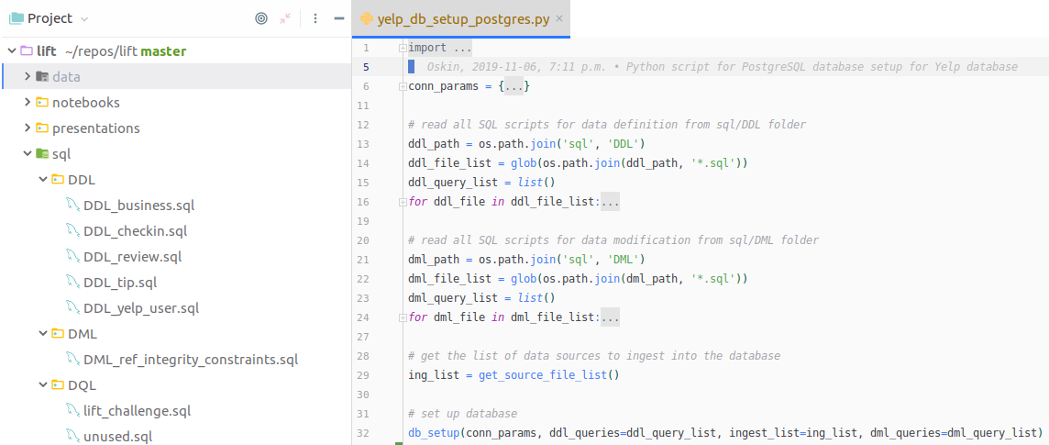
Data ingestion: PostgreSQL

Slide 10
Data ingestion: PostgreSQL

Slide 11
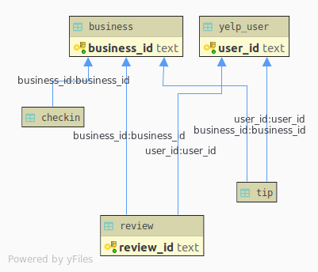
Data ingestion: PostgreSQL
Complete PostgreSQL database setup via a Python script takes 701.52 minutes
Tables are related via referential integrity constraints
SQL: Entity Relationship (ER) diagram for Yelp dataset

Slide 12
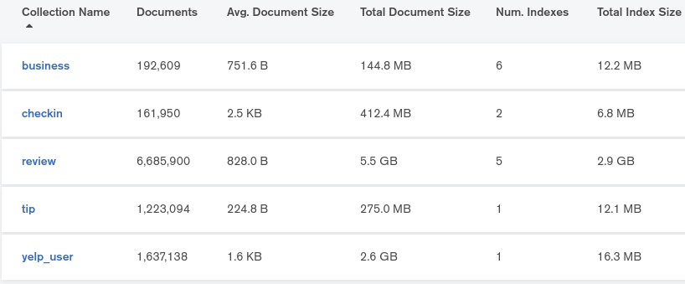
Data ingestion: MongoDB
Complete MongoDB database setup via a Python script takes 51.64 minutes
No document embedding
Collections are related via aggregation pipelines and indices
Document database: collections in MongoDB database for Yelp dataset

Slide 13
Section 2
Q2-Q7: Analytics

Slide 14
Section 3
Word clouds from Yelp reviews

Slide 15
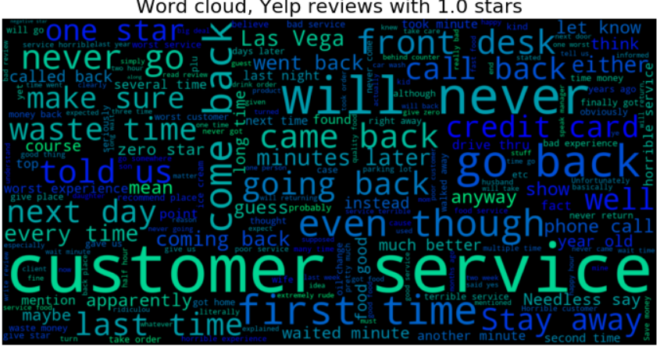

Slide 16
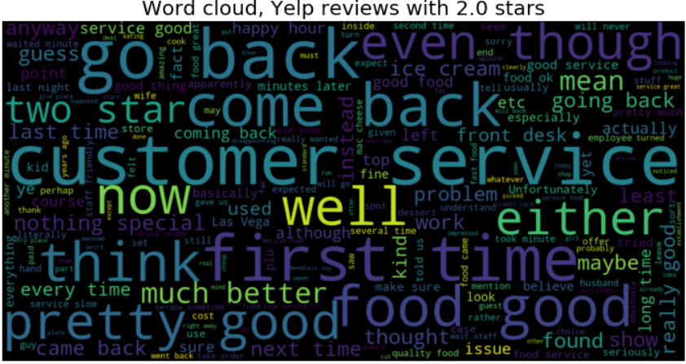

Slide 17
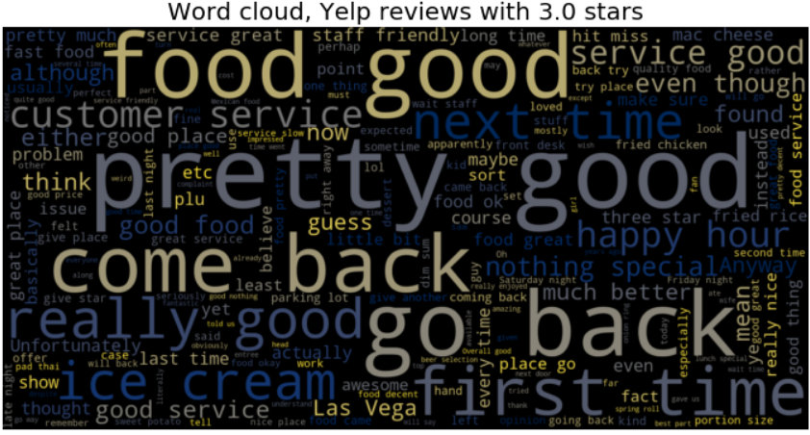

Slide 18
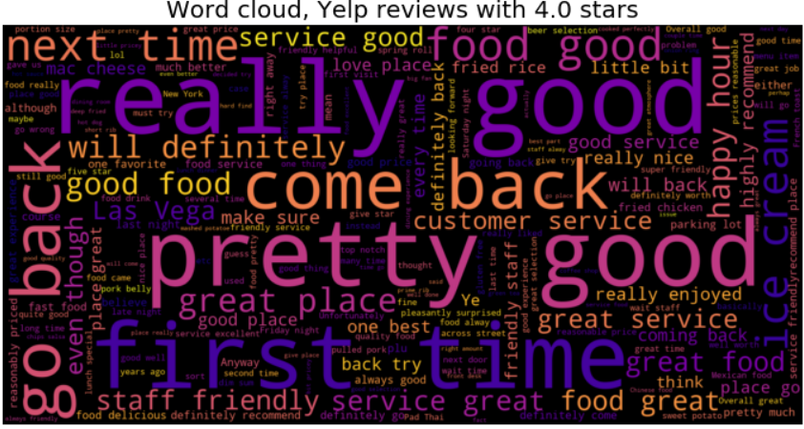

Slide 19
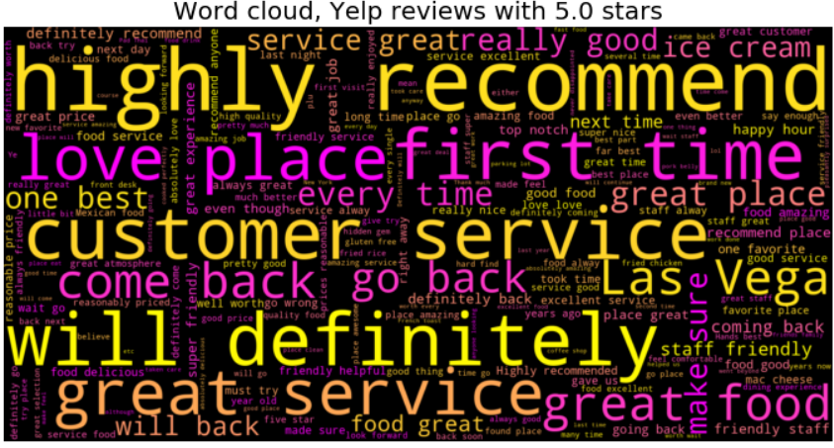

Slide 20
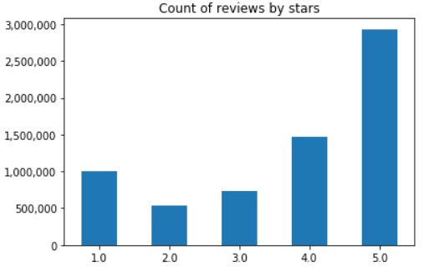
EDA findings
It’s all about customer service
Much more positive reviews, most are 5-star

Slide 21
Section 4
Modeling results: predicting rating from review text

Slide 22
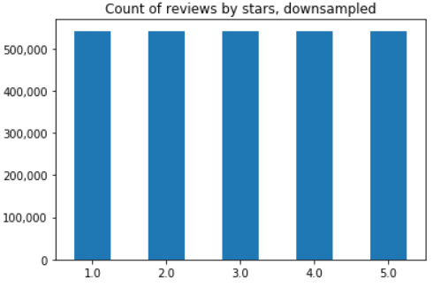
Dealing with class imbalance
To address target class imbalance, majority classes were downsampled

Slide 23
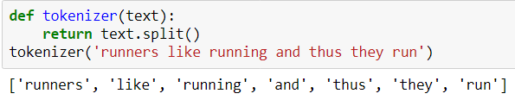

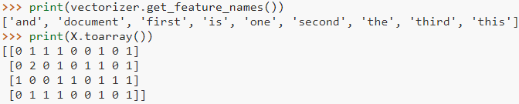
Text vectorization
Tokenization
Term frequency (bag-of-words), unigrams

Slide 24
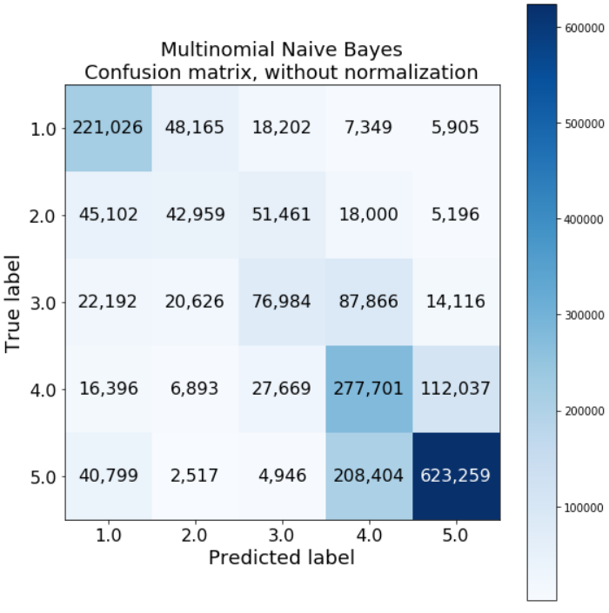
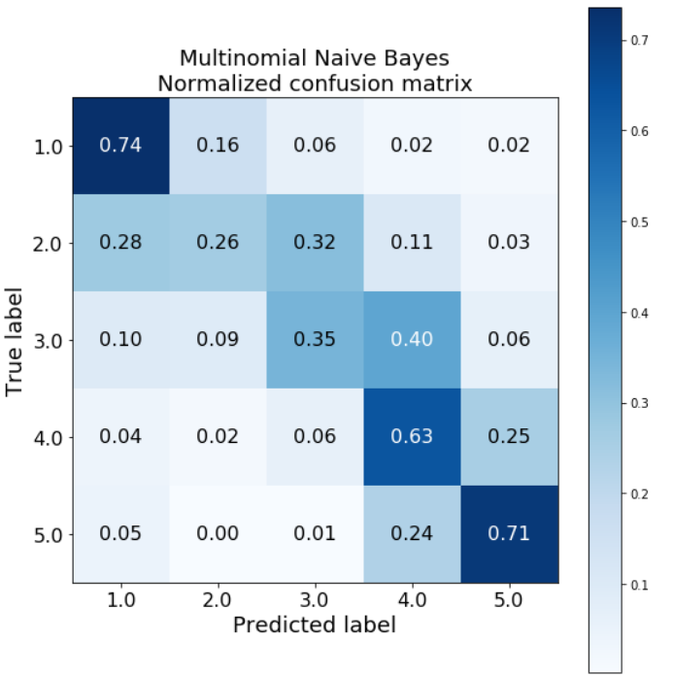
Modeling results: confusion matrix

