Slide 1

Yelp dataset
Results: ingestion, EDA, modeling
Prepared by: Stepan Oskin
Date: November 13th, 2019

Slide 2
Section 1
Q1: Data ingestion

Slide 3
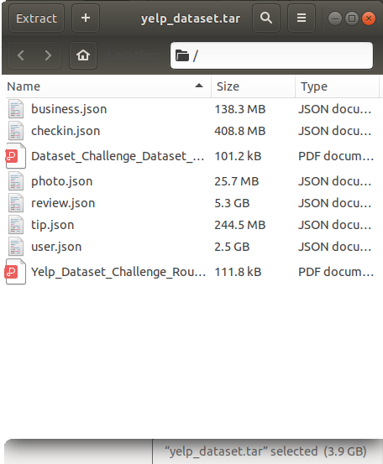
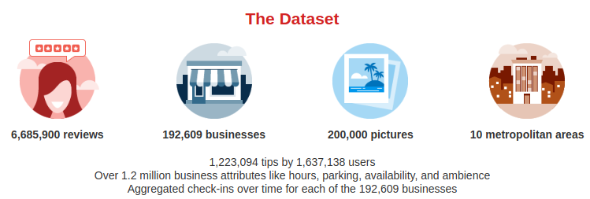
Data ingestion: Yelp dataset
Yelp dataset consists of related
JSON files
https://www.yelp.com/dataset

Slide 4
Yelp dataset characteristics
Related entities (e.g, businesses and reviews, reviews and users, etc.)

Slide 5
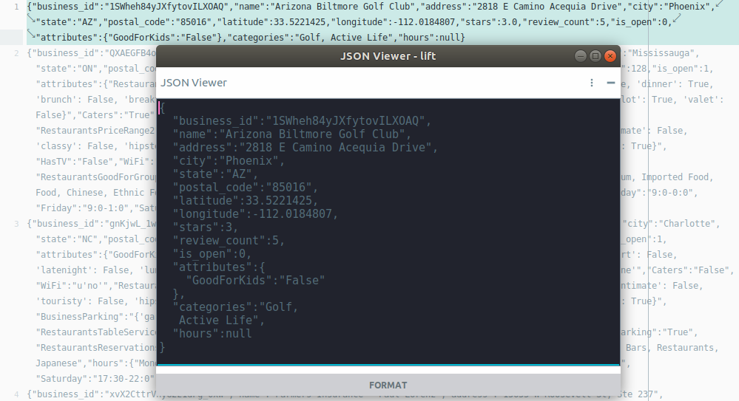
Yelp dataset characteristics
JSON
file
format
Sample of Yelp dataset: section of file business.json

Slide 6
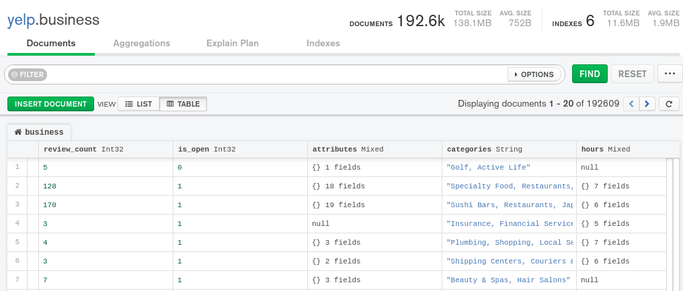
Yelp dataset characteristics
Varying and nested attributes (e.g., file “business.json”)

Slide 7

Data ingestion: Yelp dataset
Queries require joining data (e.g., “business” and “review”)
Review
Business
pk: business_id
fk: business_id
name: Mon Ami Gabi
user_id: review
user_id: review
...

Slide 8


Data ingestion: SQL or NoSQL?
SQL
“pay the price” on the write
slower ingestion
need schema
fast and efficient queries on joined tables
NoSQL
“pay the price” on the read
fast and flexible ingestion
less flexibility in writing queries on joined tables

Slide 9
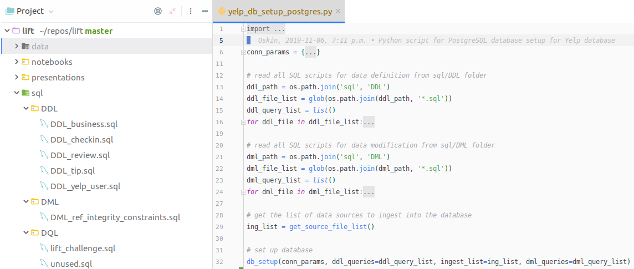
Data ingestion: PostgreSQL

Slide 10
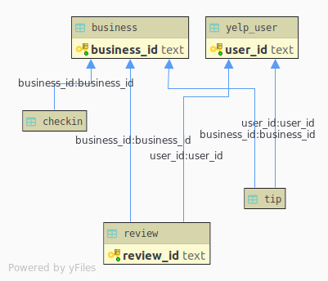
Data ingestion: PostgreSQL
Complete PostgreSQL database setup via a Python script takes 701.52 minutes
Tables are related via referential integrity constraints
SQL: Entity Relationship (ER) diagram for Yelp dataset

Slide 11
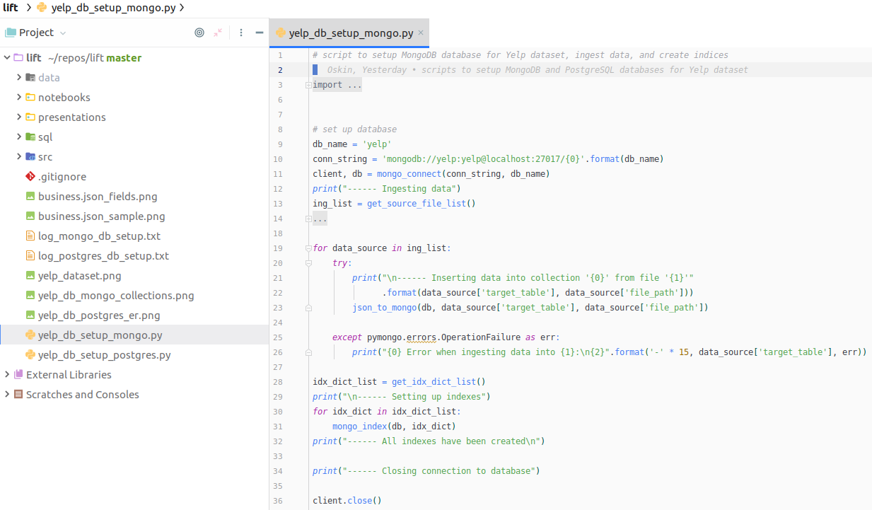
Data ingestion: MongoDB

Slide 12
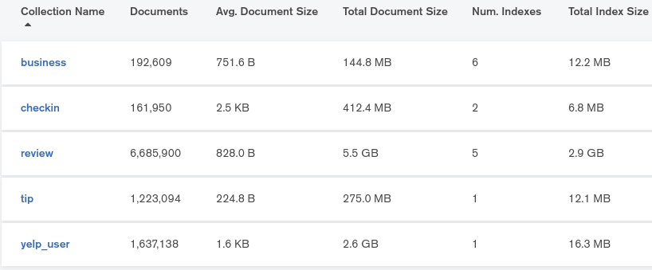
Data ingestion: MongoDB
Complete MongoDB database setup via a Python script takes 51.64 minutes
No document embedding
Collections are related via aggregation pipelines and indices
Document database: collections in MongoDB database for Yelp dataset

Slide 13
Section 2
Q2-Q7: Analytics

Slide 14
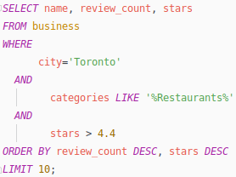

Query execution speed comparison (Q2)
PostgreSQL
MongoDB
Execution time: 0.5 s
Execution time: 2.606 s

Slide 15
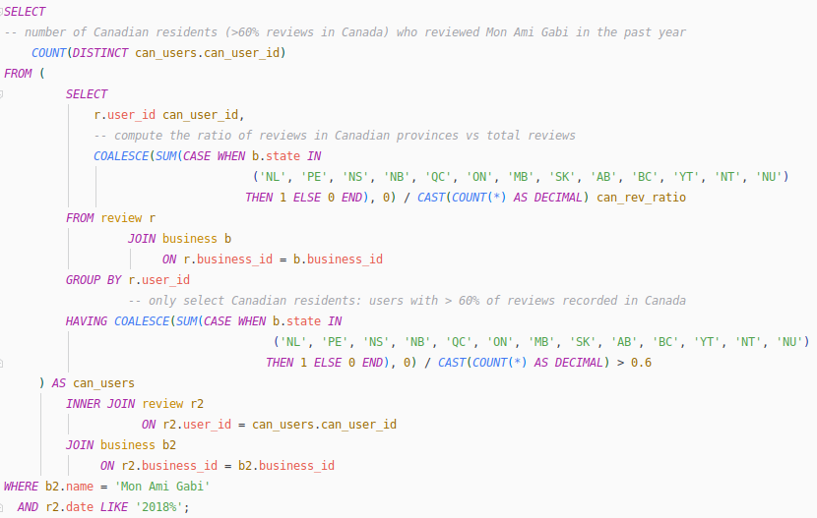
Query execution speed comparison (Q3)
PostgreSQL
MongoDB
ca_users_pipeline = [
{"$project": {"_id": 0, "b_name": "$name", "b_state": "$state", "b_business_id": "$business_id",
"b_ca_business": {"$cond": [{"$in": ["$state", ca_prov_list]},
1, 0]}}},
{"$lookup": {"from": "review","localField": "b_business_id",
"foreignField": "business_id", "as": "r" }},
{"$unwind": {"path": "$r", "preserveNullAndEmptyArrays": False}},
{"$project": {"name": "$b_name", "ca_business": "$b_ca_business", "user_id": "$r.user_id"}},
{"$group": {"_id": "$user_id", "ca_reviews": {"$sum": "$ca_business"}, "total_reviews": {"$sum": 1}}},
{"$project": {"_id": 0, "user_id": "$_id", "ca_ratio": {"$divide": [{"$convert": {"input": "$ca_reviews", "to": "decimal"}}, $total_reviews"]}}},
{"$match": {"ca_ratio": {"$gt": 0.6}}}
]
ca_users = db['business'].aggregate(ca_users_pipeline, allowDiskUse=True)
mon_ami_gabi = db['business'].find_one({"name": "Mon Ami Gabi"})
pat = re.compile(r'2018', re.I)
mag_review_users = db['review'].find({
"business_id": mon_ami_gabi["business_id"],
"date": pat
}).distinct("user_id")
intersection = [user for user in mag_review_users if user in ca_users]
Execution time: 2 m 46 s
Execution time: 18 m 17 s

Slide 16
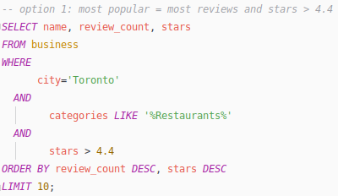
Question 2, option a
Top 10 restaurants in Toronto with the highest popularity. You are free to define your‘popularity’, as long as it can convince people
Execution time: 2.606 s

Slide 17
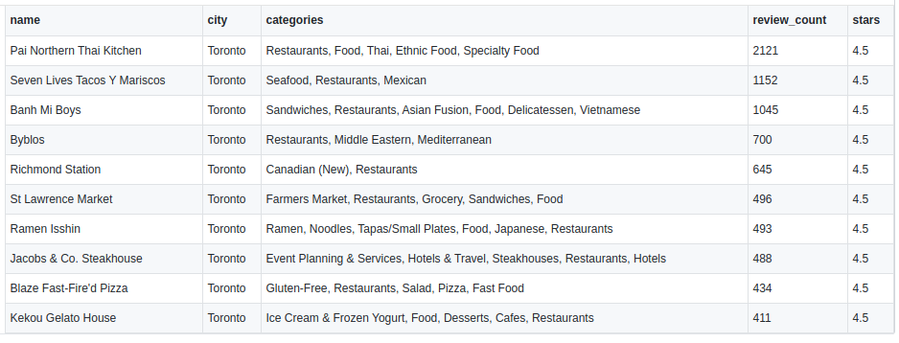
Question 2, option a
Top 10 restaurants in Toronto (largest number of reviews with at least 4.4 average stars)

Slide 18
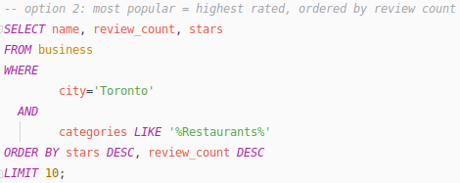
Question 2, option b
Top 10 restaurants in Toronto with the highest popularity. You are free to define your‘popularity’, as long as it can convince people
Execution time: 188 ms

Slide 19
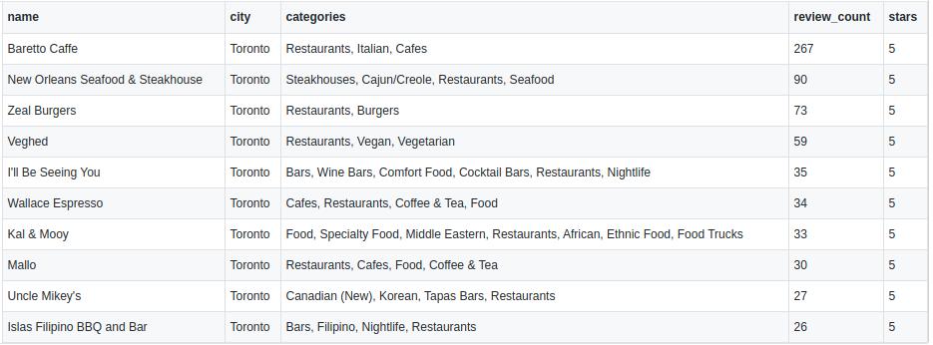
Question 2, option b
Top 10 restaurants in Toronto (ordered by stars and review count)

Slide 20
Question 3
How many Canadian residents (figure out who are Canadian residents by yourself) reviewed the business “Mon Ami Gabi” in last 1 year?
Execution time: 2 m 46 s
Answer: 10 Canadian users reviewed Mon Ami Gabi in 2018

Slide 21
Question 4
Top 10 most common words in the reviews of the business “Chipotle Mexican Grill”might be helpful and interesting to the business.
Execution time: 1 m 6 s
word ndoc nentry
chipotl 5322 9014
food 4545 6973
locat 3370 5310
order 2696 5094
time 3126 4797
word ndoc nentry
burrito 2618 4722
get 2928 4375
go 2805 3902
one 2606 3693
like 2499 3585
1.
2.
3.
4.
5.
6.
7.
8.
9.
10.

Slide 22
Question 5
What’s the percentage of users, who reviewed ​“Mon Ami Gabi”, and also reviewed atleast 10 other restaurants located in Ontario?

Slide 23
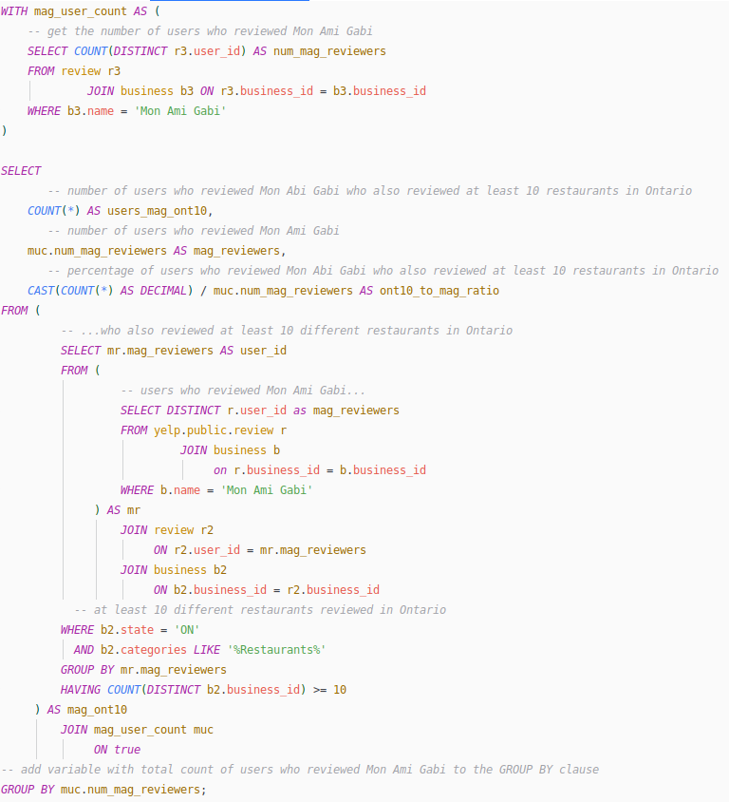
Question 5
What’s the percentage of users, who reviewed ​“Mon Ami Gabi”, and also reviewed atleast 10 other restaurants located in Ontario?
mag_reviewers
8349
users_mag_ont10
60
ont10_to_mag_ratio
0.007

Slide 24
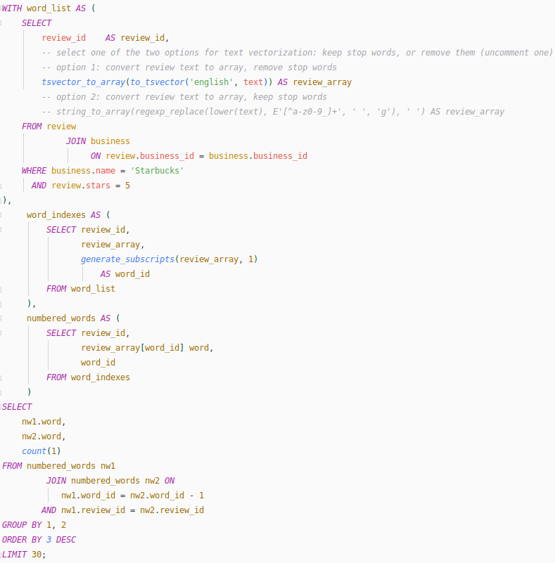
Question 6
Most frequent bi-grams (with and without stop words) for 5-star reviews of Starbucks
Could be used to investigate phrases associated with 5-star reviews of Starbucks

Slide 25
Question 6
Bi-grams of 5-star reviews of Starbucks
with stop words
without stop words
it s 1731
this location 1657
in the 1478
this starbucks 1409
of the 1334
the staff 1120
and the 1118
drive thru 1053
this is 1035
...
staff starbuck 1031
friend get 526
locat love 465
drink drive 454
get go 405
one order 381
servic starbuck 317
starbuck store 305
like locat 301
...

Slide 26
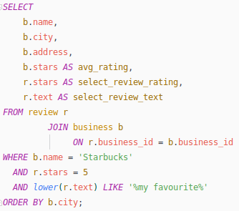
Question 7
5-star reviews of Starbucks containing words "my favourite"
Could be useful to determine strong attractors for people and reward staff at outstanding locations

Slide 27
Section 3
Word clouds from Yelp reviews

Slide 28
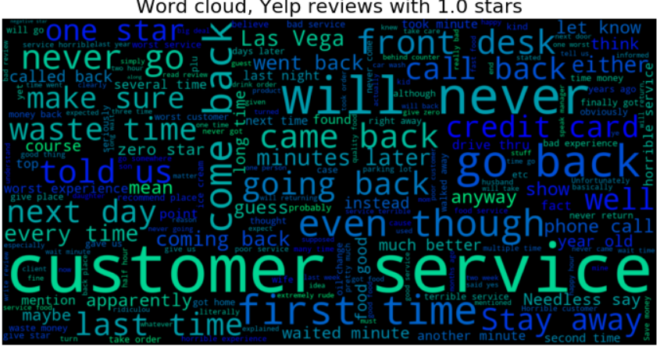

Slide 29
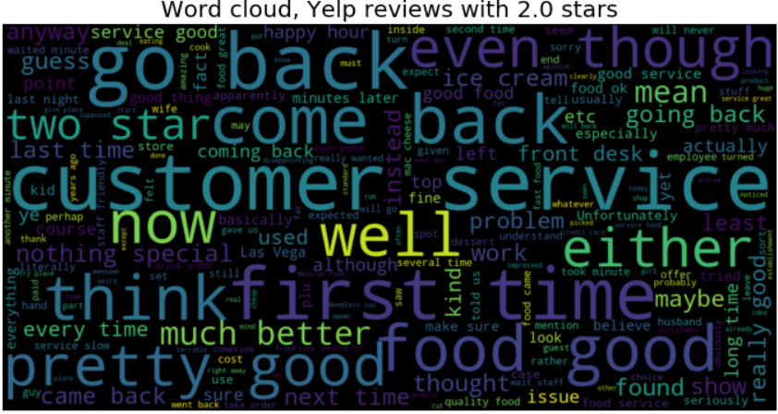

Slide 30
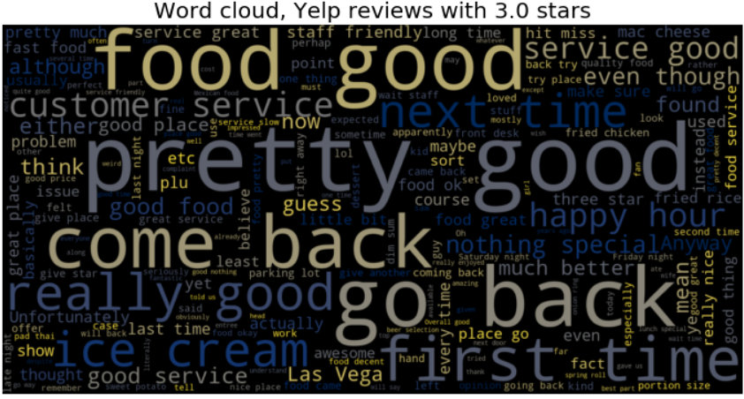

Slide 31
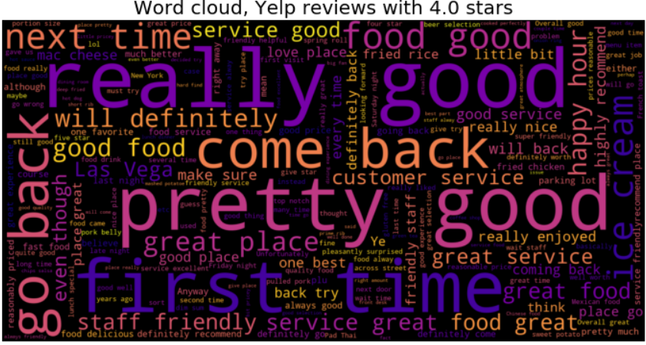

Slide 32
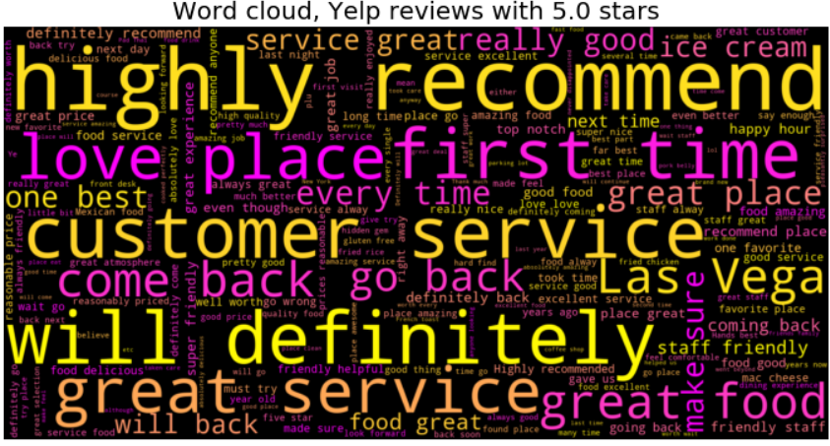

Slide 33
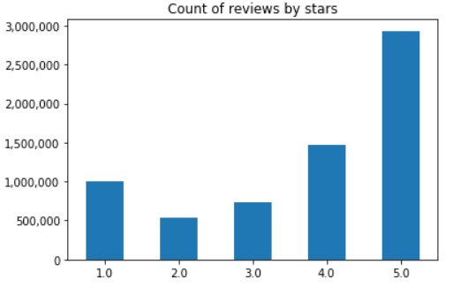
EDA findings
It’s all about customer service
Much more positive reviews, most are 5-star

Slide 34
Section 4
Modeling results: predicting rating from review text

Slide 35
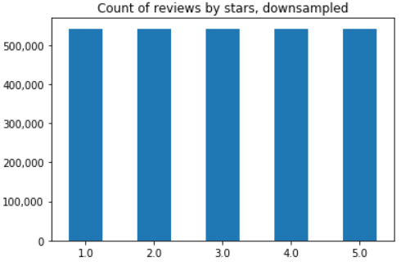
Dealing with class imbalance
To address target class imbalance, majority classes were downsampled

Slide 36
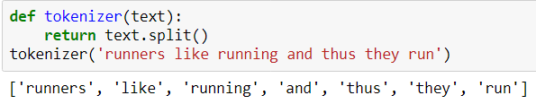

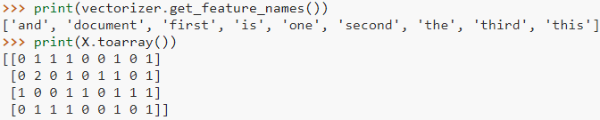
Text vectorization
Tokenization
Term frequency (bag-of-words), unigrams

Slide 37
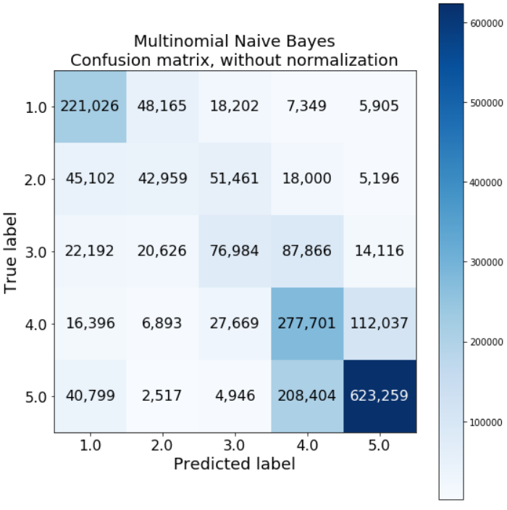
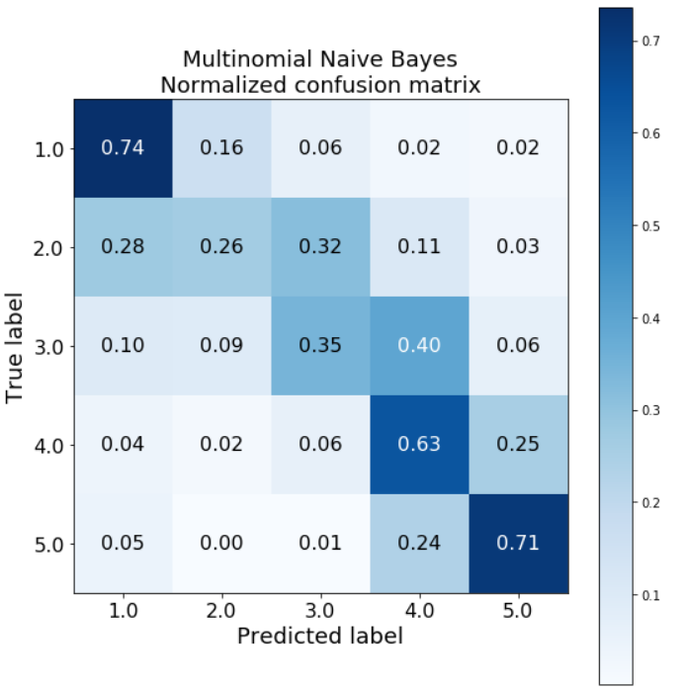
Modeling results: confusion matrix

