Slide 1

Data flow for Teranet dataset preparation
EDA results
Teranet meeting
16-Aug-2019
Presented by: Stepan Oskin
Photo by Maarten van den Heuvel

Slide 2
Presentation content
1. Data flow for preparation of Teranet
2. Results of Exploratory Data Analysis (EDA)

Slide 3
Section 1:
Data flow for Teranet preparation

Slide 4
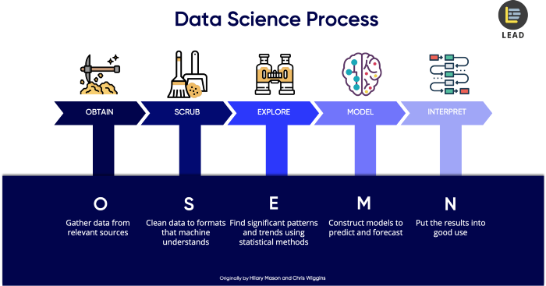
1.1 OSEMN methodology
Originally by Hillary Mason and Chris Wiggins
Source: Dr. Cher Han Lau, LEAD (https://thelead.io)

Slide 5
1.1 MASc thesis scope
Focus of this master thesis
Future work

Slide 6
1.3 OSEMN
Step 2: Scrub
Future work

Slide 7
1.3 OSEMN Step 2: Scrub Teranet
During Step 2: Scrub of the OSEMN methodology,
the Teranet dataset is transformed in 5 main stages:
(4.) Remove duplicates
(pending)
Raw
Teranet
data
2.
3.
final
0.
Add foreign
keys via spatial joins
1.
Correct
for
consistency
Add new attributes
Add to the database
HHSaleHistory.csv
2_Teranet_consistent.csv
PostgreSQL
Folder:
data/teranet/
1.1_Teranet_DA_cols.csv
3_Teranet_new_cols.csv
1.2_Teranet_DA_TAZ_cols.csv
3_Teranet_nonan_new_cols.csv

Slide 8
2.1 Data flow: Teranet dataset transformations
Transformation is performed in Python in 4 main steps:
2.1.1_teranet_gtha_da_spatial_join.ipynb
2.3_teranet_new_cols.ipynb
2.1.2_teranet_taz_spatial_join.ipynb
2.3_teranet_nonan_new_cols.ipynb
Folder:
notebooks/2.scrub/
2.2_teranet_consistency.ipynb
(4.) Remove duplicates
(pending)
Raw
Teranet
data
2.
3.
final
0.
Add foreign
keys via spatial joins
1.
Correct
for
consistency
Add new attributes
Add to the database
1.
2.
3.
HHSaleHistory.csv
2_Teranet_consistent.csv
PostgreSQL
Folder:
data/teranet/
1.1_Teranet_DA_cols.csv
3_Teranet_new_cols.csv
1.2_Teranet_DA_TAZ_cols.csv
3_Teranet_nonan_new_cols.csv

Slide 9
Section 2:
Results of Exploratory Data Analysis (EDA)

