Slide 1


GTHA housing database
A Longitudinal Analysis of housing sales
in the Greater Toronto-Hamilton Area
Database design
Photo by Paco Valerio Trujillo from Pexels
Prepared by: Stepan Oskin Date: 24-Aug-2019
Notes:
Growth centers
West Don Lands
Liberty village
Riverdale
Outline
Deadline to submit thesis
Month-by-month tuition

Slide 2
Section 1:
Data sources

Slide 3
Teranet is connected to the following data sources:
DA-level data:
Select census variables
(1971, 1976, 1981, 1986, 1991, 1996, 2001, 2006, 2011 , 2016)
Census tables: 2016 Profiles of Income, etc.
Teranet aggregates grouped by DA
(mean/median/std, spatial lag, etc.)
TAZ-level data:
Select TTS variables
(1986, 1991, 1996, 2001, 2006, 2011, 2016)
Number of jobs
(1991, 1996, 2001, 2006, 2011, 2016), etc.
TAZ info
(length, area, geometry)
1 Data sources

Slide 4
Teranet is connected to the following data sources:
Parcel-level data:
Land use information
Enhanced Points of Interest (EPOI), from DMTI
etc.
Time-indexed data:
Fuel price in Toronto from StatsCan
(1986, 1991, 1996, 2001, 2006, 2011, 2016)
Inflation correction coefficients, etc.
Postal-code-level data:
Municipality-level data:
1 Data sources

Slide 5
Section 2:
Data flows

Slide 6
Received from Teranet
2.1.1_teranet_gtha_da_spatial_join.ipynb
2.1 Teranet Spatial joins
Raw
Teranet dataset
9,039,241 rows
15 columns
points
Teranet
Teranet
data/teranet/1.1_Teranet_DA.csv
Spatial
join #1
how=‘inner’,
op=‘within’
Teranet,
filtered for GTHA,
+DA keys
6,803,691 rows
18 columns
points
data/teranet/HHSaleHistory.csv
(*) https://opendata.arcgis.com/datasets/9d262f8a576842fbb2afbc8c51a64178_1.geojson
2.1.2_teranet_taz_spatial_join.ipynb
da_census_income_obtain.ipynb
Add columns
'DAUID', 'CSDUID', 'CSDNAME'
data/teranet/1.2_Teranet_DA_TAZ.csv
DA-level
Profiles of Income
2016 Census
Esri Open
Data Portal (*)
GTHA
DA-level
Profiles of Income
2016 Census
9,182 rows
218 columns
polygons
Spatial
join #2
how=‘left’,
op=‘within’
Teranet,
filtered for GTHA,
+DA, TAZ keys
6,803,756 rows
19 columns
points
Census
data/da_census/da_census_income.csv
Add column
'TAZ_O'
taz_info_obtain.ipynb
Spatial
join #3.1
how=‘left’,
op=‘within’
GTHA
TAZ geometry and general info
1,716 rows
5 columns
polygons
data/teranet/1.3_Teranet_DA_TAZ_PG_FSA.csv
Transportation
Analysis Zones
(TAZ)
TAZ/TTS
Add column
‘FSA'
Teranet,
filtered for GTHA,
+DA, TAZ,
FSA keys
6,803,756 rows
24 columns
points
2.1.3_teranet_pg_fsa_spatial_join.ipynb
data/da_census/da_census_income.csv
Spatial
join #3.2
how=‘left’,
op=‘within’
DMTI
Download from library website (**)
https://mdl.library.utoronto.ca/collections/geospatial-data/platinum-postal-code-suite-4
Canada
FSA geometry
1,614 rows
4 columns
polygons
6,803,767 rows
27 columns
points
Forward
Sortation Areas
(FSA)
Add columns
‘PCA_ID', ‘postal_code_dmti’,
‘MAF_ID’, ‘DEL_M_ID'
Ontario
Postal Code Geography
555,668 rows
12 columns
polygons
Postal Code
Geography
Spatial
join #4
how=‘left’,
op=‘within’
Teranet dataset,
filtered for GTHA,
+DA, TAZ, FSA, PCA_ID, pin_lu keys
lu_obtain.ipynb
2.1.4_teranet_lu_spatial_join.ipynb
Geography
dept.
GTHA
parcel-level land use
1,664,862 rows
18 columns
polygons
Parcel-level
Land Use
for GTA
and Hamilton
Add columns: ‘pin_lu', ‘LANDUSE', ‘PROP_CODE'
data/teranet/1.4_Teranet_DA_TAZ_FSA_LU.csv

Slide 7
2.2 Teranet preparation data flow
2.1.1_teranet_gtha_da_spatial_join.ipynb
2.1.2_teranet_taz_spatial_join.ipynb
2.1.3_teranet_pg_fsa_spatial_join.ipynb
2.1.4_teranet_lu_spatial_join.ipynb
2.3_teranet_new_cols.ipynb
2.3_teranet_nonan_new_cols.ipynb
(4.) Remove duplicates
(pending)
2.2_teranet_consistency.ipynb
0.
1.
Correct
for
consistency
Add to the database
Raw
Teranet
data
2.
3.
final
Add foreign
keys via spatial joins
Add new attributes
HHSaleHistory.csv
2_Teranet_consistent.csv
PostgreSQL
1.1_Teranet_DA.csv
1.2_Teranet_DA_TAZ.csv
1.3_Teranet_DA_TAZ_FSA.csv
1.4_Teranet_DA_TAZ_FSA_LU.csv
3_Teranet_new_cols.csv
3_Teranet_nonan_new_cols.csv

Slide 8
2.3 General data flow: obtain and prep all data
PostgreSQL
database
new attributes,
filtered for price > 10’000 CAD
GTHA land use converted to GTA codes
Spatial join
corrected for consistency
GTA
+ Hamilton
Land use
Concat
filtered for GTHA,
new keys added via sjoins
Drop duplicated
GTA pins,
column
Teranet dataset
DA-level
Profiles of Income
2016
DA-level
Select Census Variables
TAZ info
TTS Number of Jobs
Canada
FSA geometry
Ontario
Postal Code Geography
EPOI
From DMTI
GTA
Parcel
level land use
Hamilton
Parcel
level land use
Hamilton
Land use codes
conversion
Teranet
Census
TAZ/TTS
DMTI
Geo department

Slide 9
Section 3:
ER diagrams

Slide 10
3.1 Relationship between datasets
many
fk: pca_id
pk: transaction_id
postal-code-level data
one
many
Census
pk: dauid
fk: dauid
many
fk: csduid
DA-level data
municipality-level data
many
fk: fsa
many
fk: taz_o
Teranet
FSA-level data
TTS
variables
TAZ-level data
one
pk: PIN
one
pk: dauid
fk: year
Number of jobs
many
Parcel-level
Land Use
fk: pin_lu
many
time-indexed data
pk: PIN
one
Fuel prices
Inflation
coefs.
fk: PIN
many
Parcel-level data
EPOI
one
pk: year

Slide 11
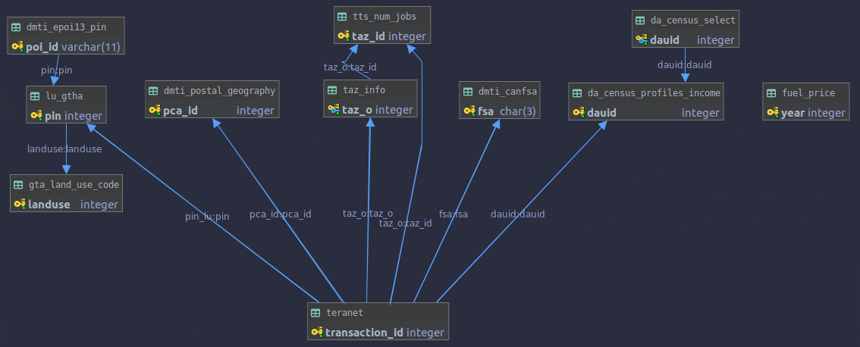
3.2 Entity relationship (ER) diagram
PIN-level data
(e.g., land use,
EPOI, etc.)
DA-level data
(e.g., select
Census variables)
Time-indexed
data
(e.g., fuel prices)
Postal-code
level data
TAZ-level data
FSA-level
data
Teranet dataset is related to multiple groups of datasets
based on different spatial and temporal relationships.

Slide 12
Section 4:
SQL examples

Slide 13
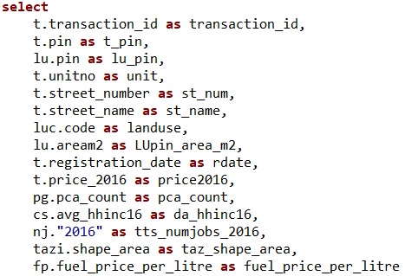
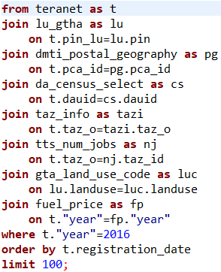
4.1 SQL example 1: join different datasets
This query joins attributes from various data sources at Teranet transaction level:
Select variables and specify column names
Join data sources
PIN-level data
(e.g., land use,
EPOI, etc.)
DA-level data
(e.g., select
Census variables)
Time-indexed
data
(e.g., fuel prices)
Postal-code
level data
TAZ-level data
FSA-level
data

Slide 14
4.2 SQL Example 2: Create table of DA-level aggregates
This query creates a new table in the database with DA-level Teranet aggregates
(mean, mean with price filtered < 5’000’000 CAD, median) and variables from Census:
create table gen_da as
select
cs.dauid as dauid,
round(avg(t.price_2016), 2) as avg_price_corr,
round(avg(case when t.price_2016 > 5000000 then null
else t.price_2016 end), 2) as avg_price16_limit_corr,
percentile_cont(0.5) within group (order by t.price_2016)::numeric as median_price_corr,
count(t.price_2016) as teranet_count,
cs.avg_rent16 as avg_rent16,
cs.avg_hhinc16 as avg_hhinc16,
cs.municipality as municipality
from da_census_select as cs
left join teranet as t
-- left join will keep DAs that have no Teranet records in 2016
on cs.dauid=t.dauid
and t.year=2016
group by cs.dauid
order by dauid;

Slide 15
4.3 SQL Example 3: modify a table
This query adds a new foreign key constraint:
alter table gen_da
add constraint gen_da_da_census_select_dauid_fk foreign key (dauid) references da_census_select(dauid);
This query adds a new column of numeric data type:
alter table gen_da
add column median_tot_inc16 numeric;
and this query populates the new column with values matched on ‘dauid’:
update gen_da
set median_tot_inc16 = ci.median_tot_inc
from da_census_profiles_income as ci
where gen_da.dauid=ci.dauid;

Slide 16
4.4 SQL Example 4: add aggregate to a table
This query adds a new column and the following query populates it with aggregated Teranet values joined on ‘dauid’:
alter table gen_da
add column avg_da_days_since_last_sale numeric;
update gen_da
set avg_da_days_since_last_sale = tagg.avg_da_days_since_last_sale
from (
select
dauid as dauid,
avg(da_days_since_last_sale)
as avg_da_days_since_last_sale
from teranet
where year=2016
group by dauid
) as tagg
where gen_da.dauid=tagg.dauid;
Query 1
Query 2

Slide 17
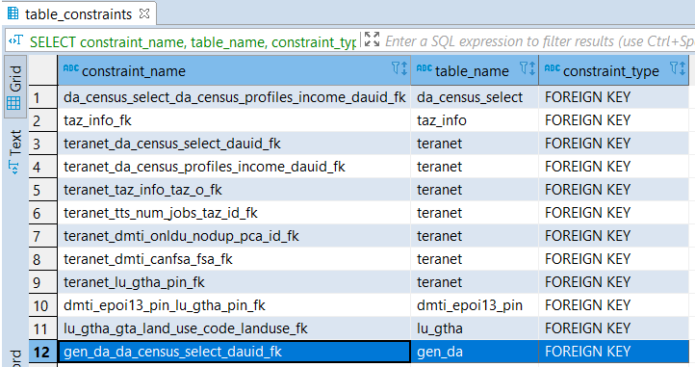
4.4 SQL Example 4: display all foreign keys
This query displays all existing foreign key constraints in the database:
SELECT constraint_name, table_name, constraint_type
FROM information_schema.table_constraints
WHERE constraint_type = 'FOREIGN KEY';

Slide 18
Suggestions / comments

